Slide 1
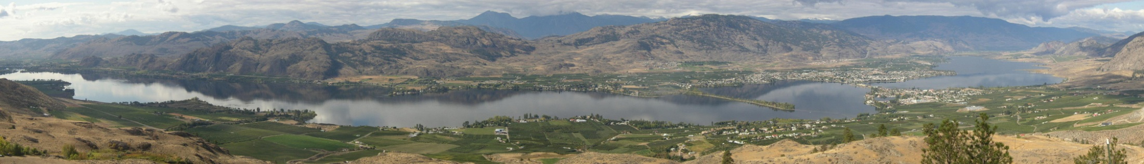

Photograph by Hartmut Suhling
Osoyoos Lake Water Science Forum
2007, 2011 ➔ 2015
A Watershed Beyond Boundaries
Clint Alexander
October 8 2015
essa.com

Slide 2
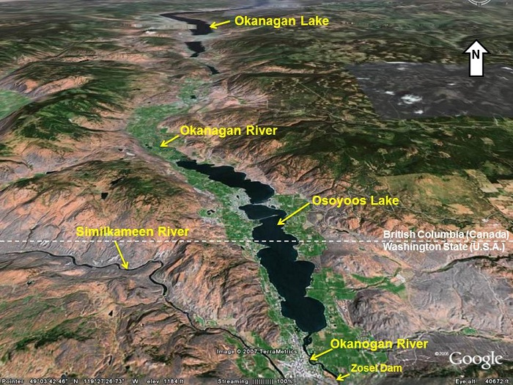

Slide 3
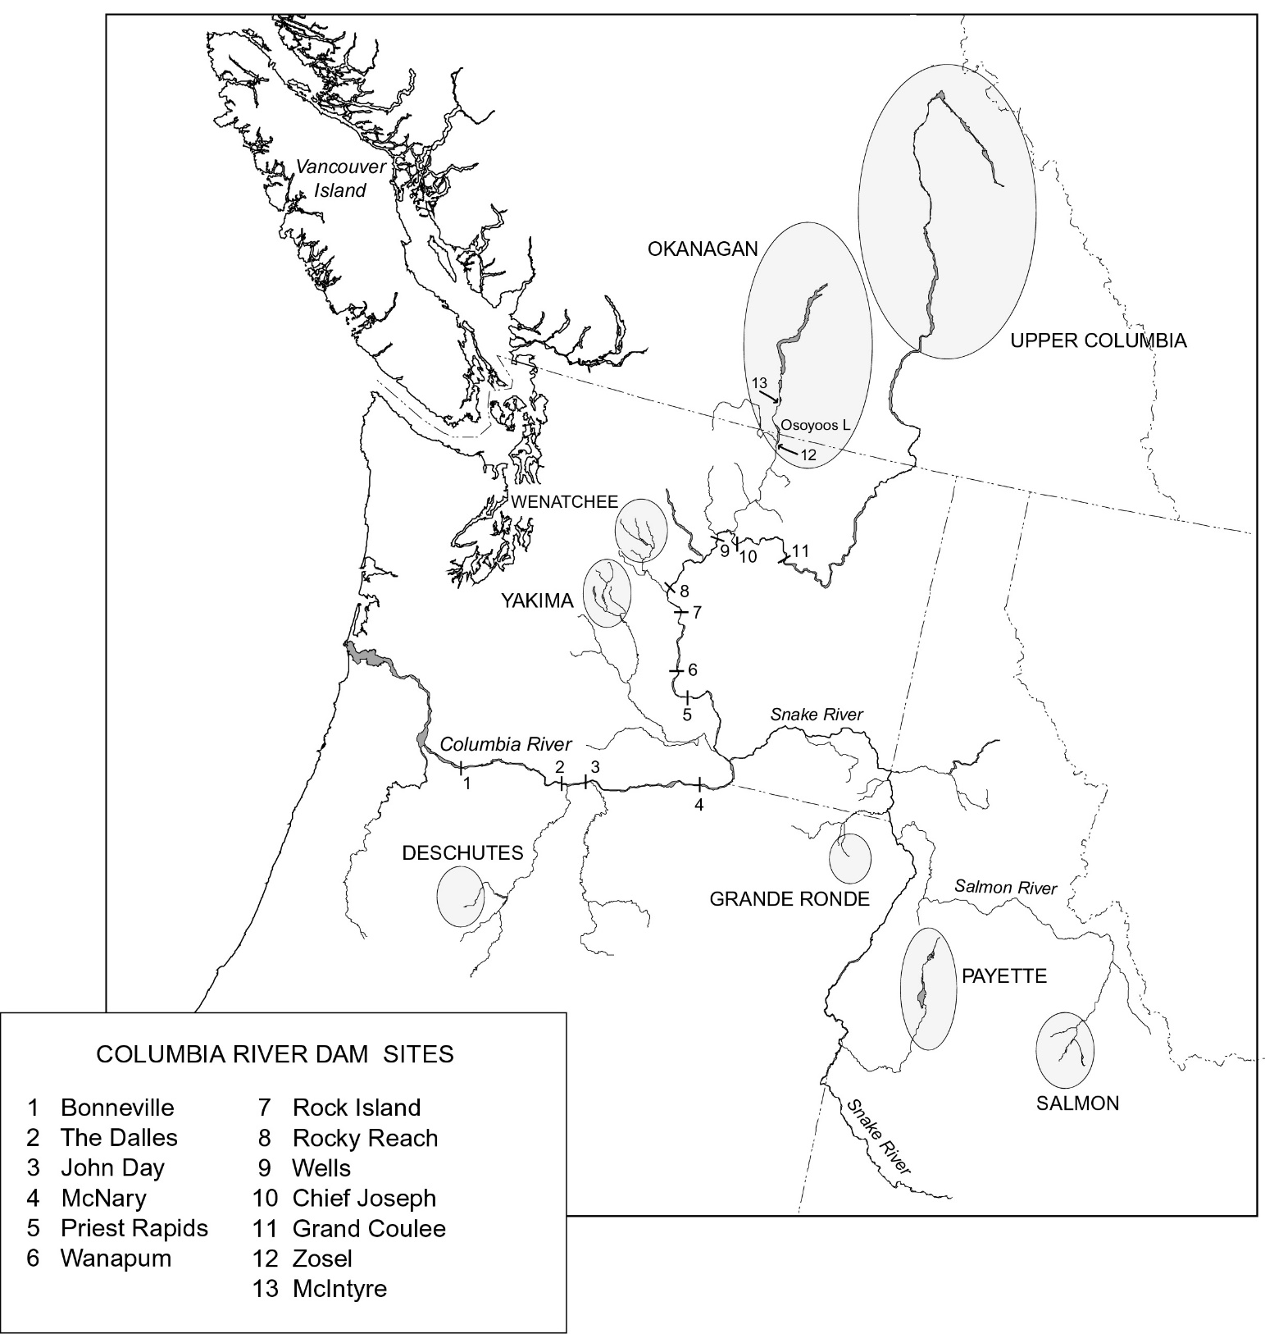
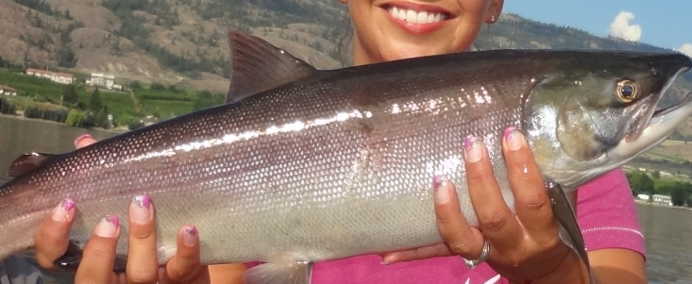
“Beyond boundaries”
ARROW LAKES
Okanagan
Historically accessible
Wenatchee
Present day viable sockeye populations
Notes:
This watershed is the natal home to the large majority of the Columbia River’s sockeye salmon, and the restoration and management of these stocks looms large on the agenda..

Slide 4
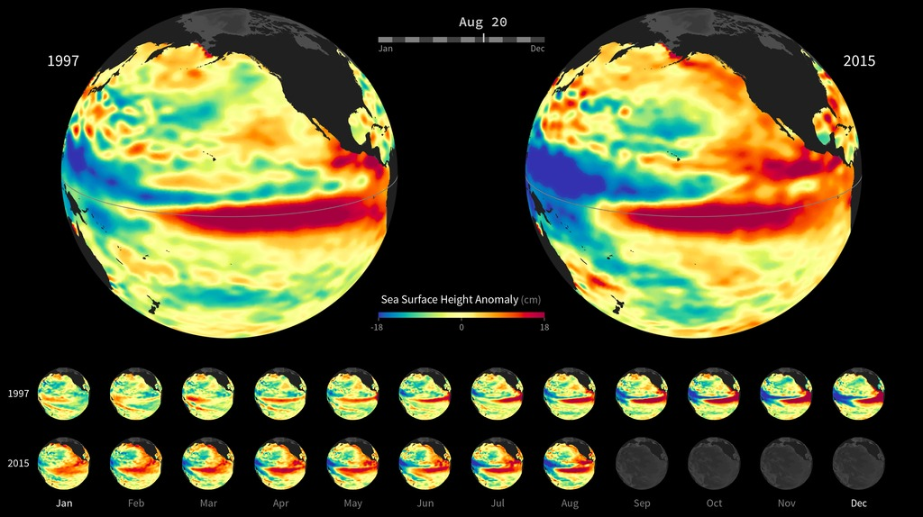
‘Godzilla’ El Niño-Southern Oscillation (ENSO): dry weather to normally wet regions (like BC) and wet weather to normally dry regions (like California).
Notes:
The El Niño-Southern Oscillation (ENSO) is a quasi-periodic fluctuation of ocean temperatures in the equatorial Pacific
Dubbed the ‘Godzilla El Niño’ by NASA scientist Bill Patzert, this year’s weather pattern will bring wet weather to normally dry regions and dry weather to normally wet regions. Though this bodes well for drought-stricken California, those on Canada’s west coast may continue to struggle with a low snowpack, little rain and unseasonably warm temperatures.
Western Drought and Salmon Top Agenda for 2015 Osoyoos Lake Water Science Forum
Forces that drive droughts are “beyond boundaries” and borders…

Slide 5

History OLWSF
2007
~180 participants
2011
~160 participants
Growing public concern sustainability Osoyoos Lake
IJC Operating Orders Zosel Dam
41 recommendations (almost half for IJC related to replacement Orders)
26 actions & scientific investigations
IJC can’t govern flows into Osoyoos Lake
77% actions Fair/Good progress
Need for basin-wide focus
Need more flexibility & integrated tools to balance trade-offs
A lot of work done, science becoming better connected
Notes:
At historical trend, should be 56 recommendations this time around.. ;)

Slide 6
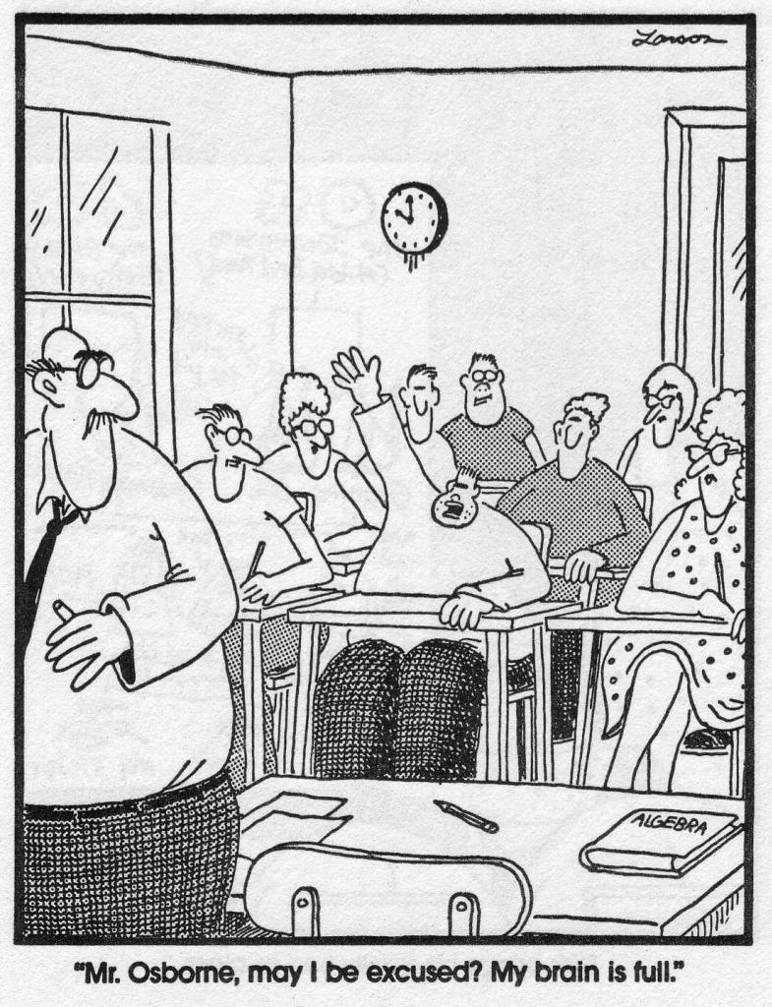
Diverse & interconnected topics
OLWSF
2015
Water supply mgmt.
Fisheries recovery / Environ.
flows
Water quality
Trans-boundary cooperation
Climate change / Drought response
Notes:
2015
It’s a very broad forum, a lot of topics

Slide 7
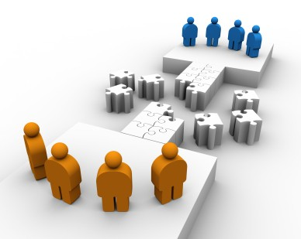

Unique, diverse audience
United States + Canada
Scientists, University researchers
Policy/ decision makers
First Nations, Tribes
Politicians
Community groups
Members of public (e.g. farmers, local residents)
Students
Notes:
Unique, diverse audience
Communication bridge

Slide 8
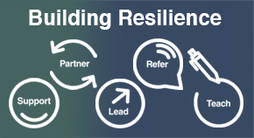
Forum role / benefits
An inclusive, international science event that helps drive accountability
A place to learn & bridge jurisdictions to find solutions for interconnected water challenges
Notes:
Working at the right scale, integrating science and pooling resources allows for more holistic solutions that will build resilience, and help with future adaptation to change.

Slide 9
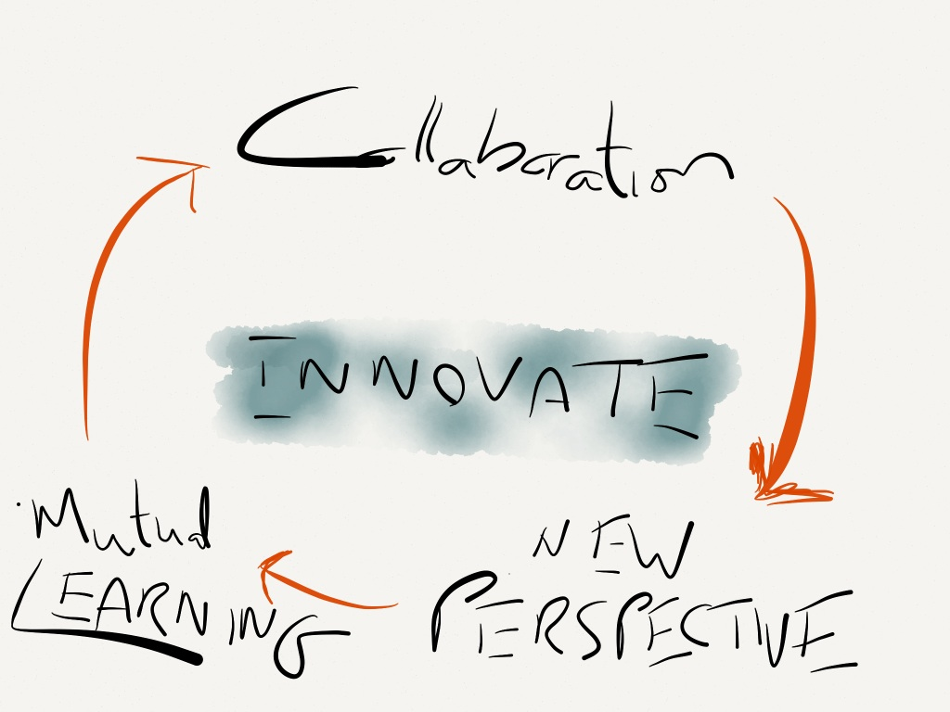
Notes:
Differentials in thinking engine of creativity and innovation

Slide 10
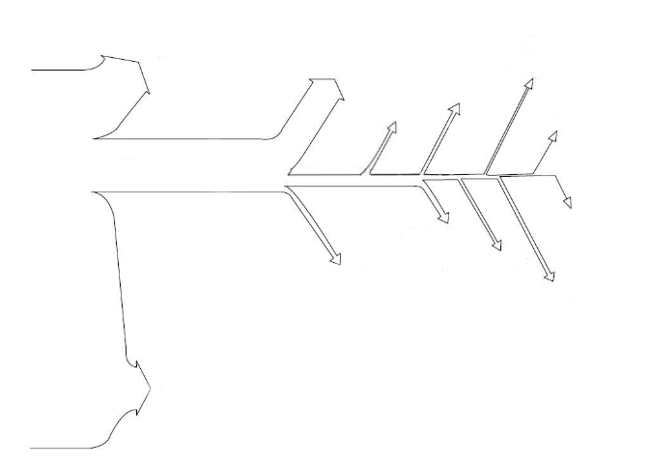

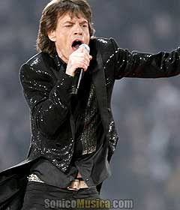
Rigorous methods for uncertain decisions
Clarifying cause-effect
Identifying critical uncertainties
No Brainers
Identifying alternative interventions
Build integrated decision support models
Evaluating effectiveness of interventions
Decisions worth applying Structured Decision Making & Adaptive Management
Closing the learning loop (Complete AM)
All Decisions
Resolving conflicts among competing objectives
Clarifying the decision problem
Improving monitoring design
Strengthening capacity and empowerment of decision-makers/ institutions
Decisions with low complexity/ small consequences
*Jagger’s Law: You can’t always get what you want (inverse correlations exist amongst objectives)
Adapted from Keeney 2004
Notes:
For complex problems, with a lot of competing values and uncertainty, need a rigorous approach to decision making.
A lot of different methods and activities, if coordinated effectively, can come together to provide solutions.
Clarifying the decision problem/needs
Clarifying cause-effect/understanding of the system
Identifying alternative management actions
Identifying critical uncertainties
Improving monitoring design
Improving data management and reporting
Improving engagement/resolving conflicts among competing objectives
Strengthening capacity and empowerment of decision makers/institutions
Evaluating effectiveness of actions
Closing the learning loop (complete AM)

Slide 11
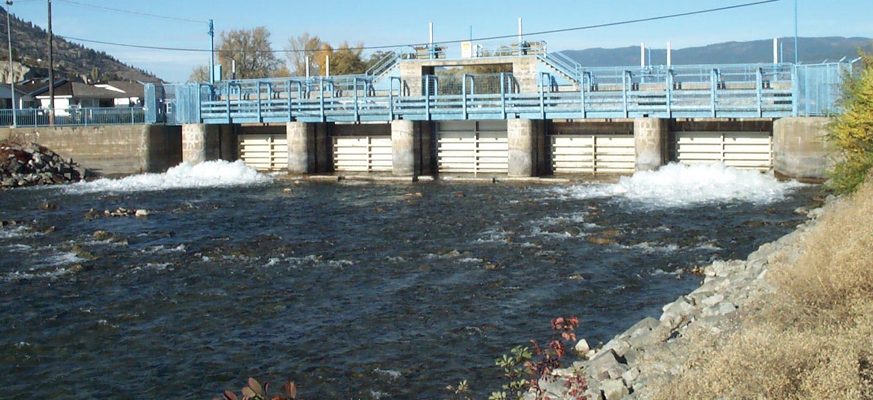
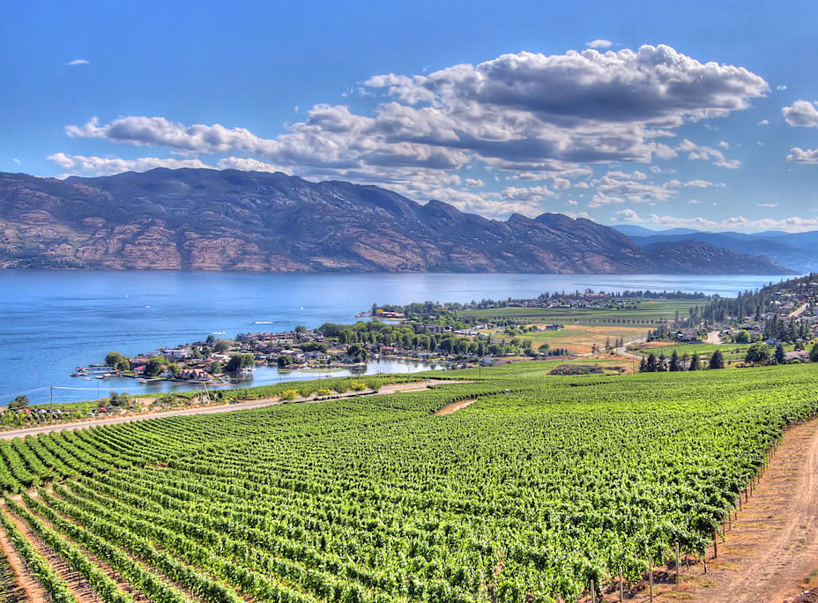
… Best water releases from Okanagan Lake Dam ?
Notes:
Okanagan Lake (and Dam)
Drainage area = 6,090 sq km
Surface area = 341 sq km
Average outflow = 14.7 m3/s

Slide 12

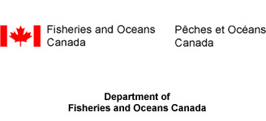


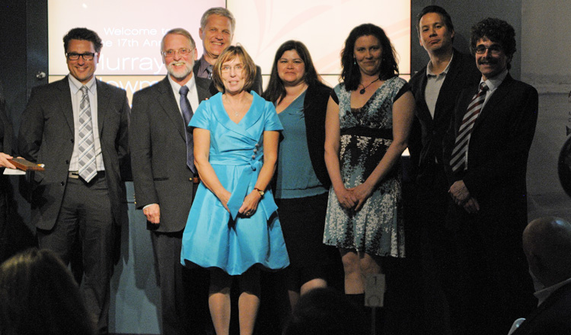


Rick Klinge, Tom Khaler
Kim Hyatt, Margot Stockwell, Paul Rankin
Brian Symonds, Andrew Wilson, Harvey Andrusak, Chris Bull
Howard Wright, Deana Machin,
Kari Long, Dawn Machin
Clint Alexander, David Marmorek, Frank Poulsen, Calvin Peters, Colin Daniel
Brian Guy, Lars Uunila, Brent Phillips
Okanagan Basin Technical Working Group receiving award for “Significant Achievement in Aquatic Conservation” from the Vancouver Aquarium for FWMT
Notes:
Collaboration occurred through the Bilateral Canadian Okanagan Basin Technical Working Group, including all of the entities shown here. Kim Hyatt of DFO initiated the idea and sold it to Rick Klinge of Douglas County PUD.

Slide 13
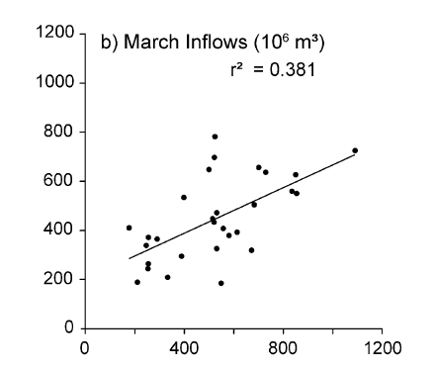
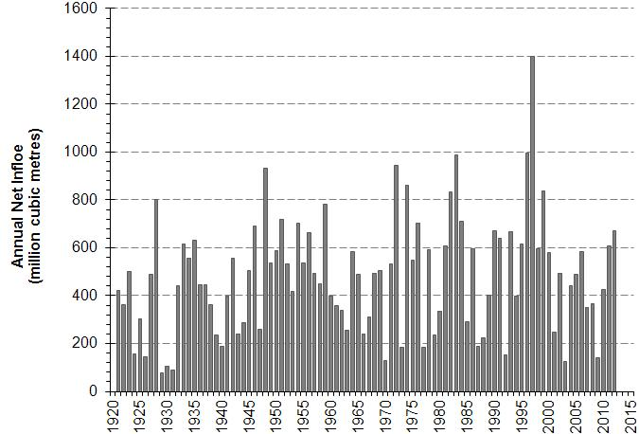
Challenge: Variable inflows. How to plan best water releases?
Notes:
Forecast uncertainty re: freshet inflow volumes and capacity to match lake spill or storage to spring inflows (“bathtub” analogy).
Effects of environmental variability (water levels, flow, temp.) on risk assessments given competing economic, social & environmental demands of multiple “parties” & authorities.

Slide 14
Multiple objectives
Notes:
FWMT simulations provide multiple objective hazard assessment (MOHA) reports on human-system and natural-system maintenance needs in each of 5 geographic segments of the Okanagan Lake and River System

Slide 15
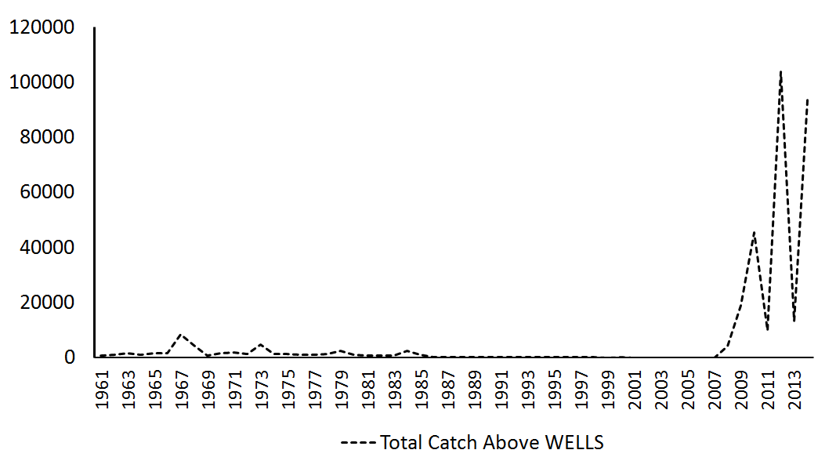
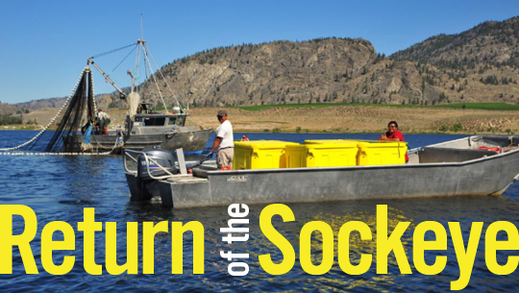
Recovery
Routine deployment
& use of FWMT
Sockeye harvest above Wells Dam
Notes:
Explanation for rebound:
The actions and events involved include: rejection of historic escapement objectives that underutilized the carrying capacity of spawning and rearing environments; development and deployment of a decision support system to facilitate “fish friendly” water storage and release decisions influencing losses of sockeye eggs or fry to density-independent events; flood-induced improvements in incubation gravel quality; a small contribution (<10% of total production) from hatchery-fry reintroductions into Skaha Lake; improvements in juvenile fish-passage in the Columbia River and a coincidental return to survival-favourable conditions for southern sockeye stocks in coastal marine waters.
Other contributing factors:
Upward revision to escapement objectives
Improved ocean survival for southern sockeye stocks
Small contribution (< 10%) from hatchery-fry reintroductions into Skaha Lake
Improvements to juvenile fish-passage in Columbia River

Slide 16
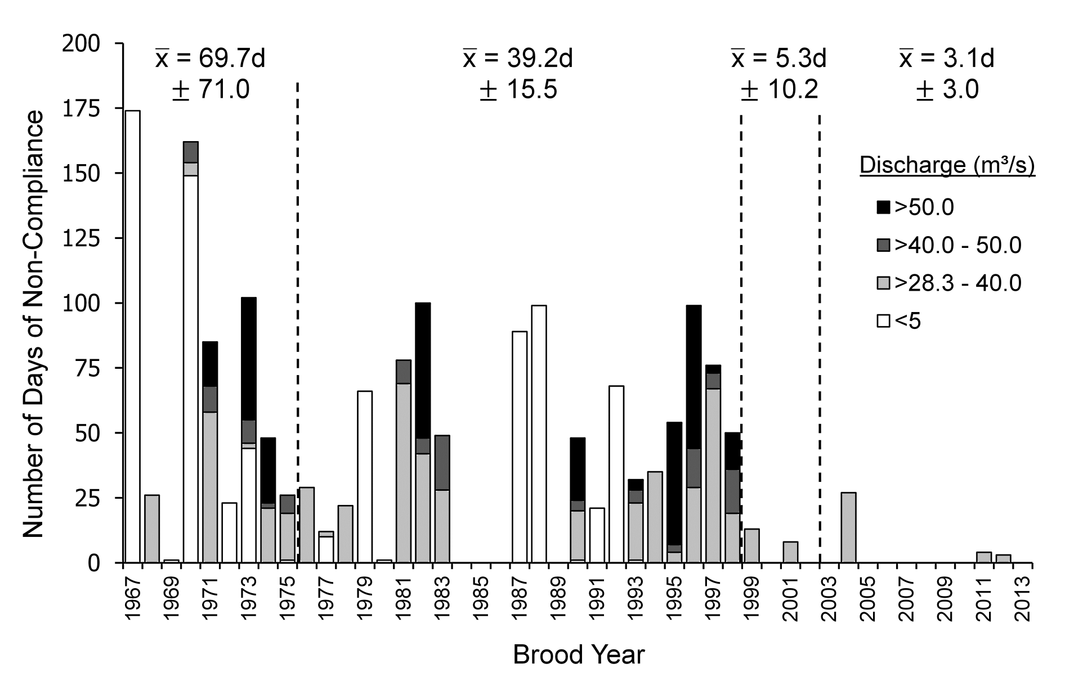
Other2
FWMT +
Vast improvement in fish-friendly flow compliance
Kim Hyatt, D., Clint A. D. Alexander & Margot M. Stockwell. 2015. A decision support system for improving “fish friendly” flow compliance in the regulated Okanagan Lake and River System of British Columbia, Canadian Water Resources Journal, 40:1, 87-110.
http://dx.doi.org/10.1080/07011784.2014.985510

Slide 17
Keys to success…
Okanagan Fish/Water Management Tool (FWMT)
Notes:
It takes more than collaborative good will..

Slide 18



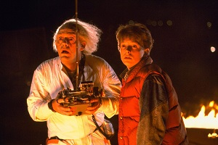

Slide 19


Slide 20
Other2
Progress 2007 ➔ 2011

Slide 21
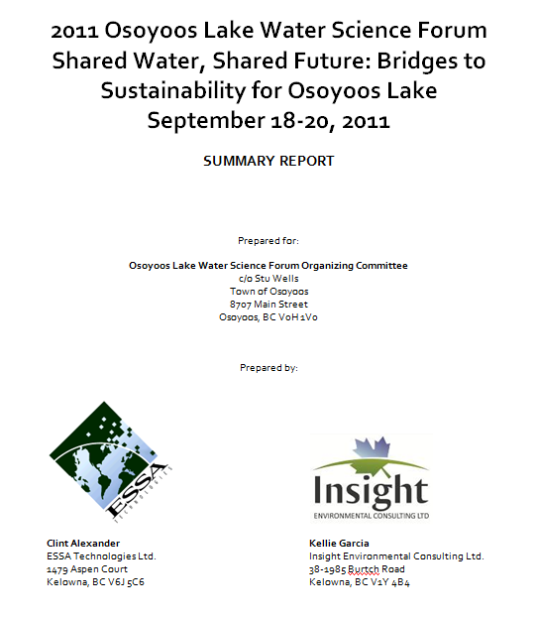

Slide 22
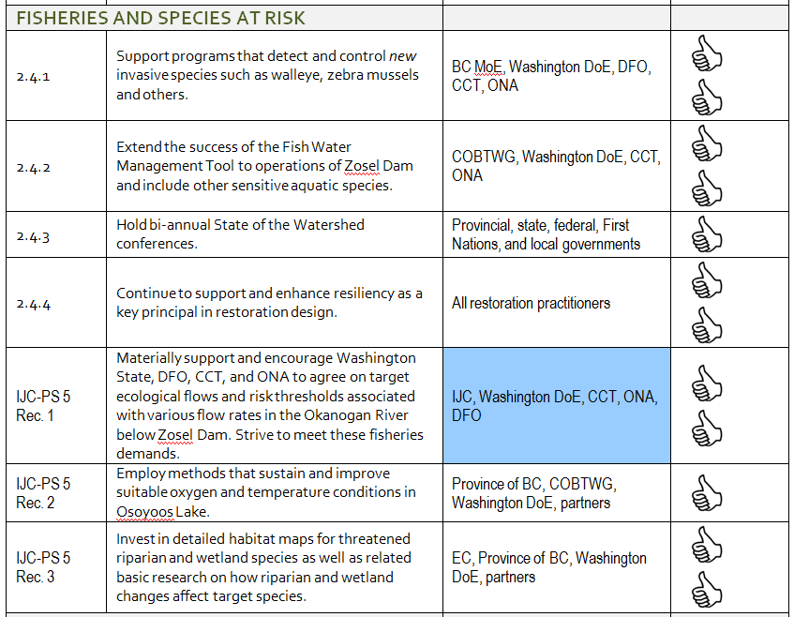
Other2
Fisheries & Species @ Risk

Slide 23
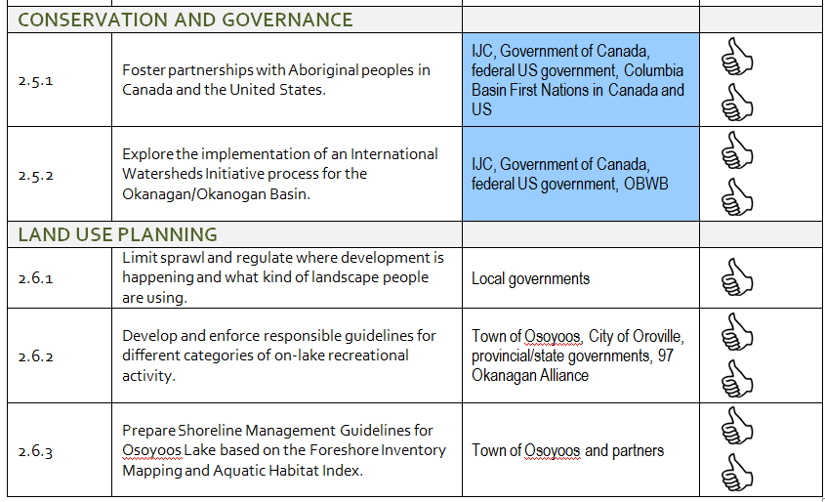
Other2
Governance & Land Use

Slide 24
Further information
Osoyoos Lake Water Science Forum
  http://www.obwb.ca/workshops/osoyoos-lake-water-science-forum-2011/
  http://www.obwb.ca/workshops/osoyoos-lake-water-science-forum-2011/2011-olwsf-presentations/
  http://www.obwb.ca/workshops/osoyoos-lake-water-science-forum-2007/
  http://www.obwb.ca/olwsf/
Notes:
24
24

