Slide 1
International Joint Commission International Watersheds Initiative (IWI)
2015 Osoyoos Lake Water Science Forum Thursday, October 8, 2015
Rich Moy, US Commissioner

Slide 2
Outline of the IWI Program
History
Goals and Principles
Strategic Priorities
Funding: past and present
Project Proposals
IWI Projects within the Osoyoos
Next Steps for IWI
Summary

Slide 3
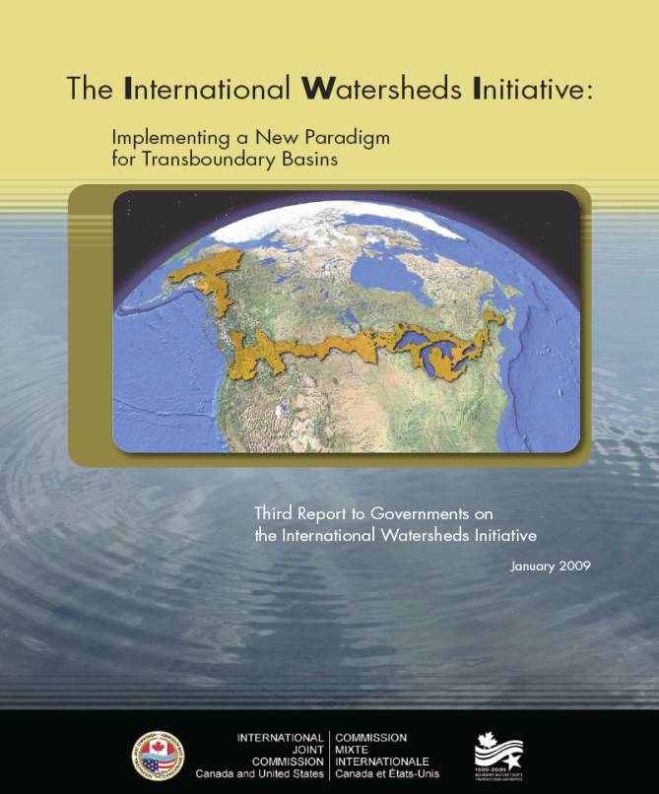
IWI History
Our Governments requested the IJC’s perspective on how to meet future challenges along our common border
In response, the IJC produced: The IJC and the 21st Century in 1997 which introduced the International Watershed Initiative or IWI
In 1998, Governments sent the IJC a Reference supporting the IWI report and its recommendations
Progress Report to Governments: 2000, 2005, 2009, 2015 (anticipated)
Both Governments sent letters of support for IWI in 2011
Notes:
Include in this slide:
How did the IWI get started? IJC’s 1997 Report The IJC and the 21st Century introduced the IWI concept and we have built upon it over the 16 years.
IJC IWI Mandate from the Governments? To establish international watershed boards that would adopt an integrated, ecosystem approach to transboundary environmental issues. Some conditions of this approval: 1) further define the general framework which watershed boards would operate (mandate, activities operating principles); 2) periodically report to governments on activities and make further recommendations. We currently continue these types of activities.
Further Conditions of 1998 Approval: Work under the IWI reference is to be performed drawing on existing resource levels and is to draw upon and complement initiatives already being undertaken at the federal, state and provincial government levels.
What is IJC trying to Accomplish with IWI? Generally speaking, to take a more holistic ecosystem approach (Rich can elaborate on this in his talk)
Recent letters of support came from each government in 2011.

Slide 4
IWI Premise
The IWI is about creating conditions at the watershed scale to help prevent or resolve water related international issues.
The premise is that local people and institutions are often the best placed to anticipate, prevent or resolve many problems related to our shared water resources and environment
Notes:
– Hence another approach to meet the mandate of the IJC.

Slide 5
IWI Goals
IWI program assists watershed Boards to:
develop a common vision of their watershed;
better anticipate and respond to watershed issues and problems;
better understanding the hydrology and ecosystem functions within their watershed;
expand outreach and better cooperation/collaboration; and
create conditions for the resolution of specific issues.

Slide 6
IWI Operating Principles for our Shared Waters
Ensure balanced and inclusive board representation which includes local experts and stakeholders;
Build binational collaboration which includes maintaining an open and respectful dialogue;
Develop an integrated ecosystem approach to transboundary water issues;
Encourage extensive public engagement; and
Build an adaptive management framework into all issues being addressed.
Notes:
– Hence another approach to meet the mandate of the IJC.

Slide 7
IWI Strategic Priorities
2009 - Ongoing
Binational nutrient modelling: Spatially Referenced Regression on Watershed Attributes (SPARROW) model
Data Harmonization: Standardized and comprehensive hydrographic data (& data display) for transboundary watersheds
Added to these in 2014 (as they relate to board mandates):
Nutrient loading, eutrophication, harmful algae blooms
Heavy metals and associated contaminants as they impact the aquatic ecosystem
Climate change impacts on water resources

Slide 8
IJC’s Foundational Activities for IWI
The IJC:
Provides funding to help boards better meet their mandates and implement their work plans
Facilitates the creation of new watershed boards
Holds educational meetings and technical workshops for IJC boards
Reports every five year to Governments on our progress in implementing IWI
Notes:
An example of point 1, is the IJC providing financial support to hold this science forum.

Slide 9
IWI Funding – The Process
Project proposals are solicited from IJC Boards
The project must be transboundary in nature
Must be an identified priority within the Board’s mandate
Both the U.S. and Canada sections spend approximately $500,000 each on IWI projects and studies
Notes:
IJC to send a letter outlining the procedure for obtaining funding to all Board Co-Chairs in February.
Not limited to “IWI” Boards other Boards may apply
Outside scope of normal duties of state or local and federal agencies
Generally for administrative needs, a project applies and is funded by one section or the other. Generally based on the entity receiving the funding. i.e. U.S. funds U.S. entities and Canada funds Canadian entities. There isn’t any “joint” money.

Slide 10
Funding by Activity

Slide 11
Funding by Basin

Slide 12
IWI Projects in the Osoyoos
The IJC:
Helps sponsor Osoyoos Water Science Forum in 2007, 2011, and 2015;
Provides financial support to the International Osoyoos Lake Board of Control to participate in IWI Workshops;
Builds a data harmonization foundation; and
Help fund the development of a documentary explaining water-management issues & practices within the Okanagan/Okanogan River System.

Slide 13
Watershed Boards
IJC Watershed Boards
Rainy-Lake of the Woods Watershed Board
St. Croix River Watershed Board
Pilot Watershed Boards
Red River Board
Souris River Board
Water Quality
Mapping.
Apportionment
Calculations
HEC-RAS
Sturgeon
Spawning.
Water Science
Forums
Outreach.
Wild Rice.
Pathogen/Parasite.
State of
The Basin.
Gate Movements
to prevent fish
stranding
Adapt.
Mgmt.
Water Quality
Mapping.
Info. Mgmt.
Info. Mgmt.
Outreach
Animations.
SPARROW
Shore Protection
Survey
Fish
Count
Run Off Model
Notes:
Considerable progress has been made through the IWI that has benefitted the Boards. Here is the distribution –to date:
Click 1: IJC Watershed Boards (Blue Shading) St Croix became a Watershed Board in 2007; Rainy- Lake of the Woods Watershed Board 2013
Click 2: Pilot Watershed Boards (Green Shading) Red River Board Pilot Watershed Board Status in 2005; Souris River Board Pilot Watershed Board Status 2007
Click 3: IJC Boards that can receive IWI funding for projects - Sample distribution of IWI funded projects (Red Dots)

Slide 14
International Rainy-Lake of the Woods Watershed Board (IRLWWB)
"As the recently appointed U.S. Chair to this new watershed board, I see a lot of excitement and energy from all the members. The board is very dynamic and fully engaged in tackling the challenging water-related issues in the basin." - Colonel Daniel Koprowski, U.S. Chair, IRLWWB.
Notes:
In 2012, the Commission submitted its report to the Canadian and U.S. governments requesting that the existing boards be merged and designated as a watershed board, and the governments concurred. In January 2013, the IRLWWB was established with the amalgamation of the International Rainy Lake Control Board and the International Rainy River Pollution Board, with water quality responsibilities in Lake of the Woods.
The IRLWWB has a water quality, water quantity and aquatic ecosystem health mandate.
This board is comprised of 20 members. One reason the Board is so successful is there are more views represented on the Board from the broad diversity of its members.
Another reason the Board is successful is because there are approximately equal numbers of local members compared to other members that are affiliated with various government agencies.
Success also stems from the Board’s advisor groups. To provide advice and insight to the Board on issues related to its mandate, the Board has both a Community Advisory Group (CAG) & Industry Advisory Group (IAG).

Slide 15
Next Steps for IWI
The fourth IWI Report entitled: Reports on IWI activities from 2010 to 2015 is scheduled to be released to the Canadian and U.S. Governments at the end of October
The Commission is holding an IWI multi-board strategic workshop on October 27, 2015, in Ottawa, Ontario
Next call for IWI project proposals is scheduled for October 16, 2015 with proposals due by November 20, 2015

Slide 16
In Summary
The IWI has provided Boards with stronger local voice and capacity to address a broader range of issues based on best available science
A number of our boards have embraced IWI framework and are very supportive of IJC assistance—both technical and financial
The US and Canadian government have clearly articulated their support for IWI.
Over the last five years, the IJC has invested $5.4M in IWI

