Slide 1
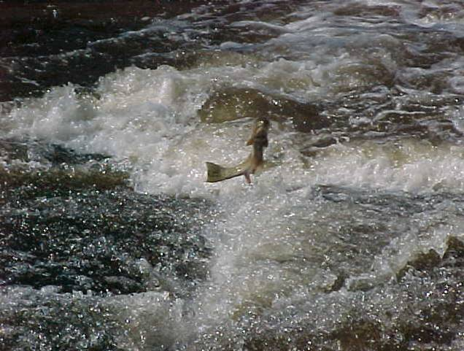
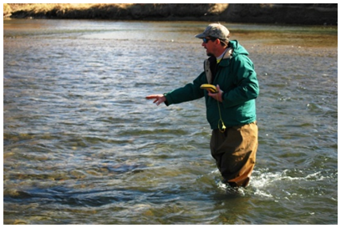
Okanogan River Fish Update for the IOLBC
2015 Osoyoos Lake Water Science Forum
Presenter: John Arterburn
Notes:
Marijke, requested I give a talk related to fisheries issues related to orders. Although this sounds like a simple request the impacts of lake levels on fish in Osoyoos lake are largely benign due to the relatively small elevational changes and the times in the year in which they occur. However, if you slightly change the question and you ask what are the fisheries issues related to Zosel Dam operations which are largely governed by the orders now we have lots to talk about.

Slide 2
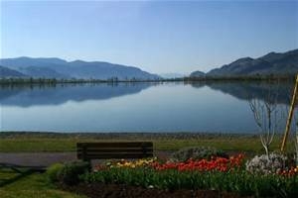
Fisheries Coordination
Colville Tribes
Okanogan Nation Alliance
Washington Department of Wildlife
Department of Fisheries and Oceans
BC Ministry of Forest , Lands and Natural Resource Operations
Zosel Dam
Operator-OTID
Owner –Washington Department of Ecology
The public
Notes:
Each spring we have our annual fisheries coordination meeting the invited attendees are listed here but the group typically consists of highly dedicated fisheries professionals and water managers from both sides of the border along with the dams operator and owner.

Slide 3
Now does it work?
The known-Annual Fish Advisory Group Meeting
IJC rule Curve
Construction
Planned water releases
Preseason run projections
The Unknown
Runoff magnitude and timing
Climate-temperature
Real fish run timing and abundance
Notes:
Fisheries coordination relative to Zosel Dam operations is carried out in two parts. First, At our annual meeting we typically talk about what is known; Things like the amount of snow that has accumulated in the mountains and plans for managing runoff; the Orders; planned water releases or reductions for; anticipated dam maintenance, restoration projects, water related studies, predicted fish returns. We also try our best to anticipate annual variation in runoff magnitude and timing, issues we might need to anticipate related to climatic events and how our local fish populations returns might vary from returns to the Columbia River basin at large.

Slide 4
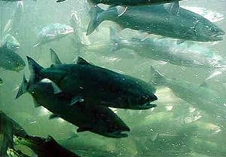
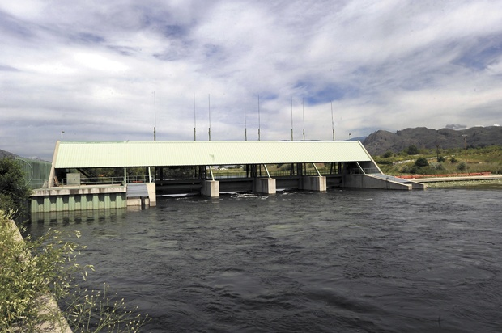
Every year’s Different
In 2014, 614,179 sockeye return to Columbia River and 490,804 returned above Well’s Dam.
Concerns about fish passage at Zosel Dam
Documented one day passage of 80,000 sockeye in one day
Notes:
All our planning is important and provides a good baseline of information but the real work doesn’t usually start until the fish arrive and every year is different. For example in 2014, over 614 thousand sockeye returned to the Columbia Basin which was an all time record in the documented record. Of these over 490 thousand made it to Well’s Dam. A conversion rate from Bonneville to Wells of 80%. The magnitude of the return created concerns about the adequacy of the fish ways at Zosel Dam to handle all these fish. Using underwater video cameras we documented single day passage of over 80 thousand sockeye and given that the majority of sockeye migrate during a two week window we anticipated that Zosel dam can efficiently pass an Okanogan River return of roughly 1.1 million sockeye before the fish ways would cause an artificial constrain to migration.

Slide 5
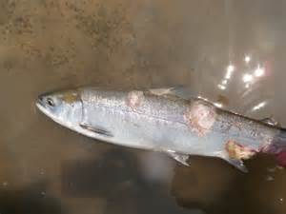
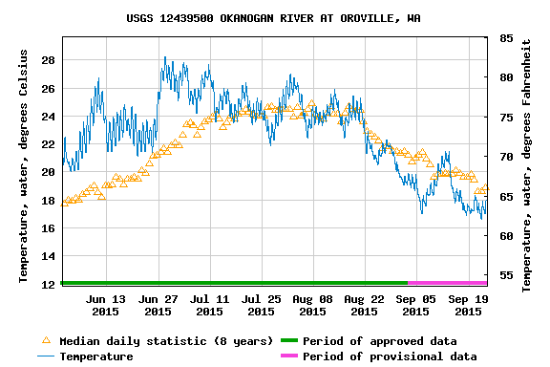
Every year’s Different
In 2015, 510,703 sockeye return to Columbia River and 186,894 returned above Well’s Dam.
Massive die off due to high water temperatures and disease issues
Notes:
A very different story emerged in 2015, over 510 thousand sockeye returned to the Columbia River and just under 187 thousand returned to well’s dam. A conversion rate from Bonneville To wells of just over 36%. Massive die offs where documented in the Willamette River, Drano Lake and the Deschutes River due to high Snake River water temperatures and a major columnaris outbreaks. Early returning sockeye to the Okanogan River also faced high water temperatures forcing these fish to face lengthy migration delays in the Columbia River. Research has shown any extended delay in sockeye migration result in large prespawn mortality events. Preliminary numbers suggest that adult returns to the spawning ground in 2015 could be less than 30 thousand fish. However, these issues were are outside of the control of the IJC or Zosel Dam operations.

Slide 6
Past work that is still paying off
Okanogan Cross Channel Project
Originally conceived during the 2005 annual fish advisory meeting to address issues with the old orders.
Washington Department of Ecology funded the design.
Colville Tribes constructed the project in 2010.
Continues to provide expanded spawning habitat for summer steelhead and Chinook salmon.
Notes:
Fish populations go through cycles of good times and bad. After talking about the issues faced by sockeye this year. I felt it was important to be balanced by talking about something positive. The Okanogan cross channel project was originally conceived in 2005 at or annual coordination meeting to address problems with dewatered summer steelhead spawning habitat. Washington Department of Ecology funded the design and the Colville Tribes constructed the project in 2010. Today, this project continues to provide expanded high quality spawning habitat for both Threatened summer steelhead and summer Chinook.

Slide 7
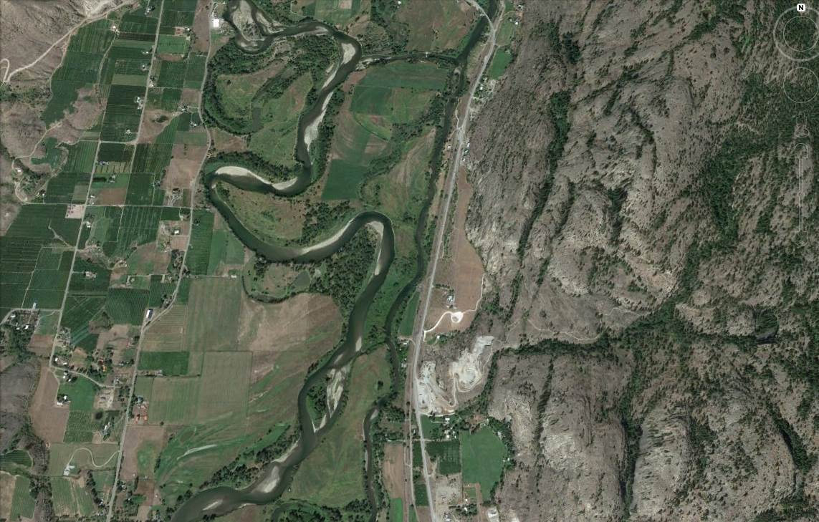
Notes:
In the spring of 2005, as the water elevations of Osoyoos Lake were required to be raised minimal water releases from Zosel Dam would follow this path down the Okanogan River. In 2010, The Colville Tribes constructed the designed cross channel weir at this location (click). The result of the cross channel weir means that at even minimal flow releases from Zosel Dam this habitat remains watered and at high flows the weir provides no change in river hydraulics.

Slide 8
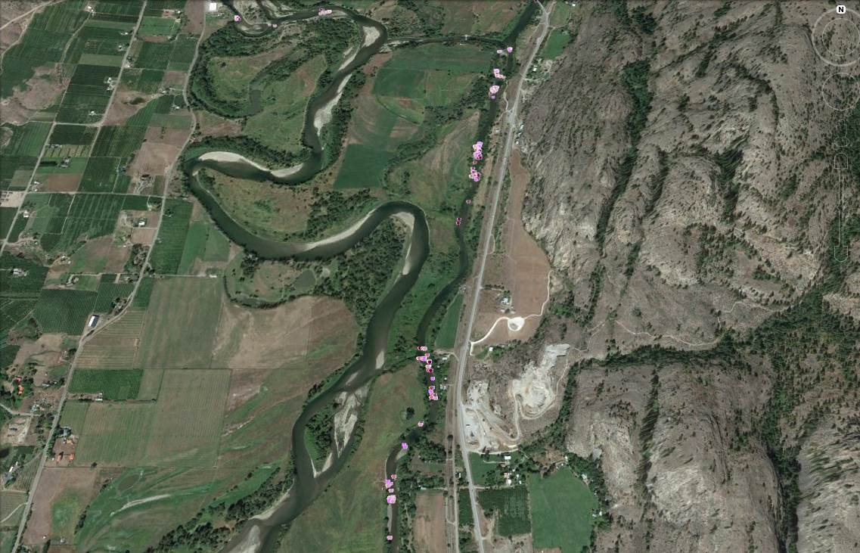
Notes:
Since this project was completed summer steelhead have completed construction of hundreds of redds in this habitat as indication by each of the small purple dots along the east channel of Driscol Island. The 2013 supplemental orders have also reduced the incidences of low spring flow releases from Zosel Dam but the combination of both the modified orders and the cross channel project work together to enhance and protect important spawning habitat for samlon and steelhead in the Okanogan River.

Slide 9
Questions and Discussion
Anadromous Fish data and reports can be downloaded at the OBMEP website:
Can be found by googling:
“cctobmep”
.
Notes:
Thank you for your time and attention if you saw anything interesting or you want more detail considerable information is available on our web page which can be found easily by googling CCTOBMEP or you can grab me after the meeting.

