Slide 1
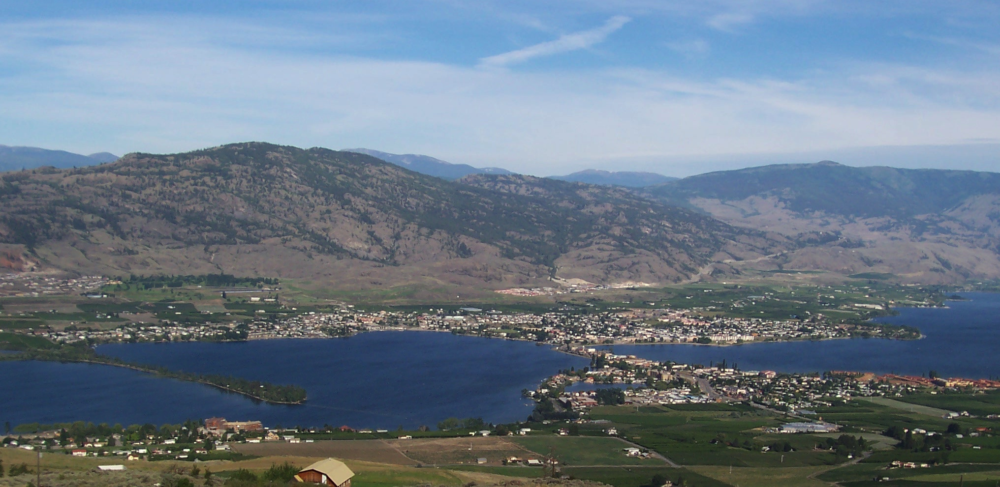
Climate Change and its Impacts in the Pacific Northwest
Meade Krosby Climate Impacts Group, University of Washington
mkrosby@uw.edu
Osoyoos Lake Water Science Forum A Watershed Beyond Boundaries: Stewardship of our Shared Waters October 7-9, 2015

Slide 2
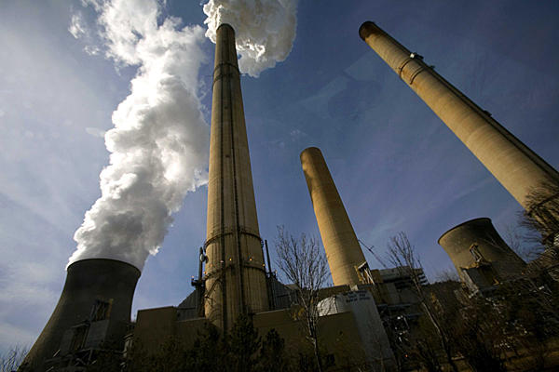
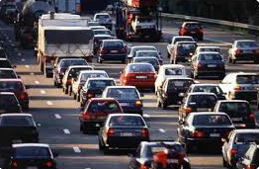
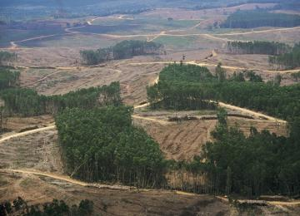
We are changing the climate....
Notes:
I want to start with a basic statement: We’re changing the climate. Human activities, and in particular combustion of fossil fuels and land conversion, are rapidly increasing the concentration of greenhouse gases in the atmosphere.

Slide 3
“It is unequivocal that the current concentrations of atmospheric CO₂ [carbon dioxide], CH₄ [methane], and N₂O [nitrous oxide] exceed any level measured for at least the past 800,000 years...
– IPCC 2013, Working Group 1 report, Chapter 6
Notes:
…And this increase in GHG is significant. Analysis of ice core data shows conclusively that the current concentrations in the atmosphere are known to exceed any level measured for at least the past 800,000 years..
We know that greenhouse gases warm the atmosphere -– this fundamental principal of physics has been known since the 1800s (Fourier – 1824, Tyndall – 1859, and Arrhenius - 1896)…
We know that human activities have caused more greenhouse gases to be emitted into the atmosphere, and
We know that the current concentration of greenhouse gases in the atmosphere exceed any level measured for at least the past 800,000 years.
[IPCC 2013, Working Group 1 report, Chapter 6]

Slide 4
….Furthermore, the average rate of increase of these three gases observed over the past century exceeds any observed rate of change over the previous 20,000 years.”
– IPCC 2013, Working Group 1 report, Chapter 6
Notes:
….We also know that the observed average rate of increase of these three gases over the past century exceeds any observed rate of change over the previous 20,000 years.

Slide 5
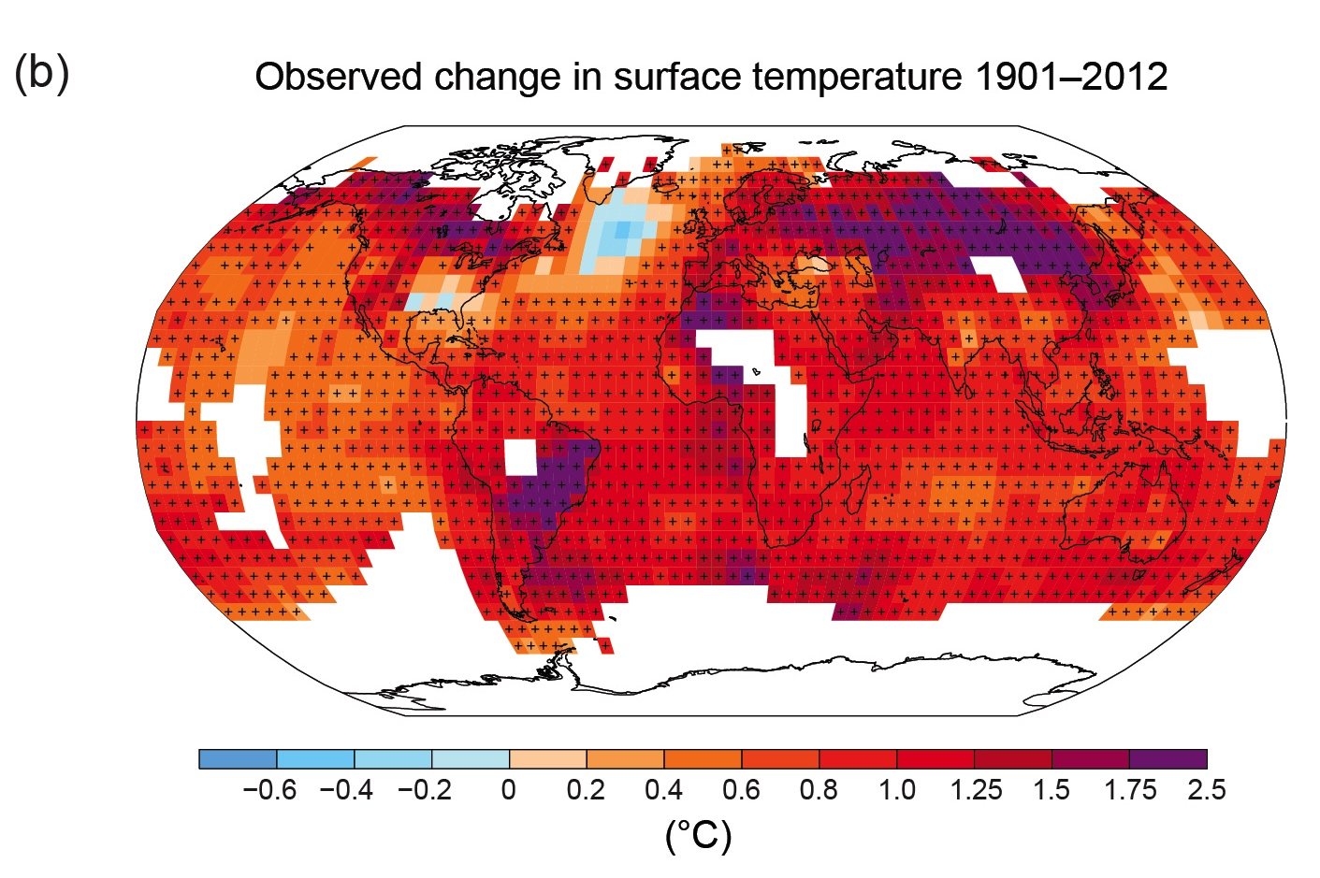
Average annual global temperature increased
0.85˚C (1.5˚F) between 1880 and 2012
IPCC, 2013: Summary for Policymakers.
Map of observed changes in global surface temperature, 1901 to 2012
Figure adapted from IPCC, 2013: Summary for Policymakers.
Notes:
All three major global surface temperature reconstructions show that Earth has warmed since 1880.5 Most of this warming has occurred since the 1970s, with the 20 warmest years having occurred since 1981 and with all 10 of the warmest years occurring in the past 12 years.6
IPCC, 2013: Summary for Policymakers. In: Climate Change 2013: The Physical Science Basis. Contribution of Working Group I to the Fifth Assessment Report of the Intergovernmental Panel on Climate Change [Stocker, T.F., D. Qin, G.-K. Plattner, M. Tignor, S.K. Allen, J. Boschung, A. Nauels, Y. Xia, V. Bex and P.M. Midgley (eds.)]. Cambridge University Press, Cambridge, United Kingdom and New York, NY, USA, pp. 1–30, doi:10.1017/CBO9781107415324.004.

Slide 6
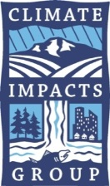
Observed changes in PNW climate
Temperature. The Pacific Northwest has experienced long-term warming, a lengthening of the frost-free season, and more frequent nighttime heat waves.
Hydrology. Long-term changes in snow, ice, and streamflows reflect the influence of warming.
Sea level. Sea level is rising along some parts of the coastline and falling in others.
Oceans. The coastal ocean is acidifying and some local inshore coastal waters are warming.
Attribution. Pacific Northwest climate is changing in ways consistent with climate change projections, however natural variability continues to play a key role in observed trends.
(Kunkel et al. 2013, Mote et al. 2013, Snover et al. 2013, NRC 2012, Feely et al. 2010, and many other sources)
Notes:
Changes have also been observed in PNW climate, although we cannot say conclusively that these changes are caused by climate change.
Trends related to temperature:
Average annual temperature has increased +1.3°F or 0.75°C, 1885-2011 (Kunkel et al. 2013, Mote et al. 2013)
Frost-free season has lengthened 35 days (+6 days), 1885-2011 (Kunkel et al. 2013)
No discernible long-term trend in precipitation (Kunkel et al. 2013)
Annual and seasonal temperatures have generally been above the long-term average for the last 25 years.
Since 1986, all but 2 years have had average annual temperatures above the 1901-1960 average.
Two of the three warmest years on record, 1992 and 2003, have occurred since 1986.
Five of the nine warmest summers have occurred since 1998. (Kunkel et al. 2013)
Trends related to hydrology (which is just anything that affects how much water, where, and when):
Spring snowpack varies year-to-year but declined ~25% from mid-20th century through 2006 (Stoelinga et al. 2009, Mote et al. 2008)
Most Washington glaciers declined during the 20th century (Sisson et al. 2011; Sitts et al. 2010; Granshaw and Fountain, 2006)
Spring peak streamflow shifted earlier by up to 20 days, depending on location (1948-2002) (Stewart 2005)
Trends in sea level:
Sea level is increasing on average, although results vary by location (NRC 2012, Mote et al. 2008)
Declining sea level found in the few areas where tectonic uplift currently exceeds the rate of global sea level rise observed to date (NRC 2012, Mote et al. 2008)
Examples of differing relative sea level rise:
Friday Harbor, WA: +0.4 in./decade (1934-2008)
Neah Bay, WA: −0.7 in./decade (1934-2008)
Seattle, WA: +0.8 in./decade (1900-2008)
Astoria, OR: −0.1 in./decade (1925-2008)
Trends related to ocean:
Ocean acidity in Washington’s marine waters has increased +10% to +40% since 1800
Ocean waters on the outer coast of Washington and the Puget Sound have become about +10 to +40% more acidic since 1800 (decline in pH of −0.05 to −0.15). (Source: Feely, R.A. et al., 2010. The combined effects of ocean acidification, mixing, and respiration on pH and carbonate saturation in an urbanized estuary. Estuarine, Coastal and Shelf Science 88: 442–449.)
Significant warming in coastal surface ocean temperatures observed in the Strait of Georgia and west of Vancouver Island (+1.4°F, 1970-2005)
No significant warming of coastal surface ocean temperatures offshore of North America, 1900-2008
Globally:
Approximately 25% of the CO2 generated by human activities since the mid-1700s has been absorbed by the oceans.
Ocean acidity has increased 30% since the start of the industrial age.
Ocean acidity is projected to increase 100-150% percent by 2100.
Current rate of acidification is nearly 10x faster than any period over the past 50 million years.
Sources:
Kunkel, K.E. et al., 2013. Part 6. Climate of the Northwest U.S., NOAA Technical Report NESDIS 142-6.
Mote, P.W. et al., 2013. Climate: Variability and Change in the Past and the Future. Chapter 2, 25-40, in M.M. Dalton, P.W. Mote, and A.K. Snover (eds.) Climate Change in the Northwest: Implications for Our Landscapes, Waters, and Communities, Washington D.C.: Island Press.

Slide 7
…and we are changing the climate in ways that have committed us to change for the next several centuries, if not longer.
Notes:
And most importantly…
(changing it as a result of rising greenhouse gas emissions)
Even if we stop emitting tomorrow, we are committed to a certain level of warming, but it will be significantly more if we don’t

Slide 8
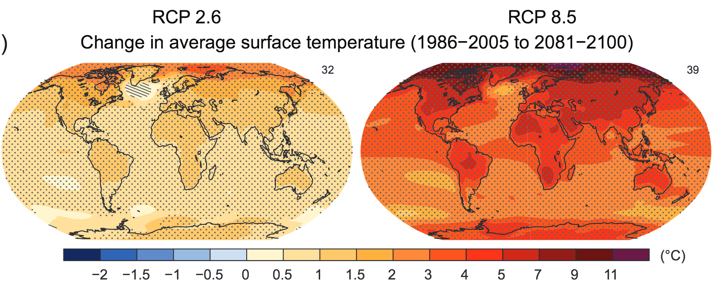
Average annual global temperature is projected
to rise +1˚C to +4˚C (+2˚F to +7˚F) by 2100
relative to 1986-2005
IPCC, 2013: Summary for Policymakers.

Slide 9
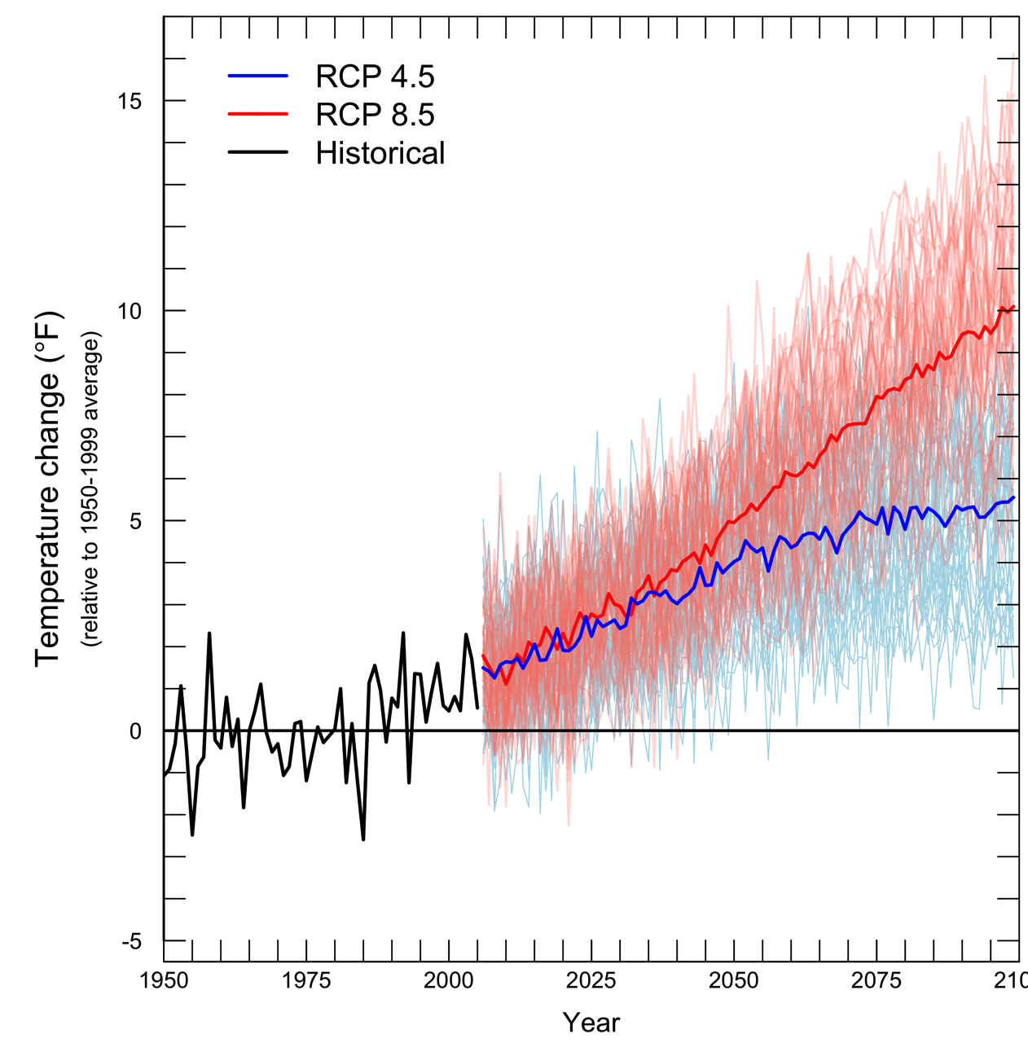
Rapid Warming Projected for the Pacific Northwest
Projected Change in Average Annual PNW Temperature (relative to 1950-1999 average)
All scenarios indicate warming in the 21st century.
(low emissions)
(high emissions)
8°C
5.6°C
2.8°C
0°C
-2.8°C
Figure source: Climate Impacts Group, based on projections used in IPCC 2013; 2050 projections from Mote et al. 2013
Notes:
In the interest of time, I want to jump straight away to the scale of the PNW….
In general: all scenarios indicate warming in the 21st century, with the amount of warming increasing as you move later into the century. Warming is expected in all seasons with the most significant warming happening during the summer months. The box here is showing projections for the 2050s.
warming is projected through the 21st century in all scenarios (although not all scenarios are shown here)
warming is expected in all seasons.
Strong agreement among models that extreme heat events become more frequent
The size of the projected change is large compared to observed variability. The region is likely to experience average annual temps by mid-century that exceed what was observed in the 20th century.
*Note ongoing variability
*By midcentury, the coldest temps are equal to todays warmest temps
For 2050s:
Provides specifics to how much change is projected
This change is significant relative to annual average temperature observed in the 20th century
2050 projections source:
Mote, P. W. et al., 2013. Climate: Variability and Change in the Past and the Future. Chapter 2, 25-40, in M.M. Dalton, P.W. Mote, and A.K. Snover (eds.) Climate Change in the Northwest: Implications for Our Landscapes, Waters, and Communities, Washington D.C.: Island Press.

Slide 10
Continued Variability in Precipitation
Projected Change in Average Annual PNW Precipitation (relative to 1950-1999 average)
Modest increases in average annual precipitation projected in most scenarios.
Seasonal patterns reinforced Wetter fall, winter, and spring; drier summers likely.
More frequent heavy rainfall events expected.
Figure source: Climate Impacts Group, based on projections used in IPCC 2013
Notes:
Changes in average annual precipitation are less pronounced. But:
Seasonal patterns reinforced. Wetter fall, winter, and spring; drier summers likely.
More frequent heavy rainfall events expected.
2050 projections source:
Mote, P. W. et al., 2013. Climate: Variability and Change in the Past and the Future. Chapter 2, 25-40, in M.M. Dalton, P.W. Mote, and A.K. Snover (eds.) Climate Change in the Northwest: Implications for Our Landscapes, Waters, and Communities, Washington D.C.: Island Press.

Slide 11
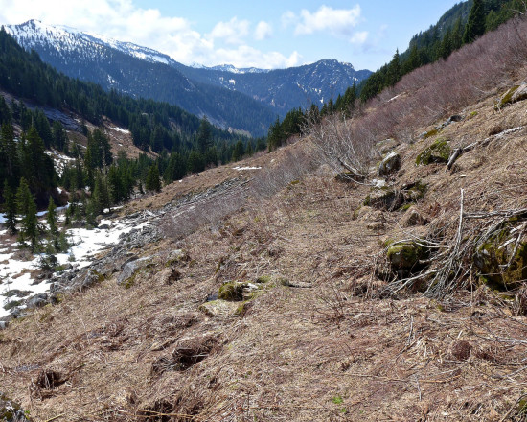
What is expected?
How projected changes in temperature and precipitation affect the Pacific Northwest
Canoe Peak. Credit: Monty Vanderbilt , March 2015
Notes:
Photo from http://crosscut.com/2015/03/problem-low-snowpack-not-water/

Slide 12
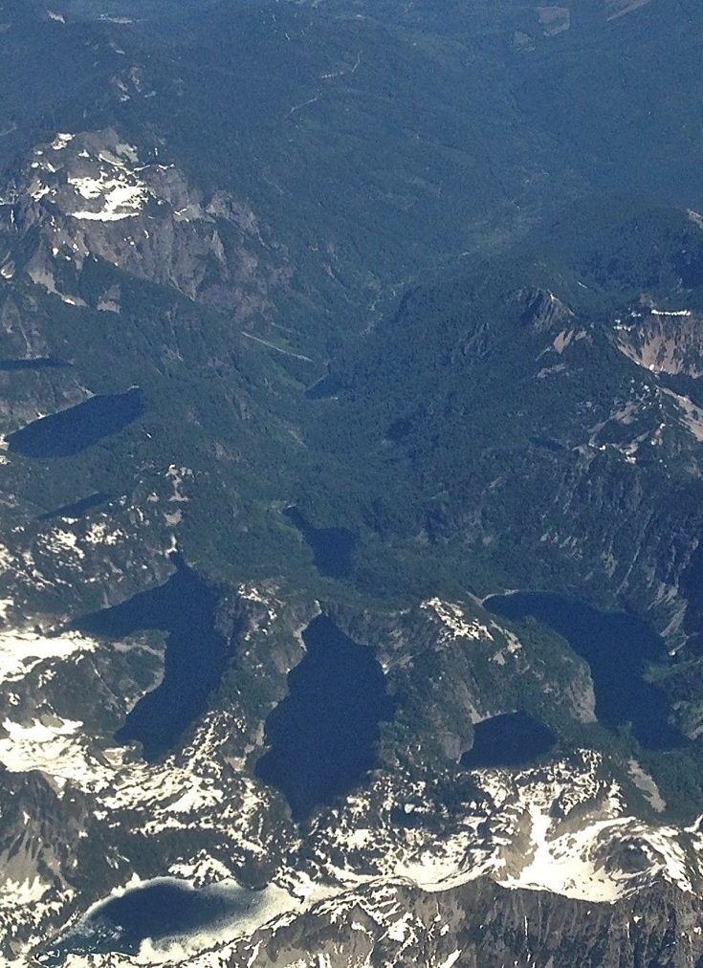
Our primary mechanism for storing water – snow – is sensitive to warming.
The Cascade Mountains have the highest fraction of “warm snow” (snow falling between -3-0°C (27-32°F) in the continental U.S.
(Mote et al. 2008)
(
Notes:
This means that it doesn’t take much of a change in average winter temperatures to have an impact on snowpack in the PNW.
Source: Mote et al. 2008, Has spring snowpack declined in the Washington Cascades? Hydrol. Earth Syst. Sci., 12, 193–206, 2008) http://hal.archives-ouvertes.fr/docs/00/30/51/28/PDF/hess-12-193-2008.pdf

Slide 13
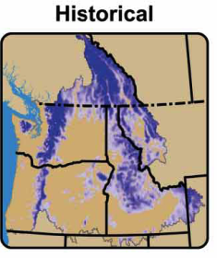
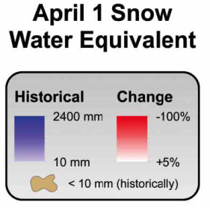
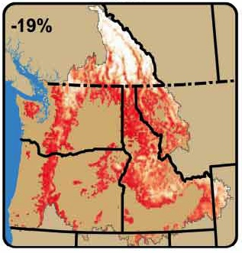
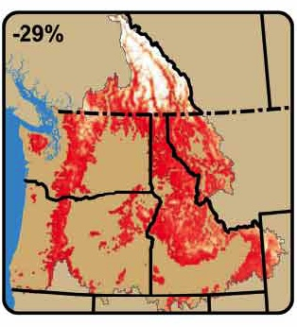
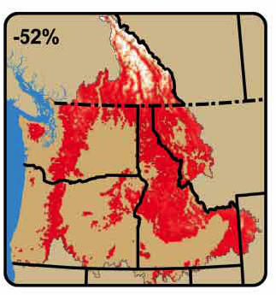
All scenarios indicate
less snow
For the A1B scenario (Medium Emissions Scenario)
Changes relative to 1916-2006
2020s
2040s
2080s
Hamlet et al. 2013; maps by Rob Norheim (CIG)
Notes:
BC: These areas are so cold in winter (DJF average on the order of -10°C temperature) that a change in temperatures of 2°–3°C has relatively little effect on seasonal snow accumulation in the 2020s and 2040s. Instead, these areas respond primarily to projected changes in precipitation until late in the twenty-first century, and in fact some of these areas show modest increases in SWE (about +5%) until the middle of the twenty-first century under the combined effects of warming and increasing cool season precipitation.
2020s - +2.0°F (1.1-3.4°F)
2040s - +3.2°F (1.6-5.2°F)
2080s - +5.3°F (2.8-9.7°F)

Slide 14
Current Streamflow
Yakima Basin
October April September
Naturalized flows (without the influence of dams); Elsner et al. 2010
Notes:
Presentation note for Amy:
You will want to talk through how the projected changes affect the likelihood of flooding, landslides, sediment transport in winter, etc. – I did not include the slides you have that shade out winter and summer flows and list implications.
------------------------------
Caption: Projected increased winter flows and decreased summer flows in many Northwest rivers will cause widespread impacts.
Mixed rain-snow watersheds, such as the Yakima River basin, an important agricultural area in eastern Washington, will see increased winter flows, earlier spring peak flows, and decreased summer flows in a warming climate.
Changes in average monthly stream flow from baseline (simulated 1916-2006 average, black) to the 2020s (blue), 2040s (yellow), and 2080s (red) indicate that the Yakima could change from a basin deriving most of its streamflow from snow melt to a rain-dominant basin by the 2080s under a scenario that assumes continued increases in emissions through mid century but declines thereafter (A1B).
Hydrologic response to climate change varies by type of watershed, with the largest responses in basins with significant snow accumulation, where warming increases winter flows and advances the timing of spring melt.
By 2050, snowmelt is projected to shift 3 to 4 weeks earlier than the 20th century average (Barnett et al. 2005; U.S. Bureau of Reclamation 2008), and summer flows are projected to be substantially lower.
Change in flood risk depends on many factors, but is projected to increase the most in mixed basins (those with both winter rainfall and summer snowmelt-related runoff peaks) and decrease in higher basins.

Slide 15
Shifting Streamflows – 2020s
Yakima Basin
October April September
Naturalized flows (without the influence of dams); Elsner et al. 2010
Notes:
Caption: Projected increased winter flows and decreased summer flows in many Northwest rivers will cause widespread impacts.
Mixed rain-snow watersheds, such as the Yakima River basin, an important agricultural area in eastern Washington, will see increased winter flows, earlier spring peak flows, and decreased summer flows in a warming climate.
Changes in average monthly stream flow from baseline (simulated 1916-2006 average, black) to the 2020s (blue), 2040s (yellow), and 2080s (red) indicate that the Yakima could change from a basin deriving most of its streamflow from snow melt to a rain-dominant basin by the 2080s under a scenario that assumes continued increases in emissions through mid century but declines thereafter (A1B).
Hydrologic response to climate change varies by type of watershed, with the largest responses in basins with significant snow accumulation, where warming increases winter flows and advances the timing of spring melt.
By 2050, snowmelt is projected to shift 3 to 4 weeks earlier than the 20th century average (Barnett et al. 2005; U.S. Bureau of Reclamation 2008), and summer flows are projected to be substantially lower.
Change in flood risk depends on many factors, but is projected to increase the most in mixed basins (those with both winter rainfall and summer snowmelt-related runoff peaks) and decrease in higher basins.

Slide 16
Shifting Streamflows – 2040s
Yakima Basin
October April September
Naturalized flows (without the influence of dams); Elsner et al. 2010
Notes:
Caption: Projected increased winter flows and decreased summer flows in many Northwest rivers will cause widespread impacts.
Mixed rain-snow watersheds, such as the Yakima River basin, an important agricultural area in eastern Washington, will see increased winter flows, earlier spring peak flows, and decreased summer flows in a warming climate.
Changes in average monthly stream flow from baseline (simulated 1916-2006 average, black) to the 2020s (blue), 2040s (yellow), and 2080s (red) indicate that the Yakima could change from a basin deriving most of its streamflow from snow melt to a rain-dominant basin by the 2080s under a scenario that assumes continued increases in emissions through mid century but declines thereafter (A1B).
Hydrologic response to climate change varies by type of watershed, with the largest responses in basins with significant snow accumulation, where warming increases winter flows and advances the timing of spring melt.
By 2050, snowmelt is projected to shift 3 to 4 weeks earlier than the 20th century average (Barnett et al. 2005; U.S. Bureau of Reclamation 2008), and summer flows are projected to be substantially lower.
Change in flood risk depends on many factors, but is projected to increase the most in mixed basins (those with both winter rainfall and summer snowmelt-related runoff peaks) and decrease in higher basins.

Slide 17
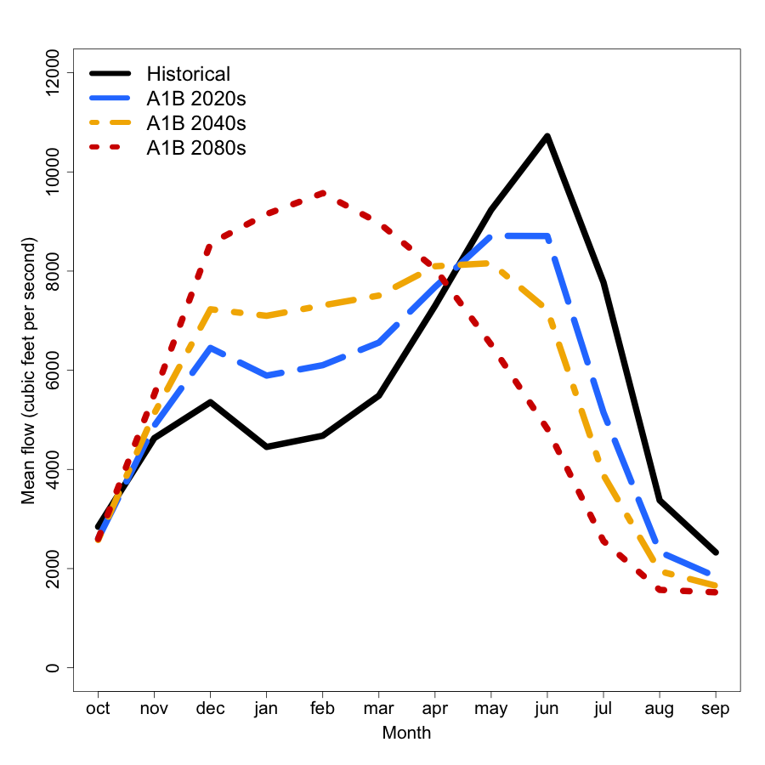
Shifting Streamflows – 2080s
Yakima Basin
October April September
Naturalized flows (without the influence of dams); Elsner et al. 2010
Notes:
Presentation note for Amy:
You will want to talk through how the projected changes affect the likelihood of flooding, landslides, sediment transport in winter, etc. – I did not include the slides you have that shade out winter and summer flows and list implications.
Take-home: We’ll havem ore water in winter when we don’t need it, less water in summer when we DO need it.
Caption: Projected increased winter flows and decreased summer flows in many Northwest rivers will cause widespread impacts.
Mixed rain-snow watersheds, such as the Yakima River basin, an important agricultural area in eastern Washington, will see increased winter flows, earlier spring peak flows, and decreased summer flows in a warming climate.
Changes in average monthly stream flow from baseline (simulated 1916-2006 average, black) to the 2020s (blue), 2040s (yellow), and 2080s (red) indicate that the Yakima could change from a basin deriving most of its streamflow from snow melt to a rain-dominant basin by the 2080s under a scenario that assumes continued increases in emissions through mid century but declines thereafter (A1B).
Hydrologic response to climate change varies by type of watershed, with the largest responses in basins with significant snow accumulation, where warming increases winter flows and advances the timing of spring melt.
By 2050, snowmelt is projected to shift 3 to 4 weeks earlier than the 20th century average (Barnett et al. 2005; U.S. Bureau of Reclamation 2008), and summer flows are projected to be substantially lower.
Change in flood risk depends on many factors, but is projected to increase the most in mixed basins (those with both winter rainfall and summer snowmelt-related runoff peaks) and decrease in higher basins.

Slide 18
Shifting Streamflows – 2080s
Yakima Basin
Increased:
Flood risk,
Landslide risk,
Sediment flows
October April September
Elsner et al. 2010
Notes:
Caption: Projected increased winter flows and decreased summer flows in many Northwest rivers will cause widespread impacts.
Mixed rain-snow watersheds, such as the Yakima River basin, an important agricultural area in eastern Washington, will see increased winter flows, earlier spring peak flows, and decreased summer flows in a warming climate.
Changes in average monthly stream flow from baseline (simulated 1916-2006 average, black) to the 2020s (blue), 2040s (yellow), and 2080s (red) indicate that the Yakima could change from a basin deriving most of its streamflow from snow melt to a rain-dominant basin by the 2080s under a scenario that assumes continued increases in emissions through mid century but declines thereafter (A1B).
Hydrologic response to climate change varies by type of watershed, with the largest responses in basins with significant snow accumulation, where warming increases winter flows and advances the timing of spring melt.
By 2050, snowmelt is projected to shift 3 to 4 weeks earlier than the 20th century average (Barnett et al. 2005; U.S. Bureau of Reclamation 2008), and summer flows are projected to be substantially lower.
Change in flood risk depends on many factors, but is projected to increase the most in mixed basins (those with both winter rainfall and summer snowmelt-related runoff peaks) and decrease in higher basins.

Slide 19
Shifting Streamflows – 2080s
Yakima Basin
Water needed for:
irrigation,
instream flows,
fall hydro-production
Warmer stream temperatures.
October April September
Elsner et al. 2010
Notes:
Caption: Projected increased winter flows and decreased summer flows in many Northwest rivers will cause widespread impacts.
Mixed rain-snow watersheds, such as the Yakima River basin, an important agricultural area in eastern Washington, will see increased winter flows, earlier spring peak flows, and decreased summer flows in a warming climate.
Changes in average monthly stream flow from baseline (simulated 1916-2006 average, black) to the 2020s (blue), 2040s (yellow), and 2080s (red) indicate that the Yakima could change from a basin deriving most of its streamflow from snow melt to a rain-dominant basin by the 2080s under a scenario that assumes continued increases in emissions through mid century but declines thereafter (A1B).
Hydrologic response to climate change varies by type of watershed, with the largest responses in basins with significant snow accumulation, where warming increases winter flows and advances the timing of spring melt.
By 2050, snowmelt is projected to shift 3 to 4 weeks earlier than the 20th century average (Barnett et al. 2005; U.S. Bureau of Reclamation 2008), and summer flows are projected to be substantially lower.
Change in flood risk depends on many factors, but is projected to increase the most in mixed basins (those with both winter rainfall and summer snowmelt-related runoff peaks) and decrease in higher basins.

Slide 20
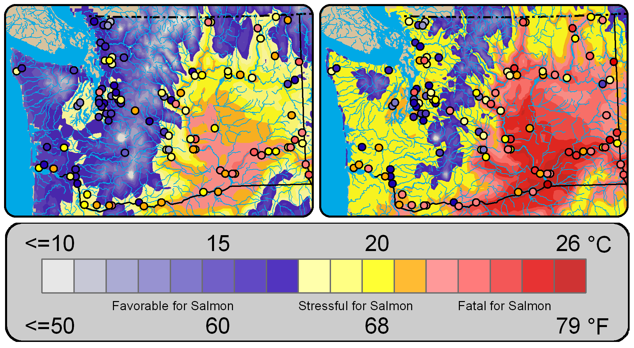
Increased stream temperatures
August Mean Surface Air Temperature and Maximum Stream Temperature (dots)
Historical (1970-1999)
2040s medium (A1B)
* Projections are compared with 1970-1999 average
Mantua et al. 2009
Notes:
20
Figure 9. August mean surface air temperature and maximum stream temperature for 1970-1999 (top left) and the 2040s (top right, emissions scenario A1B). The area of favorable thermal habitat for salmon declines by the 2040s in western Washington, and in eastern Washington many areas transition from stressful to fatal for salmon.
*Lower streamflows AND higher summer air temps = higher summer stream temps
Cold water refugia – lots of work trying to identify those places that will remain cold.

Slide 21
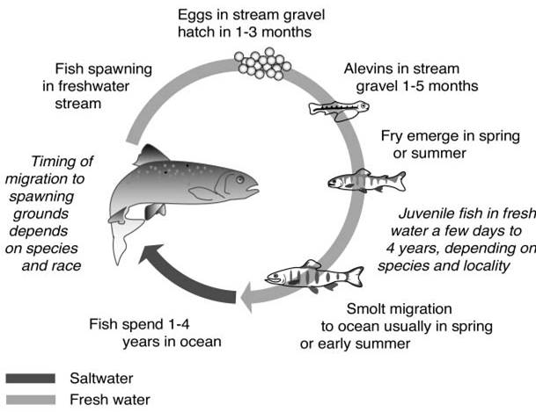
Impacts to salmon will occur across their lifecycle
Floods
Early peak flows
Warm, low
streamflow
??
Notes:
Thermal barriers to migration for salmon: 70-72°F (21-22°C)
The key for understanding climate change impacts on salmon comes with understanding the cumulative impacts of all the factors that influence salmon during their life cycle. Climate change (global warming) can be considered as being a part of habitat change and habitat degradation, but the ultimate impacts of climate change on NW salmon cannot be assessed in isolation from the impacts of other factors influencing habitat, or harvest and hatchery practices. This framework also suggests that at least some of the negative impacts of climate change on salmon can be mitigated by alleviating existing negative impacts on salmon that come with other aspects of habitat, hatchery and harvest practices.
Floods: higher winter streamflow can lead to more streambed scouring events
Early peak spring floods: could lead to a disconnect between when estuary-bound migrating juveniles need the increased streamflow and when the water is there to carry the juveniles out (the water may come too early)
Warm, low summer streamflows: Warm, summer streamflows can cause stress or create thermal barriers to salmon living in summer streams or migrating in summer back to their spawning grounds. Thermal stress typically begins when average air temperature exceeds 68F; thermal barriers exist when average air temperature exceeds the 70-72F range.
Questions about the ocean: We do not know how climate change will alter coastal ocean conditions and, in turn, affect salmon.

Slide 22
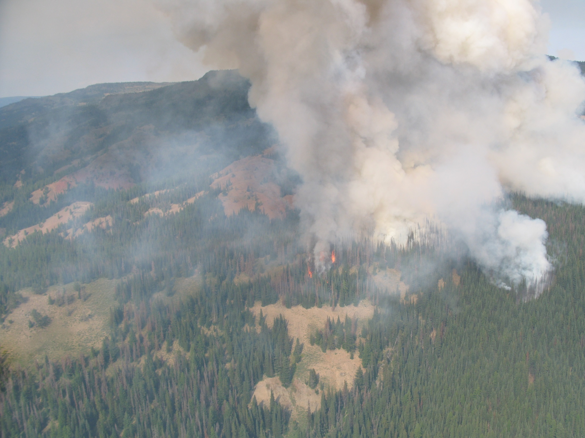
Increased wildfire risk
Area burned by fire in the Columbia River Basin is projected to double by 2020s, triple by 2040s, x5 by 2080s (relative to median for 1916-2006). (Littell et al. 2010, 2012)
Discovery Fire burns near volatile stands of insect-damaged trees, 2009, DNR
Notes:
2009 Discovery Fire burns near volatile stands of insect-damaged trees, DNR
Https://www.flickr.com/photos/wastatednr/3773164066/in/set-72157621770445607
The area burned by fire regionally (in the U.S. Columbia Basin) is projected to double or triple (medium scenario, (A1B)), from about 425,000 acres annually (1916-2006) to 0.8 million acres in the 2020s, 1.1 million acres in the 2040s, and 2.0 million acres in the 2080s.
Median regional (WA, OR, ID, w. MT) area burned is projected to increase from about 0.2 million ha (0.5 M ac, 1980-2006) to 0.3 million hectares (0.8 M ac) in the 2020s, 0.5 million ha (1.1 M ac) in the 2040s, and 0.8 million ha (2.0 M ac) in the 2080s (average of CGCM3 and ECHAM5 GCM simulations under the SRES-A1B emissions scenario, Littell et al. 2010). The probability of exceeding the 95th percentile area burned for the period 1916–2006 increases from 0.05 to 0.48 by the 2080s (Littell et al. 2010). The probability of exceeding the late 20th century historical (1980-2006) 95th percentile under expected future hydroclimate (Elsner et al. 2010; Mote and Salathé, 2010, for SRES-A1B and SRES-B1 ensemble averages of 20 and 19 GCM realizations for the 2020s, 2040s, and 2080s) is a range of 0 to 30% for non-forested systems, 1 to 19% for the western Cascade Range, and 0 to 76% for the eastern Cascade Range, Blue Mountains, and Okanogan Highlands (after Littell et al. 2010). No statistical relationships could be constructed for the Oregon Coast Range and Olympic Mountains, though climate effects on fire in those ecosystems are evident in the recent paleoecological record (Henderson et al. 1989) and the consequences of rare events are extreme (>0.5 million ha burned in single events).
There is greater uncertainty about impacts to western WA/OR forests than interior PNW forests.
Changes in forest fire risk: Higher fire frequency and higher fire intensity expected, especially in drier interior PNW where fuel hazard is high. Increases in area burned projected. Increased potential for regional/landscape scale fires (regional synchronization of fuel availability)
As temperature increases, the atmosphere evaporates more water from the landscape, plant tissues, and fine fuels
This produces larger than normal, and more connected areas of depleted fuel moisture during the fire season
Regional synchronization of fuel availability occurs
Fire “blowups” are driven by extreme weather, but are contingent on climatically-driven fuel moisture.
3 ingredients: Fuel (forests), Dry (warmer, drier summers), Ignition (lightning, people)

Slide 23
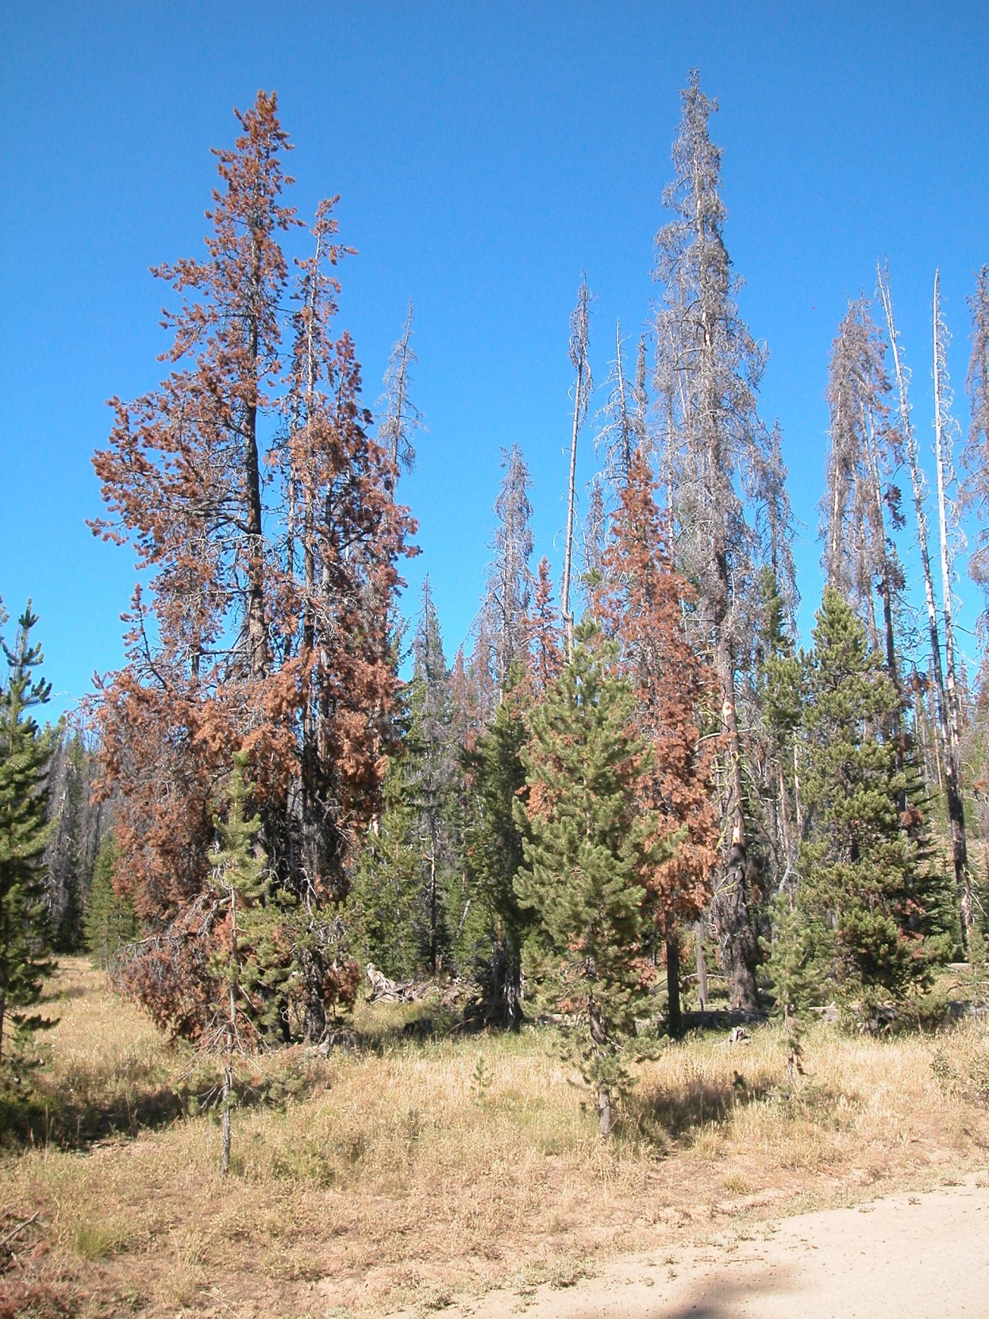
Increased risk of insect outbreaks
Near-term increased risk of mountain pine beetle outbreaks in drier forests will exacerbate fire risk. (Littell et al. 2010, 2012)
Discovery Fire burns near volatile stands of insect-damaged trees, DNR
Photo: DNR
Notes:
DNR photo: https://washingtondnr.files.wordpress.com/2012/08/rp_fh_mtn_pinebeetle_mortality.jpg
Due to climatic stress on host trees, mountain pine beetle outbreaks are projected to increase in frequency and cause increased tree mortality. Climatically suitable habitat for pine species susceptible to mountain pine beetle is likely to decline dramatically by the 2040s.
Note also another beetle that is making its way north and affecting west side pines
“Newcomer beetle is not welcome in Washington State
November 30, 2012” -- California fivespined Ips (CFI)
“The beetle referenced in our previous blog (California fivespined Ips) is a different bark beetle species that also attacks pines, primarily ponderosa. This beetle has not previously been known to occur in Washington, although it is considered native to California and Oregon. We’ve detected it as far north as Joint Base Lewis-McChord now. It probably is focused on trees that are weakened by something else like drought or snow-breakage wounds and may be moving north due to a favorable climate. It seems to be mostly confined to ponderosa pines that grow west of the Cascades and in relatively weak trees. Landowners in the Washington Gorge area are working to reduce populations by controlling the amount of dead host material created by fires, storms, etc. that the beetles breed in.”

Slide 24
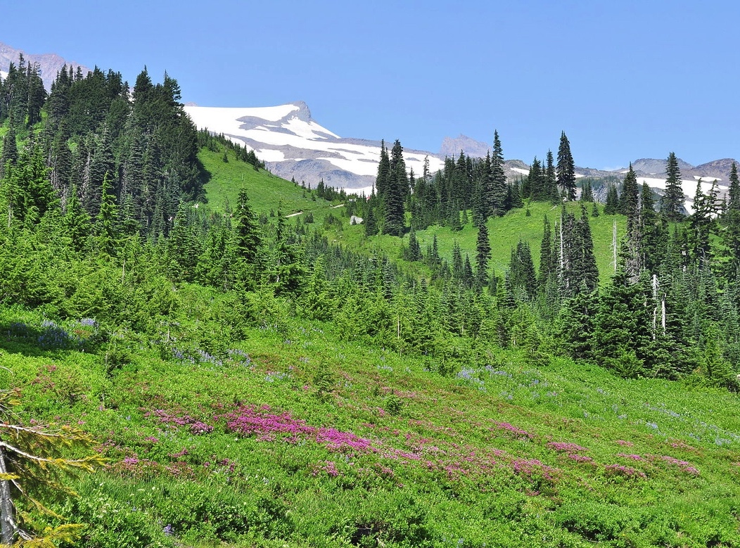
Impacts on species and ecosystems
Changes in the timing of biological events
Changes in species distributions
Novel ecological communities

Slide 25
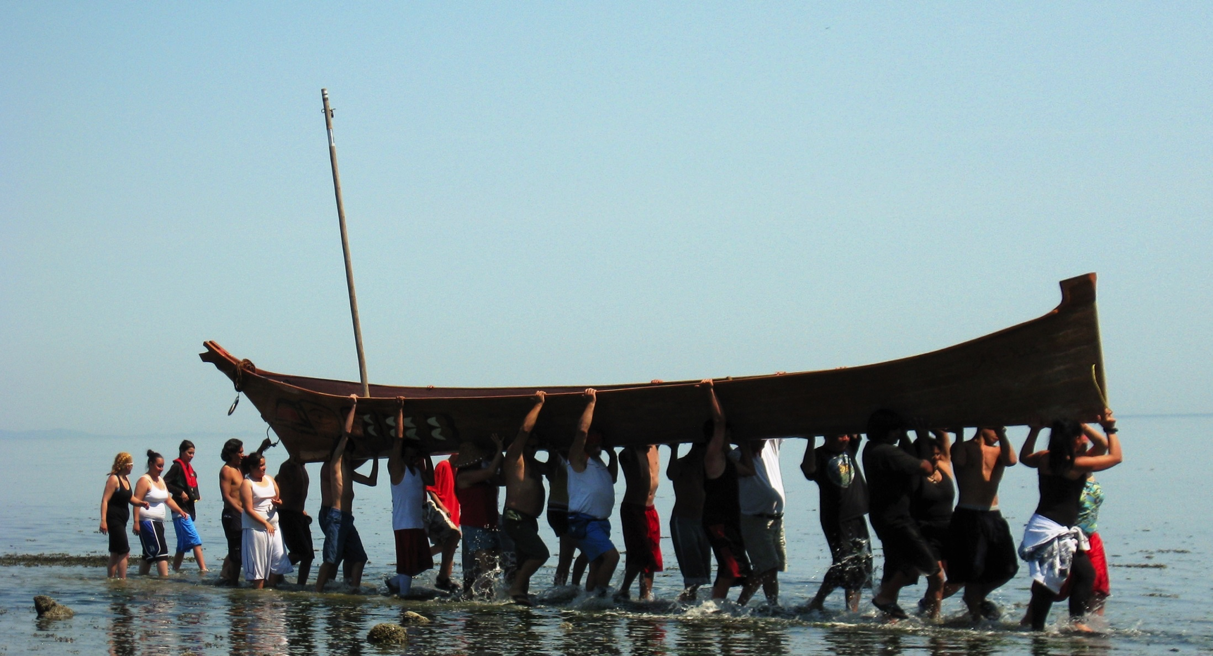
Impacts on Tribes and First Nations
Risk of increased physical and psychological stress from loss of cultural identity due to:
Decline or loss of important plant and animal species
Loss or changes in traditional foods
Loss of reservation land and cultural sites due to sea level rise
Coast Salish Canoe Journey 2009 landing in Pillar Point; photo by Carol Reiss, USGS
Notes:
Coast Salish Canoe Journey 2009 landing in Pillar Point; photo by Carol Reiss, USGS
Image source: http://www.eopugetsound.org/sites/default/files/topical_article/images/canoe_landing--Carol_Reiss_0.jpg
Swinomish have an EPA grant to dig more deeply into what the health consequences are for tribes.

Slide 26
Summary Considerations
Climate change will affect multiple, competing demands
In the Columbia Basin, climate change will increasingly disrupt the existing balance between hydropower, flood control, and instream flow augmentation for fish, requiring adjustments in reservoir operating policies

Slide 27
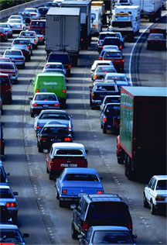
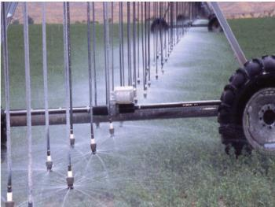
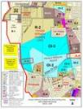
Summary Considerations
Reducing risk will require both mitigation and adaptation
Mitigation
Reducing emissions of greenhouse gases
Adaptation
Preparing for and managing the change that occurs as mitigation strategies are implemented

Slide 28
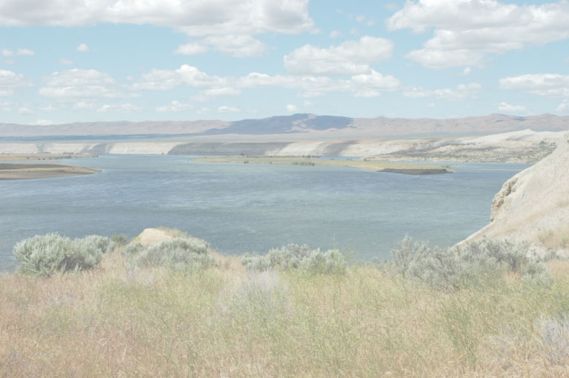
UW Climate Impacts Group
www.cses.washington.edu/cig
mkrosby@uw.edu
cig@uw.edu
Northwest Climate Science Center

