Slide 1
Osoyoos Water Science Forum
October 8, 2015
Kelsey Collins
Statewide Trust Water Coordinator
Washington State Department of Ecology

Slide 2
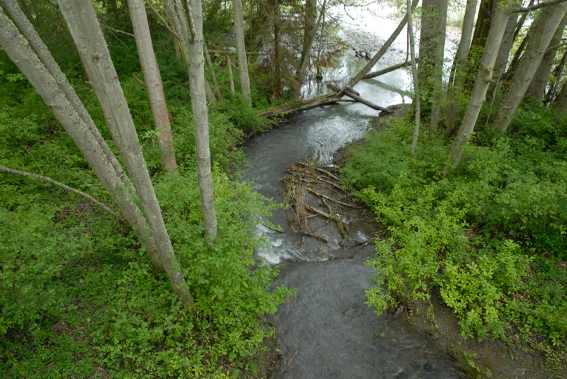
  What is the Trust Water Rights Program?
  How does a water right become a trust water right?
  Development of instream flow projects
  Water Banking
Presentation Outline
Photo: Brian Walsh
Notes:
Lots of material to cover
Save questions for afterward
2

Slide 3
WA State Department of Ecology
“Extinction is not an option.”
Irrigation Efficiencies
Grant Program (IEGP)
RCW 90.90
Office of
Columbia River
RCW 90.42
Statewide Trust
Watershed Planning Act
RCW 90.38
Yakima Basin
Acquisitions
Program
1989
1991
1997
1999
2001
2003
2006
$4 mil/bi
$8 mil/bi
$1-3 mil/bi
200 mil
2001

Slide 4
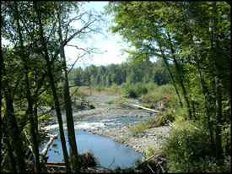
Trust Water Rights Program (TWRP)
TWRP provides WA state a way to legally hold water rights for future uses without the threat of relinquishment.
Only Ecology can hold a water right in trust
    Temporarily or permanently
    For instream and out of stream uses
Notes:
Lots of material to cover
Save questions for afterward
4

Slide 5
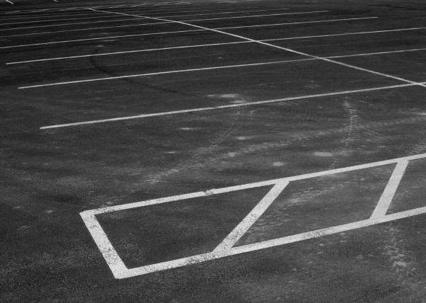
Mechanisms of conveyance
  Ecology acquires water rights through donation, lease, purchase, or other means.
      Donations = SHALL
      Everything else = MAY
Notes:
Lots of material to cover
Save questions for afterward
5

Slide 6

Other means
  Ecology may acquire water rights by “other means” through….
    Agreements, contracts
          mitigation banks
          water right swaps
Notes:
Lots of material to cover
Save questions for afterward
6

Slide 7

Everything Else
Ecology chooses
Where there’s choice and flexibility, there’s greater complexity.
Notes:
Lots of material to cover
Save questions for afterward
7

Slide 8
Project Development
Target
FINANCIAL CONSIDERATIONS
  profitability
  Ecology’s time and resources
PUBLIC BENEFIT
  Instream flow
  New uses
Donations
(for instream and
groundwater preservation)
OPPORTUNITIES
  Partnerships
  Seller’s goals for water right/land
Notes:
q

Slide 9
Water Banking
Supply
Sellers: Water right holders
Projects:
Retime available water
Demand
Buyers:
Mitigation for new uses
Reliability for existing uses
Banking Functions
Certifies validity of water rights
Business rules for bank
Establishes pricing
Marketing
Regulatory interaction
Notes:
Lots of material to cover
Save questions for afterward
9

Slide 10

Managing Expectations
Everybody wants dessert.
There’s only enough time and resources to make JELLO, but the expectation is Chocolate Raspberry Soufflé.

Slide 11

Water Banking
Water Banking is one tool in the toolbox.
Other tools:
    Direct transfer under RCW 90.03.380
    New storage
    Private agreements
    Other?

Slide 12
Project Development
FINANCIAL CONSIDERATIONS
  profitability
  Ecology’s time and resources
PUBLIC BENEFIT
  Instream flow
  New uses
OPPORTUNITIES
  Partnerships
  Seller’s goals for water right/land
Notes:
q

Slide 13
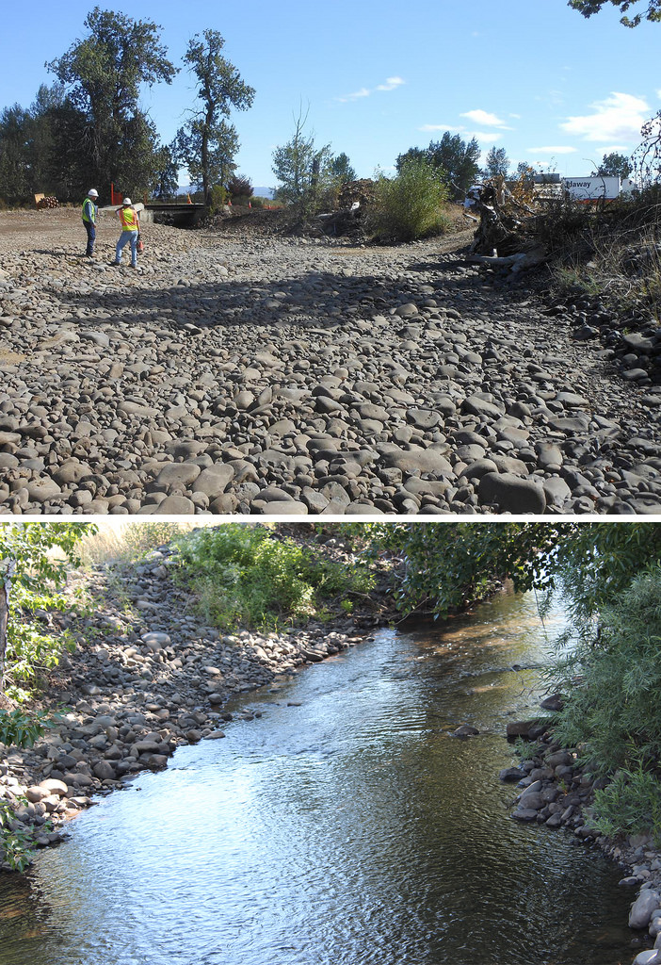
Trust Water Coordination
Best job at Ecology
Restoring stream flow with state and federal $$
Using a diverse portfolio of water rights to fix problems

Slide 14
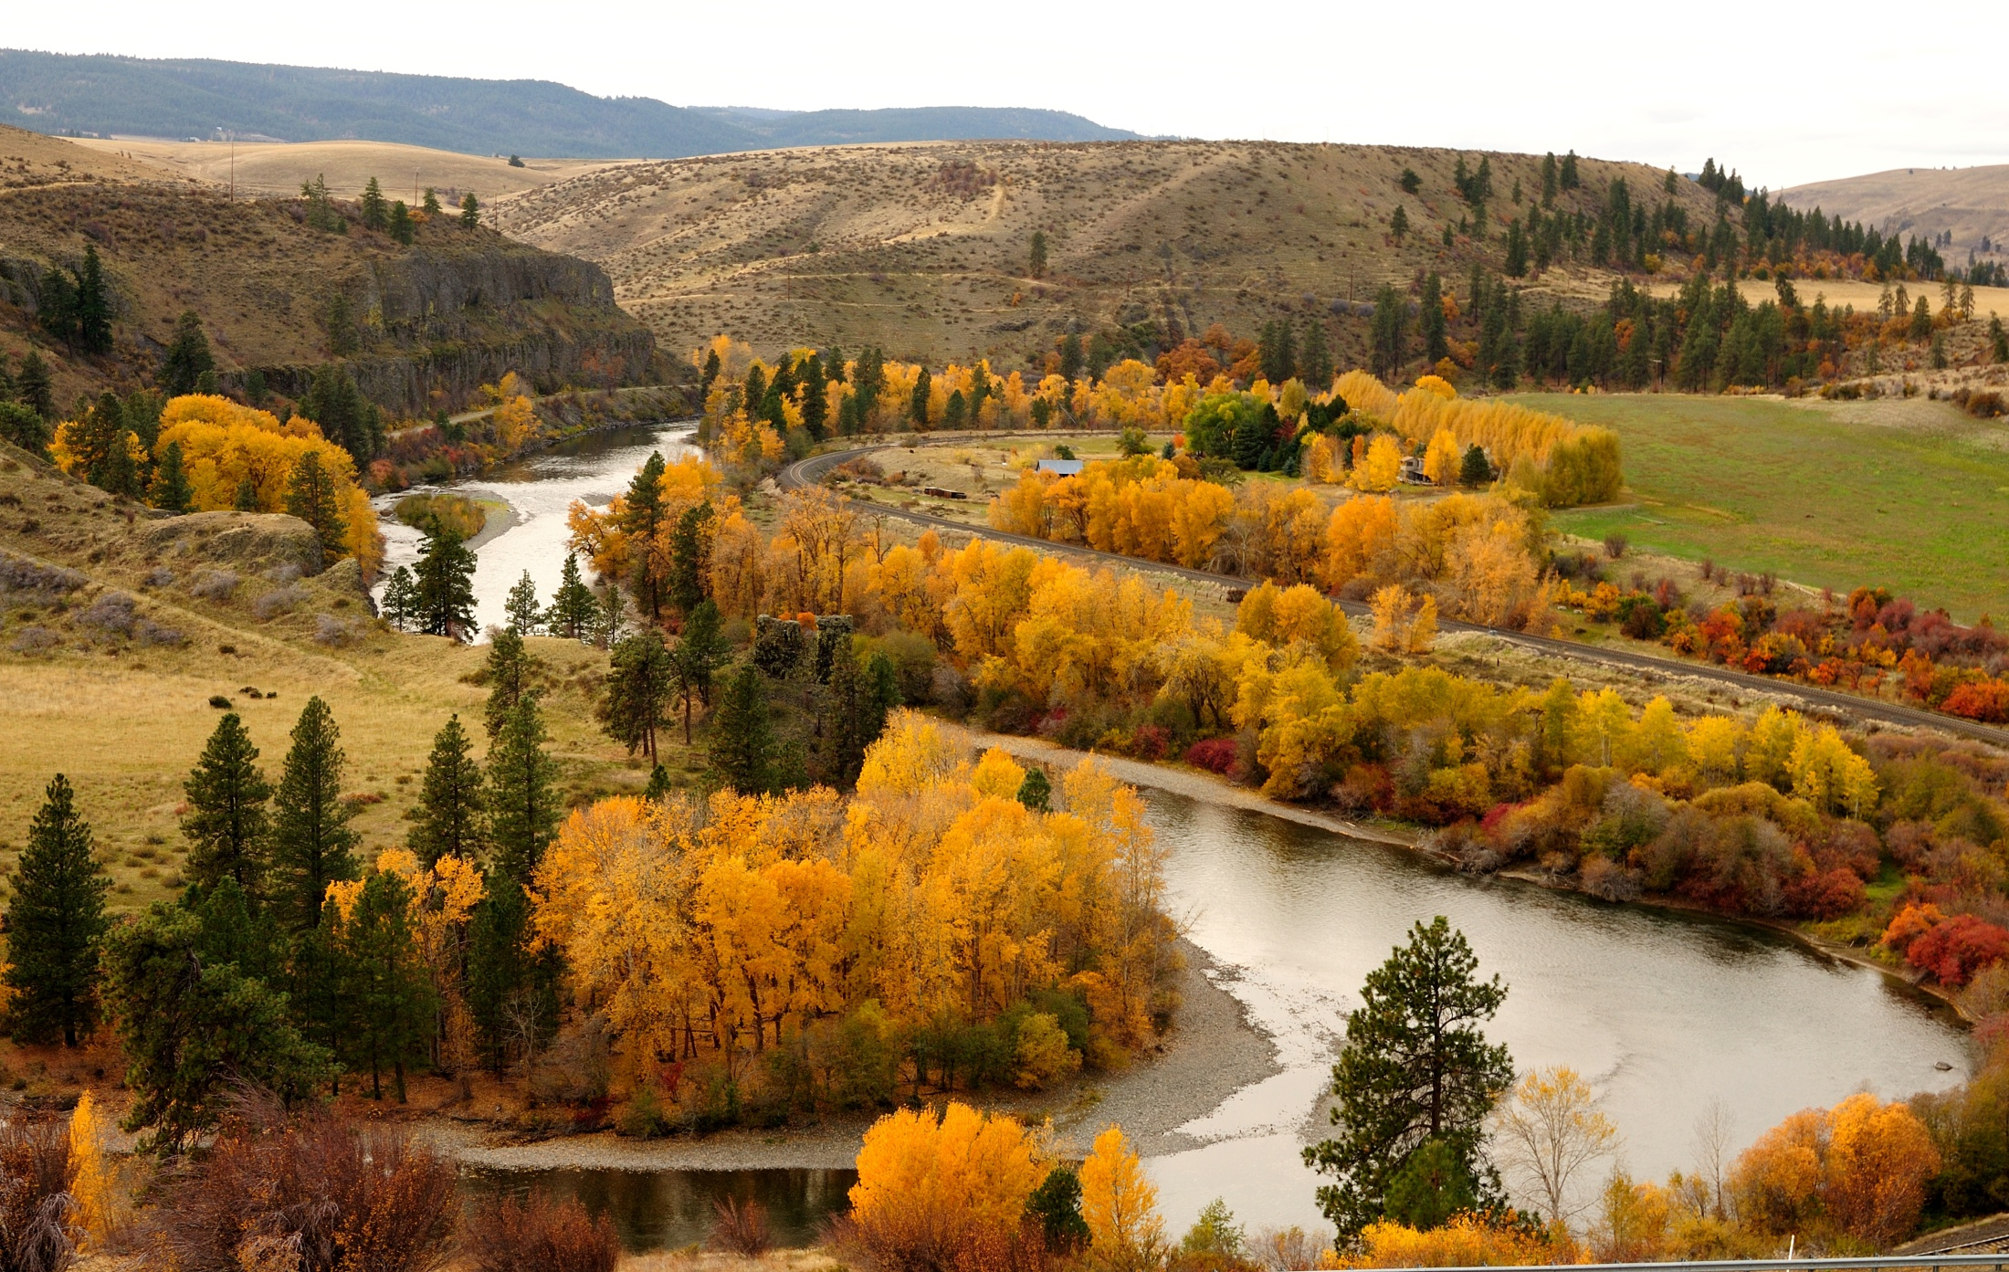
Questions
Photo Courtesy of Tom Ring
Thank You

Slide 15
Project Development
Studying local issues
Weighing local solutions
Consulting with local stakeholders
Time + Money

Slide 16
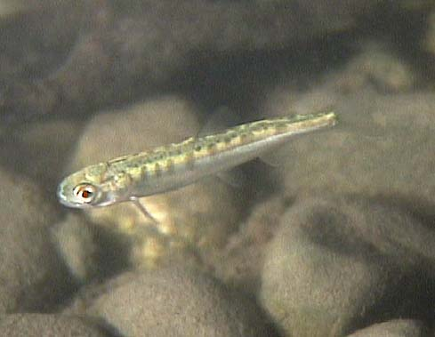
Project Examples
Town of Roslyn, WA
  Relies on a 1908 surface water right
  Acquired 2 senior water rights and applied to move them upstream.
      ESA Consultation to
      address impairment

Slide 17
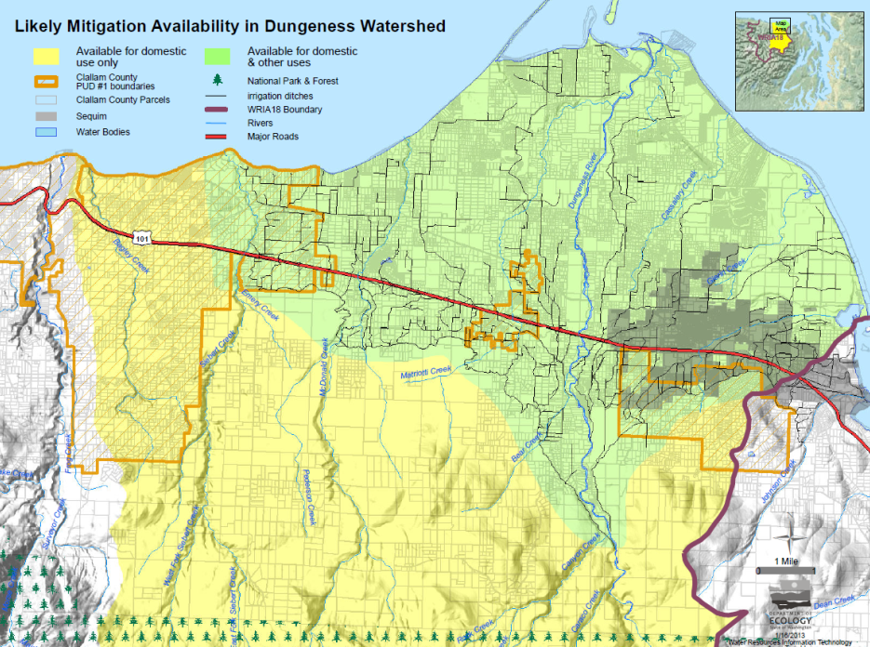
Project Examples
Clallam County PUD #1
  Applied to use new wells to avoid seawater intrusion.
  New wells subject to instream flow rule
    Purchased mitigation from Dungeness Water Exchange

Slide 18
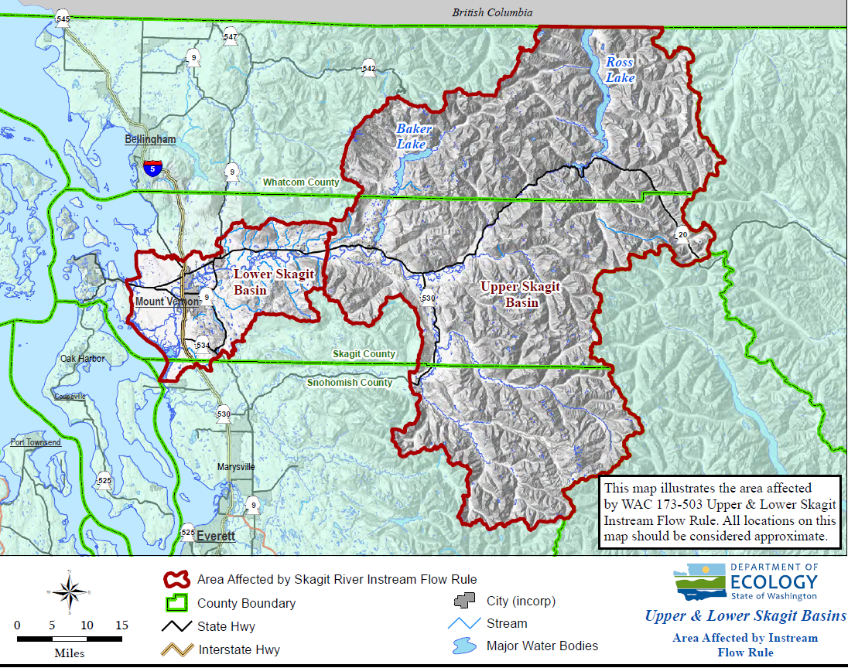
Project Examples
Big Lake Water System
  WWT purchased
  Class A water right
  Big Lake users will be served by Skagit PUD
  Ecology will use the water right for
      water banking
      instream flow improvement

Slide 19
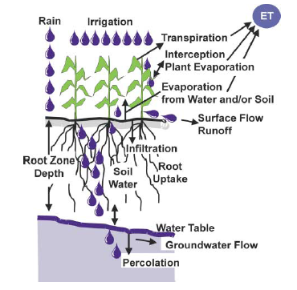
Ecology’s GUID 1210
Calculating Irrigation Efficiencies

Slide 20
Project Development
Draft Agreement
Transfer water right(s) to instream flow:
    Submit application to Ecology to change the purpose and place of use
        Investigation
          Is the right valid? -- Yes
          Would the change impair existing users?
            Managing the water past other diverters

Slide 21
Project Development
Draft Agreement
Transfer water right(s) to instream flow:
    Submit application to Ecology to change the purpose and place of use
        Investigation
          Is the right valid? -- Yes
          Would the change impair? -- No
          Ecology issues a decision defining instream flow Qa, Qi, location

Slide 22
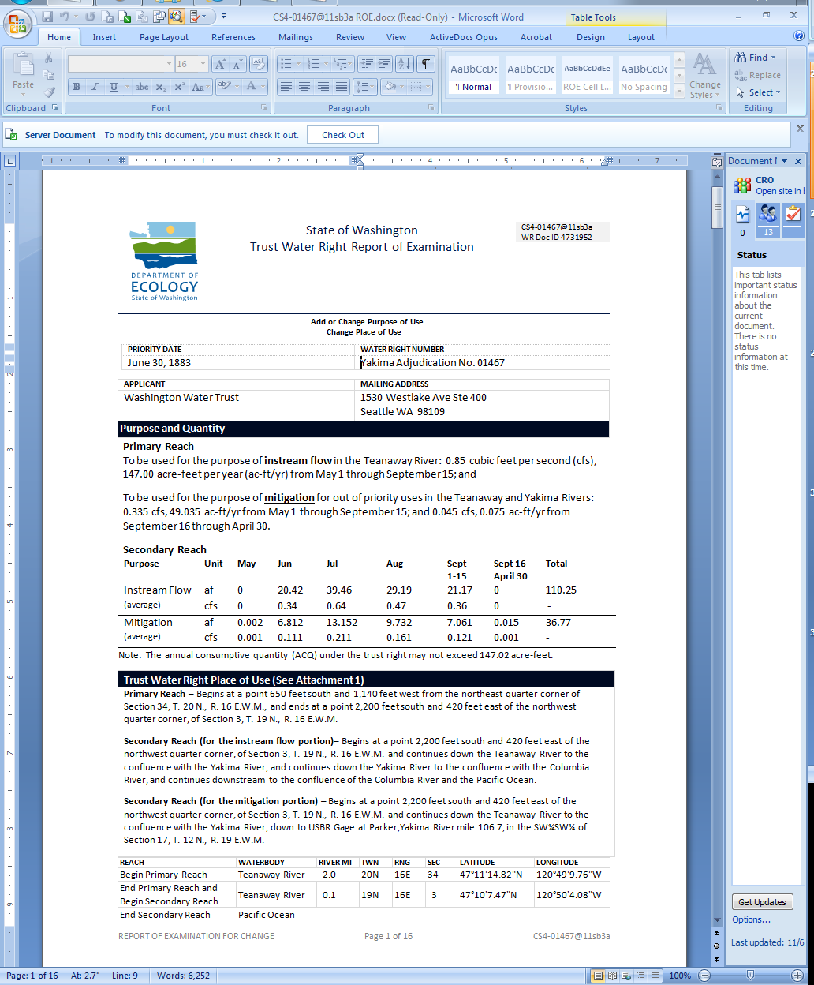

Slide 23
Authorized Place of Use
Primary Reach
Return Flows
    Instream Flow Place of Use
Secondary Reach

Slide 24
Primary and Secondary Reaches
Primary Reach contains all the saved water:
    the length of stream between the historic point of diversion and the point downstream where historic return flows rejoined the stream.
Secondary Reach contains the former consumptively used portion of the right:
    the length of stream from the end of the Primary Reach to as far downstream as the Pacific Ocean.

Slide 25
Quantifying Instream Flow
Primary Reach
  Acre-feet/year
    Total volume historically applied
  CFS
    Peak rate
Secondary Reach
  Acre-feet/month
    Volume consumed per month
  CFS
    Average rate to get monthly volume
*Mimic historic use to minimize
the risk of an impairment claim

Slide 26
Authorized Place of Use
Primary Reach
Return Flows
    Instream Flow Place of Use
Secondary Reach

Slide 27
Project Development
Draft Agreement
Transfer water right(s) to instream flow:
    Submit application to Ecology to change the purpose and place of use
        Investigation
          Is the right valid? -- Yes
          Would the change impair? -- No
          Ecology issues a decision – No Appeal
Ecology obtains a deed for the water right
Ecology issues mitigated permits for new uses

Slide 28
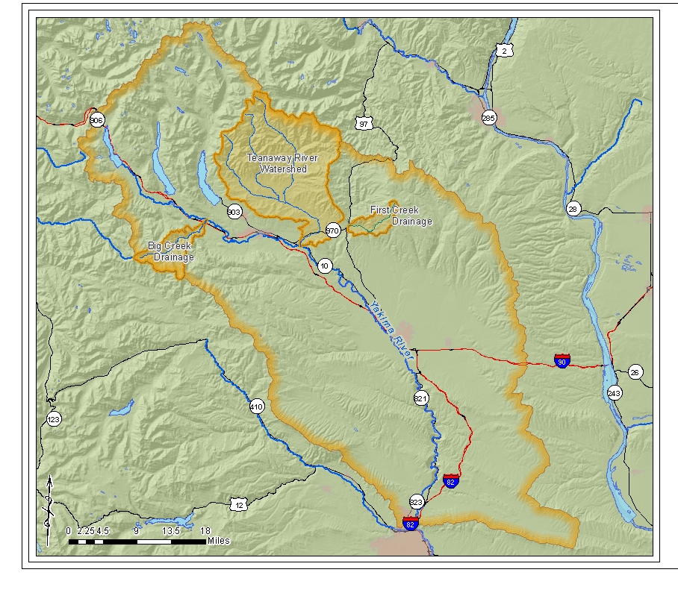
Teanaway Example

Slide 29
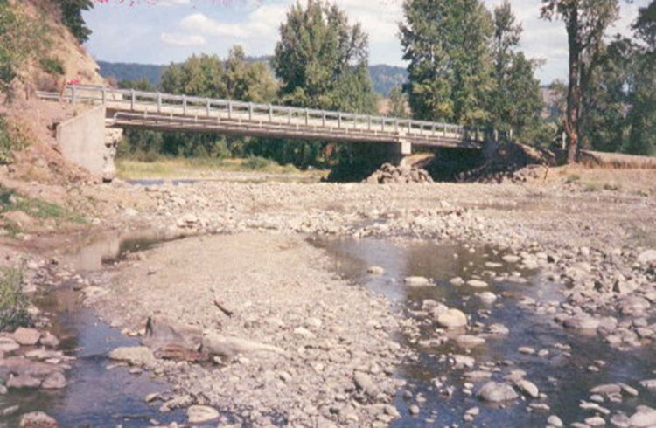
Teanaway River

Slide 30
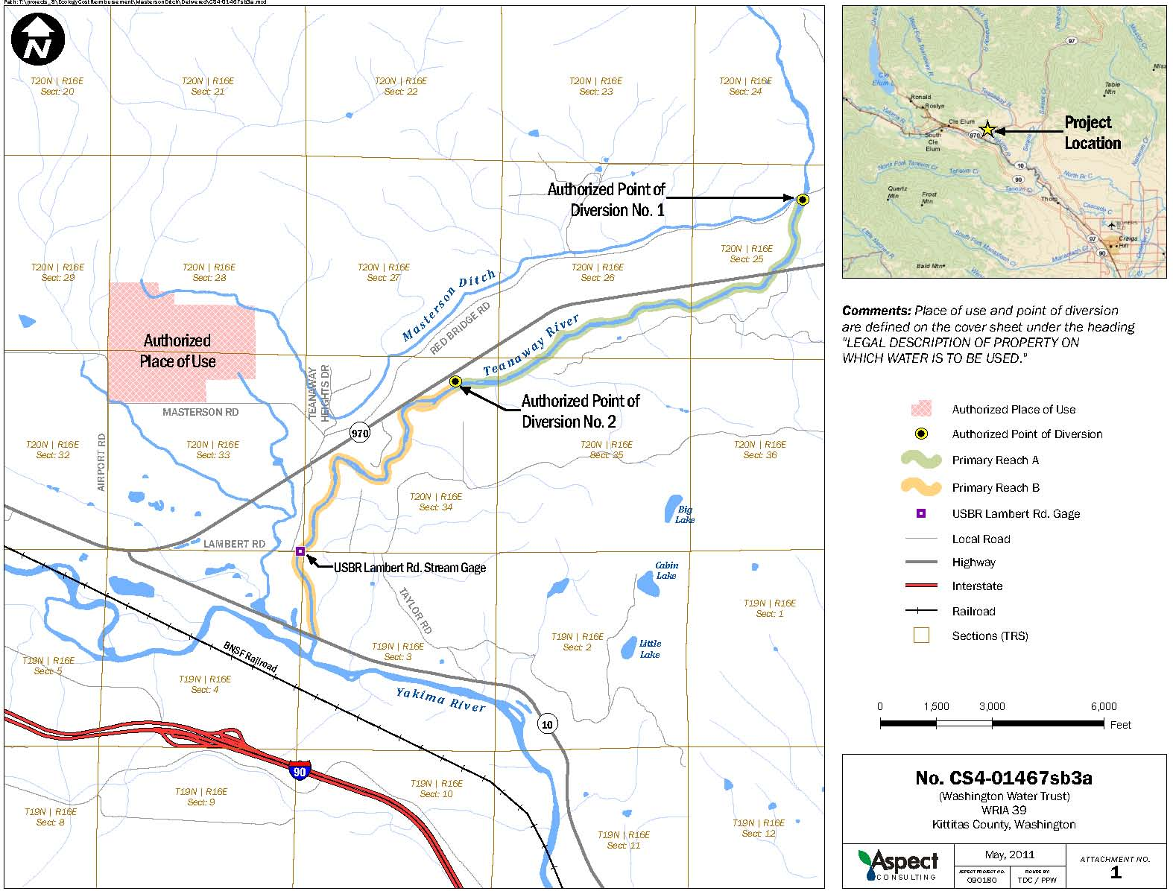
Historic Point of Diversion:
Masterson Ditch
Masterson/Mundy
pump station

Slide 31
1883 Claim from Teanaway River
Up to 7.6 cfs during freshet, 1 cfs stock watering
Masterson irrigation
Instream Flow from retiring ditch
Instream Flow from fallowing land for:
    mitigation
    stream benefit

Slide 32
A
Masterson Ditch
Masterson / Mundy
Pump Station
Seaton Ditch
Primary Reach
B
Yakima River
Lambert Bridge Gage
(USBR)
Secondary Reach

Slide 33
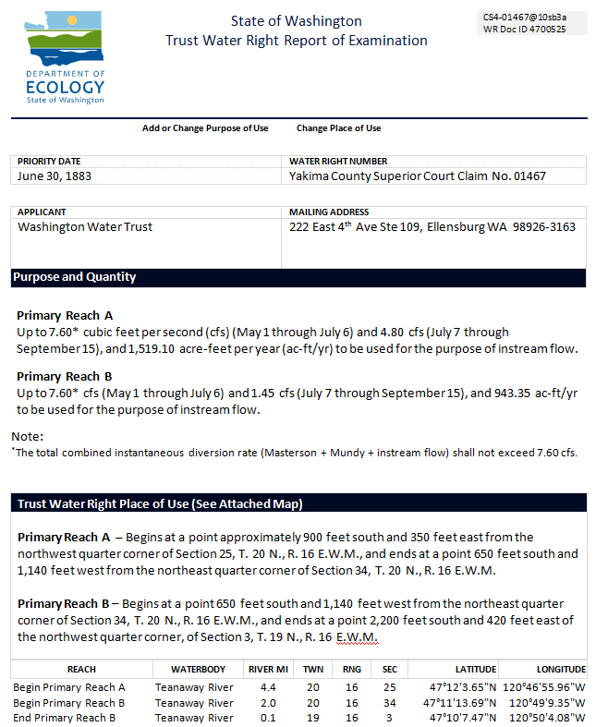

Slide 34
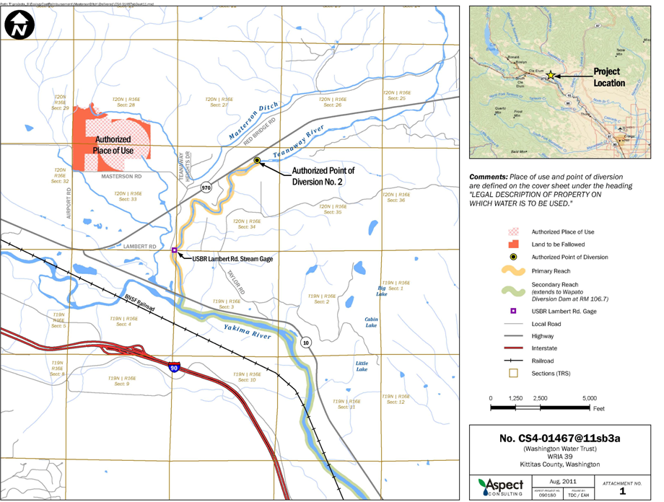

Slide 36
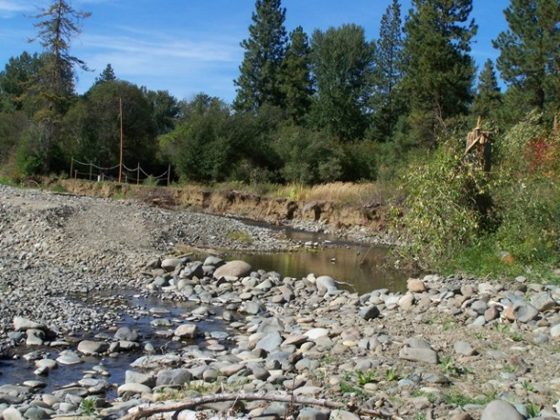
Example: Teanaway River (Masterson)
Instream Flows
Improved Passage
Retained Irrigation
Flexibility of Retained Water for Future Uses
Serves as a model for public/private partnership
Masterson Diversion – Full Passage Blockage and
low (no) flows – 1990’s
3M Diversion – Full Passage Blockage and low
flows - 2008

