Slide 1
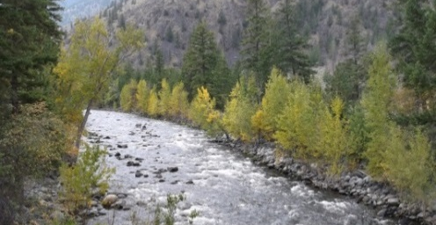
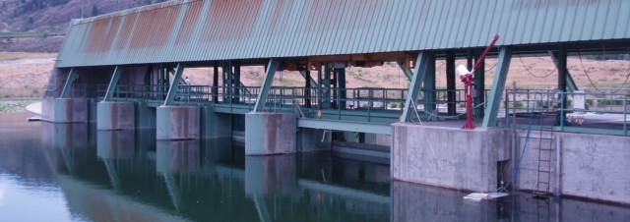
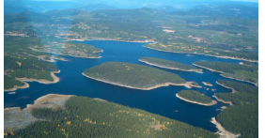

Water Supply and Demand in the Okanagan and Similkameen River Basins
Brian Guy, Ph.D., P.Geo.
National Practice Leader, Environmental Science
September 2015
Notes:
I’m going to briefly summarize 7 reports related to water supply and demand stacked up on the desk over there: 4 on the Okanagan and 3 on the Similkameen
Then conclude with some comments on current water supply and demand issues

Slide 2
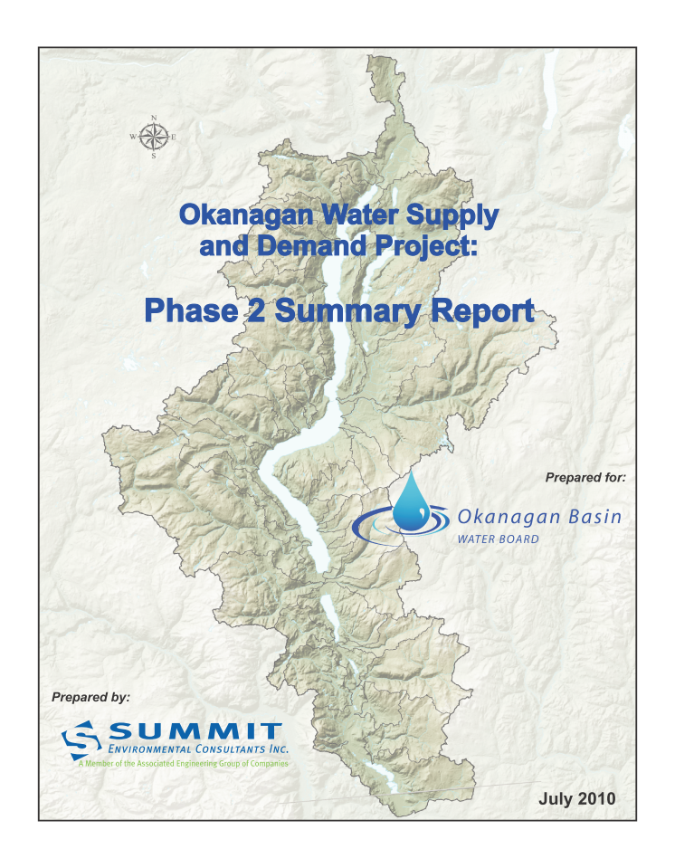
Notes:
The Supply and Demand Project has been conducted in several phases.
It was triggered by a realization that population had grown at a rate higher than predicted in the last major study in 1974, there was a concern that many streams had been licenced to a high level, that the climate was changing (there had been recent fires and a couple of significant droughts in the late 1990’s and early 2000’s) and that there had not been a basin wide update on the supply and demand situation since 1974.
In Phase 1 we developed a plan for a comprehensive water supply & demand study (2004-2005)
In Phase 2 we evaluated current and future water supply and demand (2007-2010).
This is the report cover for the Phase 2 Summary report

Slide 3
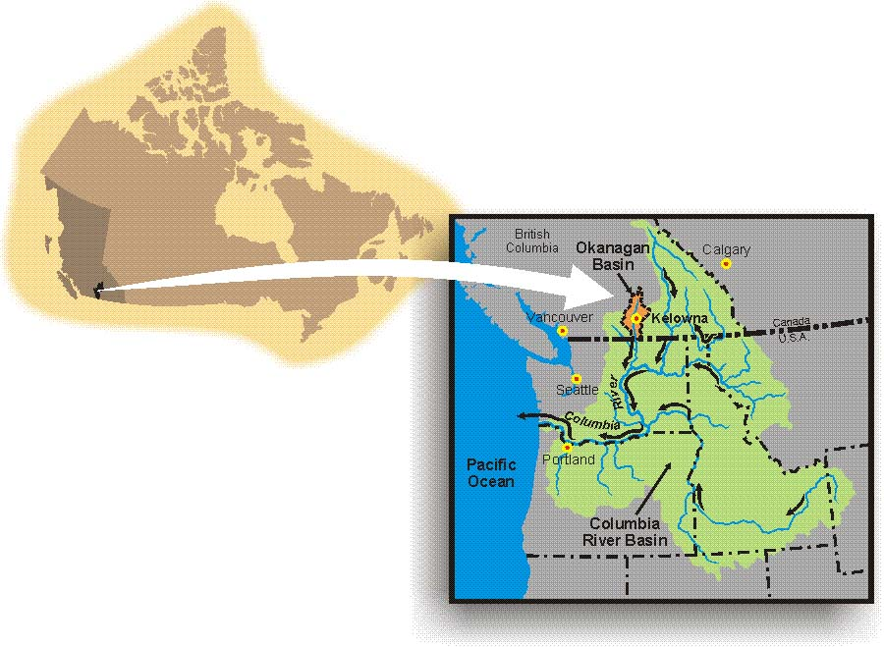

Okanagan location
From Natural Resources Canada (2008)
Notes:
Here’s the location of the Okanagan Basin, showing its position as a tributary of the Columbia River, the fourth largest river in North America.

Slide 4
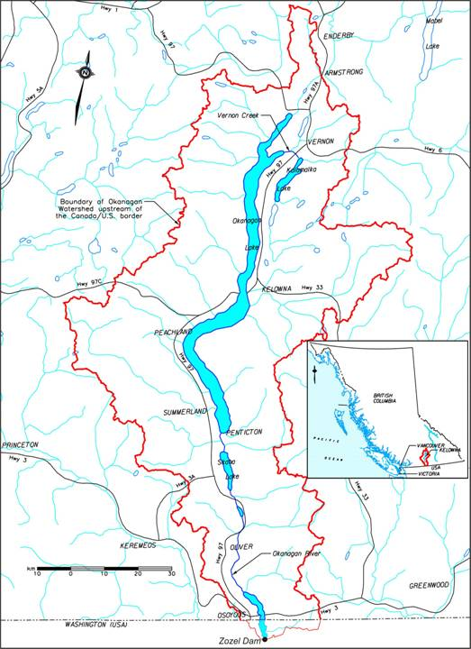
Notes:
Here’s a slightly larger view of the basin – it’s about 200 km long and averages about 40 km wide, covering about 8,000 square km.

Slide 5
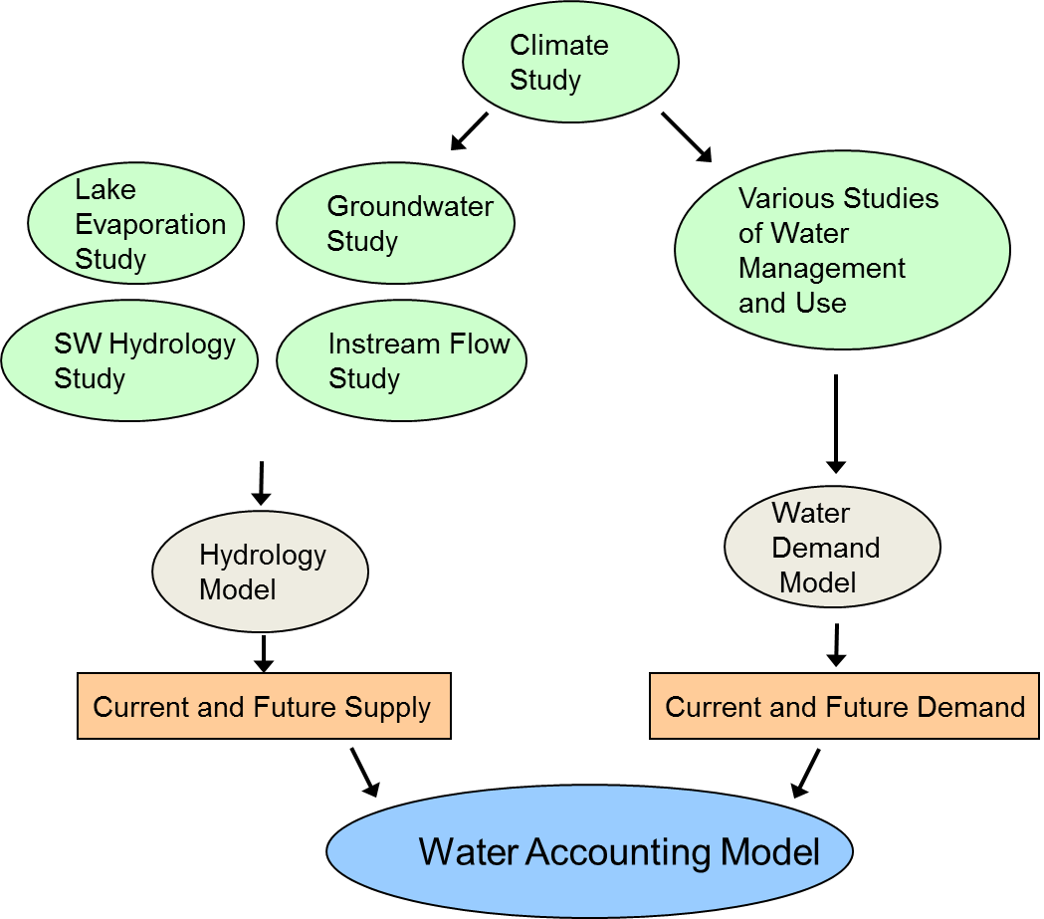
Phase 2 Study Components
Water Supply
Water Demand
Notes:
The work was divided into the Supply side on the left and the Demand side on the right
We did several technical studies under each heading and built two key models: a Hydrology Model and a Water Demand Model. Then combined then to create a combination Water Accounting Model
All the models were calibrated using existing data and then ran a limited number of future scenarios

Slide 6
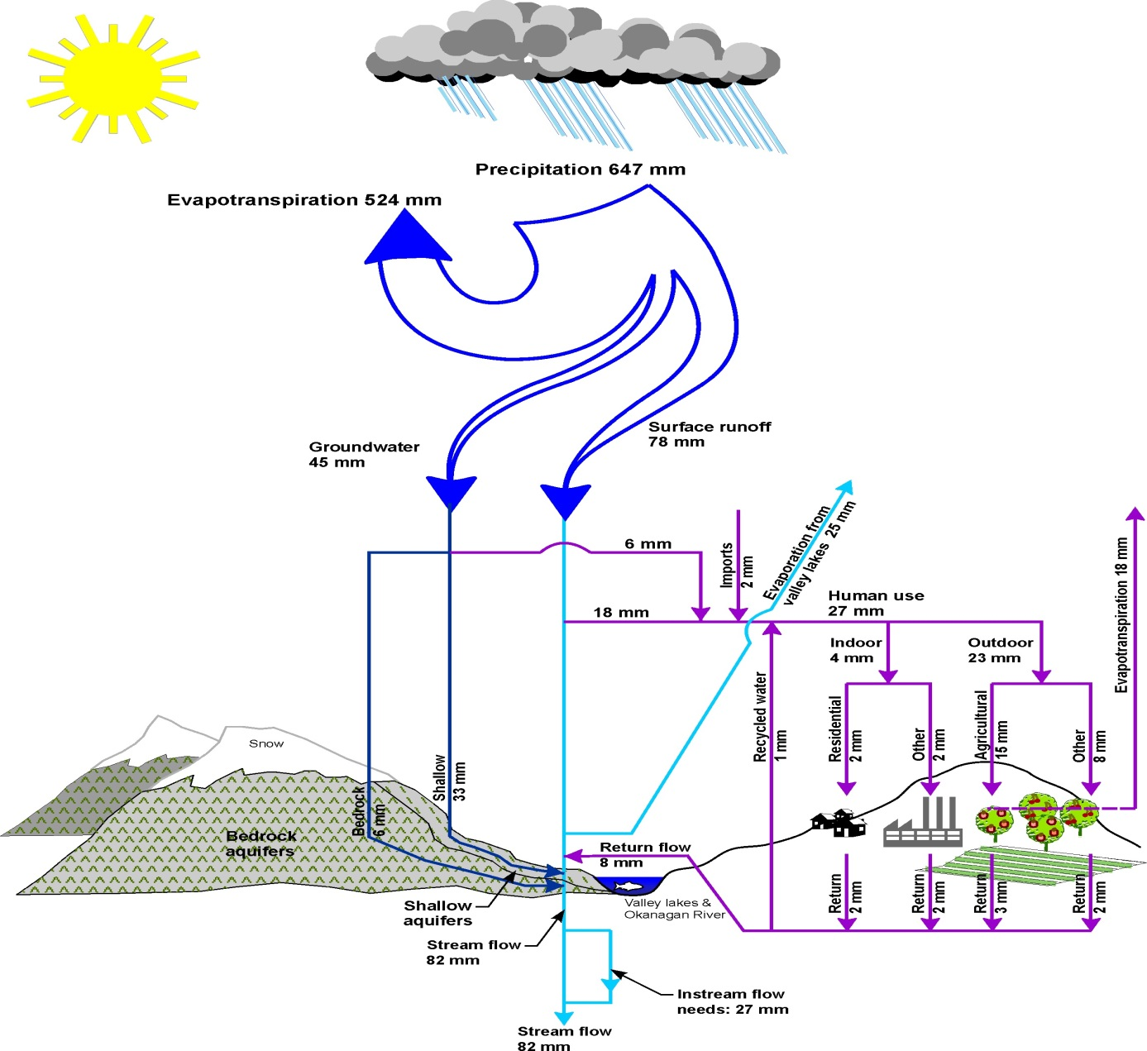
Basin-wide water balance
Notes:
Here’s the average annual water balance for the Basin.
Its an arid area, and on top of that, 80% of the incoming precipitation evaporates and never enters the stream, or groundwater, or lakes in the Okanagan.
So water is precious around here.

Slide 7
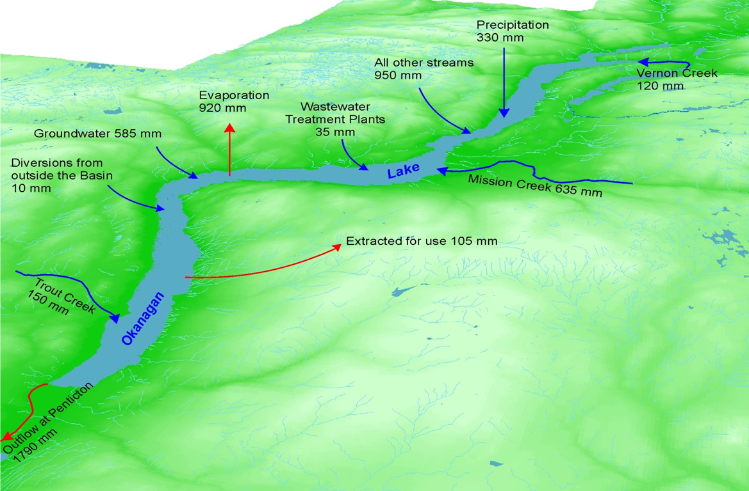
Okanagan Lake water balance
Half the net inflow evaporates
Notes:
Average annual water balance for Okanagan Lake (1996-2006 data).
Half of the net inflow evaporates (about 900 mm)

Slide 8
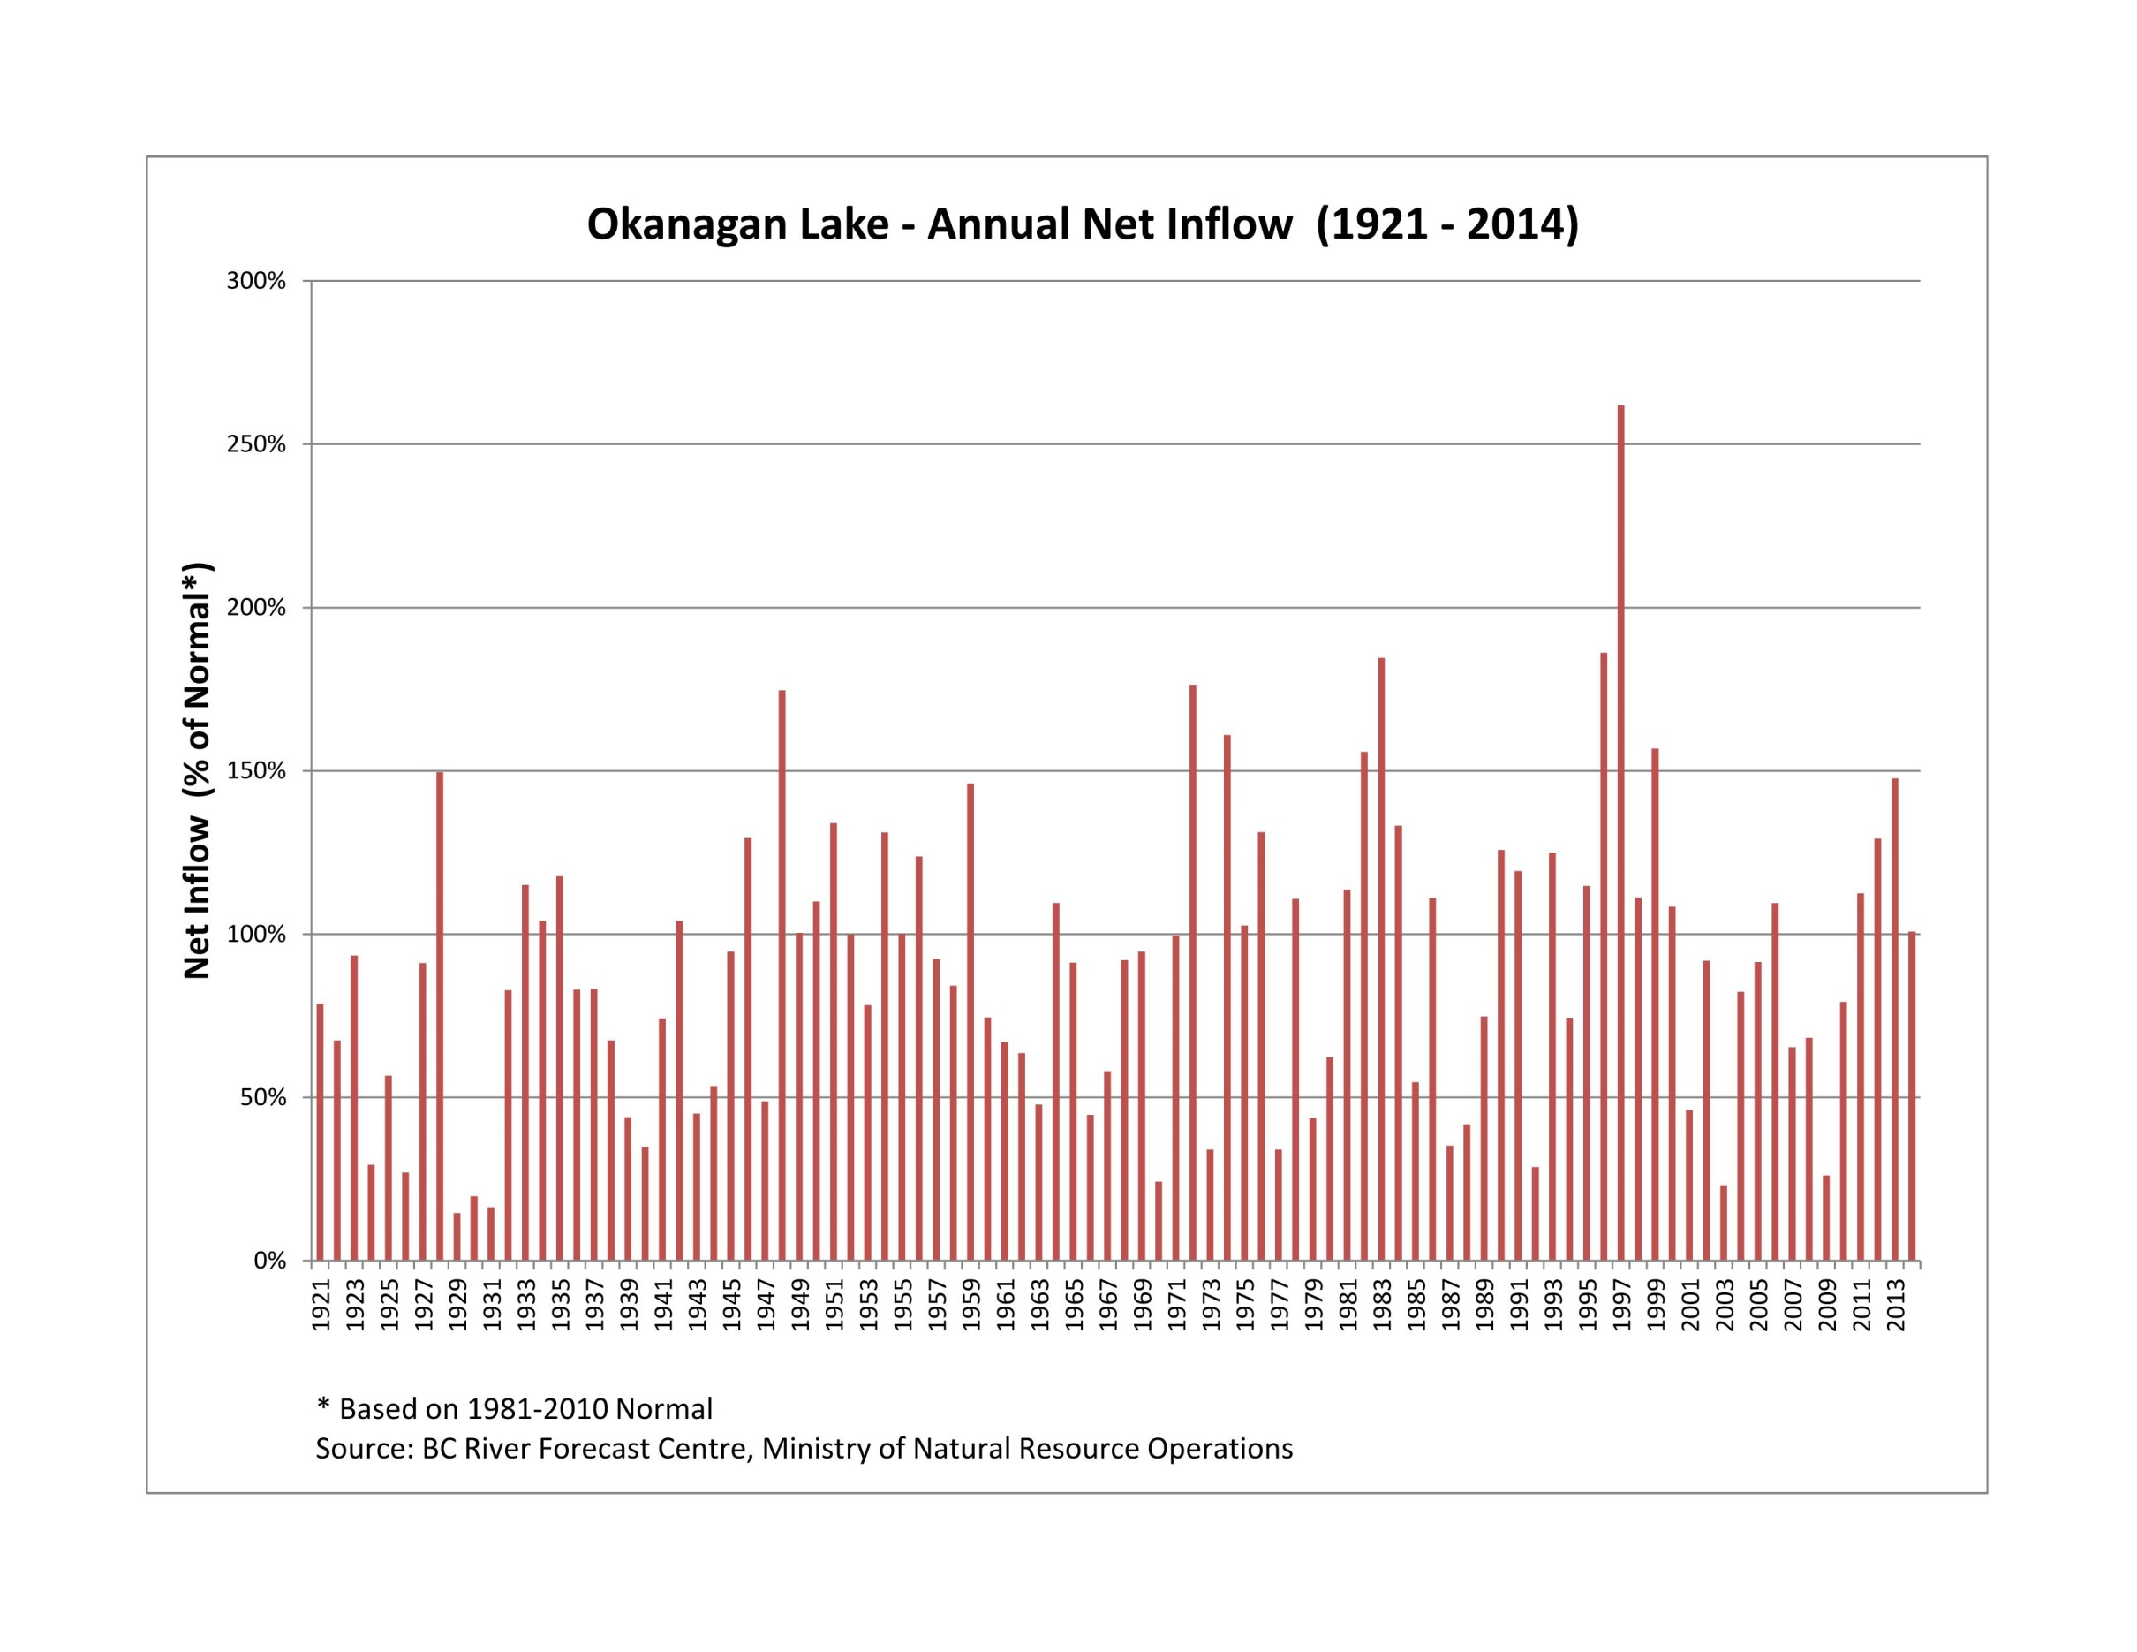
Notes:
This graph shows total annual net inflow to Okanagan lake between 1922 and 2004.
There two things to note – first the average rate of flow in the Okanagan River downstream of Penticton is about 500,000 Mega litres, which is about 16 cubic metres per second
This is even though about 23 cubic metres per second flows into the lake – the rest is lost to evaporation and withdrawals.
The other observation is the high degree of variability from year to year.
It doesn’t show it here but streamflow varies widely during the year – about 85% comes down from the hills in the five months between March and July, and only 15% occurs in the other 7 months

Slide 9
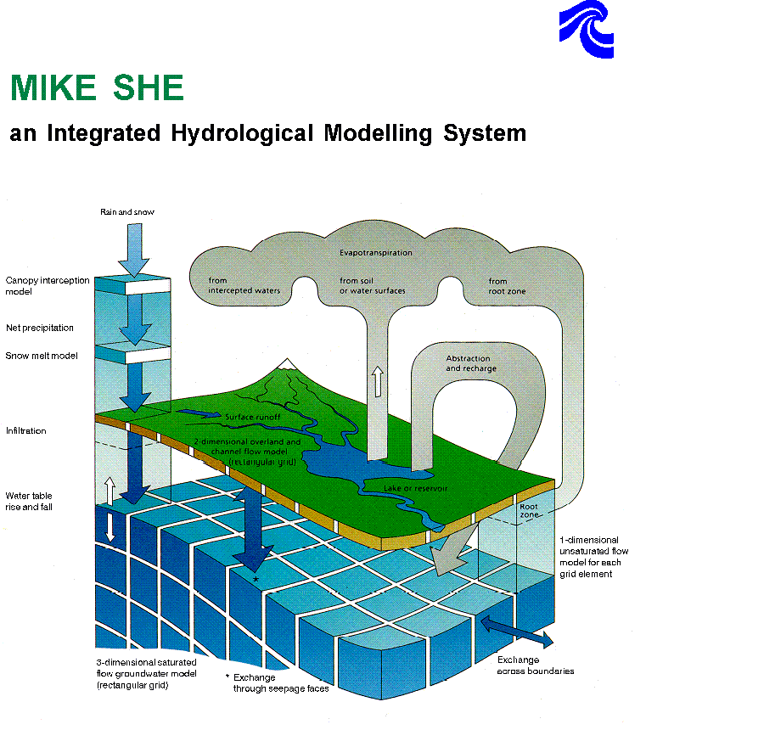
Okanagan Basin Hydrology Model
an Integrated Hydrological Modelling System that covers all land-based phases of the hydrologic cycle
Notes:
We compiled all the precipitation, groundwater, snow depth, and streamflow data and built a very complex Hydrology model, using the Mike She modelling platform.
The model is driven by a 500 m by 500 m climate grid developed by Environment Canada.
The model can be used to predict streamflow at virtually any location within the Basin at a daily time interval.
In Phase 2 we simplified the output to about 80 specific locations and lengthened the time step to weekly.

Slide 10
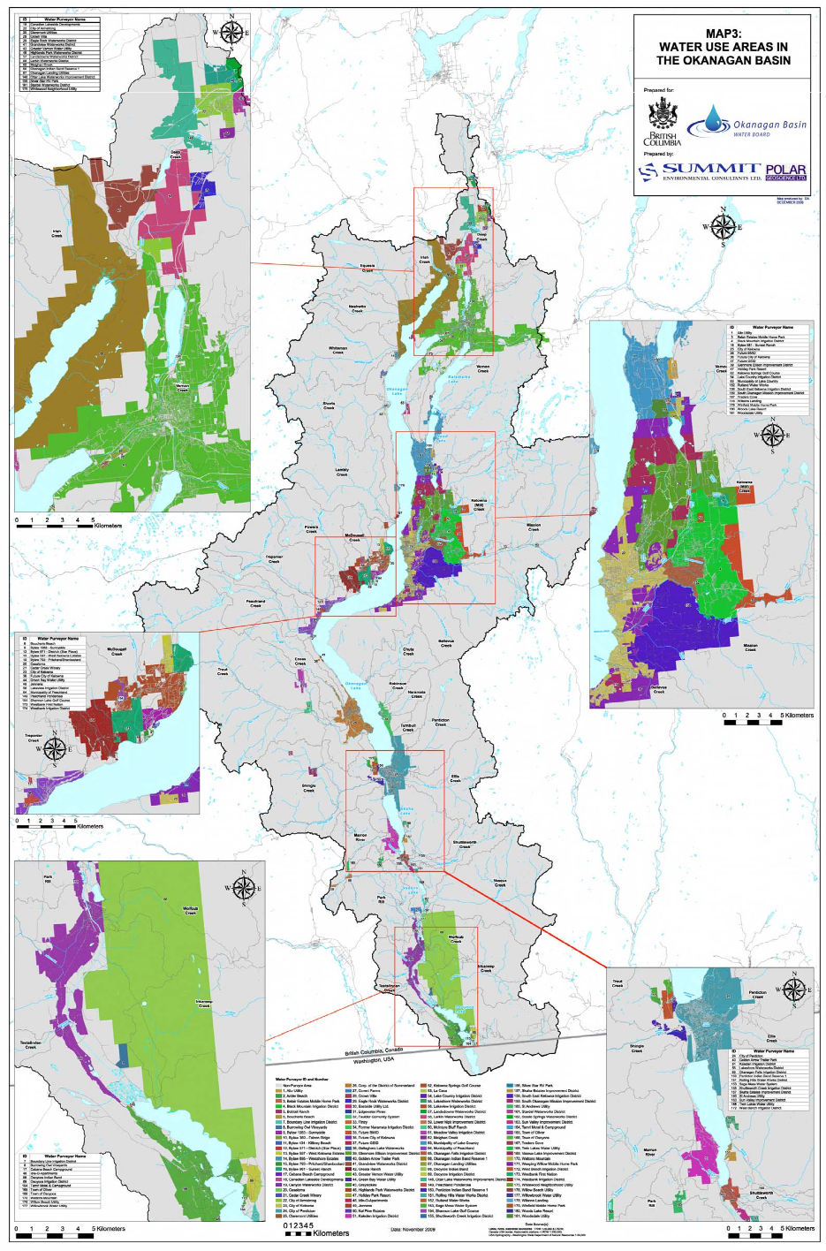
Notes:
Over to the water demand side:
Here’s one of the great maps produced during Phase 2:
it shows ALL of the water suppliers in the entire Okanagan and the land areas that each one delivers water to

Slide 11
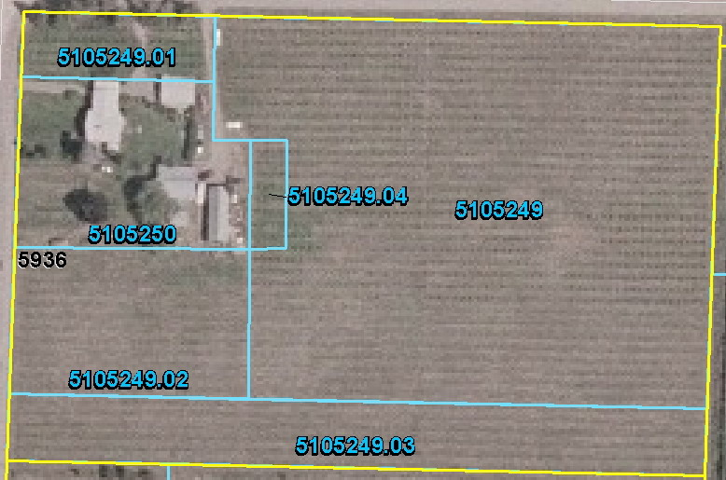
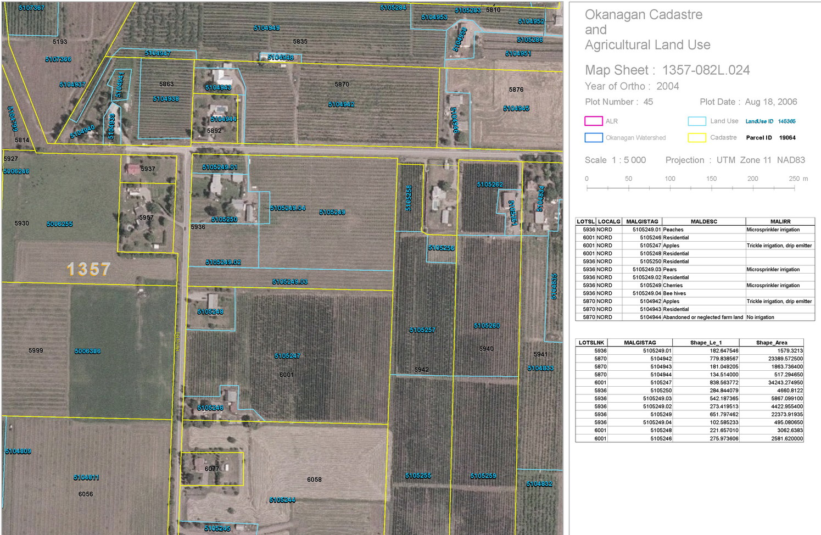
Okanagan Water Demand Model:
Cadastre, Soil, Climate and Land Use Polygons
1
2
5
6
Microsprinkler on peaches
Microsprinkler on cherries
Microsprinkler on pears
Drip on pears
Residential
Bee hives
4
3
Cadastre
Polygon
Notes:
Another great product of Phase 2 on the demand side was the Okanagan Water Demand Model
It’s a very sophisticated model developed by Provincial and federal agriculture ministries

Slide 12
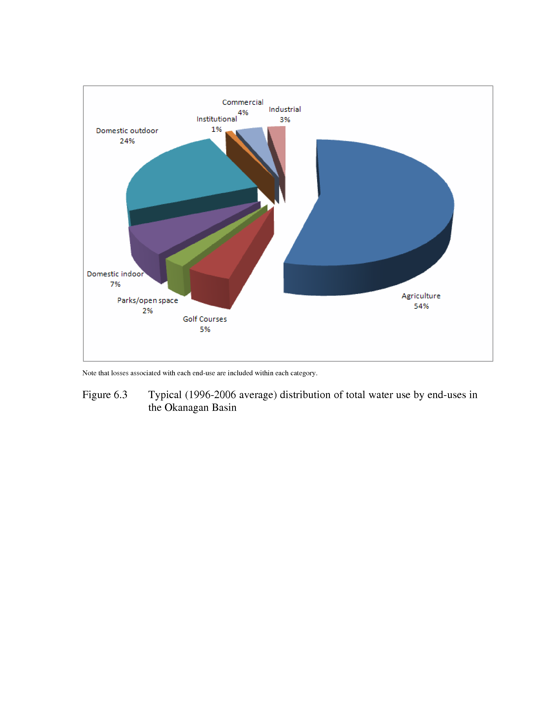
Water Use
Notes:
What we learned is that there are about 101 water suppliers and 4,000 water licences in the Okanagan.
443,000 megalitres (a megalitre is one million litres) is licensed for offstream use and 351,000 ML is licensed to remain in the streams for aquatic ecosystem purposes.
About one-third of the 443,000 ML licensed for diversion are supported by storage.
Average annual water use is about 220,000 ML (147,000 from surface water and 49,000 from groundwater), so only about one-third of the water licensed for withdrawal is actually withdrawn – in other words the water suppliers have lots of room under their existing licenses
whether that water will be there in the future is another question.
Here’s how the water is used in the Okanagan - 86% is used outdoors (54% for agriculture, and 32% for domestic and other outdoor uses)

Slide 13
Phase 2 Recommendations
More monitoring
More research
More scenarios
Work to make the Phase 2 models more accessible
Notes:
The Phase 2 report made several recommendations, including:
More monitoring of streamflow and groundwater levels
More research (on several issues, eg groundwater, groundwater-surface water interactions, environmental flow needs …)
And some work to turn the Phase 2 models into forms that make them easier to use for water allocation and other purposes – they are very complex, take special knowledge and experience to operate, and they take a long time to run.

Slide 14
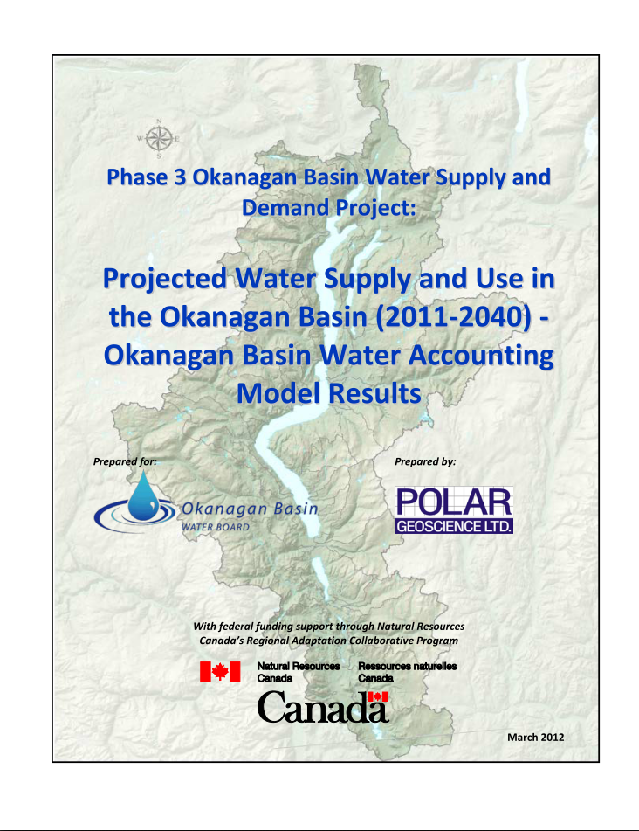
Notes:
The 2010 Phase 2 report had examined a small number of future scenarios - considering both population grown and climate change, but it was not extensive.
This 2012 report (part of Phase 3) looked at future scenarios in much greater depth

Slide 15
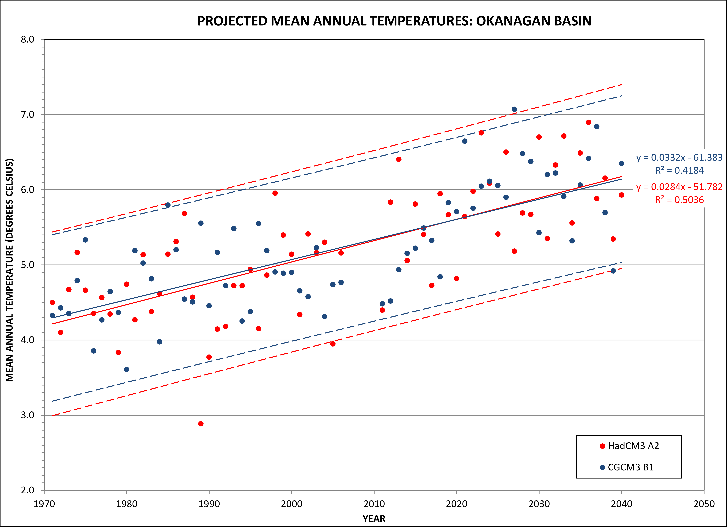
This is the “Blank+Dots Blue” layout.
Use it for impact text, callout quotes,
and photos with defined borders,
or as a bold contrast from a
predominantly white slide deck.
Notes:
First off, the climate really is changing.
Here’s what has happened and what is likely to happen with respect to air temperatures

Slide 16
Expected Streamflow in 2080 -
Okanagan River at Oliver
Projected monthly streamflow in 2080
250000
Spring runoff decrease
230000
210000
190000
170000
2080s
Streamflow (dam³)
150000
Lower summer flows (with longer duration)
130000
110000
Winter runoff increase
90000
70000
50000
oct
nov
dec
jan
feb
mar
apr
may
jun
jul
aug
sep
Historical
Average of projections of 10 GCMs
Recreated from Hamlet et al. (2010)
Notes:
This is what is expected to happen to streamflows in the Okanagan River in the future.
the blue hydrograph is the historical average, and the red line shows expected conditions in 2080 (based on the B1 emission scenario which assumes some future reductions in CO2 emissions).
The red line indicates more winter runoff, earlier spring melt, lower spring peak flows, and lower summer and early fall flows.

Slide 17
Growth projections - Central Okanagan
36% increase 2012 to 2035
Source: BC Stats 2012
Notes:
The same goes for population growth – we’re looking at a 36% increase between 2012 and 2035 in the central Okanagan

Slide 18
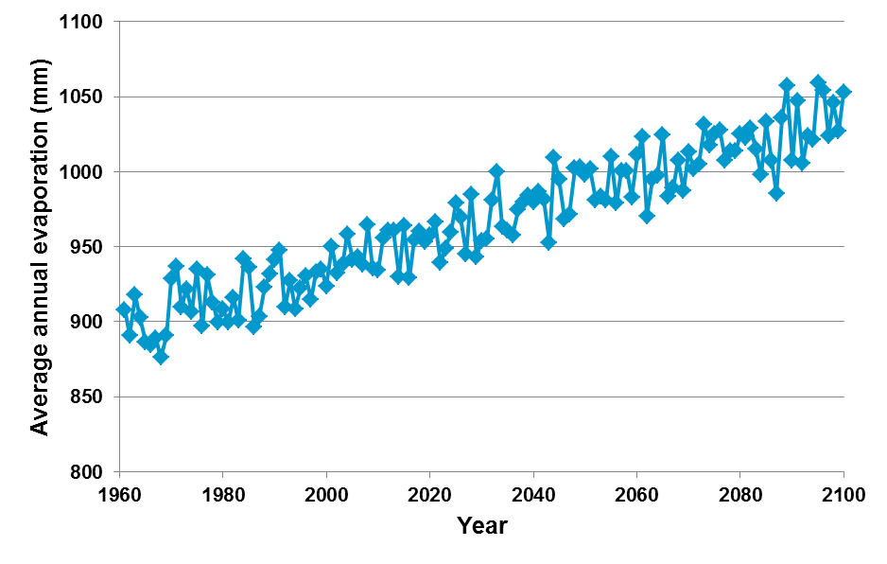
Historic and Predicted Annual Evaporation from Okanagan Lake
Notes:
Here are modelled estimates of past and future lake evaporation
By the way, these modelled estimates were checked by Environment Canada in a recent 3-year study and were found to be pretty close.

Slide 19
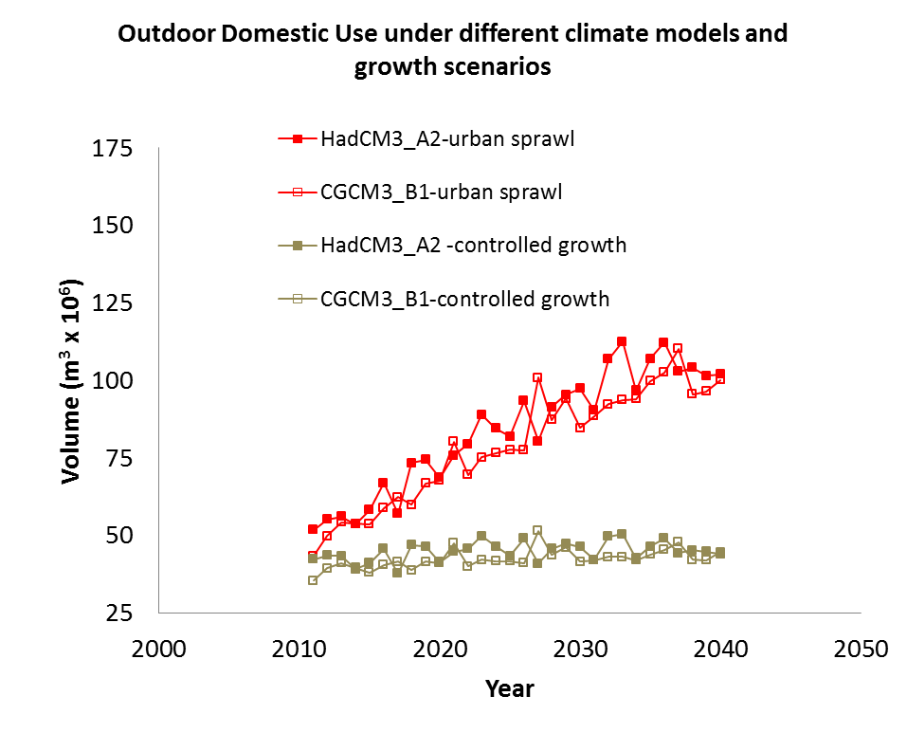
Future Okanagan Basin Outdoor Domestic Water Use
Build-out with landscaping
Infill
Notes:
here are some estimates of future outdoor domestic water use with two different land use scenarios.
Build-out with landscaping is basically business-as-usual.
Infill requires a significant change to higher densities and smaller gardens – yet this is the only way to keep future water demands at present levels.

Slide 20
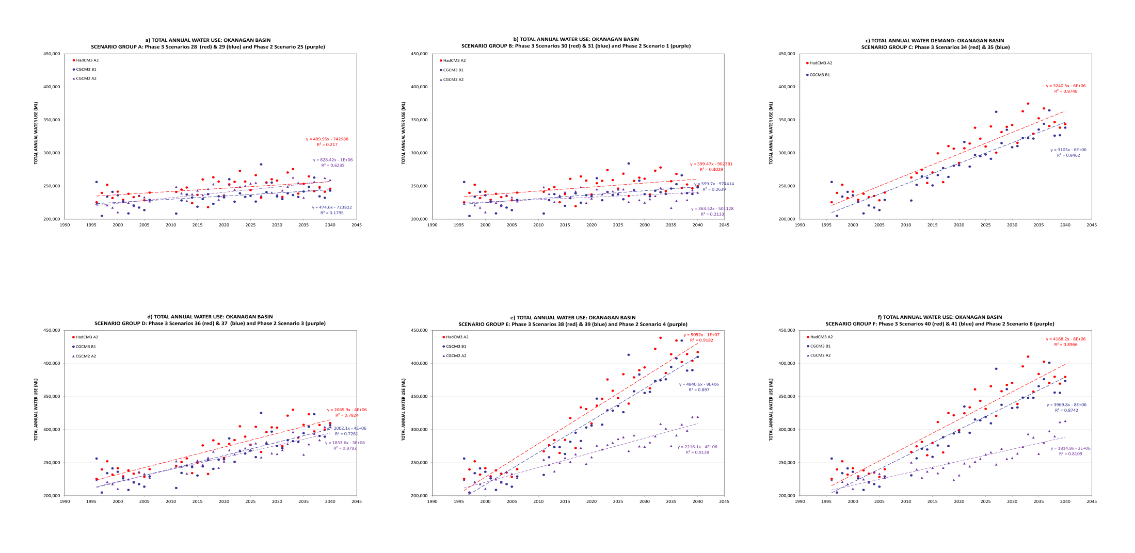
Projected annual water use 2011-2040
(entire Okanagan) under 6 scenarios: 2011 - 2040
Notes:
Here’s a plot that you can’t read – it shows what is likely to happen to water use in future … using 3 climate models and 6 land use scenarios
What you should get from this slide is the simple observation that no matter what model or what scenario you pick, all of the graphs slope up and to the right, in other words, water use will increase.
Red = Had CM3 A2; Blue circles = CGCM3 B1; Purple triangles = CGCM3 A2

Slide 21
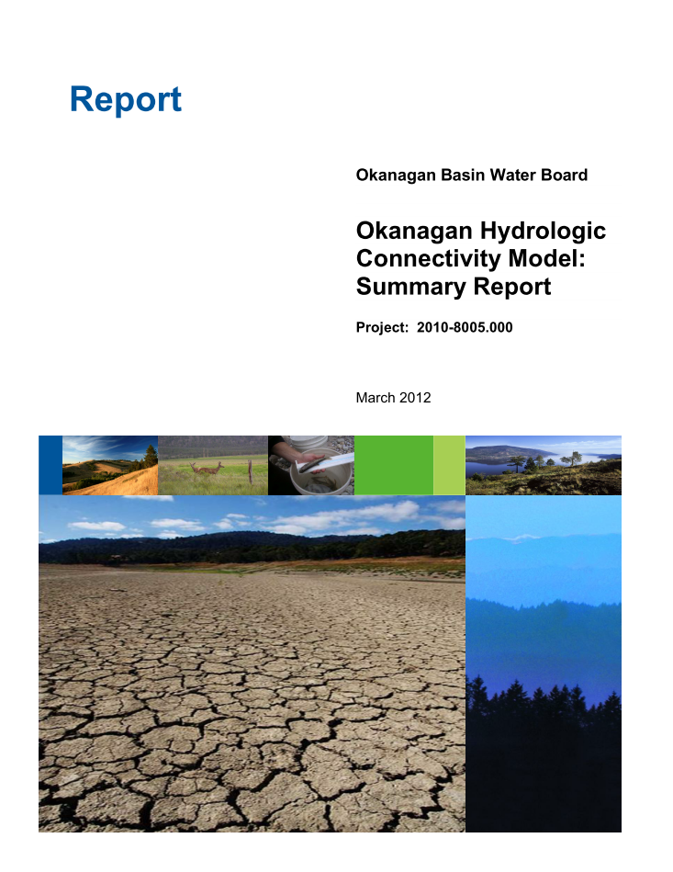
Notes:
This is the report cover for the 2012 Hydrologic Connectivity study - in this study we tried to find a way to get a simpler use interface to piggyback on the complex Phase 2 models to make it way easier and faster to run scenarios – which we did,
And we also used this simpler modelling approach to demonstrate clearly how water use in one part of the Basin affects fish and other water users downstream throughout the entire Basin – for example we showed how a water extraction in Vernon can affect the ability of water managers to meet instream flow requirements in the Okanagan River between Penticton and Oliver.
It allowed us to game with priorities – for example the model could pretend that meeting fish flows was a very high priority, or alternatively a very low priority.

Slide 22
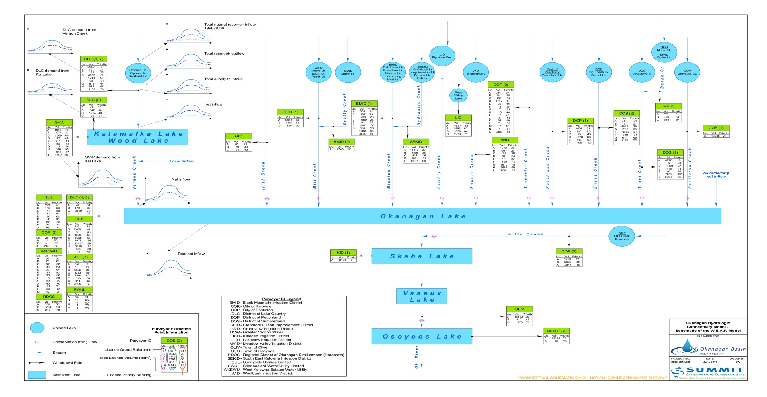
Hydrologic Connectivity Model (2012)
Notes:
This is a schematic created for this Okanagan Hydrologic Connectivity Project that shows the connectivity between water in each part of the Basin

Slide 23
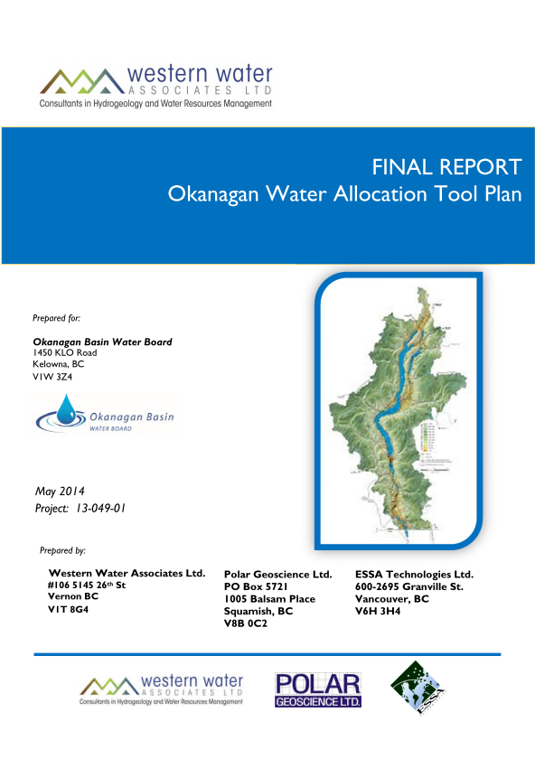
Notes:
So we’ve learned a lot about water supply and demand over the past 10 years, but not enough …
This is the report cover for a 2014 study in which we were asking – what have we done and what are the next steps – i.e. what’s still to be done.
I’ve always thought that the title of this report is unnecessarily limiting (since it’s focussed on a particular product) – but the results provide a future roadmap for a range of water supply and demand related work that’s still needed.

Slide 24
OWAT – Okanagan Water Allocation Tool
Notes:
Here’s a summary from that report – a list of next steps and a schedule.
I’ll briefly discuss some of the key next steps in a couple of minutes after reviewing the status of work in the Similkameen

Slide 25
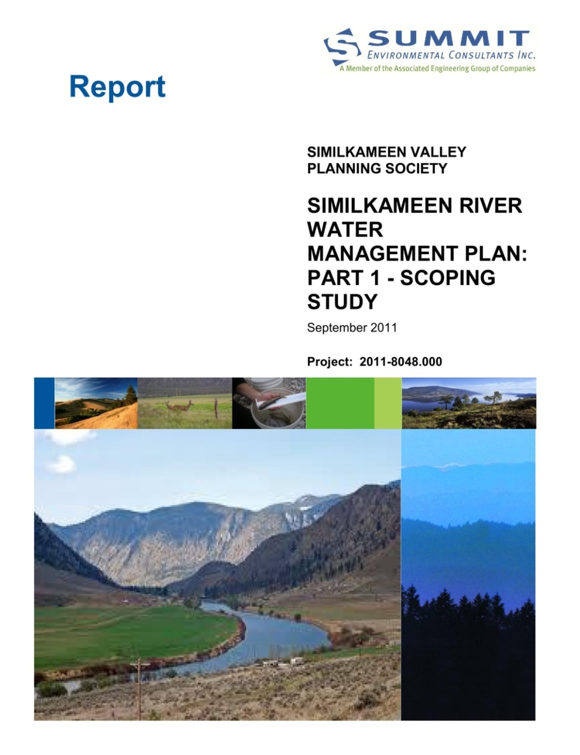
Notes:
For the Similkameen, there have been three notable water supply and demand studies conducted since 2010
I’ll briefly describe them in the next couple of minutes
All three have been completed as part of the “Strategy for a Sustainable Similkameen Valley”, which was a strategy developed in 2010 by the Similkameen Valley Planning Society (the SVPS).
The following year (2011), the SVPS produced a Scoping Report that identified the data that is available to support a Watershed Plan for the Valley.

Slide 26
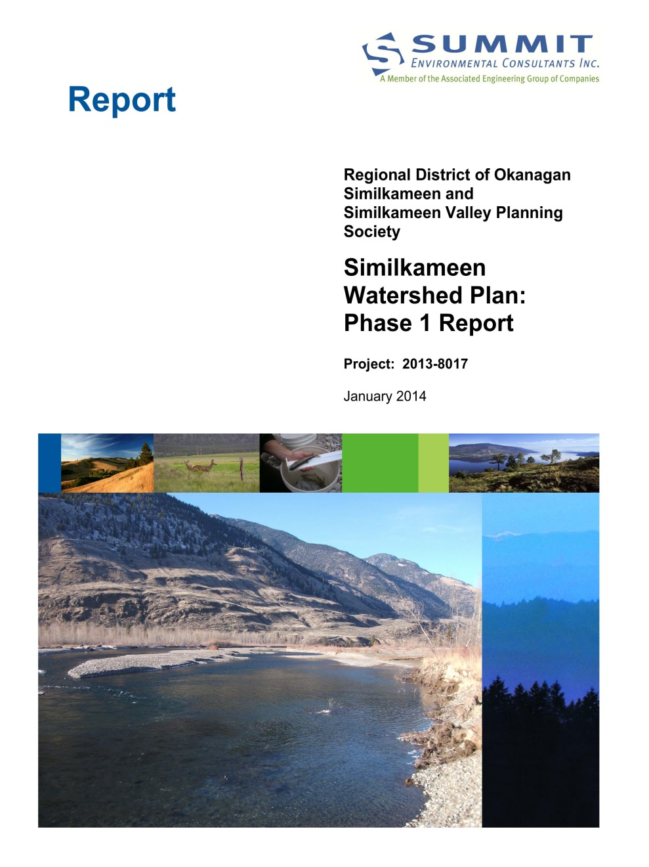
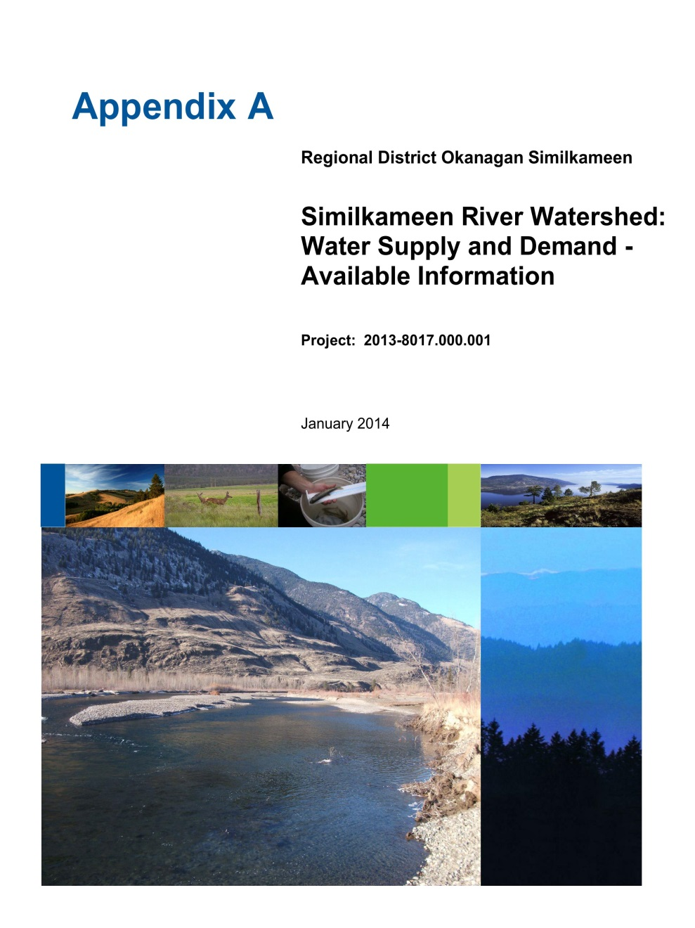
Notes:
The SVPS followed that with a Phase 1 Watershed Plan report in 2014 that:
compiled and analysed available information on water,
created a water information database,
identified and prioritized data gaps,
developed a communication plan, and
produced 8 Backgrounder Reports on water issues.
Here’s the report cover and the Water Supply and Demand Appendix

Slide 27
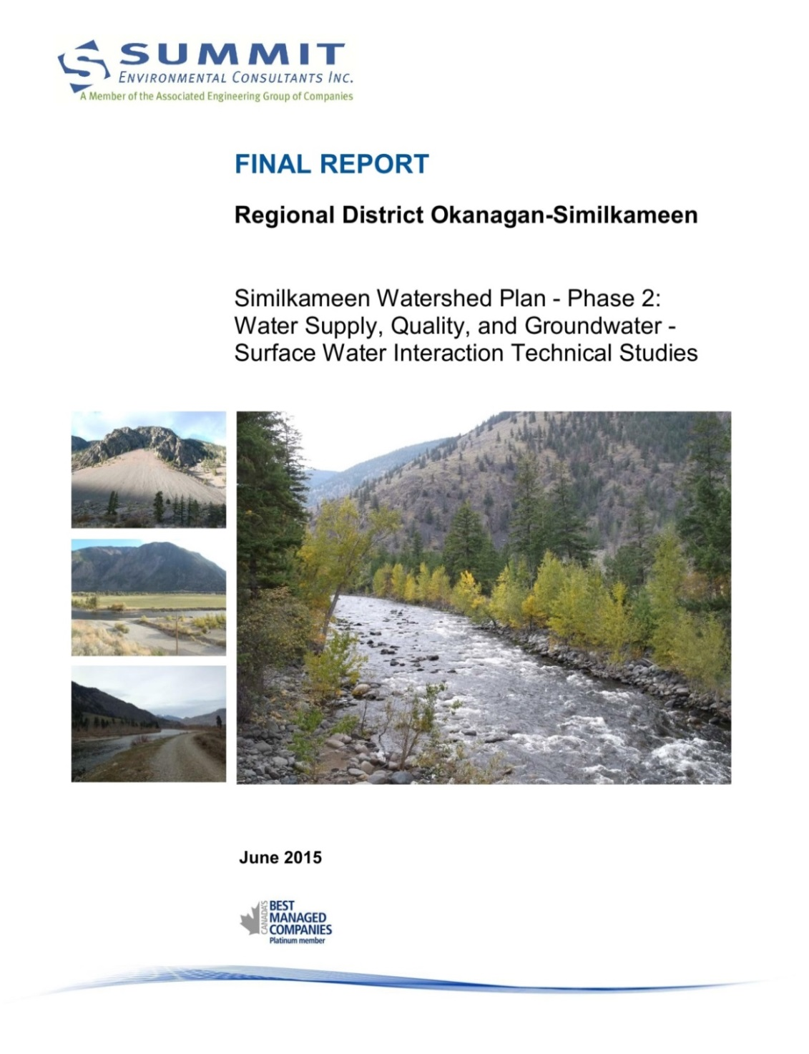
Notes:
The Phase 1 report was followed in 2015 by Phase 2, in which three of the highest priority data gaps identified in Phase 1 were filled:
a comparison of water supply with current and projected water demand,
a characterization of groundwater-surface water interactions, and
an analysis of water quality in the watershed.

Slide 28
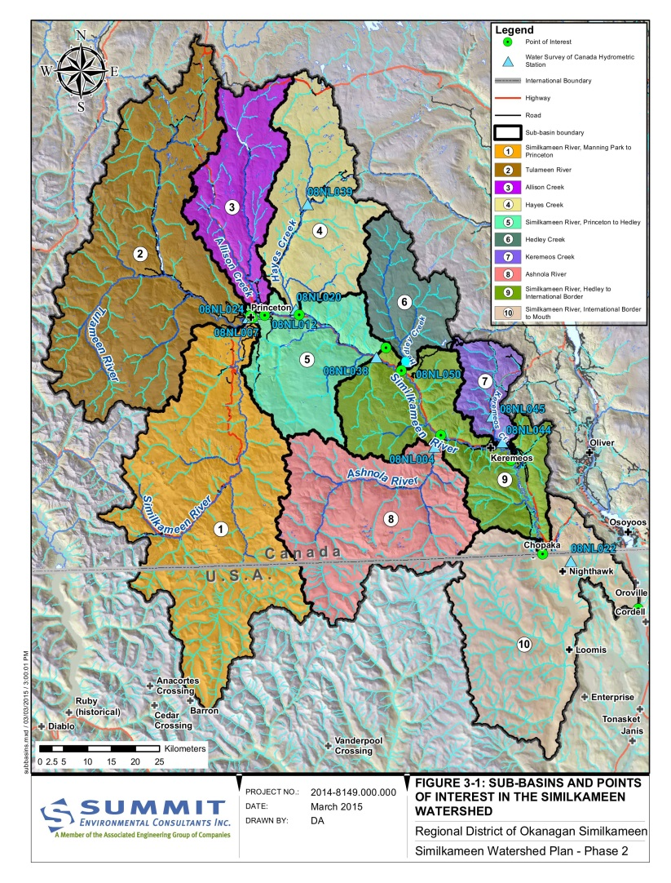
Notes:
Here’s the major sub-basins of the Similkameen River watershed, with the river flowing from left to right.
You can see the International boundary crossing some of the sub-basins across the bottom.
The western part on the left is located in the wetter Cascade Mountains and the eastern part is located in the arid interior.
The area of the Basin is 9,270 square km in total, of which about 80% is located in Canada.

Slide 29
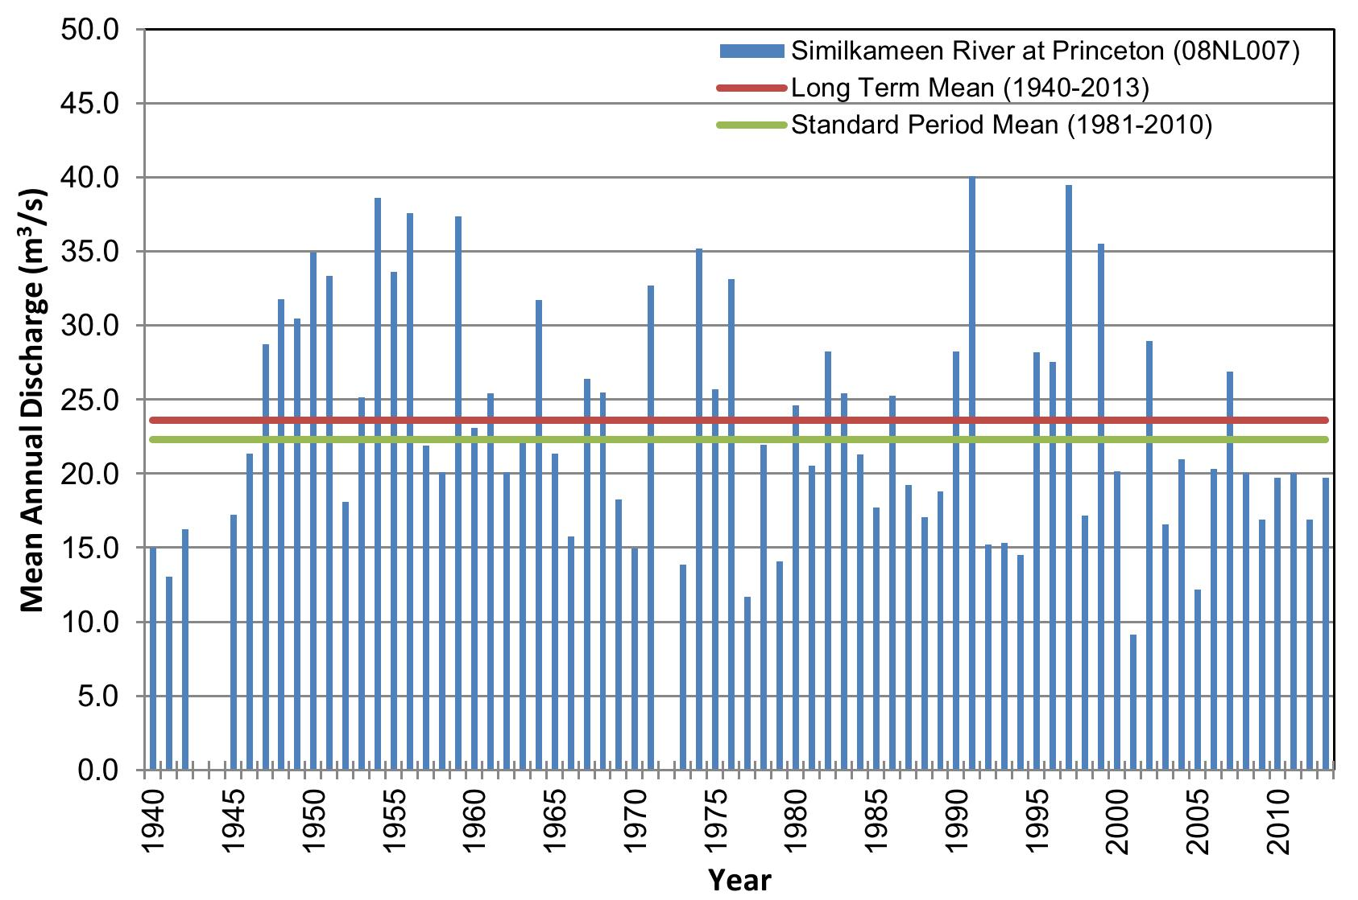
Flow of Similkameen River at Princeton
Similkameen River at Princeton (WSC 08NL007)
Notes:
Streamflows vary widely from year to year, just like in the Okanagan
Average annual flow of the river at its mouth is about 59 m3/s, so while the Basin is about the same size as the Okanagan Basin, the flow is about 2.5 times as much.
That’s because the upper headwaters in the west are located up in the Cascade Mountains, not that far in from the coast.
Also, just like the Okanagan, flows vary widely from month to month, with a lot of flow occurring in the spring during the snowmelt period, with a secondary peak generated from fall rains in the Cascade mountains in the west, with lower flows in between.
The peak flows are about 8 times the peak flows of the Okanagan River

Slide 30
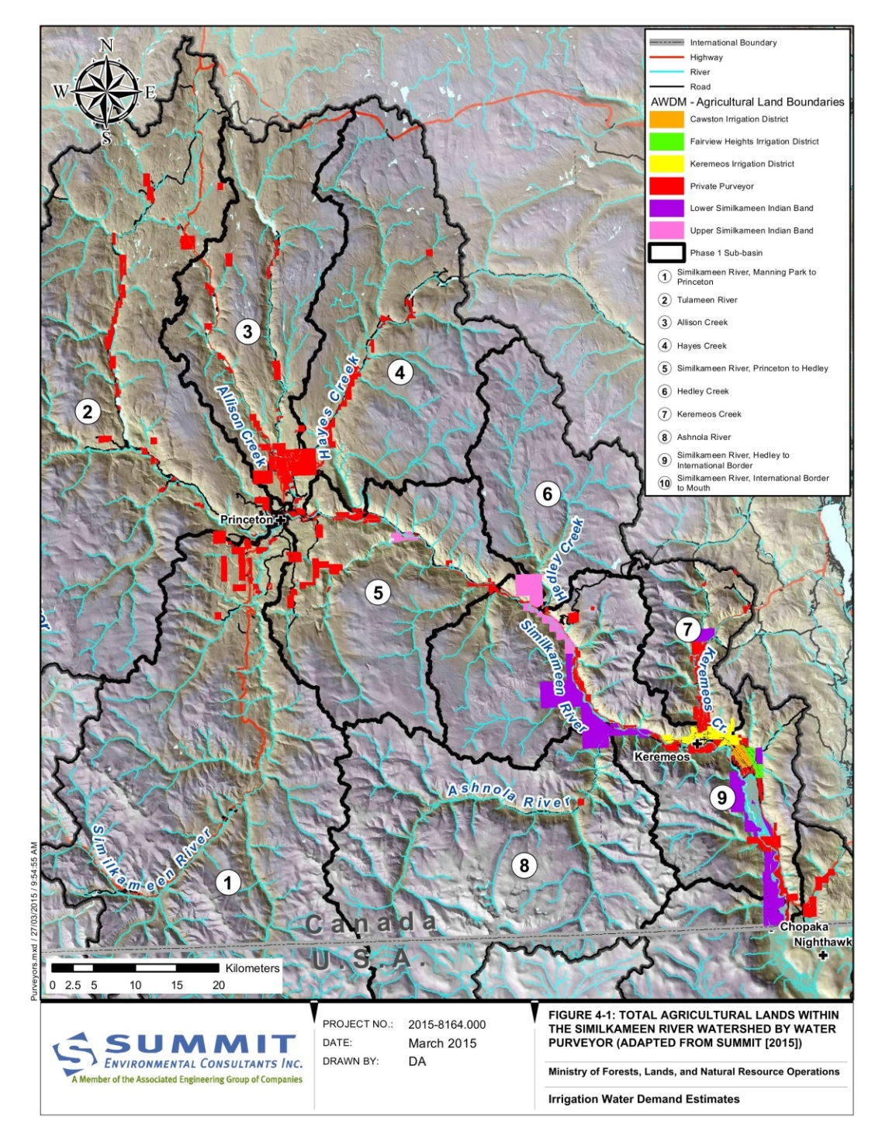
Notes:
The coloured areas on this map show all the irrigated lands in the Canadian portion of the Similkameen River Basin.
The total licensed water extractions are 116,000 ML, but the actual use is much smaller, about 27,000 ML.
If you express the actual water use as a fraction of the river flows, its relatively small, about 2 to 5%.
But that’s on an annual basis – if you look at a daily or weekly basis in the mid to late summer, it can be much more significant, and we saw evidence of that this summer in the Similkameen River.
Finally, as for the Okanagan, we have looked at future water use and future streamflows under the influence of climate change, and the results are just like for the Okanagan: larger winter flows, earlier spring snowmelt flows, lower summer flows, and extended durations of low flow periods.

Slide 31
Current Supply and Demand Issues
Monitoring networks
Environmental Flow Needs
Groundwater
Flooding (floodplains, stormwater systems)
Drought
Source Protection
Water storage
Invasive mussels
FN/provincial water management
Notes:
Finally, I’ll conclude with some comments on current supply and demand issues:
First, as a general comment, we need more ongoing monitoring of streamflows, groundwater levels, and other water parameters
We need to know about the instream flow requirements to support healthy aquatic ecosystems
We need to know more about groundwater as the Water Sustainability Act will soon require licensing of groundwater extractions
We need to get on top of floodplain mapping – since climate change may mean that future flood levels (for example in the City of Kelowna) will be higher than they are today
We need to get on top of drought planning and response - again because the climate is changing – we’re seeing more frequent and severe droughts – and 2015 was a good example – there’s room for better coordination between the province and the local water suppliers, and perhaps also for better valley-wide coordination as well.
Source Protection – ongoing recreational use continues to present water quality problems for water suppliers
Storage – climate change is adding a focus on adding water storage to account for a bigger gap between streamflow and water demand in future
Stormwater – are current storm systems good enough for the increasing precipitation intensities and storm intensities
Zebra and Quagga mussels represent a major threat to water suppliers – with huge cost implications to keep their intakes and pipes free of these mussels.
Finally, I think that we need to work hard to bridge the apparent gap between the modern water management systems used by us relatively recent arrivals (as represented by the province and local governments and water suppliers) on the one hand; and the much older systems, values, uses, rights, and relationships to water that the First Peoples of the Okanagan had developed before our arrival. I firmly believe that a genuine desire exists to seek commonalities and opportunities to work together in support of mutual interests.

