Slide 1
Water Management of the Okanagan Lake Regulation System
October 2015
Presented to the Osoyoos Lake Water Science Forum
Shaun Reimer, P.Eng.
Public Safety & Protection
Ministry of Forest, Lands and
Natural Resource Operations
Penticton

Slide 2
Watershed Description
Tributary to Columbia River
Okanagan Basin Drainage area = 8,200 km² (in Canada)
Main stem lakes:
  Kalamalka/Wood (3520 ha; 8700 acre)
  Okanagan (34075 ha; 84200 acre)
  Skaha (2023 ha; 5000 acre)
  Vaseux (243 ha; 600 acre)
  Osoyoos (2318 ha; 5728 acre)

Slide 3
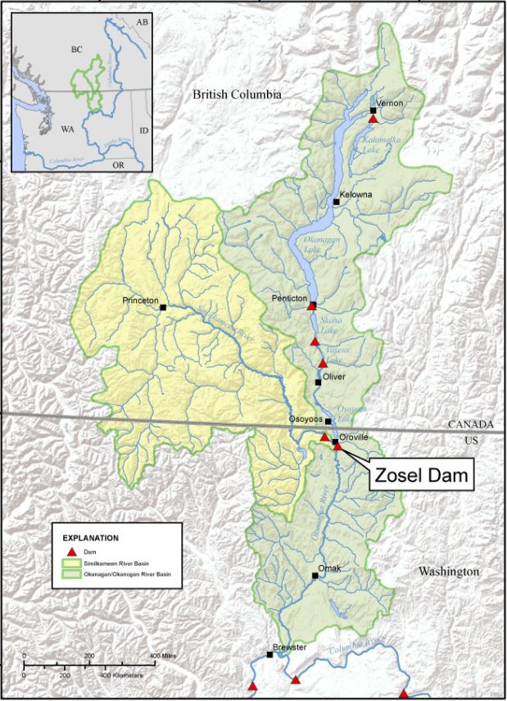
Skaha Lake Dam
Columbia R.
Kalamalka Lake Dam
Okanagan Lake Dam
McIntyre Dam
Okanagan R.
Osoyoos Lake
Similkameen R.
Okanogan R.
Columbia R.

Slide 4
Okanagan Lake Regulation System
System extends from Kalamalka Lake to north end of Osoyoos Lake
4 dams (Kalamalka, Okanagan, Skaha & Vaseux Lakes)
17 vertical drop structures
38 km of engineered channel, including 68 km of dikes
4 sediment basins

Slide 5
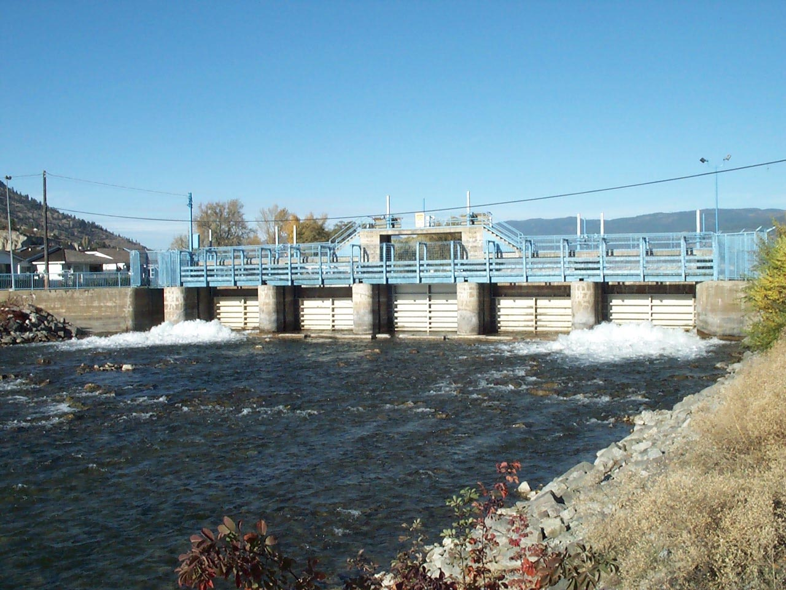
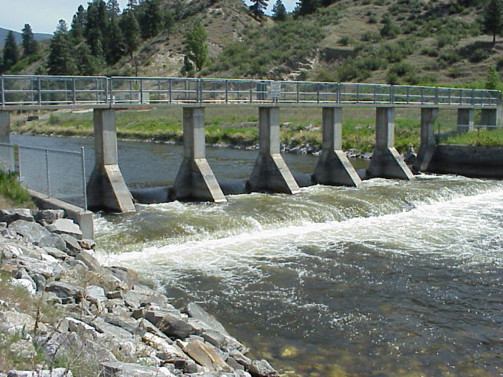
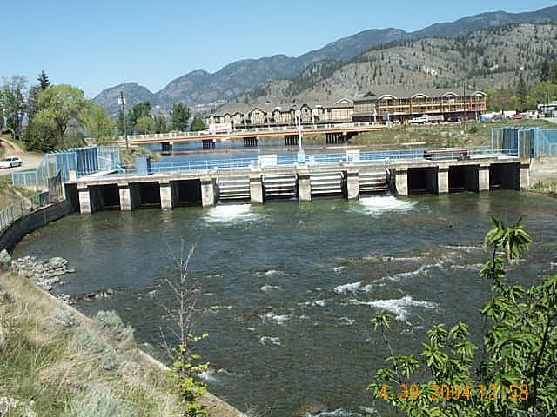
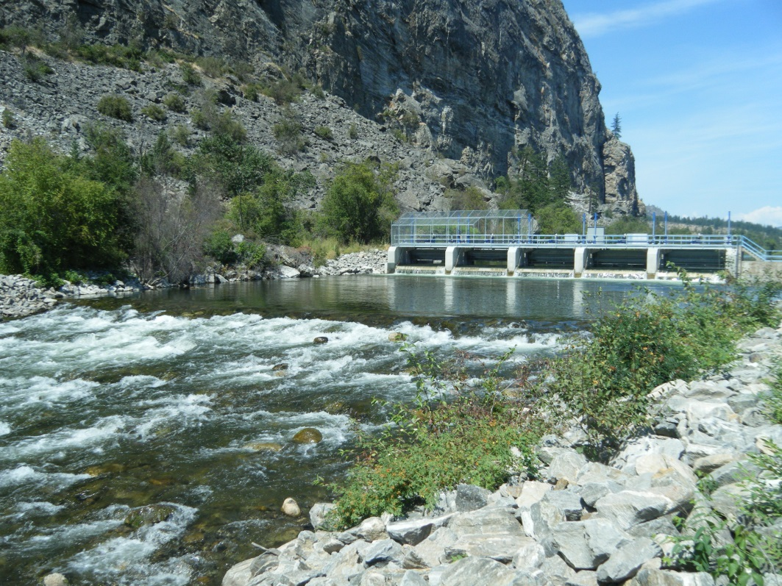
OLRS Structures
Okanagan Lake Dam
VDS 10
Skaha Lake Dam
Vaseux (McIntyre) Dam
Photo courtesy of ONA

Slide 6
Construction of the Okanagan Flood Control System
A Joint Board of Engineers:
  Appointed in 1943 to report out after a major 1942 flood;
  Recommended the construction of dams, vertical drop structures, and river channelization, as well as the establishment of operating ranges;
Recommendations were implemented after a “Memorandum of Agreement” was signed in 1950 between the Federal and Provincial governments;
Project was completed between 1950 &1958;
Costs of the construction and maintenance were shared equally.

Slide 7
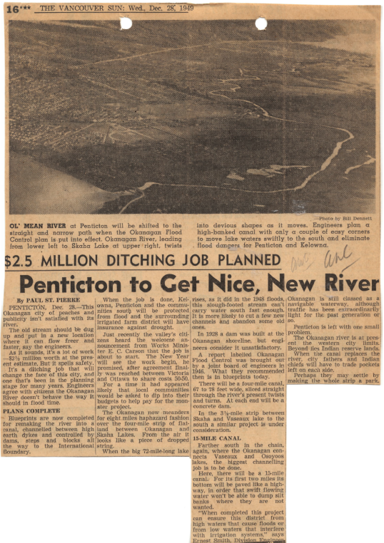

Slide 8
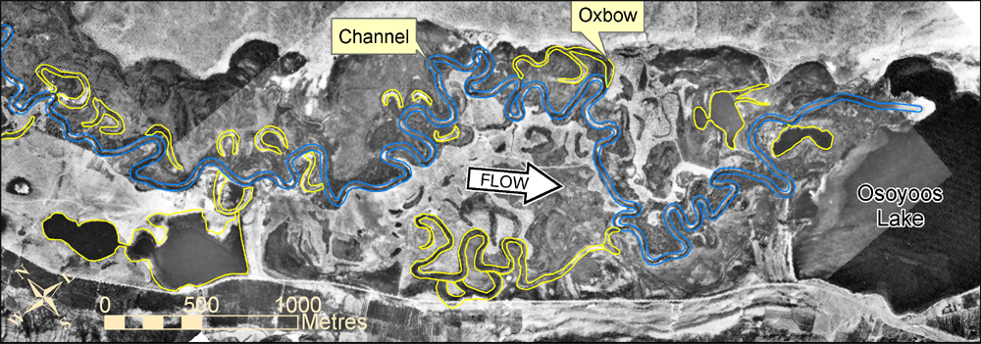
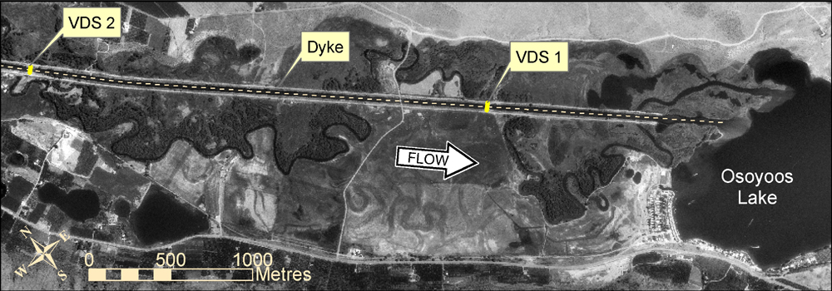
Okanagan River in 1938 and in 1996

Slide 9
Okanagan Basin Implementation Agreement
In 1976, the Okanagan Basin Implementation Agreement was signed by the Federal and Provincial Governments;
It set out seasonal targets for main stem lake elevations and river flows. These targets take into account:
  Anticipated flood and prolonged drought conditions;
  Water requirements for Sockeye and Kokanee
Some infrastructure was upgrades and repaired (1976-1981);
Under this agreement, the Province became the operators of the Okanagan Flood Control System.

Slide 10
Range of Flows and Lake Levels
Okanagan Lake operational range: 1.15 m
  341.34 m to 342.48 m geodetic;
  Under prolonged drought conditions (successive years <247 Million m³), lake may be drawn down to 340.4 m;
Average inflow into Okanagan Lake: 530 Million m³ (1.5 m on lake);
How are decisions made??

Slide 11
Fish Water Management Tool
Computer Model used for decision making support;
Forecasts Okanagan Lake and River levels based on inflow forecasts from River Forecast Centre (Victoria) and a Release Schedule from Okanagan Lake Dam;
Uses peak spawning dates and temperature data to inform the water manager of fish hatching and emergence;
Seasonal or monthly target levels conform to those developed under the Okanagan Basin Implementation Agreement.
Partners include Douglas County PUD (US), DFO, ONA, FLNRO.

Slide 12
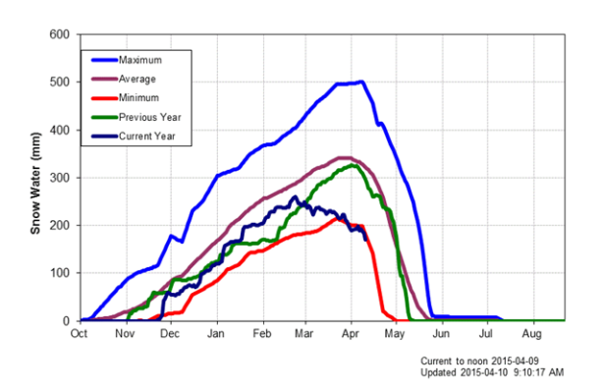
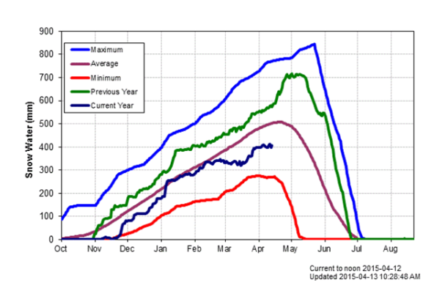
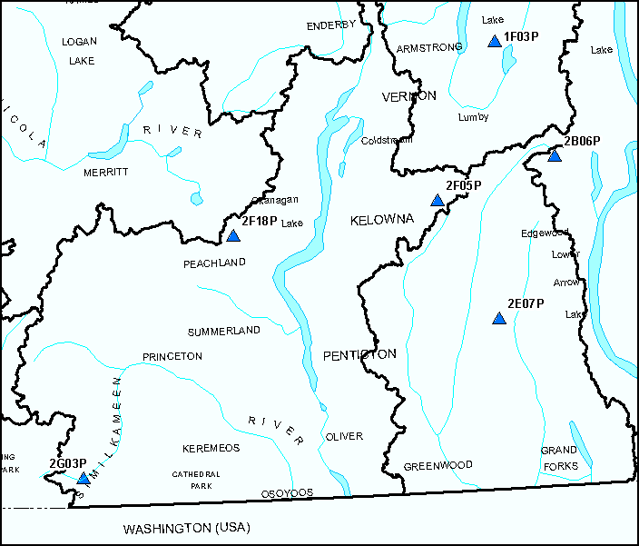
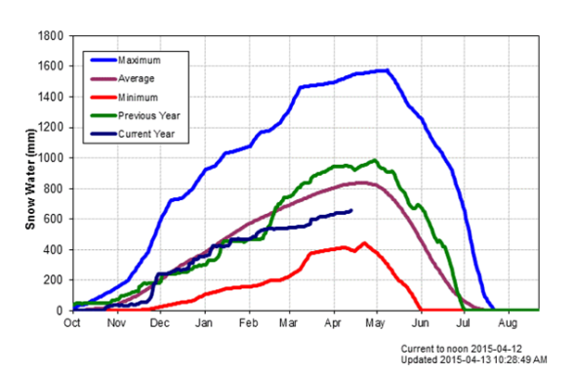
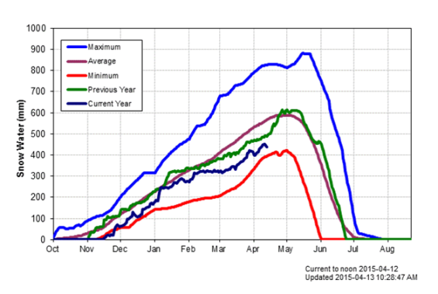
Brenda Mine
Mission Creek
Blackwall Peak
Grano Creek
SWE - 12th April
Monitoring Snow

Slide 13
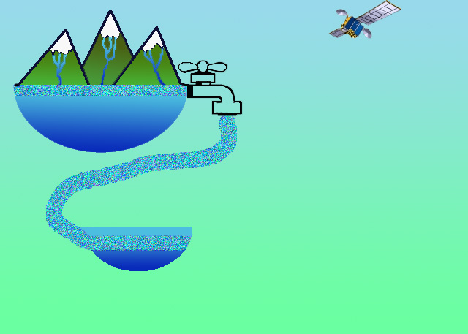
Snow pack
Satellite
Runoff
Lake level
Dam
Discharge
Okanagan Lake
Fisheries
Okanagan River
Temp / O2
Management Tool
Osoyoos Lake
Decision Makers (Multidisciplinary team)

Slide 14
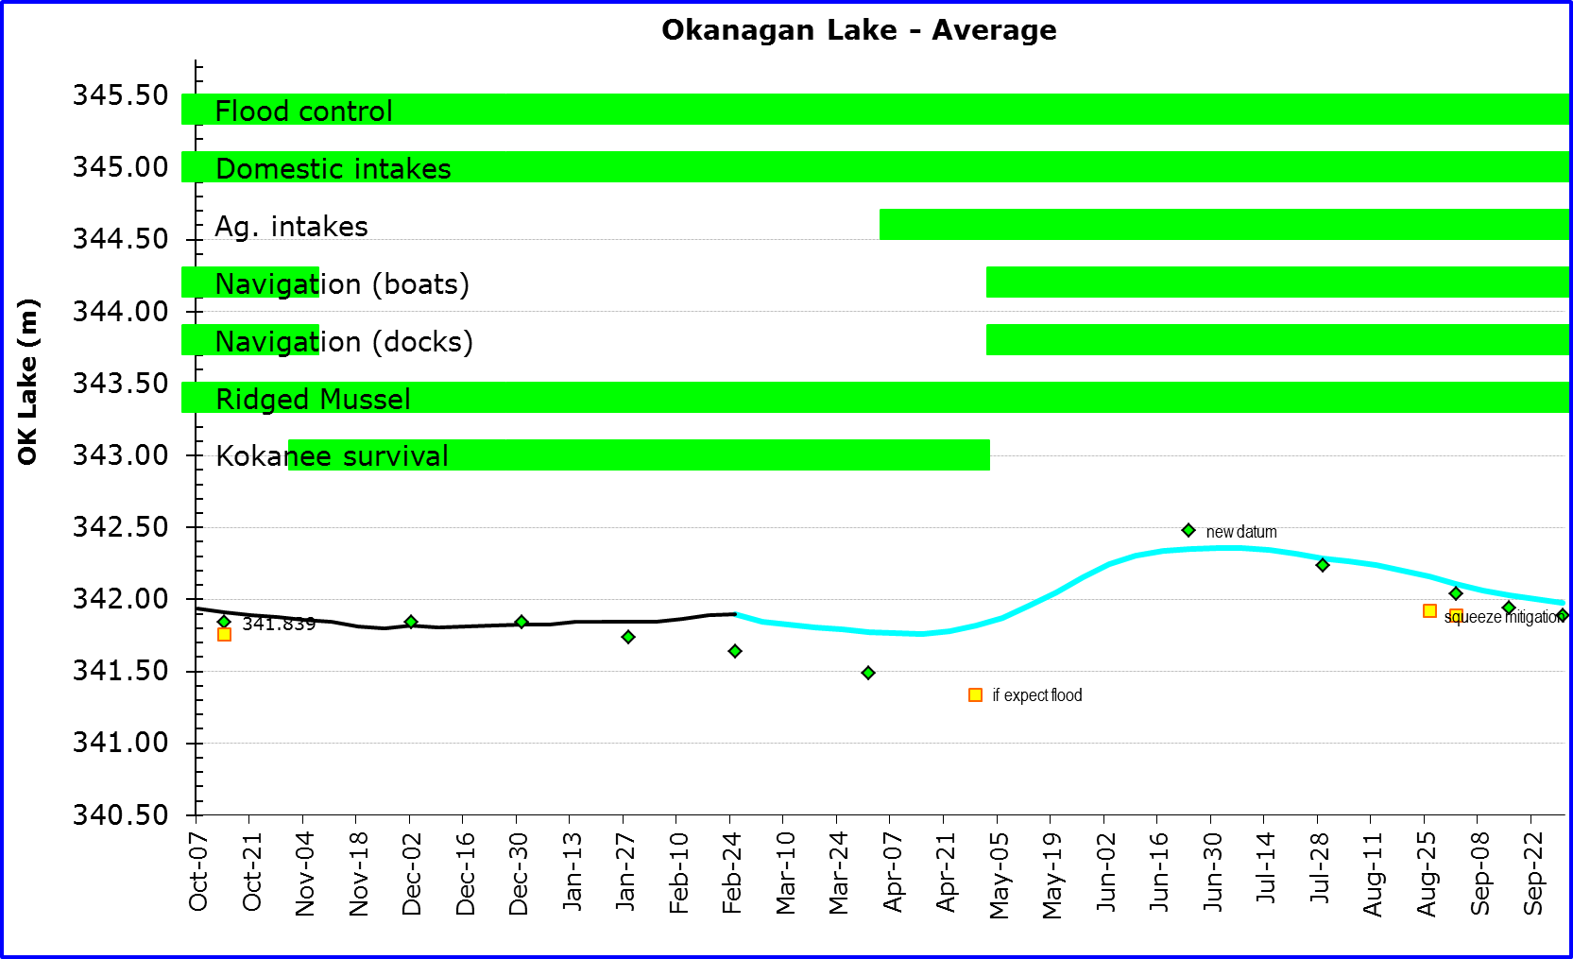
Fish Water Management Tool Output
February 2015

Slide 15
Fish Water Management Tool Output

Slide 16
Management Constraints
Okanagan River Design Flows range from 60 m³/s in Penticton to 96 m³/s south of Oliver;
Net difference of 40 m³/s (inflow - outflow) on Okanagan Lake = 1 cm/day.
Seasonal constraints include maximum flow of 28.3 m³/s (1000 cfs) in Okanagan River at Oliver until Sockeye eggs hatch and emerge from gravel;
  This constraint overridden for large snowpacks;
  Tributary flow downstream of Penticton means that this flow may be much less out of Okanagan Lake Dam.

Slide 17
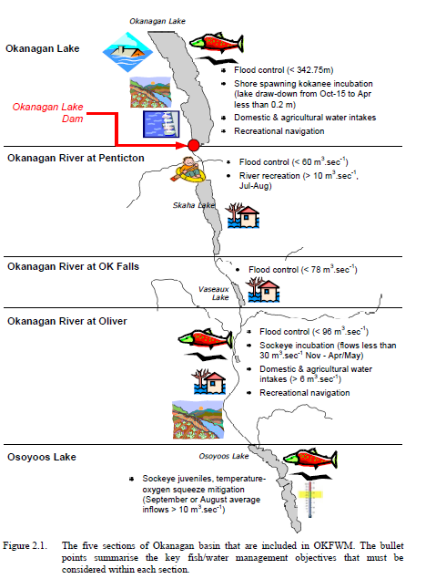

Slide 18
Similkameen River Impacts
Similkameen River enters Okanogan River below Zosel Dam;
High Similkameen flow (> 10000 cfs) slows the Okanogan River (backwaters) or even reverses flow northward and potentially increases Osoyoos Lake levels;
Okanagan River releases at Okanagan Lake Dam have been reduced in the past to reduce the impact of high peaks on the Similkameen.

Slide 19
This Year: 2015
Warm winter and early snowmelt meant that Lake was higher than target values for much of spring;
2015 Peak Net inflow to Okanagan Lake approximately 460 Million m³ (1.33m);
Dry summer with warm lake temperatures adding to high evaporation;
15 centimetres lower than September target elevations (beginning and end).

Slide 20
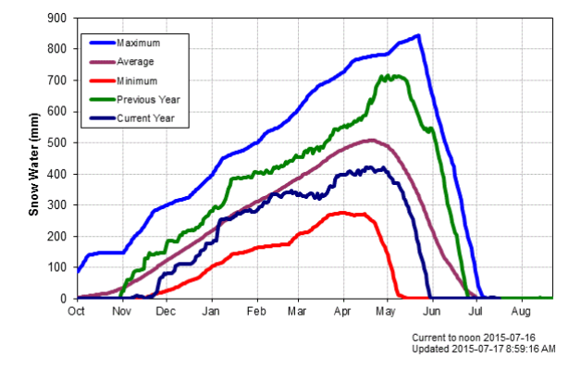
Mission Creek Automated Snow Pillow

Slide 21
Questions?

