Slide 1
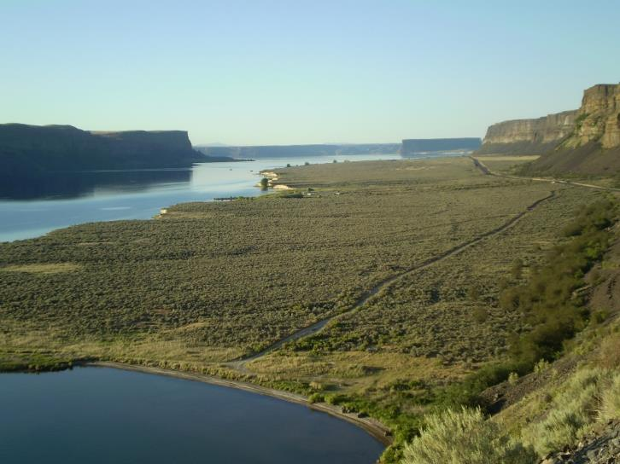
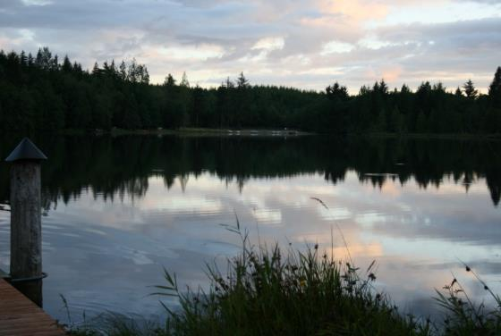





2016 Columbia River Basin
Long-Term Water Supply and Demand Forecast
Dan Haller, PE
dhaller@aspectconsulting.com
509.895.5462
Notes:
Summary
Why are we updating the forecast?
Summary of 2011 Forecast
Summary of 2016 Forecast Approach
Summary of Emerging Policy Issues
Schedule and Input Opportunities

Slide 2
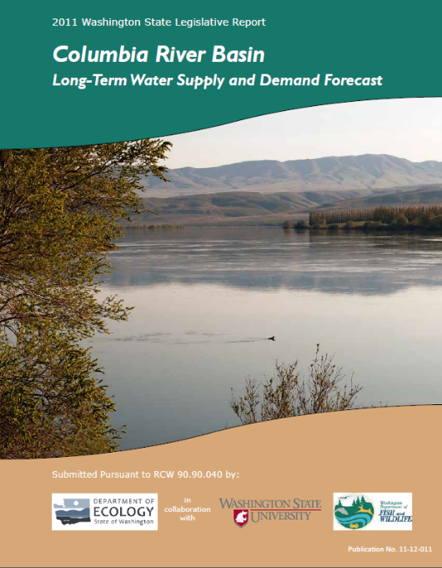
2011 Water Supply & Demand Forecast
Update required every 5 years
Audience includes policy makers, water managers, general public
Water and economic modeling
Interviews with water managers
Peer review
Predicts agricultural, municipal, instream, and hydropower needs
Guide for future investment
Emerging policy issues

Slide 3
2011 Forecast Findings: Supply
Water forecasted through 2030
Modeled surface water supply / demand
Did not forecast GW supply / demand
Supply: surface water supplies estimated to increase statewide by 3% average
Climate change: water supply projected to shift earlier in the year
WDFW created an Instream Atlas to help characterize fish flow, habitat, and utilization

Slide 4
2011 Forecast Findings: Demand
Demand Type | Estimated Volume (acre-feet)
2030 New Irrigation Demand | 170,000
2030 New Municipal and Domestic Demand (including municipally-supplied commercial) | 117,500
Unmet Columbia River Instream Flows | 13,400,000
Unmet Tributary Instream Flows | 500,000
2030 New Hydropower Demand | 0
Alternate Supply for Odessa | 164,000
Yakima Basin Water Supply (pro-ratables, municipal/domestic and fish) | 450,000
Unmet Columbia River Interruptibles | 40,000 to 310,000

Slide 5
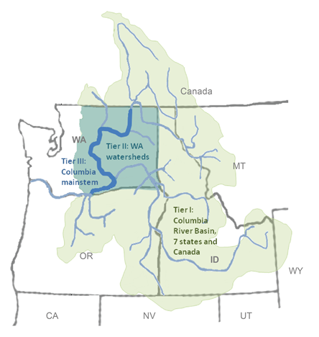
2016 Forecast Analysis Will…
Forecast through 2035
Include groundwater evaluation
Improve hydrology, cropping
models, consumptive loss
simulation
Include climate change predictions
Forecast water right and reservoir
curtailment
Evaluate potential for the forecast to be extended to Western WA in 2021
Evaluate policy issues necessary for program administration and investments

Slide 6
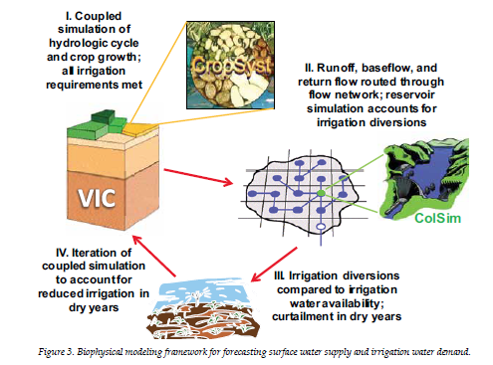
Forecast Approach: Modeling

Slide 7
Forecast Approach: Economics

Slide 8
Policy Issues in 2016 Forecast
Water Banking: How can water banking assist in meeting demand?
Cost Effects of Water: How is an applicant-pays model affecting program participation?
METRIC: How can remote sensing improve demand projections?
Groundwater Integration: Where and how much will declining groundwater supplies affect demand?

Slide 9
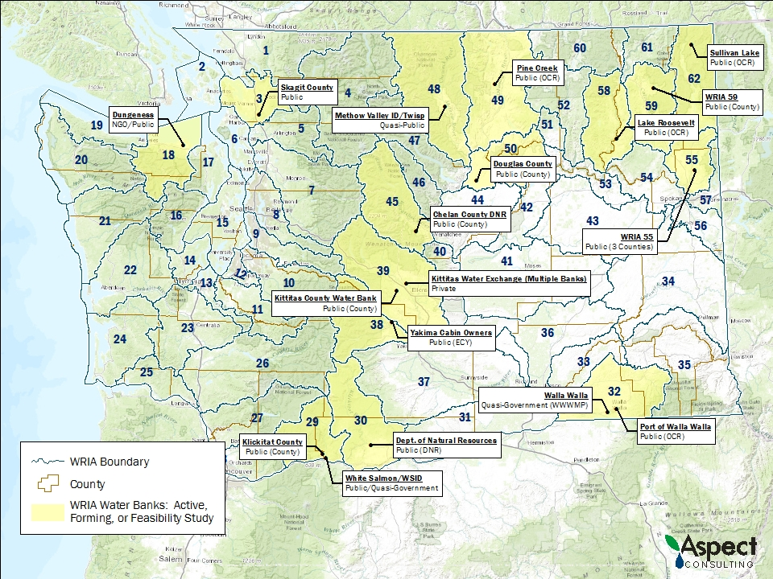
Water Banking In Washington
Insert figure 5 here
WA Water Banks
Private | 11
Quasi-Gov’t & NGO | 4
Public | 13
Notes:
Water Banking: Scope and Policy Considerations
Update 2004 Water Banking Report
Survey/inventory water banks
Document Ecology impacts
Roles – Regulator, Funder, Incentivizer, Banker, and Auditor
Quantify costs
Document how bank design/operation affect costs
Identify regulatory, funding, and operational barriers
Recommendations and future visioning

Slide 10
Cost Effects of Water
Legislature has moved towards an applicant-pays system
  Cost-reimbursement permitting
  Recovery of water supply development costs
Some applicants are choosing to defer or postpone rather than receive new water rights when offered
This study will survey 500 applicants from various programs (Lake Roosevelt, Wenatchee, Yakima, Cabin Owners, etc.) to understand how time and financial terms of a program are affecting processing and demand for new service

Slide 11
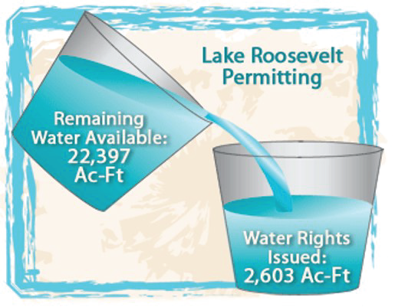
Cost Effects of Water: Policy Considerations
What price points incentivize
applicant participation?
What other program criteria
affect participation (e.g. lead
time, water right type,
purpose of use, location)?
What should Ecology’s
reaction be to applicants that decline processing?
Should application requirements be augmented to better reflect processing level of effort?

Slide 12
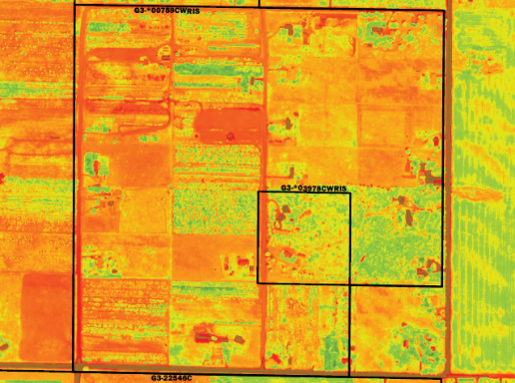
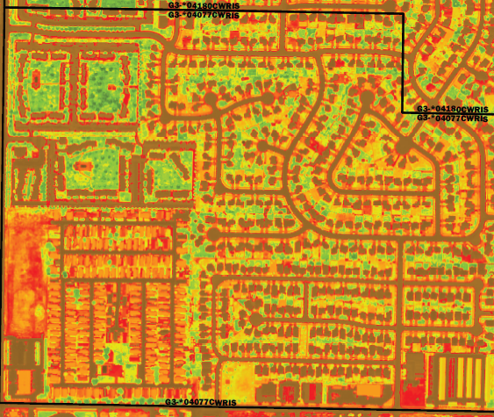
METRIC: Forecasting Irrigation Use
METRIC uses field-calibrated satellite imagery to improve consumptive use forecasting
Predict agricultural crop consumption and return flows at the field and
watershed scales
Pilot 3 subbasins: Walla Walla Basin, Yakima Basin and Okanogan Basin
Model inputs from volunteer farms:
  Soil moisture
  Weather data (wind speed, temperature, heat flux)
  Applied irrigation (Applied Water Duty)
  Landsat flights
Notes:
METRIC Policy Considerations
Can it improve accuracy of demand estimates?
Can it provide a surrogate or compliment to metering data?
Can it assist in water right evaluations and adjudications?
Can it assist in identifying areas of crop stress?

Slide 13
Groundwater Integration
New component for 2016 Forecast
Why:
  2011 Forecast did not evaluate effects of declining groundwater on demand
  Users who rely on declining groundwater supplies may rely on surface water in the future
  Surface and groundwater interactions can lead to water rights conflicts
Goals:
  Improve forecasting of groundwater shortages by identifying data gaps and use existing tools to predict the scope of the problem
  Estimate surface water demand changes caused by groundwater shortages
Notes:
Groundwater Integration Policy Considerations
What is the state of the science on declining groundwater areas?
How can groundwater be integrated into comprehensive supply and demand forecasting?
Where is demand on surface water likely to occur?
What is the magnitude of that future demand?
How does it compare to available water supply?
What are the economic effects of not ensuring a firm water supply?

Slide 14

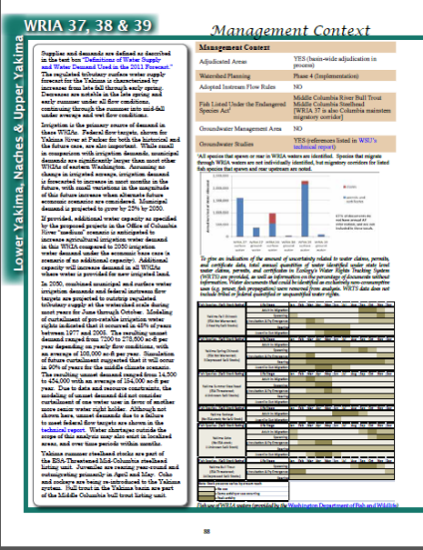
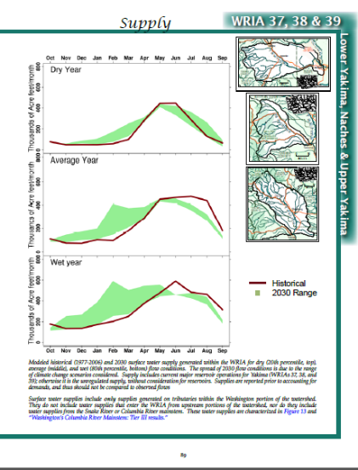
Forecast Report
50+ page Summary Report
WRIA-focused pages
Large Technical Report
Web applications / content
Instream Flow Atlas Update

Slide 15

Schedule / Opportunities for Input
Data collection and modeling in 2015
Presentations to stakeholder groups
in 2015
Watershed planning input in 2015
Sector expert input in 2015
Analysis and draft results in early 2016
Public workshops and draft report in summer 2016
Final Report Due November 15, 2016

