Slide 1
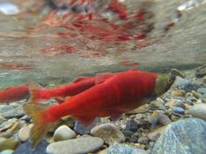
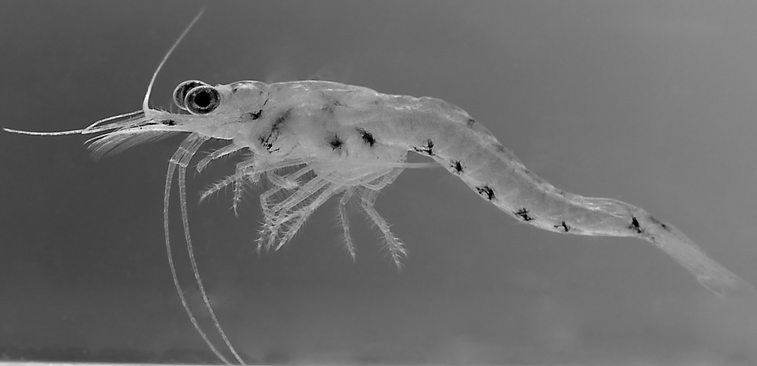
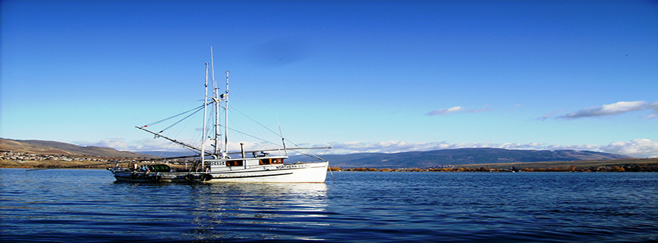
Mysis Shrimp Fishery On Okanagan Lake
Nuri Fisher, President
Piscine Energetics Inc.
3417 27th Avenue
Vernon, BC, V1T 1S2
nuri@mysis.com
778-475-0082

Slide 2
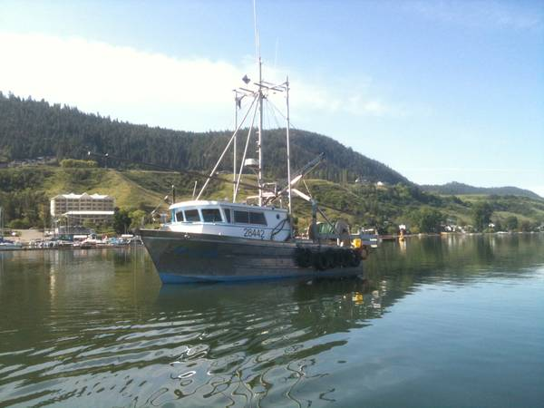
Mysis Shrimp Fishery On Okanagan Lake
What is Mysis Shrimp?
The “Introduction”
The “Problem”
The “Fix”
The “Take away”
Questions?

Slide 3
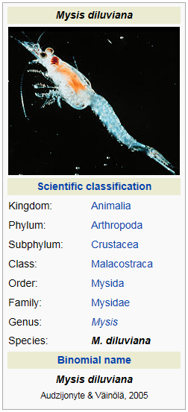
Mysis Shrimp Fishery On Okanagan Lake What is Mysis Shrimp?
Mysis diluviana
Small transparent shrimp-like crustacean
Max size 25mm (1”)
Lives in deep water during the day
Feeds on zooplankton at night (near the surface)
Source: www.wikipedia.org

Slide 4
Mysis Shrimp Fishery On Okanagan Lake The “Introduction”
How did mysis shrimp get introduced to Okanagan Lake?
Deliberately introduced by fishery biologists
Why were mysis shrimp introduced to Okanagan Lake?
To provide additional food for rainbow trout and Kokanee
When did this introduction take place?
In 1966

Slide 5
Mysis Shrimp Fishery On Okanagan Lake The Problem
So a few shrimp were put into Okanagan lake in 1966 what’s the big problem?
By early 2000’s Mysis biomass population reached 6,000 metric tonnes in Okanagan Lake!

Slide 6
Mysis Shrimp Fishery On Okanagan Lake The Problem
So a few shrimp were put into Okanagan lake in 1966 what’s the big problem?
Depth of Okanagan Lake
Mysis and Kokanee are at different levels of the lake
Mysis need to eat too!
Mysis are competing with Kokanee for zooplankton

Slide 7
Mysis Shrimp Fishery On Okanagan Lake The Problem

Slide 8
Mysis Shrimp Fishery On Okanagan Lake The Fix – Mysis Fishery
Okanagan Lake Action Plan
Experimental Mysis fishery
Goal is to reduce mysis biomass numbers in an effort to improve lake-rearing conditions for kokanee

Slide 9
Mysis Shrimp Fishery On Okanagan Lake The Fix – Mysis Fishery
How does one harvest these small mysis shrimp
Small shrimp need small mesh trawl nets
How do we ensure the mitigation of bycatch?

Slide 10
Mysis Shrimp Fishery On Okanagan Lake The Fix – Mysis Fishery
Piscine Energetics Inc.
The development of an apparatus for separating target and non-target species harvested from water bodies
https://www.youtube.com/watch?v=3T2rBTrG2tY

Slide 11
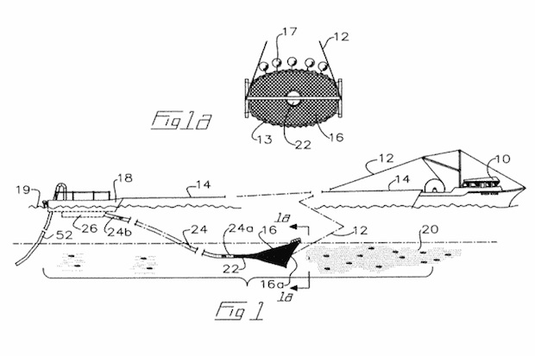
Mysis Shrimp Fishery On Okanagan Lake The Fix – Mysis Fishery
Apparatus for separating target and non-target
species harvested from water bodies.

Slide 12
Mysis Shrimp Fishery On Okanagan Lake The Fix – Mysis Fishery
Apparatus for separating target and non-target
species harvested from water bodies.

Slide 13
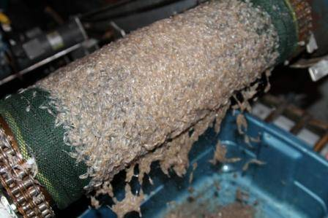
Mysis Shrimp Fishery On Okanagan Lake The Fix – Mysis Fishery
Piscine Energetics patented harvesting systems ensures all mysis are alive on harvest and any by catch is return to the lake alive!

Slide 14
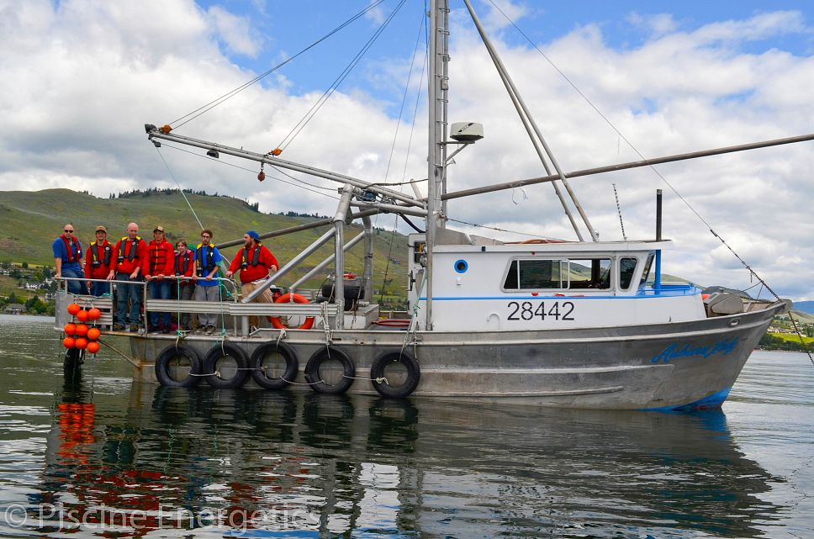
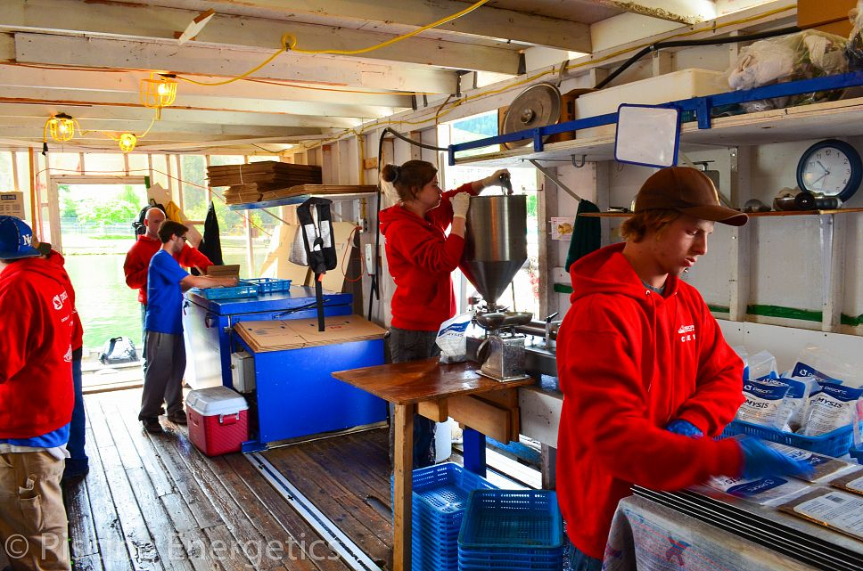
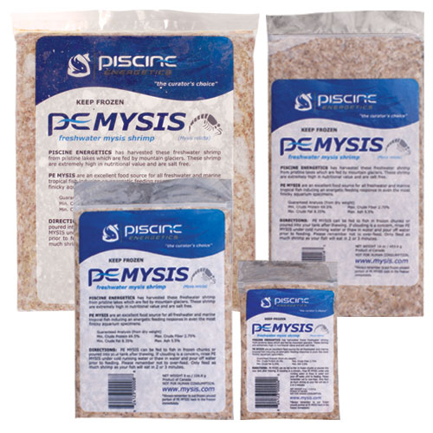
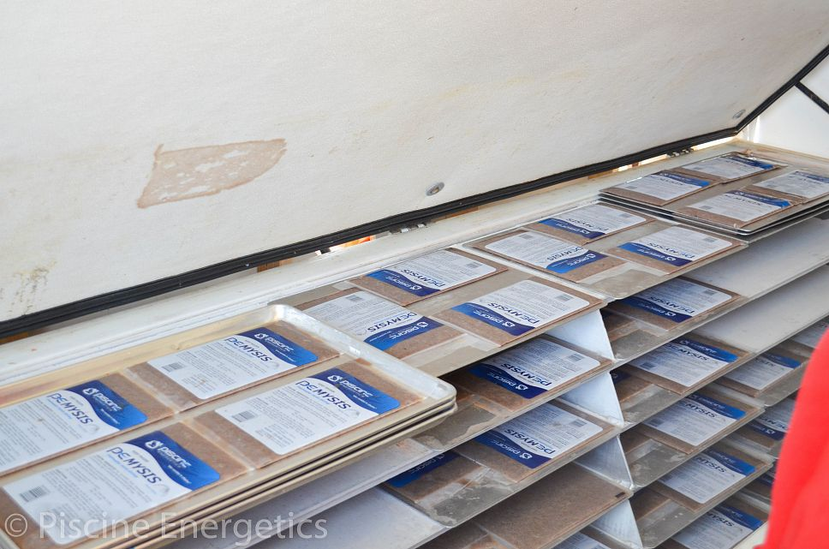
Mysis Shrimp Fishery On Okanagan Lake The Fix – Mysis Fishery

Slide 15
Mysis Shrimp Fishery On Okanagan Lake The Fix – Mysis Fishery
What do we do with the shrimp?
Feed it to fish of course!
Developed and brought to market a sustainable aquarium food for zoological institutions, public aquarium and aquarium hobbyists.
https://www.youtube.com/watch?v=1NxuRDj22yI

Slide 16
Mysis Shrimp Fishery On Okanagan Lake The Fix – Mysis Fishery – Future plans
Continue to increase annual biomass removal in Okanagan Lake.
Mysis have migrated to other lakes in the region.
Investigate removal from other lakes
Skaha Lake Mysis Test Fishery. 2013 Collaboration with ONA fisheries department

Slide 17
Mysis Shrimp Fishery On Okanagan Lake The Take Away
Mysis Fishery is a tool for Kokanee recovery
Mysis shrimp are competing with Kokanee for the same food source. As more mysis are removed from the lake(s), more zooplankton will become available for fish.
2. DO NOT MESS WITH MOTHER NATURE!
3. Pay attention to invasive species!

Slide 18
Mysis Shrimp Fishery On Okanagan Lake Questions?

