Slide 1
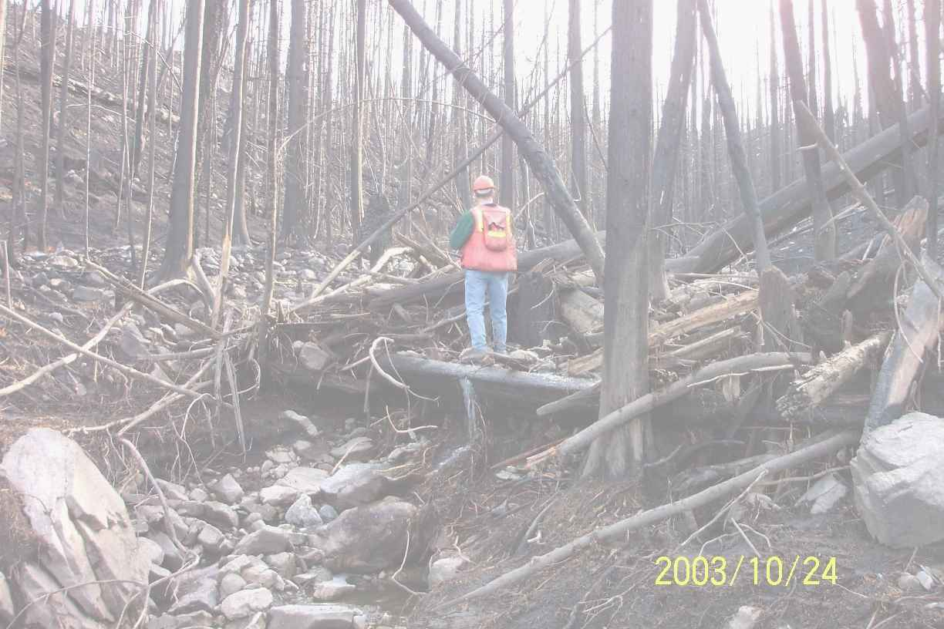
Fire and Water
Presentation
to the
Osoyoos Lake Science Forum
October 8, 2015
Don Dobson, PEng

Slide 2
Outline
Wildfire impacts to water quality and stream ecosystems
How is water quality impacted by wildfires?
How long do impacts last?
Are there beneficial impacts?
What are the adverse impacts?
Can impacts be prevented, mitigated or minimized?
Summary

Slide 3
Wildfire impacts to water quality
Water quality
Increased turbidity levels and sediment transport in streams
Increased runoff – more frequent higher, short-duration peak flows
Earlier snow melt and runoff
Increased nitrates and possibly heavy metals
Microbial pathogens

Slide 5
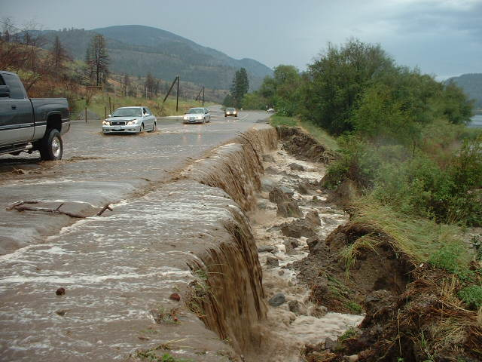

Slide 6
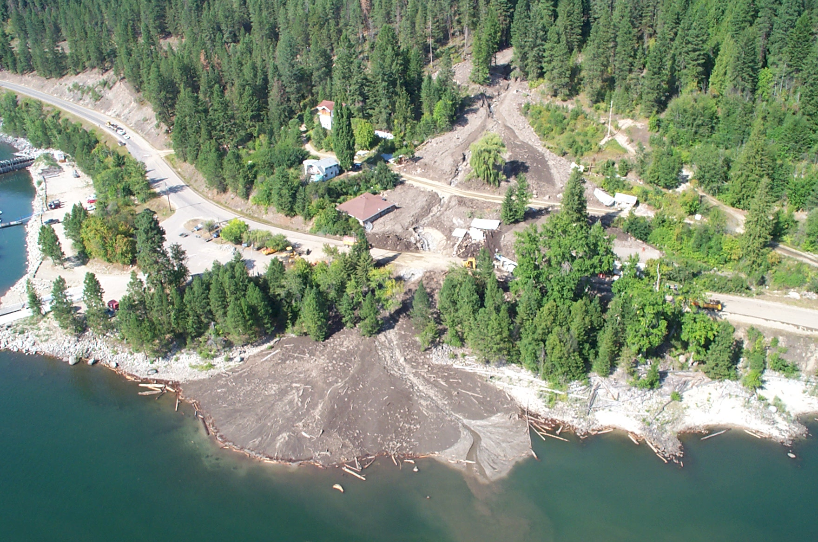

Slide 7
Wildfire impacts to stream ecosystems
Fish and stream ecosystems
Increased water temperatures
Loss of cover
Change in pH
Altered water flow and chemical pathways
Influx of nutrients, sediments, organic and inorganic carbon
Decrease in dissolved oxygen

Slide 8
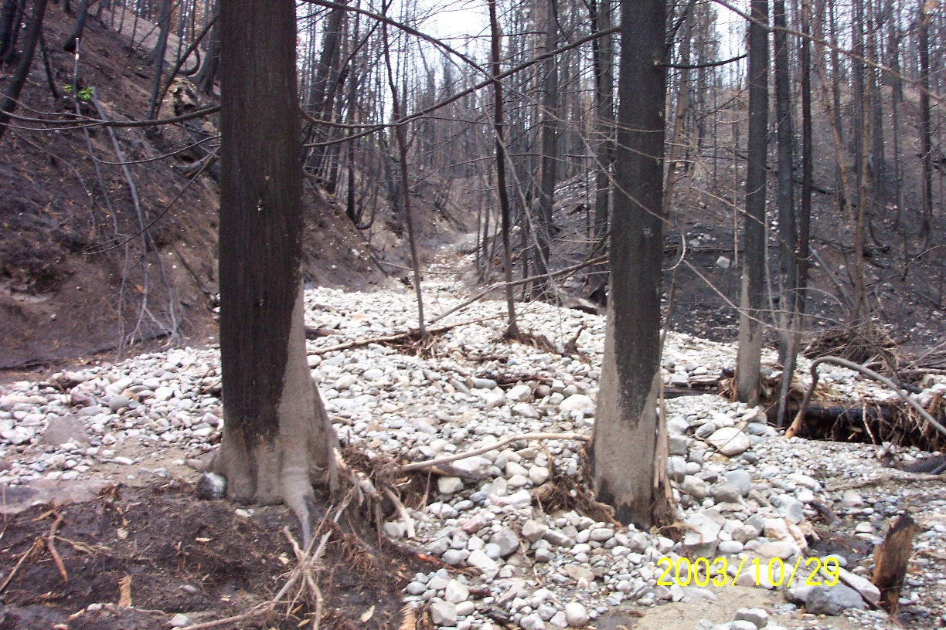

Slide 9
How is water quality impacted by wildfires?
Loss of vegetation
Increased slope failures and landslides
Increase in runoff
Water repellent soils
Short-duration intense rainstorms

Slide 10
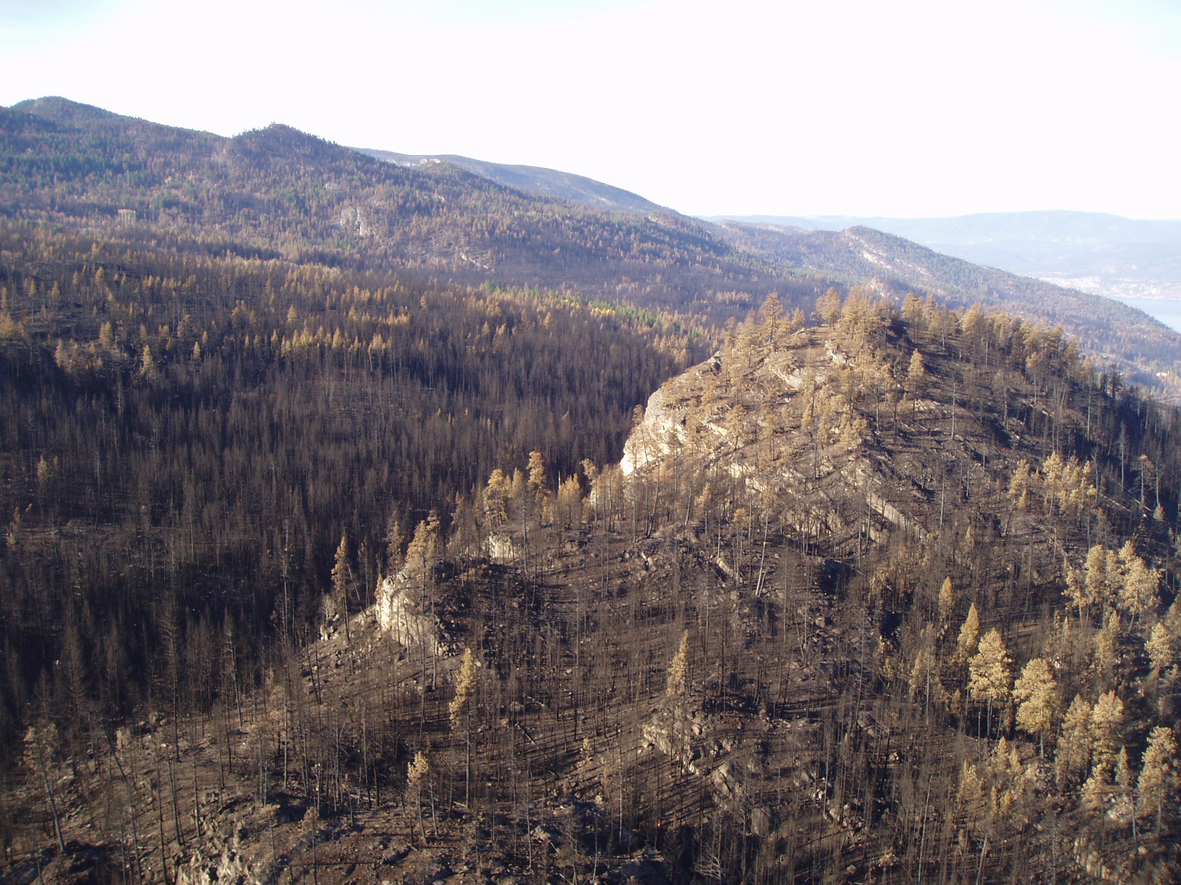

Slide 11
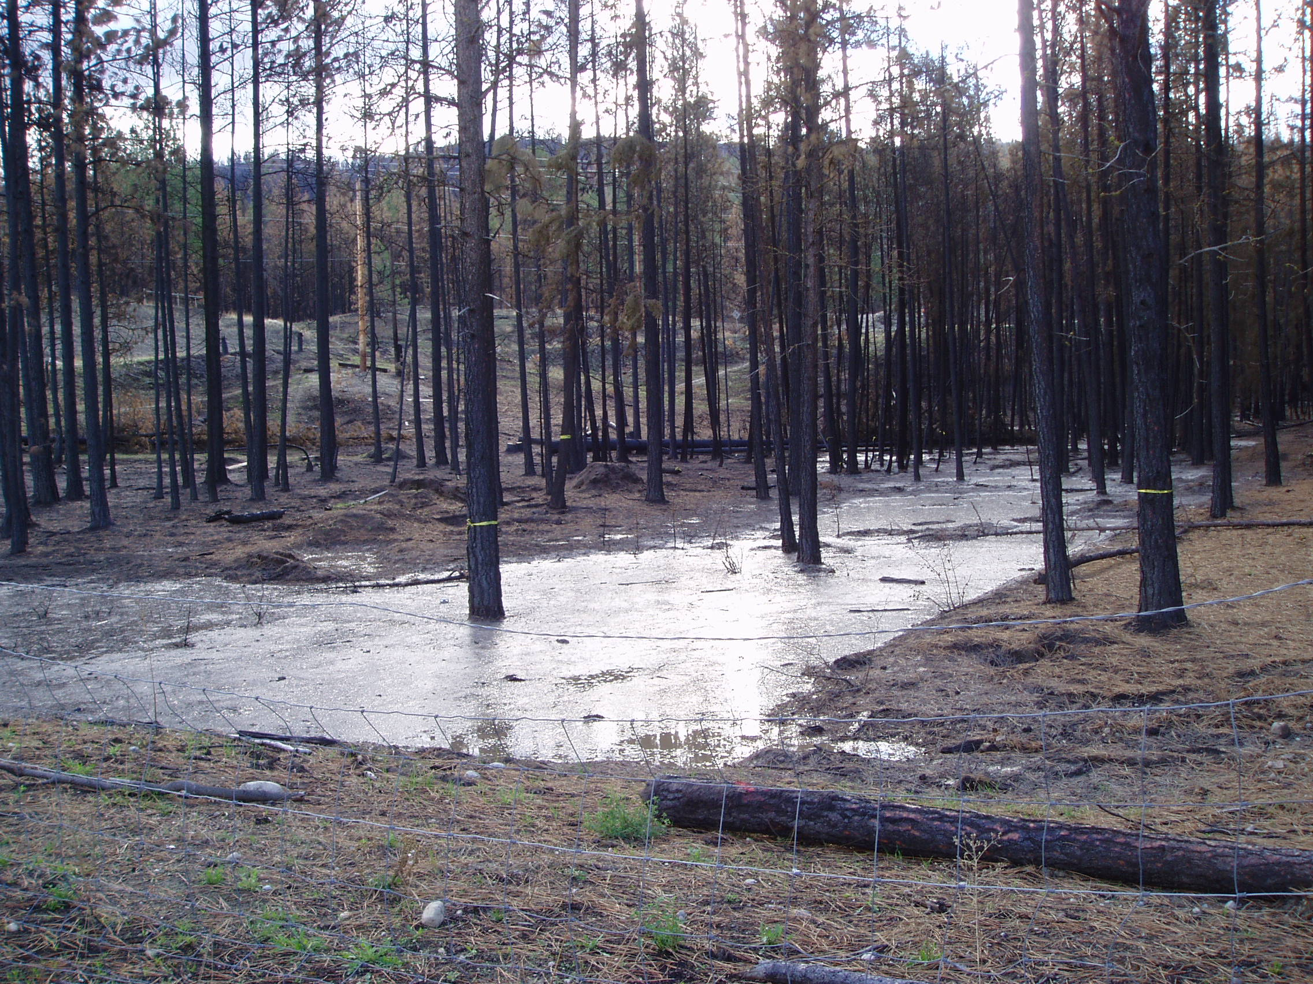

Slide 12
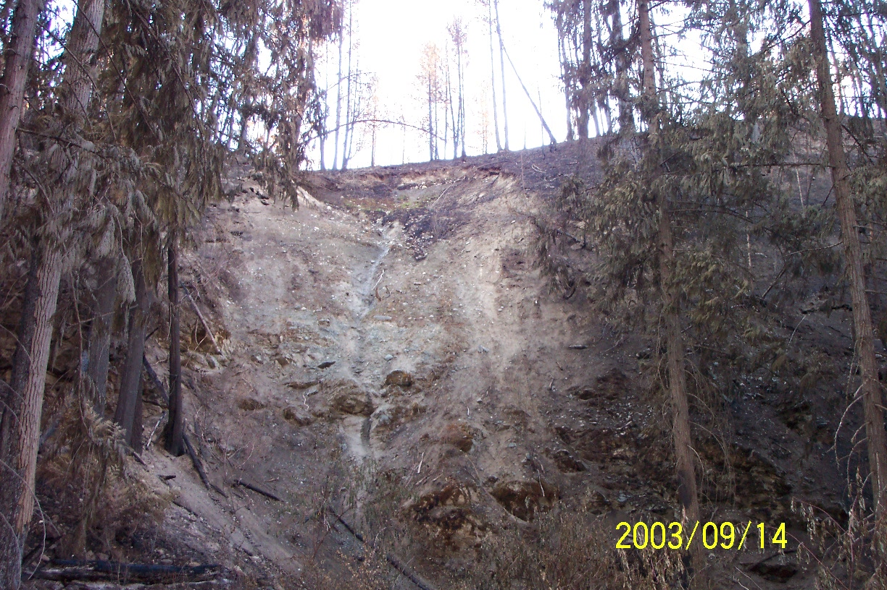

Slide 13
How long do impacts last?
Depends on the fire intensity and the burn severity
Low burn severity
High burn severity
Extent of water repellent soils
Extent of fire suppression disturbance
Post-fire remedial action

Slide 15
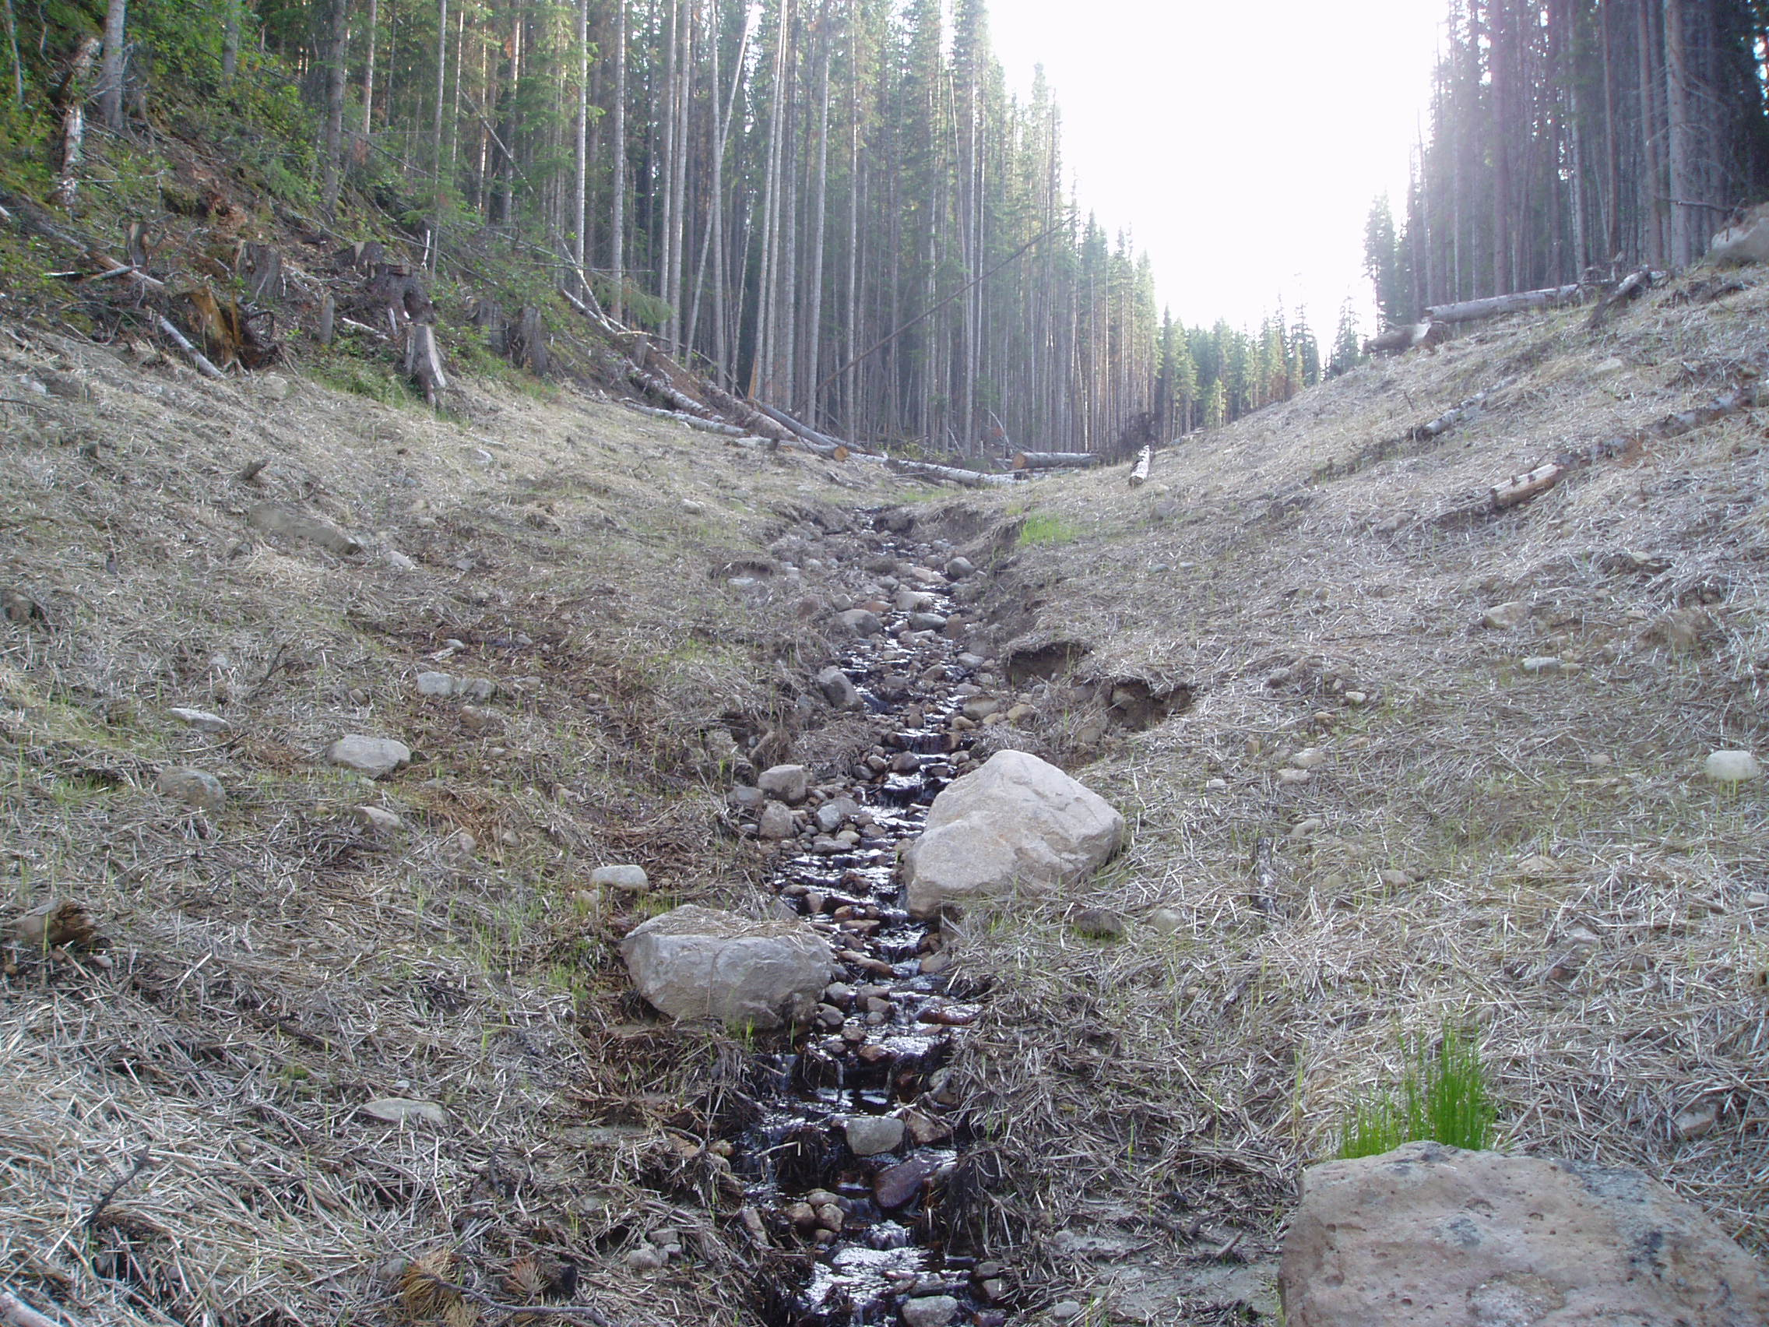

Slide 16
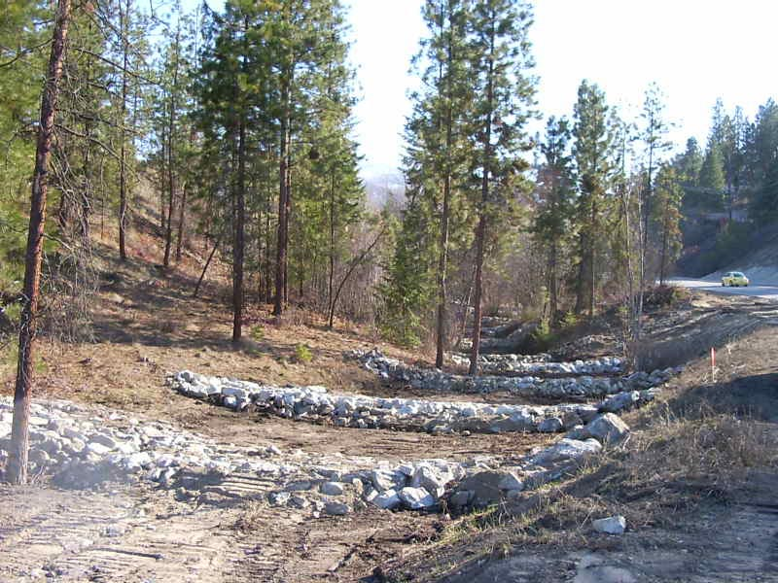

Slide 17
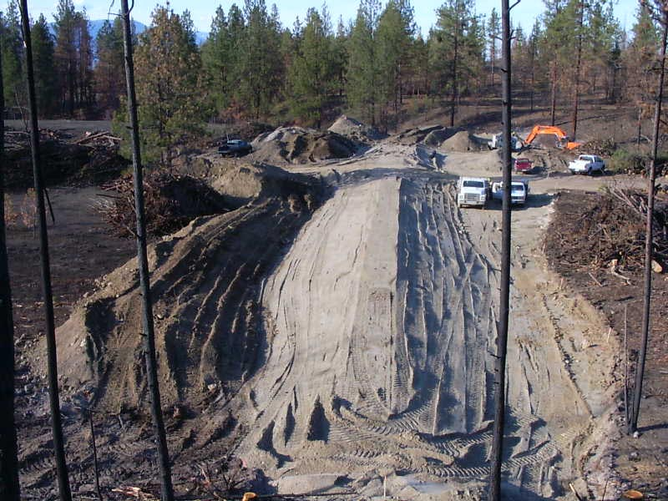

Slide 18
Are there beneficial impacts from wildfires?
Wildfires (from natural causes) are a natural occurrence on the landscape
Small, low intensity fires reduce fuel loads, rejuvenate plant communities, reduce the risks of large catastrophic fires
Healthy forests promote good water quality

Slide 19
What are the adverse impacts?
Large, high intensity with high burn severity fires can result in the loss of a watershed as a source of drinking water and destroy a fishery and the fish habitat
The impacts from a wild fire can extend well beyond the burned watershed
The length of time for a severely burned watershed to recover can be decades.

Slide 20
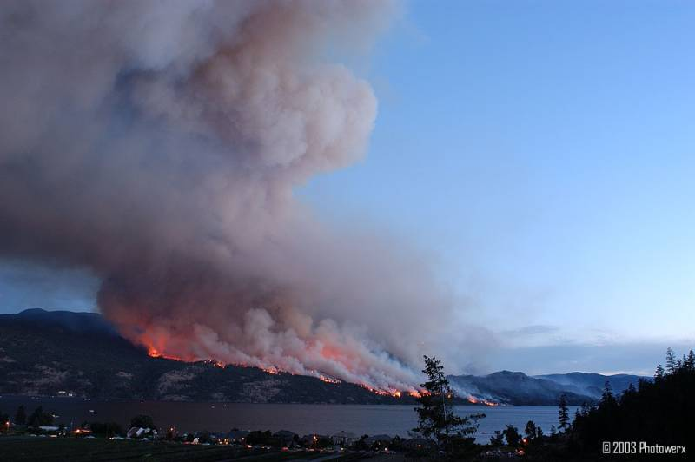

Slide 21
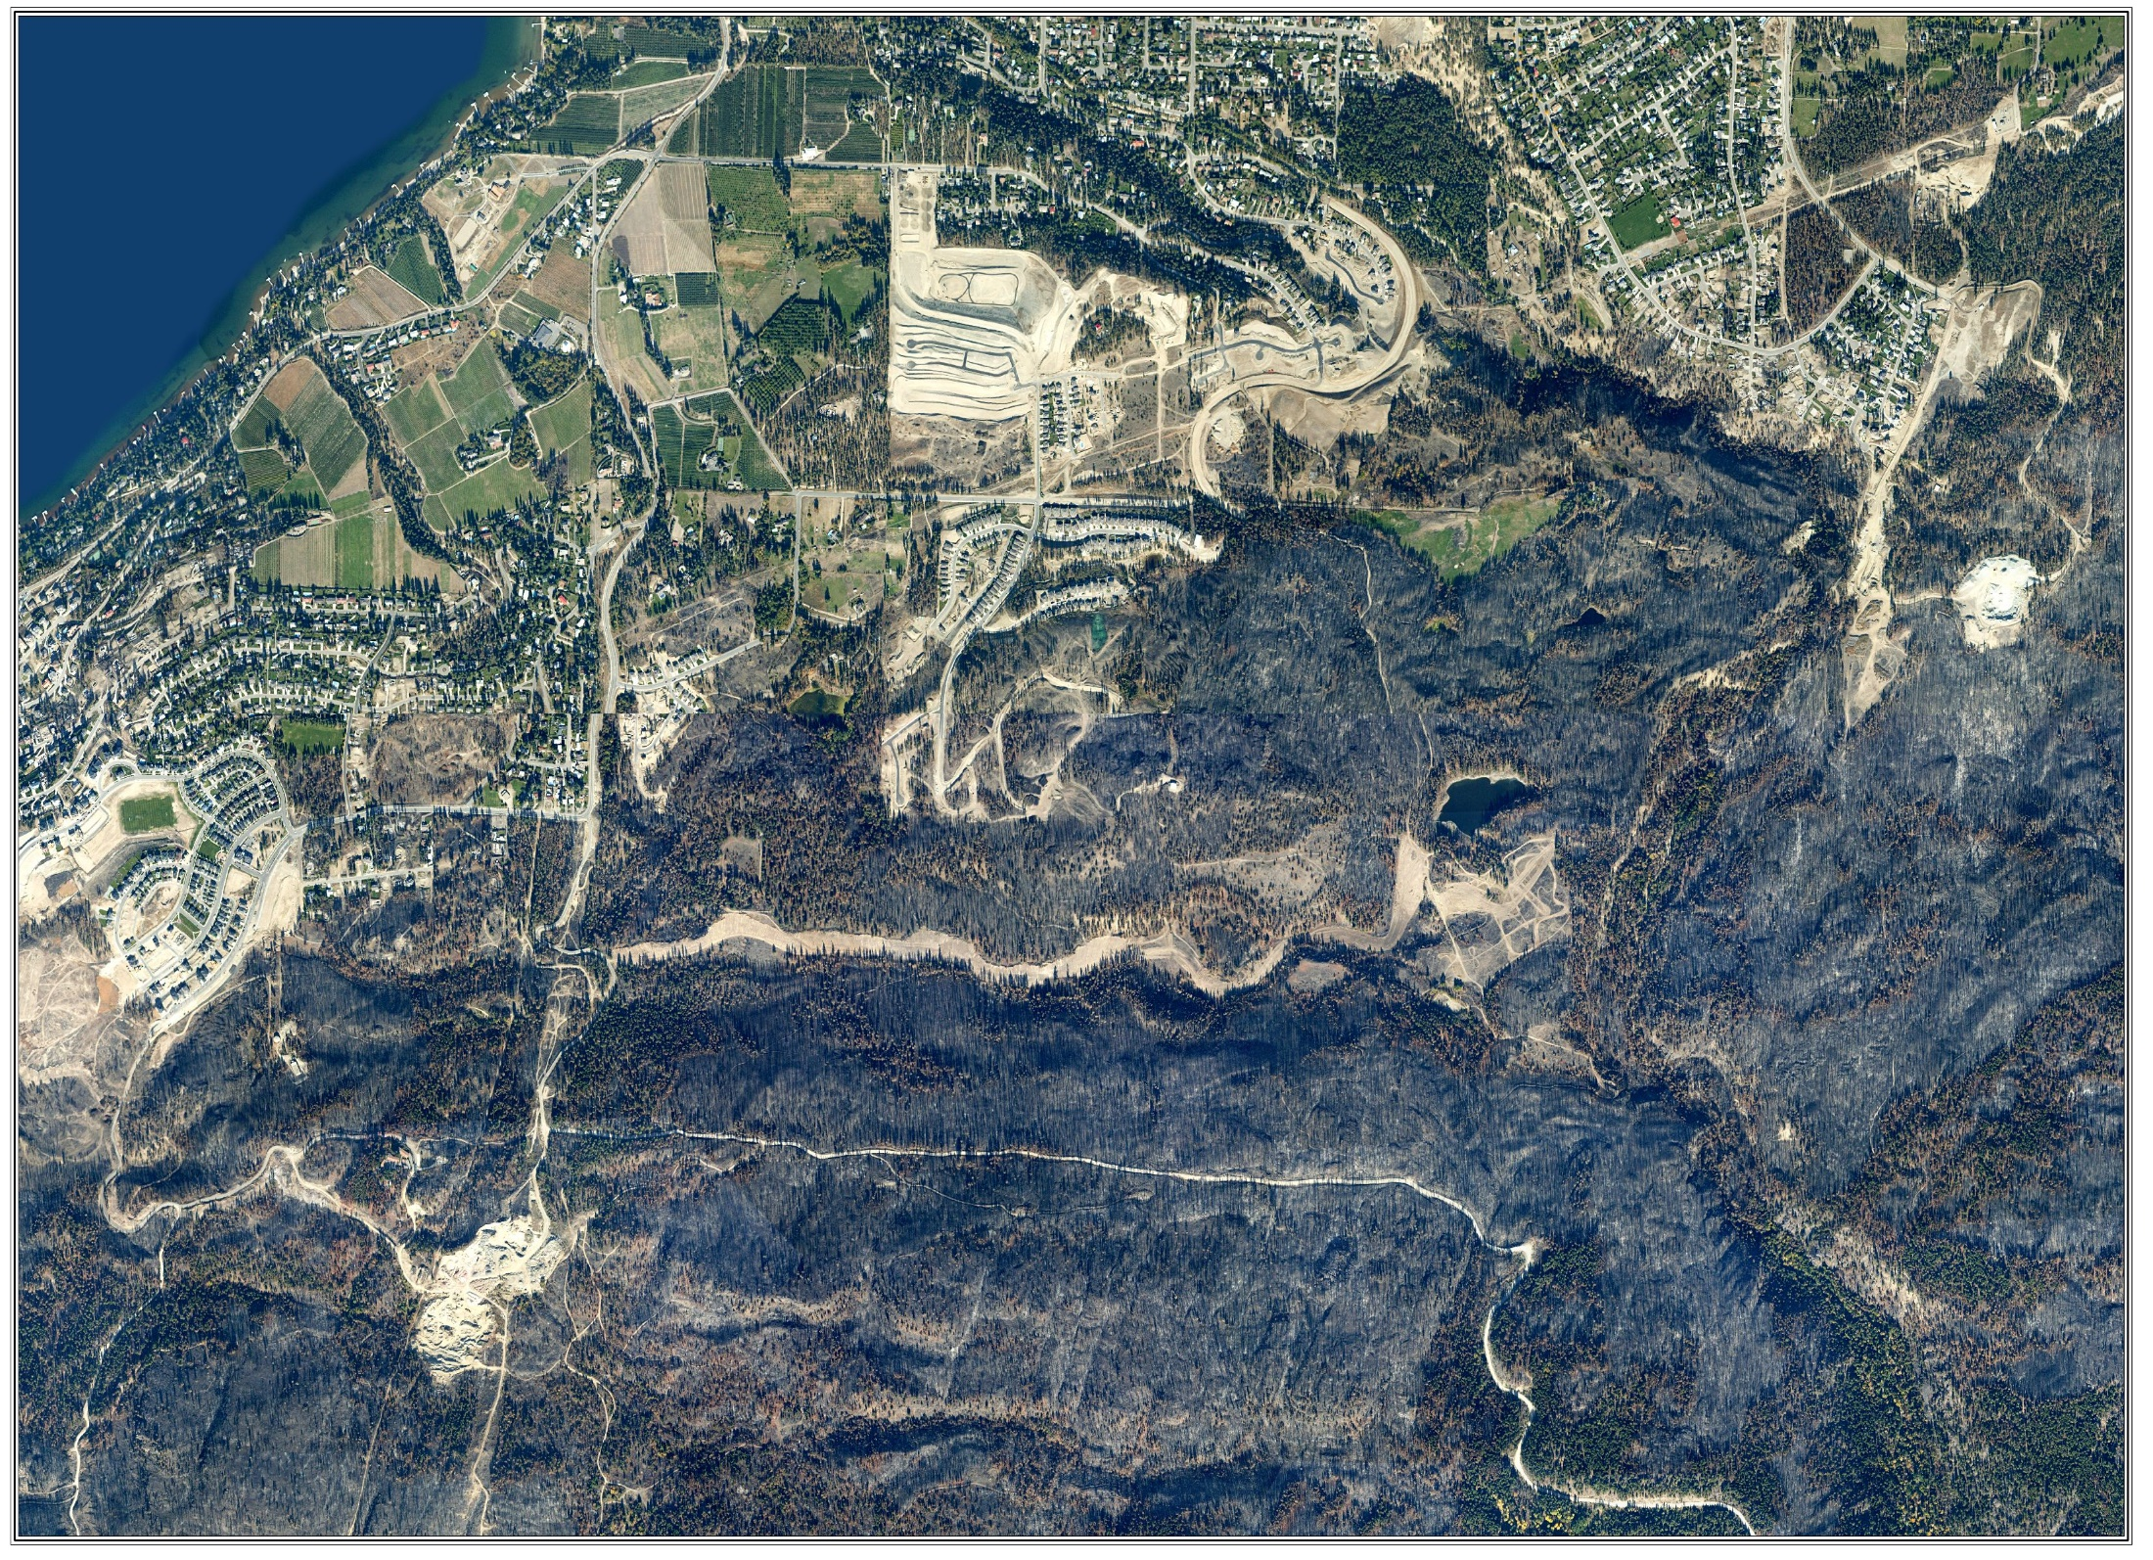

Slide 22
Can impacts be prevented, mitigated or minimized?
The answer to all three questions is YES.
Prevention
The best defense against wildfires is to prevent them from starting.
Fires depend on three elements – fuel, oxygen and a source of ignition
The most practical approach is to reduce the fuels
Over most of BC the fuel loading in our forest is rated as high to extreme
Obviously logging is one way to reduce fuels
Managing fuels in the interface areas has also proven very effective
Logan Lake was the first Fire Smart community in BC

Slide 24
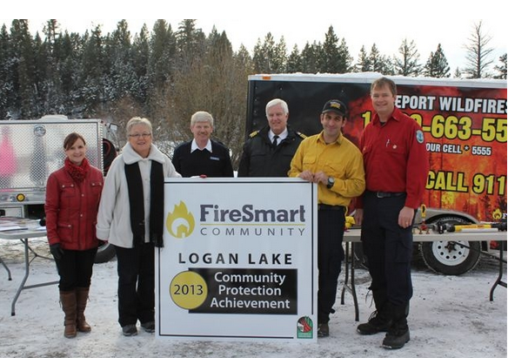

Slide 25
Can impacts be prevented, mitigated or minimized?
Mitigation
Very similar to prevention but actions are aimed at reducing the impact of a wildfire
Minimized
The impacts of a wildfire can be minimized by implementing a comprehensive wildfire plan or by implementing an aggressive post-fire response plan
In the US there is the BAER program
In BC we have the Post-Wildfire Risk Assessment procedure

Slide 26
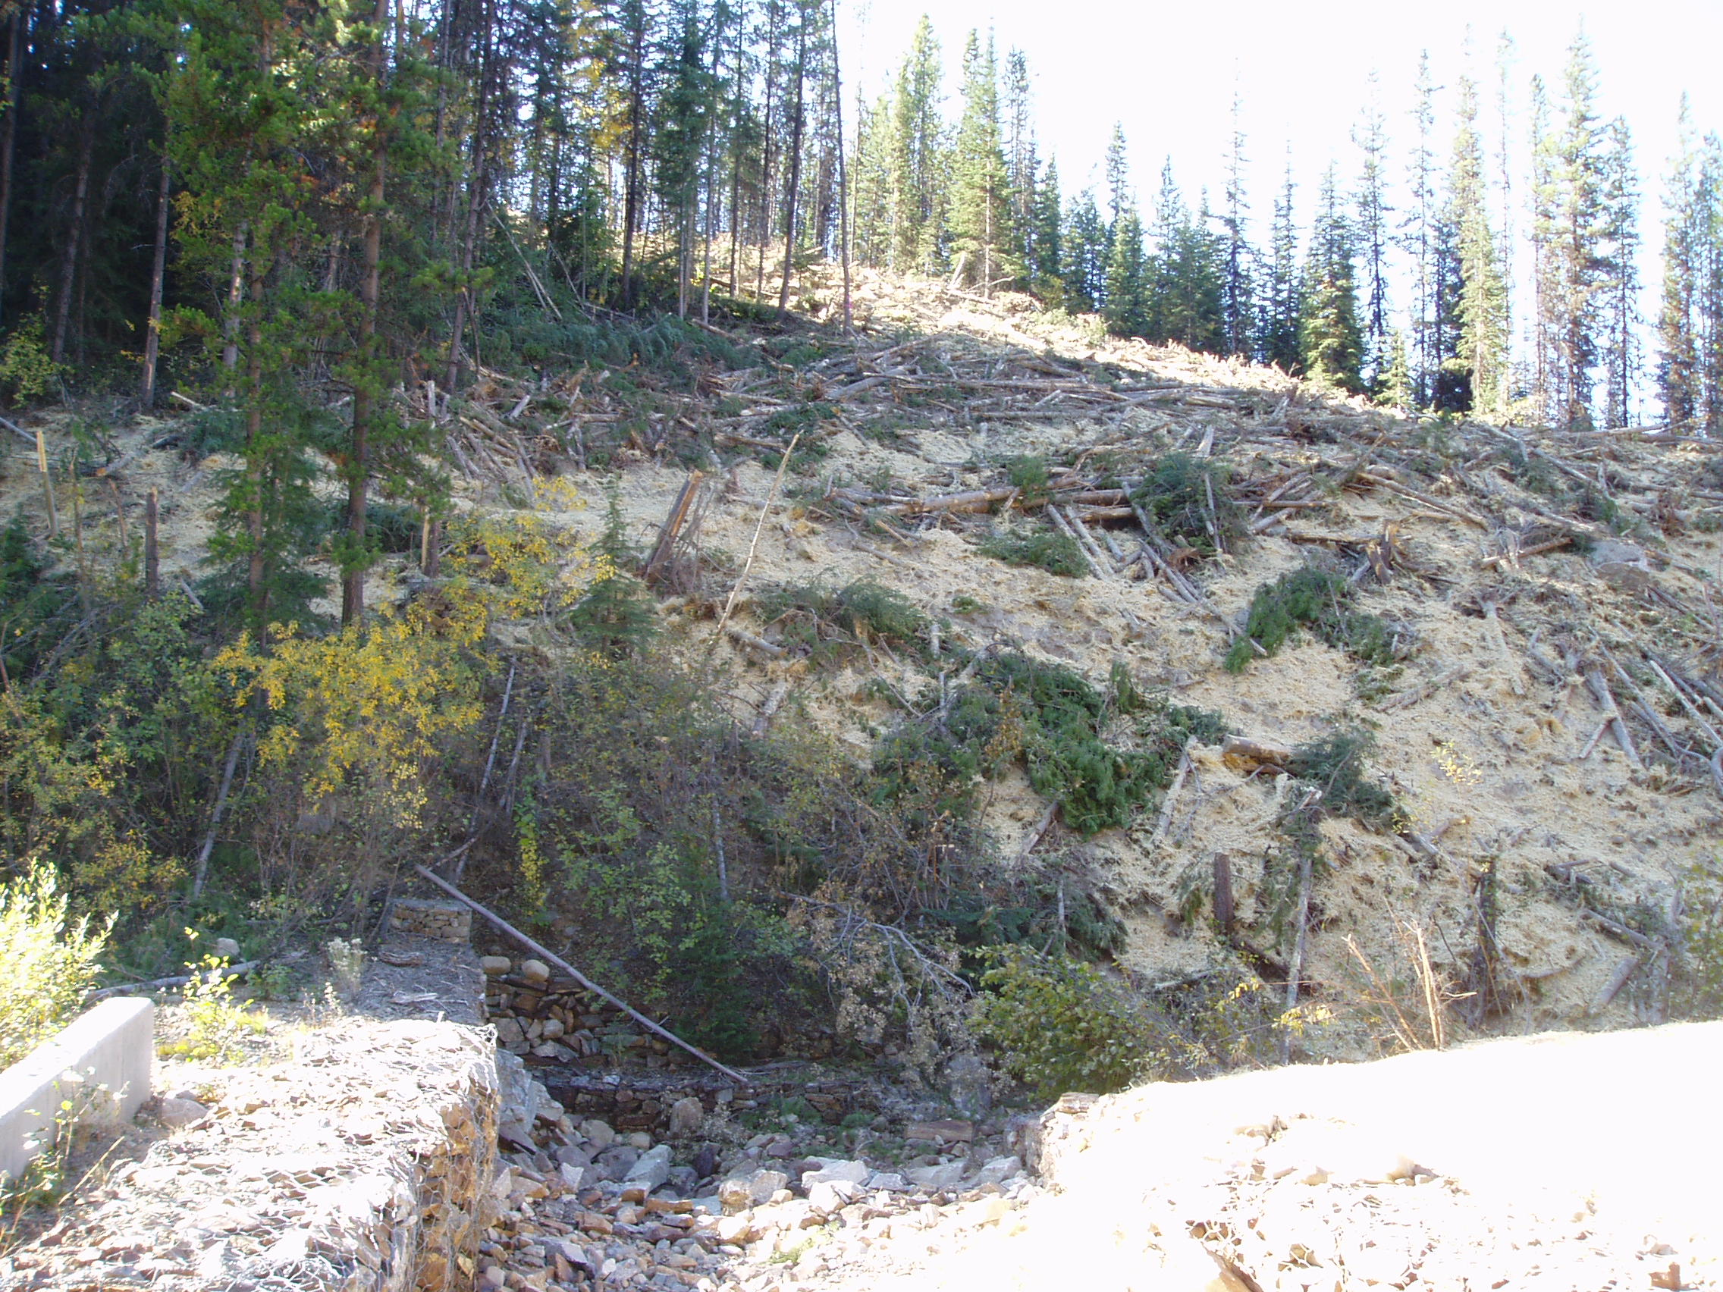

Slide 28
Summary
Wildfires can have long lasting, devastating impacts on both water quality and a steam’s ecosystem
The best defense is preventing catastrophic fires – Fire Smart
There are practical, cost-effective ways to mitigate the impact of a wildfire working with the Forest Service and the forest industry
The Post-Wildfire Risk Assessment procedure is a proven practical approach to identifying hydrologic and slope stability risks after a wildfire and implementing remedial works to reduce or eliminate impacts.

Slide 29
