Slide 1


Towards Adaptive Harvest Management of a Small Scale Transboundary Fisheries During Salmon Recovery:
Okanagan Salmon Community Initiative (OSCI)
Presented by Richard Bussanich (ONA) and Rick Simpson (BCWF)
Osoyoos Lake Water Science Forum
October 9, 2015
Notes:
Introduction of presenter and presentation.

Slide 2
REVITALIZATION OF AN OKANAGAN FISHERY
  ONA Mandate: Conservation, protection, restoration, and enhancement of indigenous fisheries (anadromous and resident) and aquatic resources within Okanagan Nation Territory

Slide 3
Okanagan Salmon History
Element | Pre-Contact (1800’s) | Industrial Era (1830-1985) | Current Status (1985 to present)
Okanagan Population | 75,000 – 100,000 | 15,000 to 70,000 | 15,000 (5,000 CAN/10,000 US)
Salmon Abundance | 1-6 million | 0.2 -1 million | 0.005-0.2 million
Salmon Diversity (viable populations) | Five species (Chinook (chief), Sockeye, Steelhead, Coho, Chum) | Sockeye, Chinook | Sockeye
Salmon Distribution | Osoyoos Lake, Skaha Lake, Okanagan Lake | Osoyoos Lake | Osoyoos Skaha (2009+) Okanagan (outplant 2014)
Salmon Timing | May to October | July to September | July to October
Fishery Management | Salmon Chief (tribal/kinship) | Canadian/US federal agencies | Joint Management (ONA-DFO, Canada, Pacific Salmon Treaty; US vs Oregon
Fishing Camps/Sites | Kettle Falls (US; hoop net, dip, gaff) Okanagan River (Weir) Skaha Falls OK Falls (Fish baskets, gaff/dip) | Collapse of fishery by 1960’s (loss of food fishery, intertribal trade essential) | Re-vitalize platforms (base of Chief Joe) Okanagan Weir, Osoyoos Lake, Ok Falls trap.

Slide 4
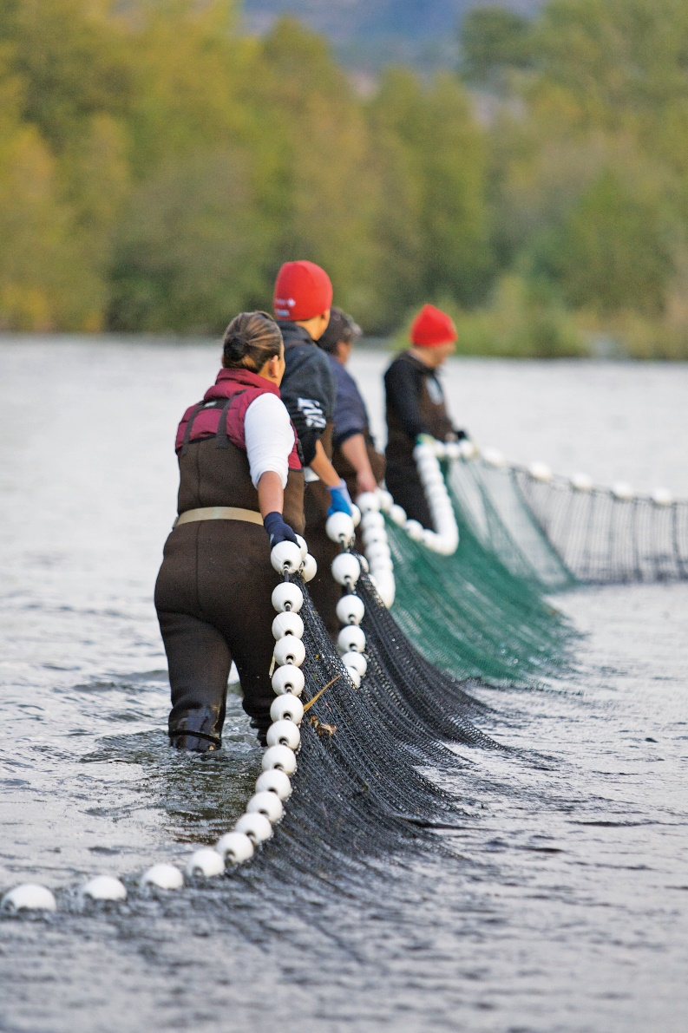
MOVING FORWARD
Establishment of the Okanagan Salmon Community Initiative
Build a Best Practices Forum for Okanagan fishers
Peer review of a Eco-Guiding Protocol (e.g. Okanagan-Columbia)
Continue creating community partnerships.
Notes:
1. Establishment of the Okanagan Salmon Community Initiative: A Network of Fishers, Environmentalists, Consumers, Naturalists, and Conservationists, Knowledge Keepers building a responsible, ecosystem-based fisheries. Our Vision: building a resilient, responsible, community fishery based on respect, relations, and relevance, for generations.

Slide 5

Okanagan Salmon Community Initiative
Goal of the Okanagan Salmon Community Initiative is:
To build a resilient, responsible, community fishery based on respect, relations, and relevance, for generations.

Slide 6
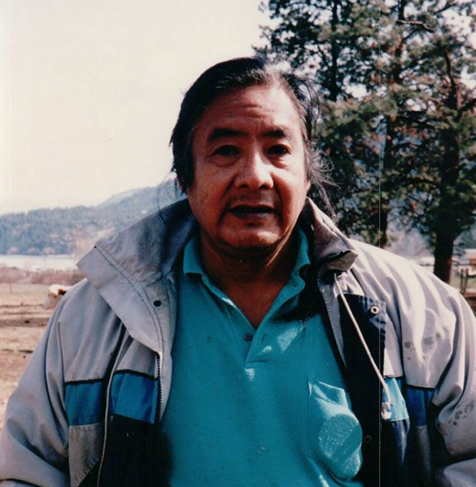
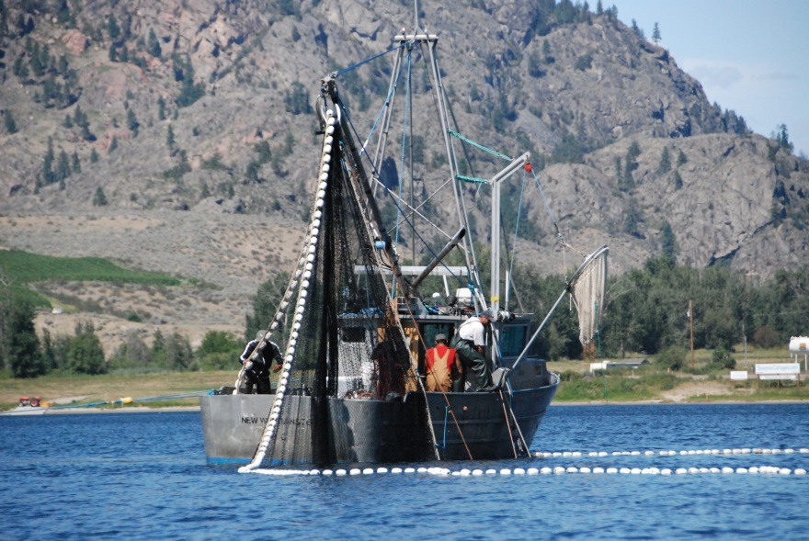
Relationship Building
1970’s Albert Saddleman (OKIB) message simple – put back the water and put back the fish
1995 Lowest return to Okanagan River (< 5000 salmon from millions)
2000 COBTWG formalized (integrated recovery plan and experiment initiated)
2005+ ONA presentation/mtgs with BCWF, and Sports Advisory board rep to discuss finding a way to get along
Test food fishing in Osoyoos Lake (PICFI Program)
2010 Food, communal, economic (seine) and recreational fishery opened 1st time, “silo fisheries”
2011 Troll experiment (Rodney Reels – ONA), and Pescatourism pilot study (ONA-chefs)

Slide 7
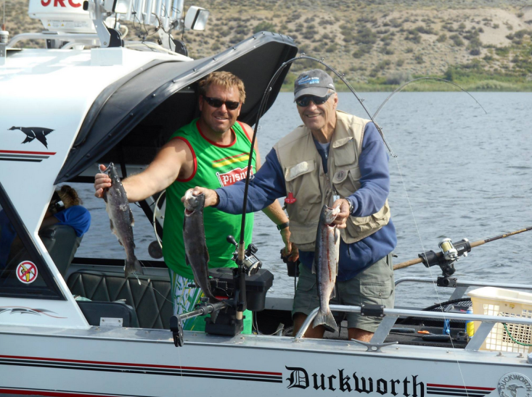
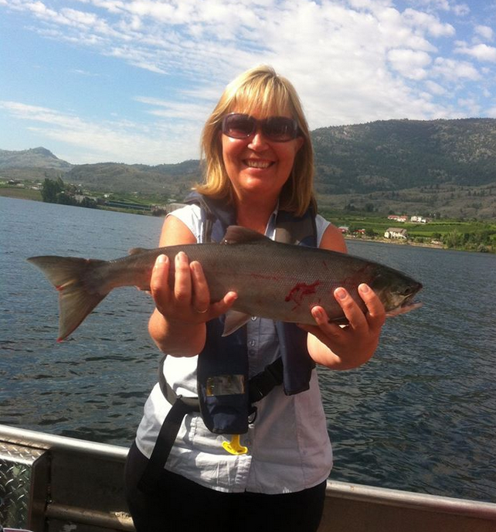
Relationship Building cont.
2012 Eco-Fishing (BC Sportfishing – OIB members – ONA), training guides
OSCI key steering committee members (virtual committee), principles, operational plan, communication strategy, and recruitment path
OSCI operational, > 55 fishers trained , 5 vessels per day two weeks (Aug), $100k economic impact to Osoyoos , met biological and compliance targets
OSCI develops charter and approved by ONA Chief Executive Council, OIB access site (fishing camp), no sockeye fishery, BUT participants for experimental chinook fishery (Tagging study)….

Slide 8
Building Collaboration (2011-2015)
ONA
COBTWG (DFO, BCFLNRO, ONA)
Local Fishers
N’kmip Desert Cultural Centre
Osoyoos Wildlife Federation
BC Federation Drift Fishers
N’kmip Camp ground
Local Resorts: Spirit Ridge and Watermark Beachfront
Okanagan Commercial fishers
Local Fishing Guides
Codfathers
Town of Osoyoos
Global TV, Outdoor Canada, Globe Mail
Slow Fish Canada
Foodies, Chefs Association
Thompson Okanagan Tourism Association
Okanagan Fisheries Foundation
BC Wildlife Federation
OSCI

Slide 9
Adaptive Co-management social-ecological systems Resilience Self-determination Community WILD FRESH Fair Access Fish Habitat Causing to Come Back local Sustainable Good news story Authentic Sockeye Recovery Extirpated best science Traditional First Foods Ecosystem Governance Cost Benefits Artisanal Participatory, Vulnerable Transformation

Slide 10
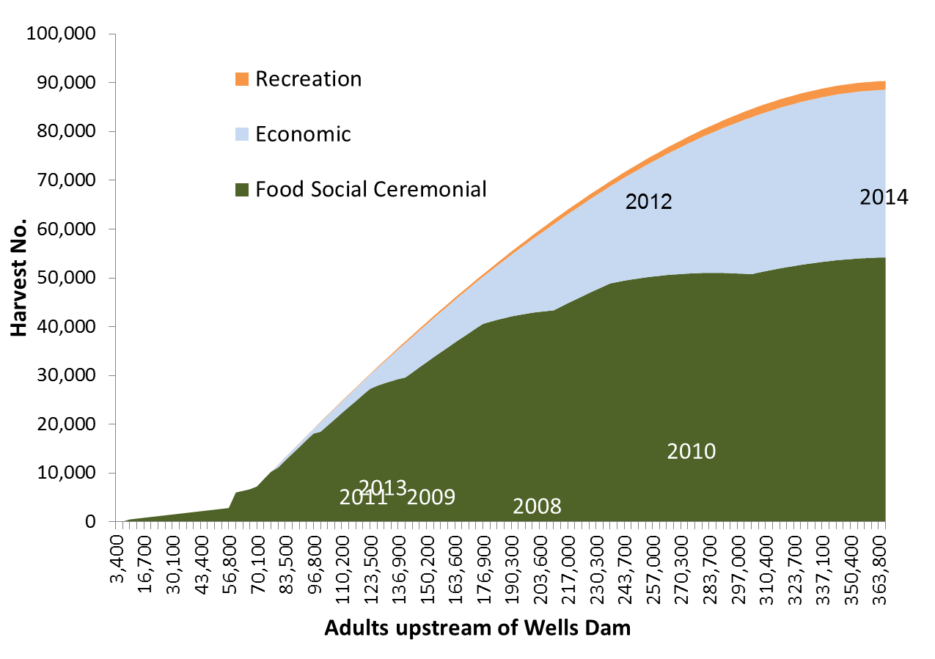
Canadian Sharing Allocation
2015
2015

Slide 11
Self-organized Adaptive Harvest System
Governance that creates social space for ecosystem management (bottom up), (ONA, COBTWG)
Funding for action (ONA, picfi, Fishers, Nkmip-ndcc)
Ability to monitor and respond to environmental feedbacks (OIB, ONA, DFO)
Information flow & social networks (key stewards) for ecosystem management (ONA/OSCI)
Combining science, traditional knowledge, and local knowledge (ONA, DFO, Okanagan knowledge keepers, local fishers)
Sense-making of information (gaps) to action-solution based (DFO, ONA/OSCI)
Arena of collaborative learning (ONA/OSCI, fishery managers)

Slide 12
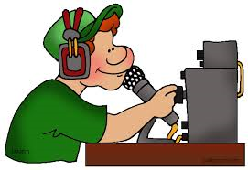

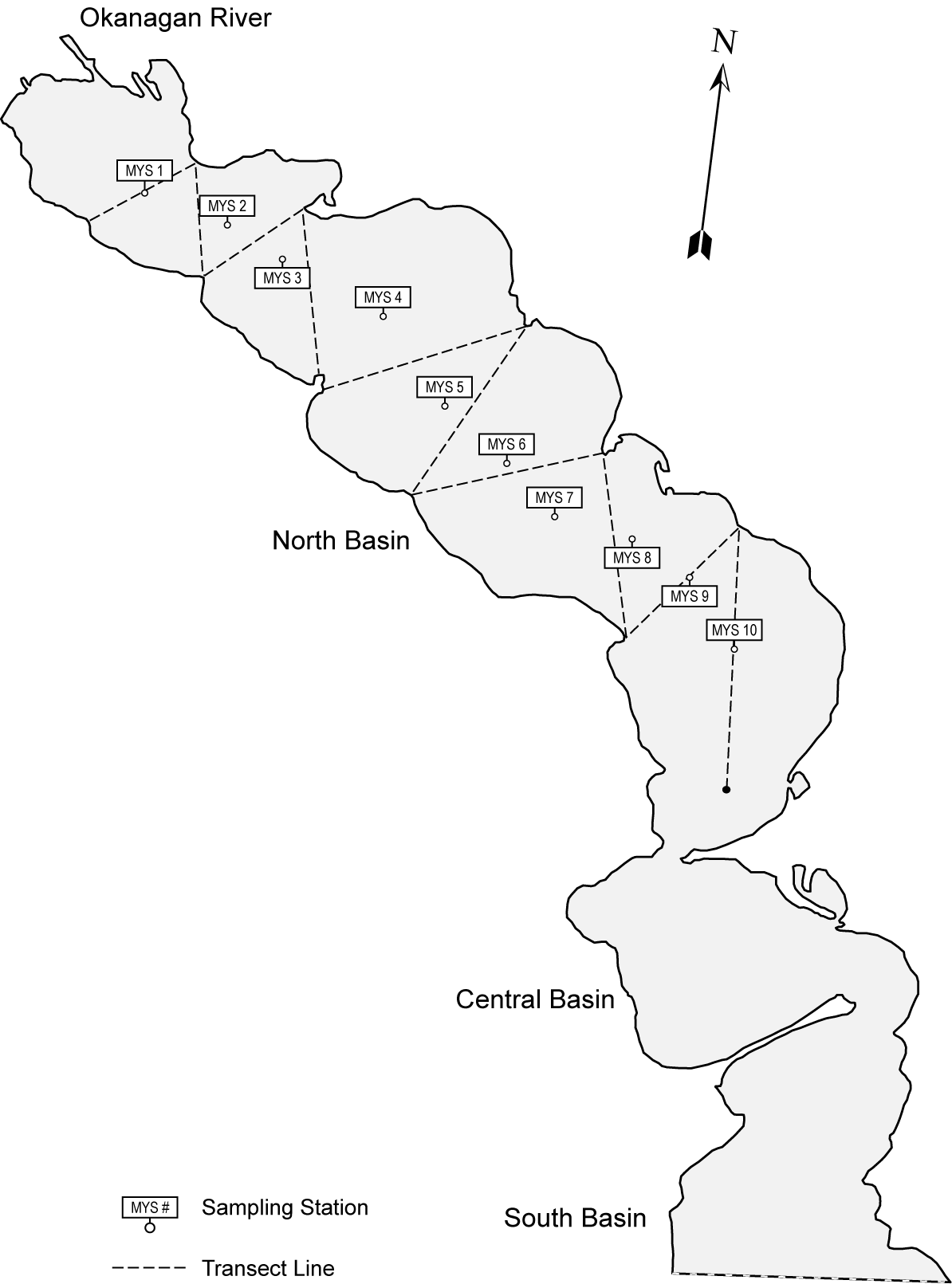
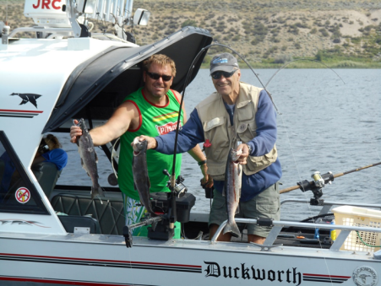
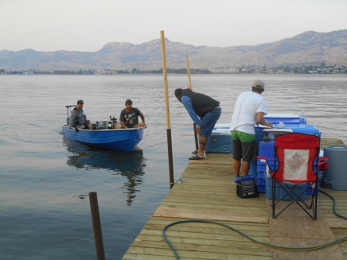
ONA Proposed Daily Fishing Plan

Slide 13
OSCI Daily Fishing Plan
Offer catch and retain fishing experiences
to a qualified, designated fisher group (max. 30 vessels per day)
best practices orientation (pre-season, 2-4 hr session)
for validation, landing, and distribution to ONA (mothership)
adhering to standard recreational regulations
ice, coolers, catch logs, vessel flags provided by ONA
hail in to mothership (from 6 am +)
hail out/final landing to mothership (by 1 pm), return coolers, logs
option to trade back fish, fisher receive ONA fish landing slip/transport form
fish sales partial proceeds back to fisheries & fish recovery, retailed at Nkmip-Watermark (Osoyoos), Codfathers (Kelowna)

Slide 14
Fisher Interest in Year 1 (2014)
42 Fishers
Rick Simpson,
Danny Coyne,
Mat Hanson,
Judie Steeves,
Bob Otoway,
Dale Maloney,
John Maloney,
David Hoffart,
Linda Hoffart,
Brian Henschell,
Phillip Fuhr,
Freday Lang,
Tim Baxter,
Kelly Eastbrook,
Dale McLean,
Kevin Hubnar,
Russ Friesen,
William Houston,
Ian Holmes,
Warren Neely,
Carlos Dematos,
Lorin Lowell,
Lowell Lowell,
Scott Nicol,
Gary Ellis,
Barry O Connell,
Jame Wells,
William Purper,
William Thompson
Mike Kamann,
Brett Tepper,
Gordan Marano,
Darlene Rogers-Neary,
Laura Nymeyre,
Lee Edmonson,
Ryan Olender,
Curtis Woodkey,
Geoff Neily,
Todd Nicol,
Robert Lurdin,
Fara Slavashi, and
Maddy Baxter.

Slide 15
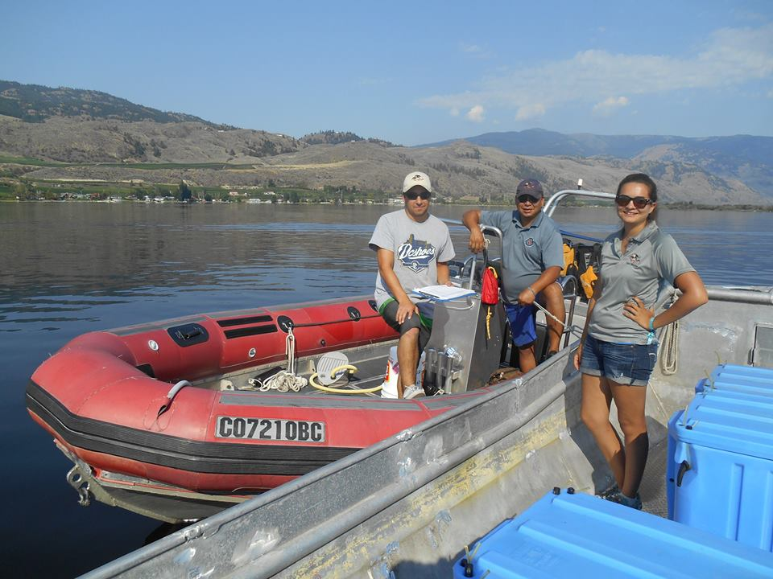
For More Information visit us at
www.okanagannation.com
Follow OSCI on Facebook

