Slide 1
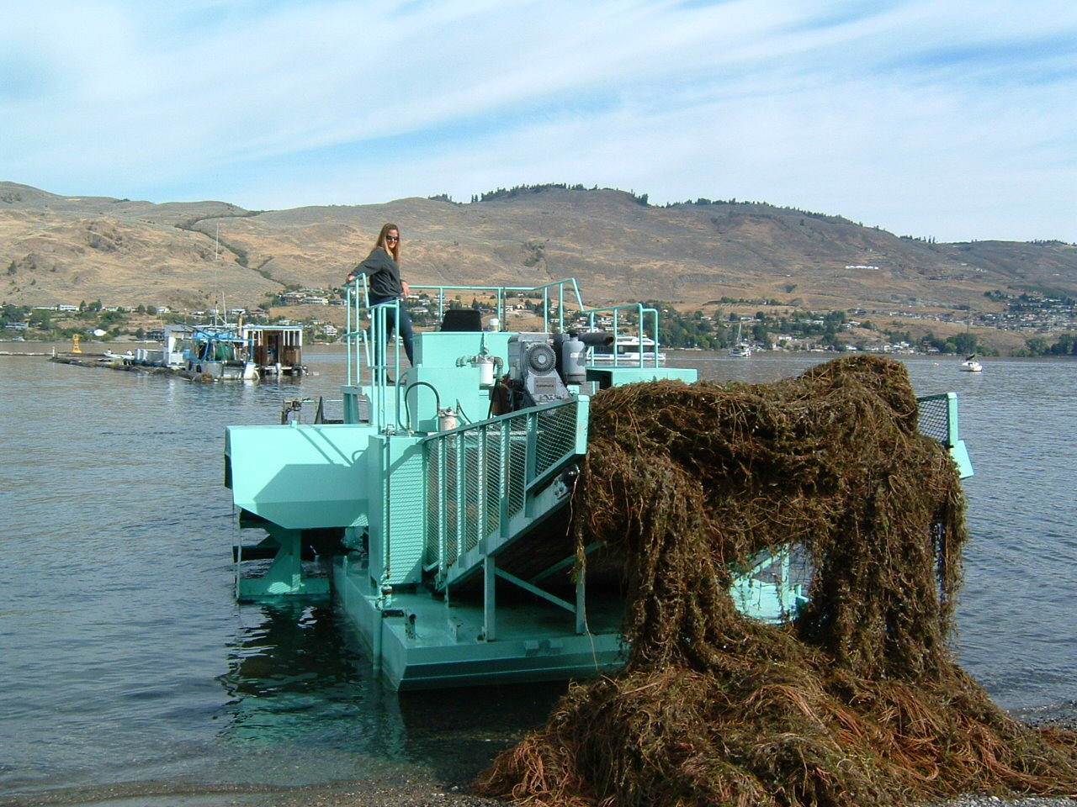
Okanagan Basin Water Board
Eurasian Watermilfoil Control Program
James Littley
Operations and Grants Manager
James.littley@obwb.ca (250) 469-6270

Slide 2
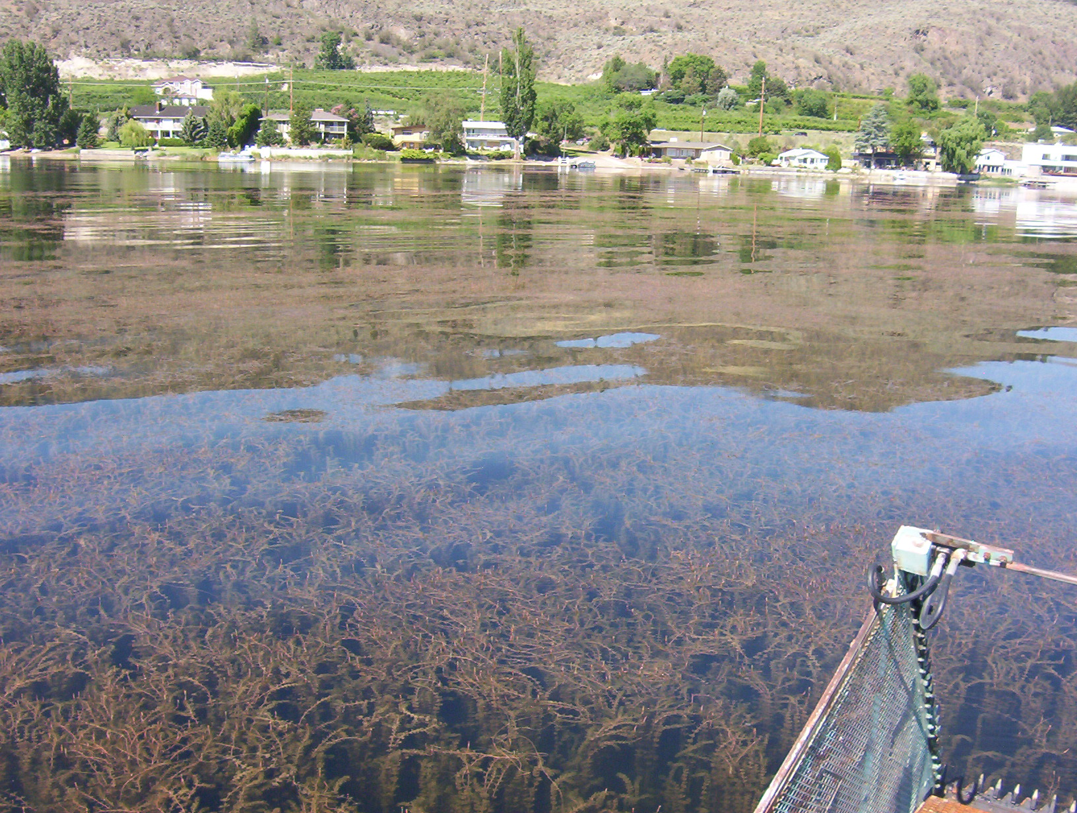
Okanagan Basin Water Board
Eurasian Watermilfoil Control Program
Robs Oxygen and lowers water quality
Restricts native fish habitat and promotes algae blooms
Causes unsightly, smelly mess on beaches
Lowers property values and discourages tourism

Slide 3
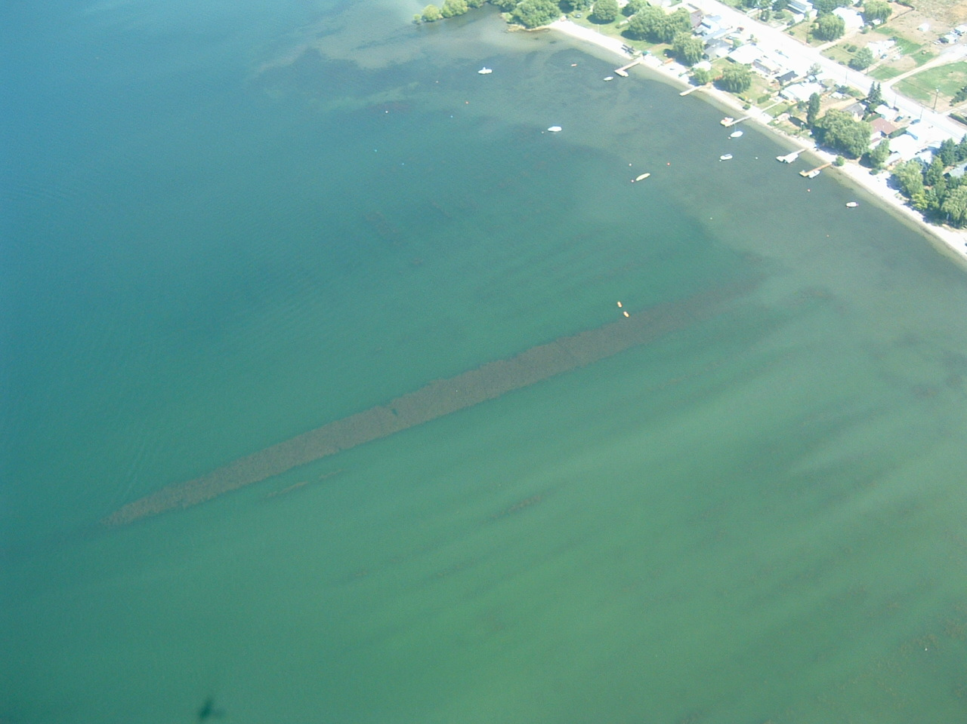
Okanagan Basin Water Board
Eurasian Watermilfoil Control Program
Summer harvesting – like mowing grass – no permanent effect
Needs to be removed from water and beaches
Transfer sites should be near work area

Slide 4
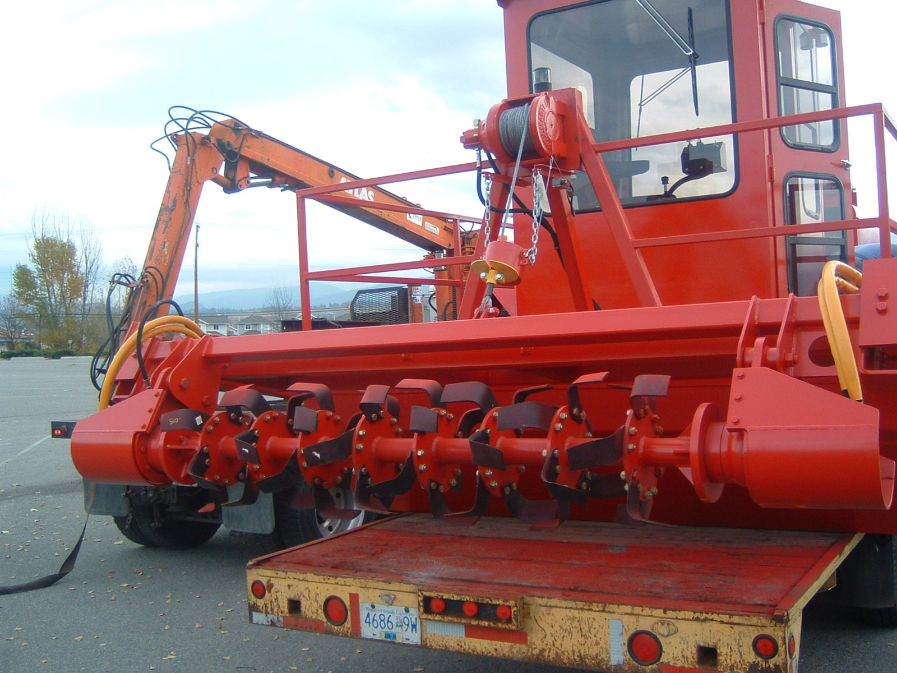
Okanagan Basin Water Board
Eurasian Watermilfoil Control Program
Winter rototilling – removes dormant root fragments
Not permitted in all areas
Has multi-year cumulative effect, but not permanent

Slide 5
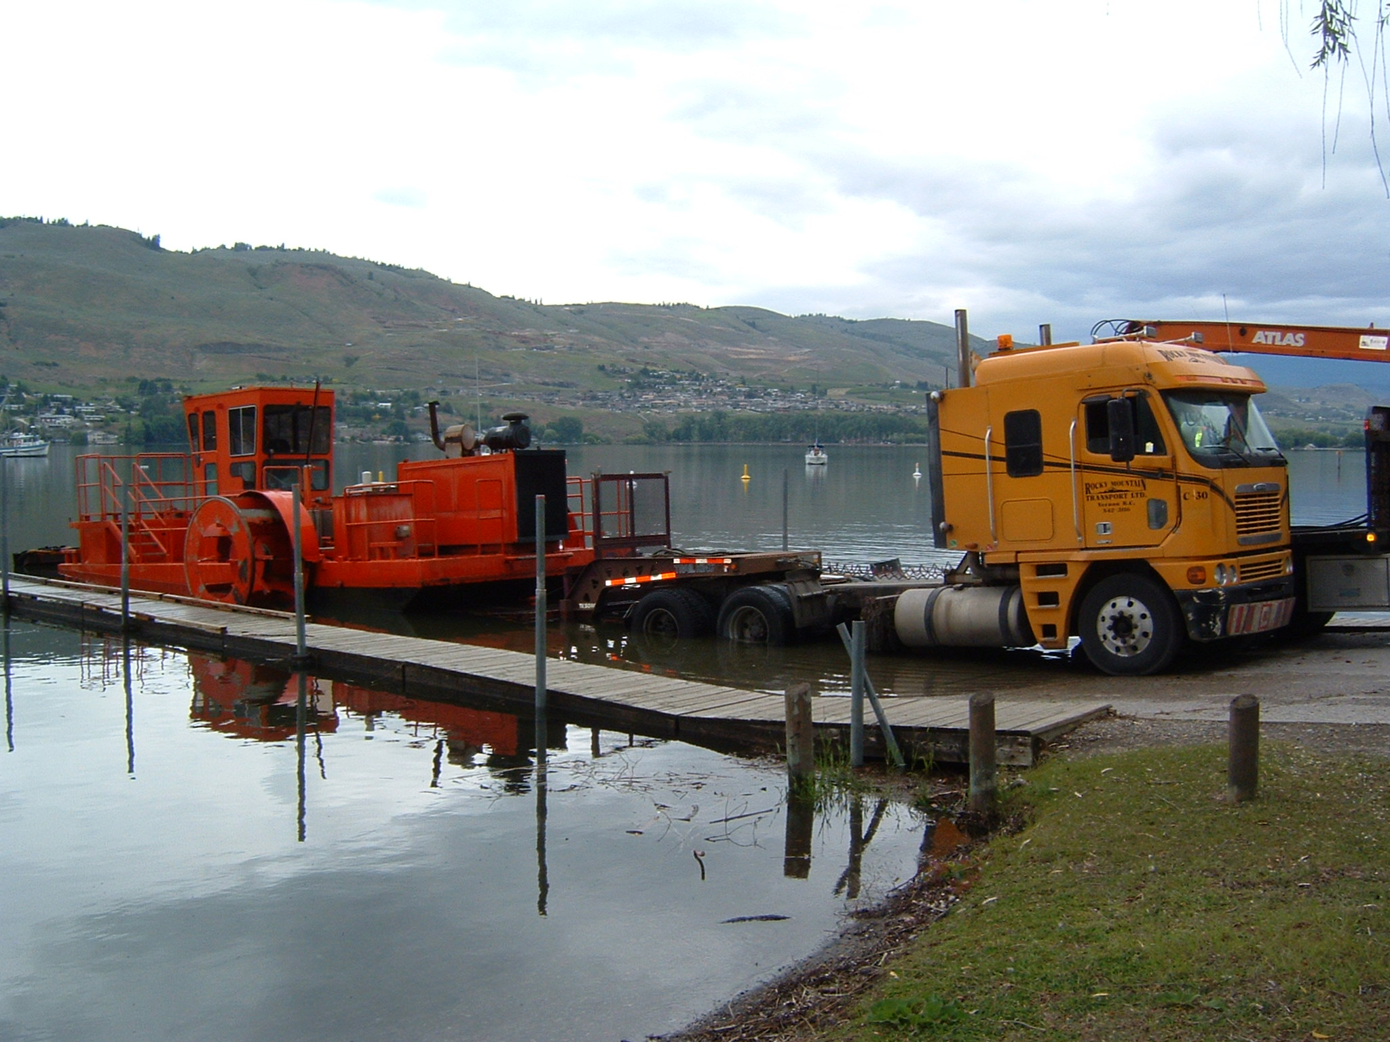
Okanagan Basin Water Board
Eurasian Watermilfoil Control Program
Operational Needs
Boat Launches for large equipment
Milfoil transfer sites accessible from land and water
Designated safe moorage

Slide 6
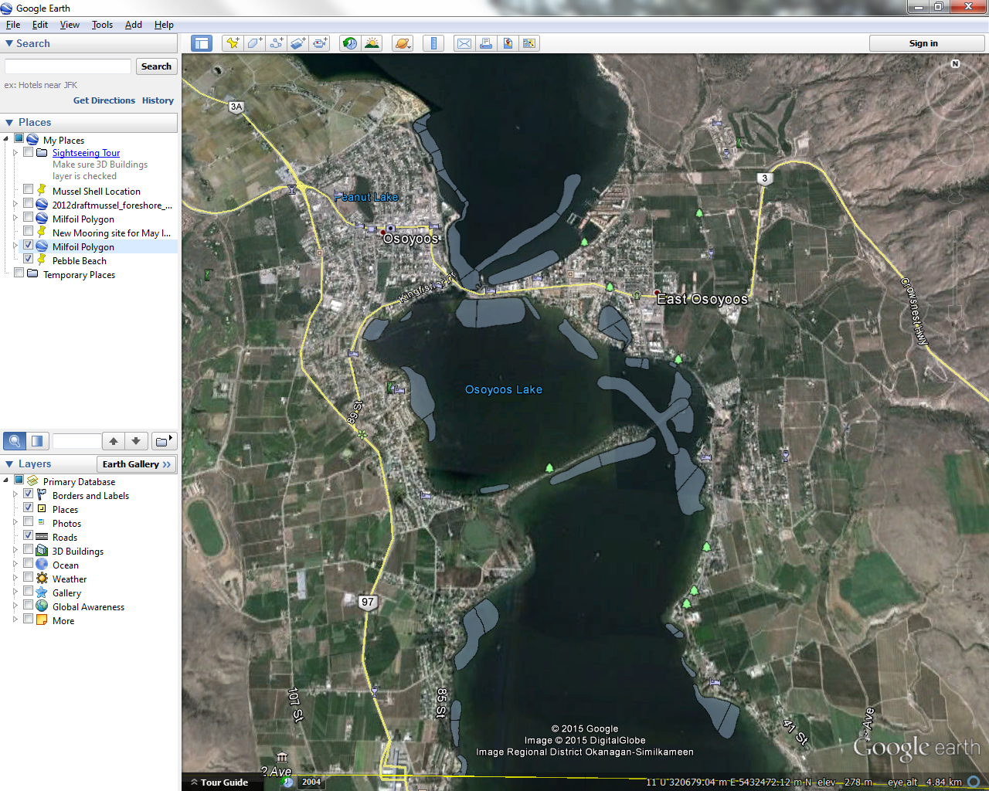

Slide 8
Okanagan Basin Water Board
Eurasian Watermilfoil Control Program
More than just Eurasian milfoil in the water
Public swimming and boating areas get priority treatment over private docks
Cost $0.01 per $1,000 property value to run this program.

Slide 9
Okanagan Basin Water Board
Eurasian Watermilfoil Control Program
James Littley
Operations and Grants Manager
James.littley@obwb.ca (250) 469-6270

