Slide 1
The Washington-British Columbia Transboundary Climate-Connectivity Project: Engaging science-management partnerships to address climate impacts on wildlife connectivity
Meade Krosby Climate Impacts Group University of Washington
Osoyoos Lake Water Science Forum A Watershed Beyond Boundaries: Stewardship of our Shared Waters October 7-9, 2015
Notes:
I’m going to talk about a project I’ve been leading to help land and wildlife managers in Washington and British Columbia integrate climate change into their management of landscape connectivity. We’re actually in the middle of this project now, so I’m mostly going to focus on the justification and rationale for this work, and the approach that we’ve taken, paying particular attention to the organizational, conceptual, and technical challenges involved and how we’ve been tackling those. And I’ll start with the very big picture, why do we need to address climate impacts on landscape connectivity?

Slide 2
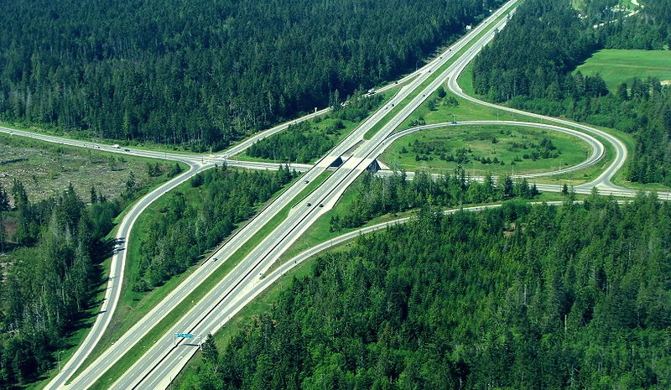
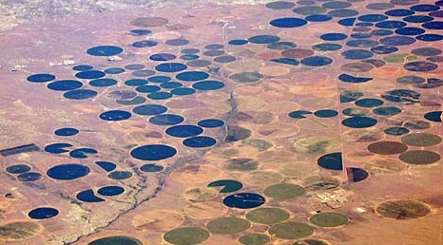
Movement is key to the health of species and ecosystems, especially under climate change
Notes:
Because movement is key to the health of species and ecosystems, especially under climate change. daily movements, seasonal movements, and especially impt under cc, b/c range shifts are the primary way that biodiversity responds to climate change, it’s how it’s always responded. But this time, climate is going to change must faster than ever before, and there’s all this stuff in the way.
Upward ~11m /decade
Poleward ~17km /decade
But unlike birds (wings) many species will have a hard time tracking shifting climates, because of human-caused barriers.
For this reason, enhancing connectivity is number 1 recommended strategy for climate adaptation for biodiversity conservation.
Another significant barrier to species movements and climate adaptation is posed by political borders

Slide 3
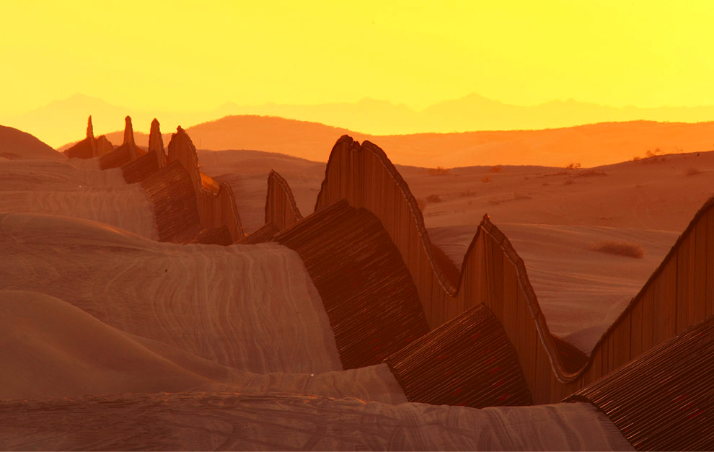
Political borders can pose significant barriers to climate-driven movement
Notes:
Some of these barriers are pretty obvious – like the wall along the US-Mexico border,which unfortunately runs E-W, directly in the way of poleward range shifts, but some are more subtle

Slide 4
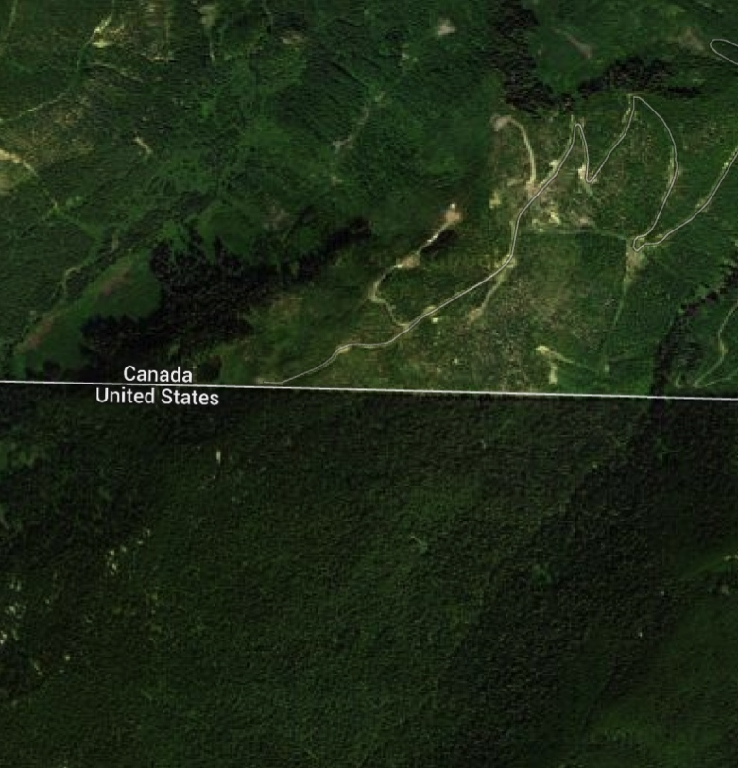
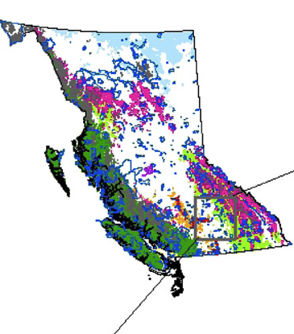
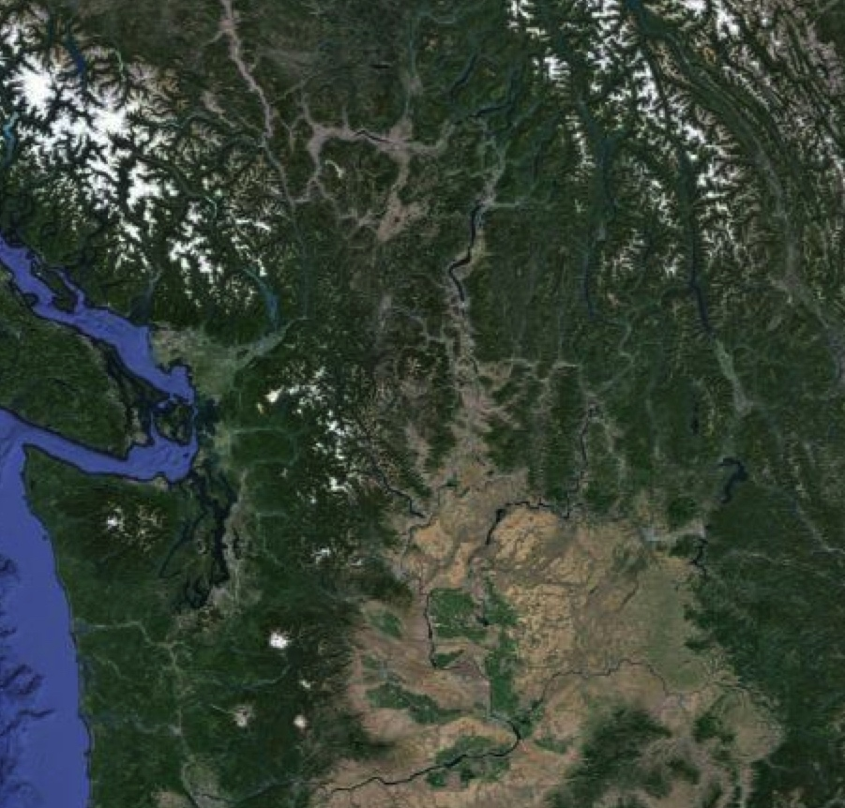
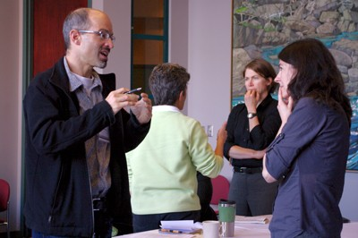
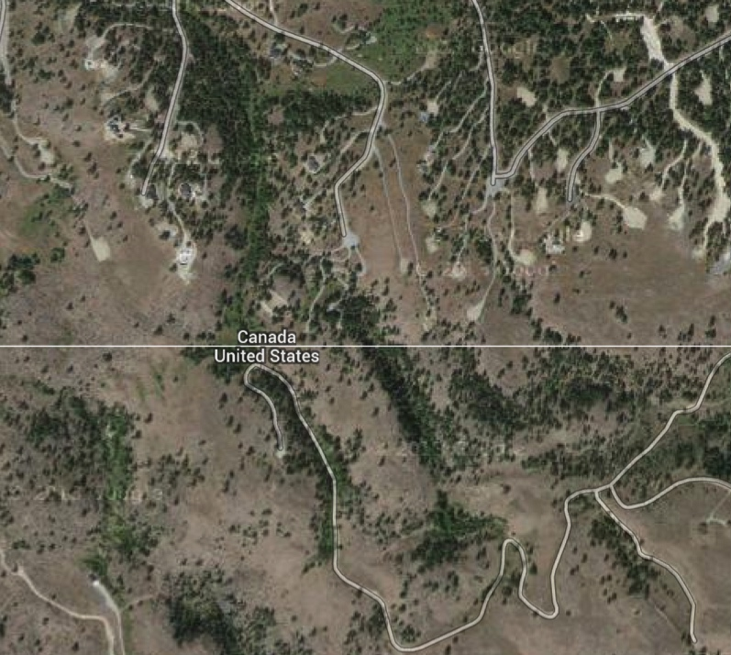
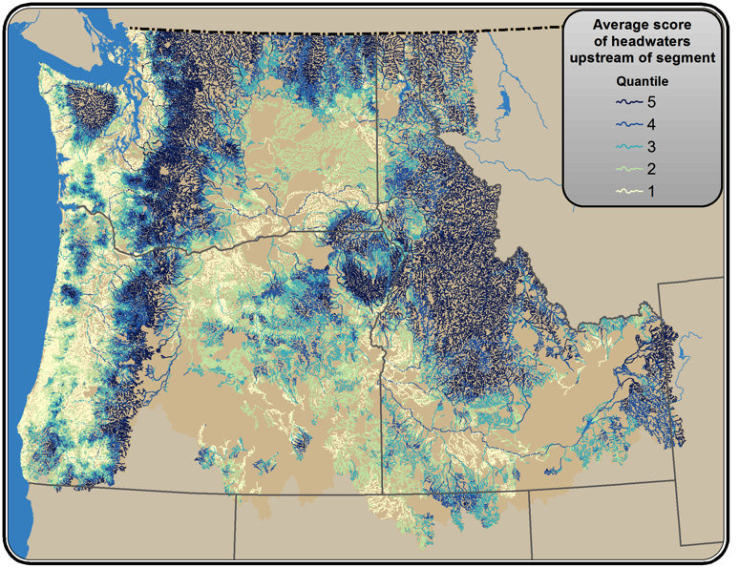
Political borders can pose significant barriers to climate-driven movement
Notes:
The northwest looks pretty good from the stratosphere, but our border also runs directly in the way of poleward range shifts, and poses more of a barrier than you might think, since land use often is not coordinated between Washington and BC, so that you can have parks bordering industrial logging areas, or areas of low population density in Washington bordering areas of high development in BC, like the Okanagan Valley (palm springs). Identifying key transboundary corridors that are resilient to climate change is challenged by data gaps, inconsistencies, and errors at the border (either apples and oranges, or data don’t talk to eachother, or disagree). And finally, there are insitutional barriers – managers don’t talk to eachother to coordinate their activities.

Slide 5
Washington – British Columbia Transboundary Climate-Connectivity Project

Slide 6
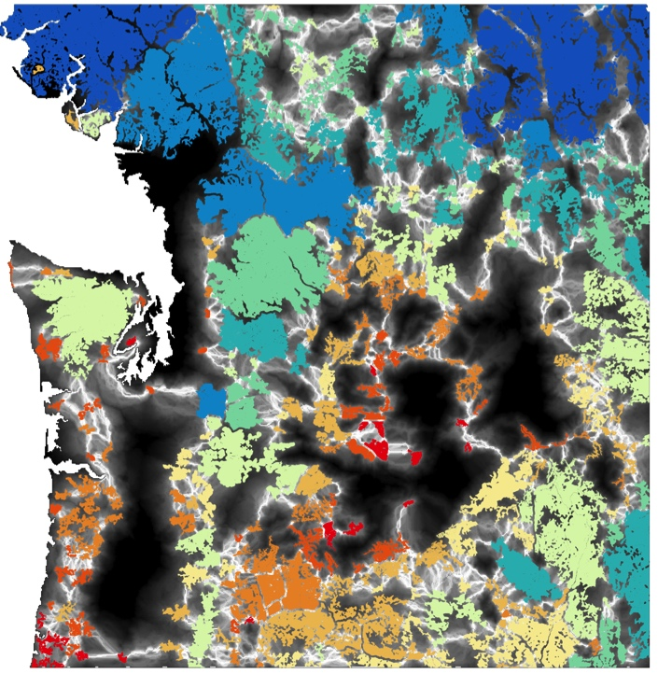
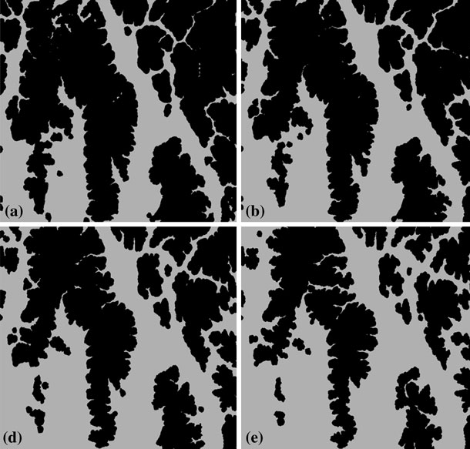
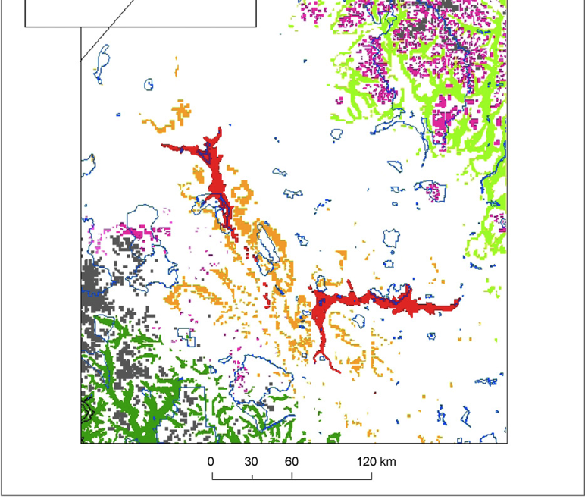
Apply the best available science to promote a resilient, connected transboundary region
Notes:
Goal of the project is to engage science-management partnerships to apply the best available science to inform management activities that affect land and wildlife connectivity in the transboundary region of WA and BC, in order to promote a resilient, connected transboundary region.

Slide 7
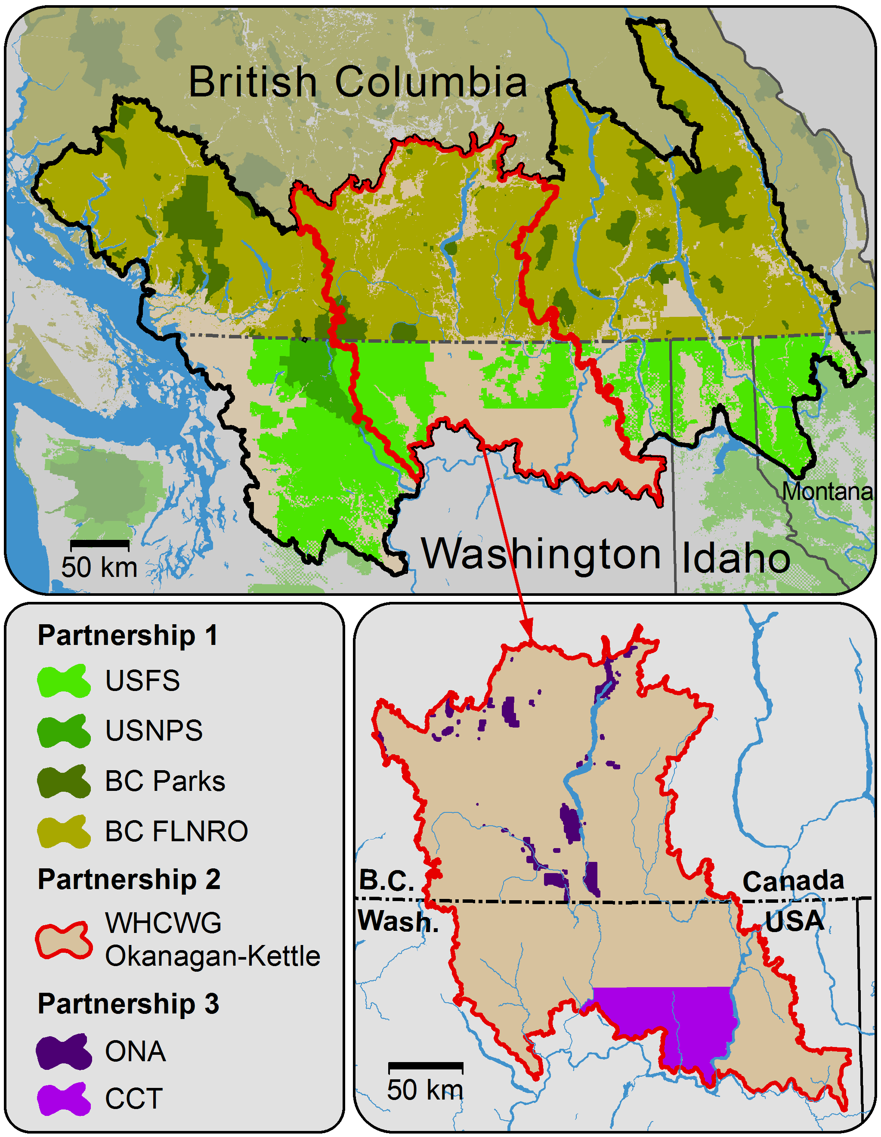
Notes:
Gather, interpret, and apply existing datasets to identify climate impacts to ecological connectivity in the transboundary region
Develop and disseminate management strategies and tactics for conserving climate-connectivity in the transboundary region
Identify information gaps and institutional barriers, and the additional research and policy needed to address them
Increase climate adaptation and connectivity conservation capacity of participant agencies, tribes, and organizations
Increase transboundary and inter-agency/tribe/NGO collaboration
Lay the foundation for a future initiative to identify and establish resilient transboundary wildlife corridors

Slide 8
WORKSHOP I: Identify connectivity management goals, objectives, and activities
ANALYSIS: Identify potential climate impacts to connectivity
WORKSHOP II: Develop adaptation strategies and tactics to address climate impacts
ANALYSIS: Finalize products and tailor to needs of practitioner
PRODUCT DELIVERY:
Maps, data, reports, webinars/trainings
Notes:
In theory, the project would neatly follow this framework.
In practice, we had some serious issues to tackle, organizationally, conceptually, and technically.
Beginning with the fact that it’s extremely difficult to get managers across the border

Slide 9
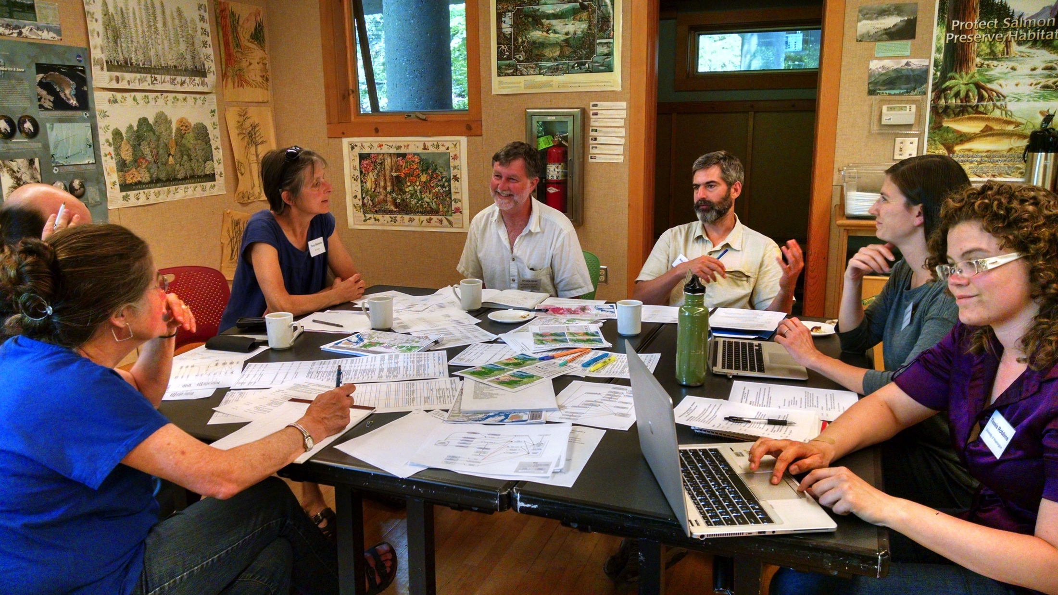

Slide 10
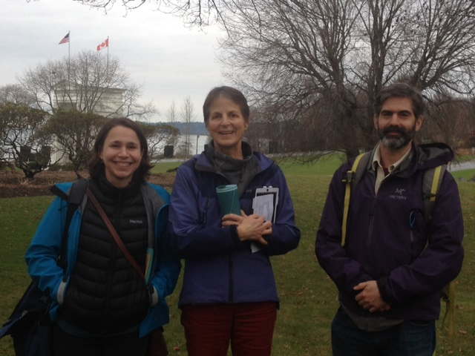
Notes:
Ultimately, we discovered that there was a day use facility in Peace Arch Park along the Inters5ate 5 border crossing b/t WA and BC, and folks from either side of the border could meet there without having to technically cross the border. So we were able to get folks together there.
So, just getting folks in the same room was a major challenge.

Slide 11
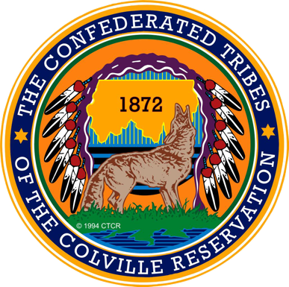
BC
WA
Notes:
But we then had to figure out how to get all of these disparate partners, with their own mandates and priorities and management activities, to identify shared priorities that we could use to focus this work, given our limited capacity and desire to promote transboundary and inter-agency collaboration.

Slide 12
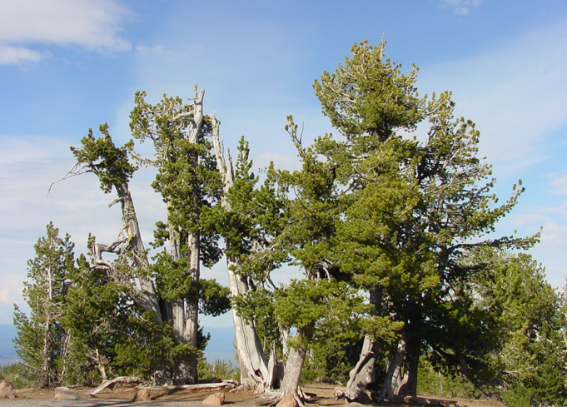
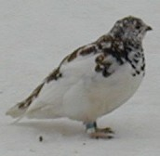
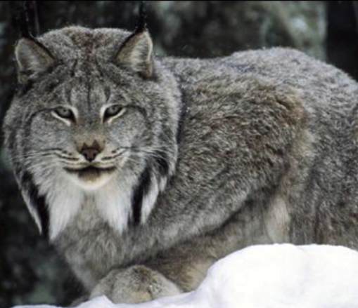
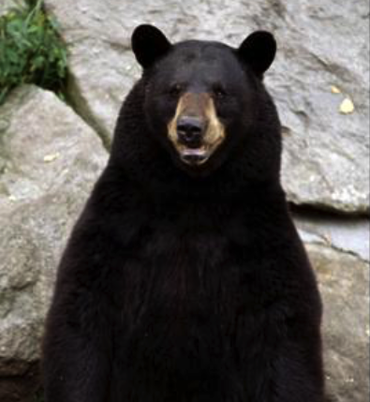
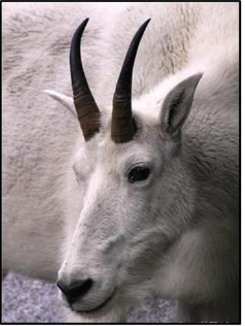
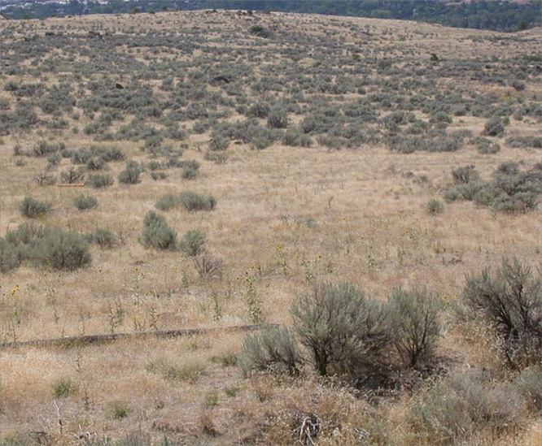
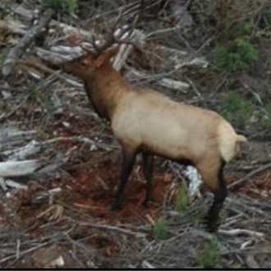
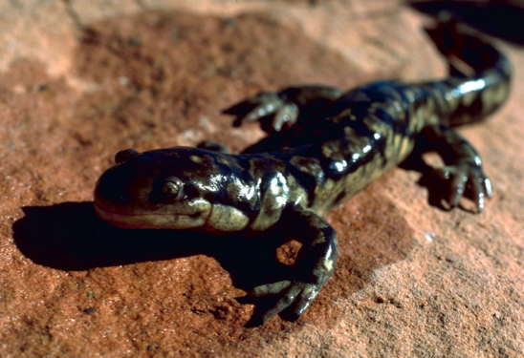
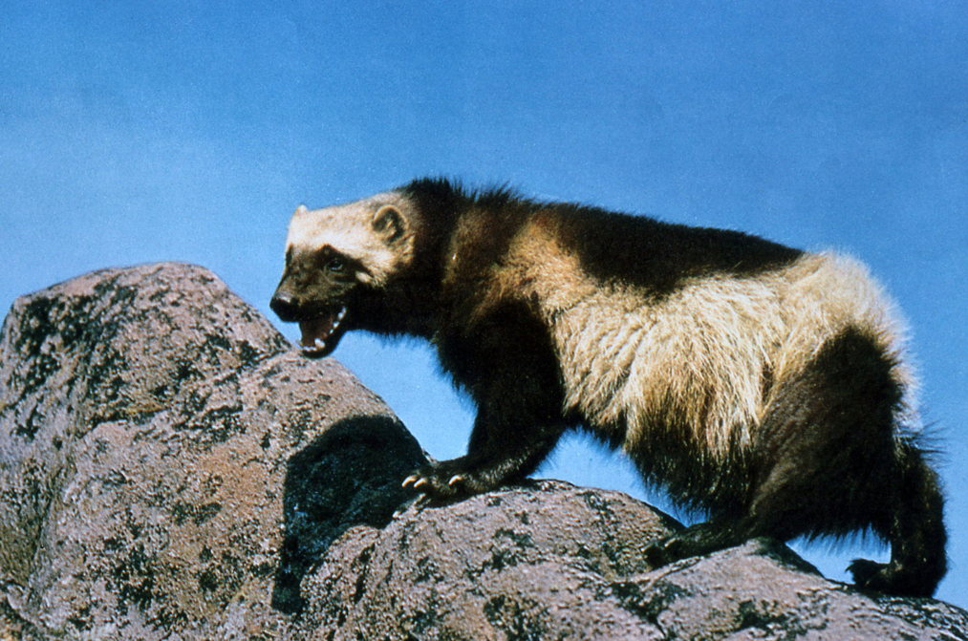
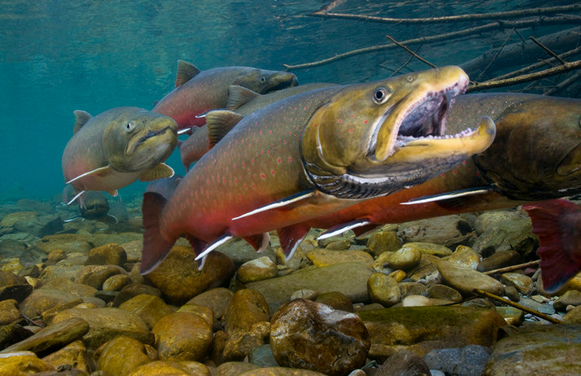
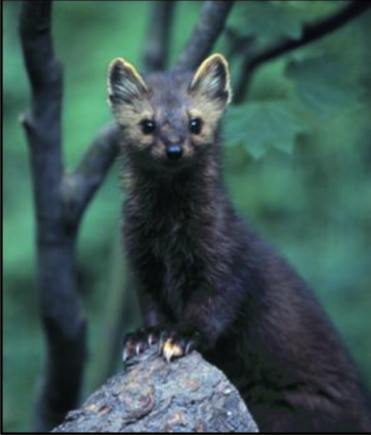
Notes:
Ultimately, focused on case study species and vegetation communities. Note that aren’t focal species (umbrella concept breaks down), but rather were chosen based on their shared priority status among transboundary partners, and their representation of diverse climate and connectivity sensitivities, which would expose managers to a range of climate and connectivity data.
Build a conceptual model of connectivity
What landscape features and processes affect connectivity?
What management activities influence these?
Which of these is influenced by climate?
Identify specific management intervention points and adaptation actions to address impacts
Use spatial climate and connectivity data to identify priority areas for implementing adaptation actions

Slide 13
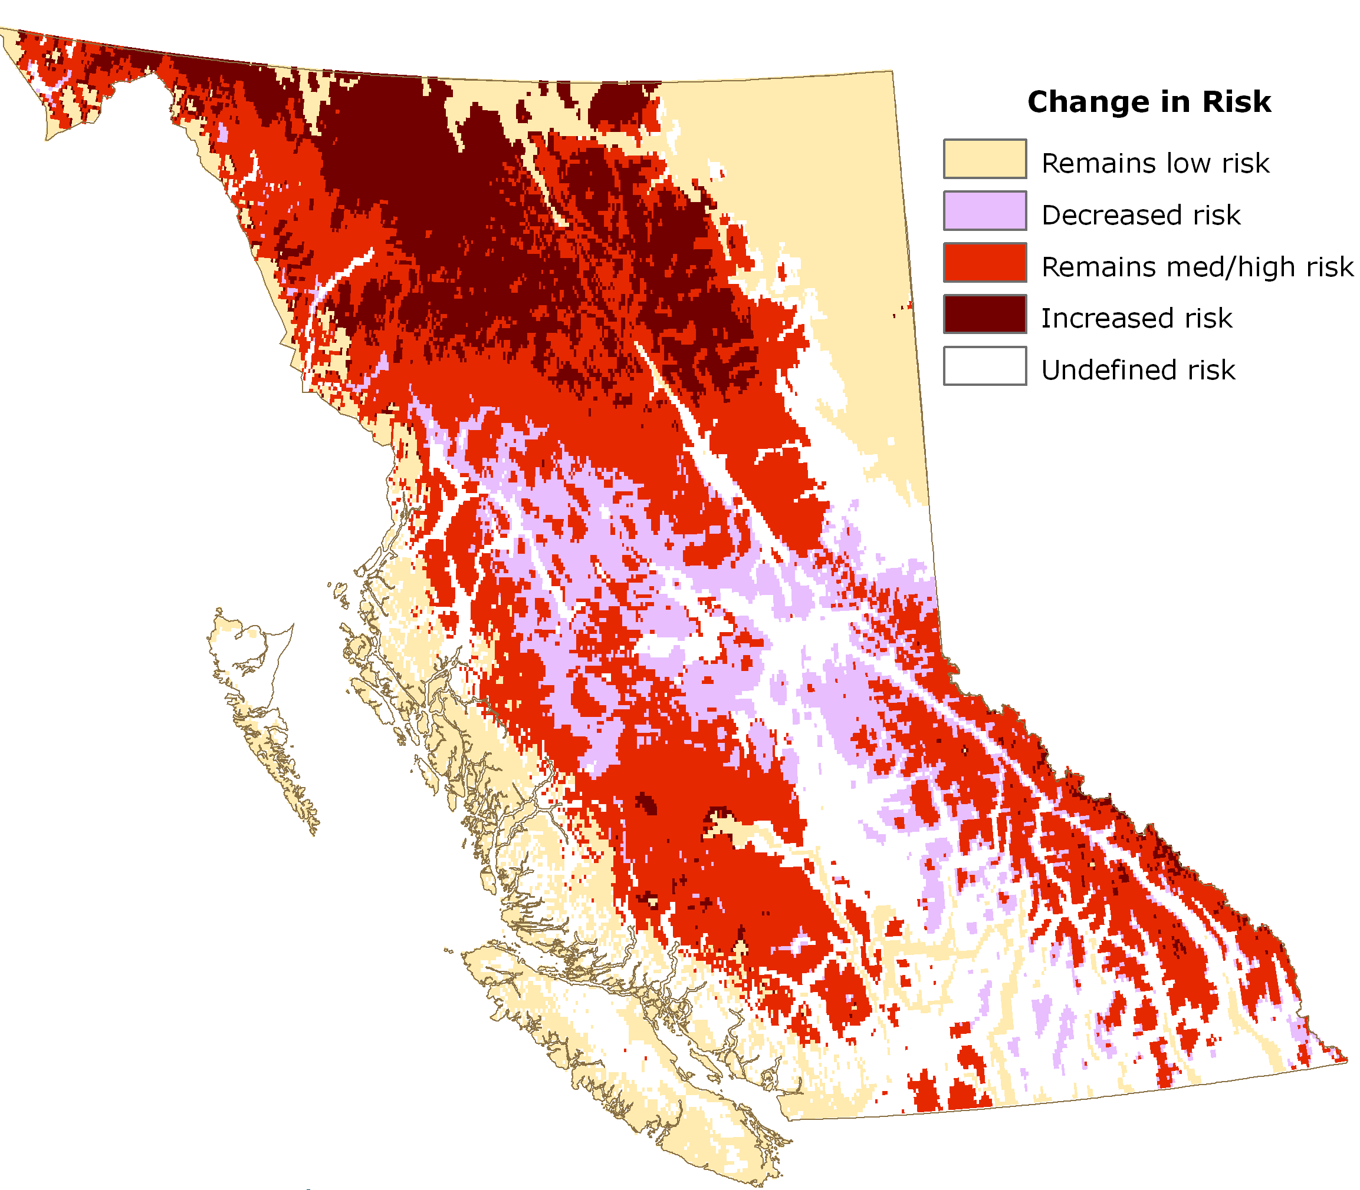
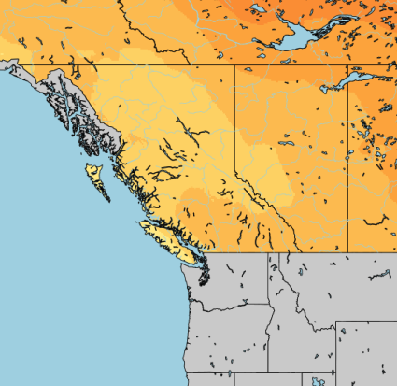
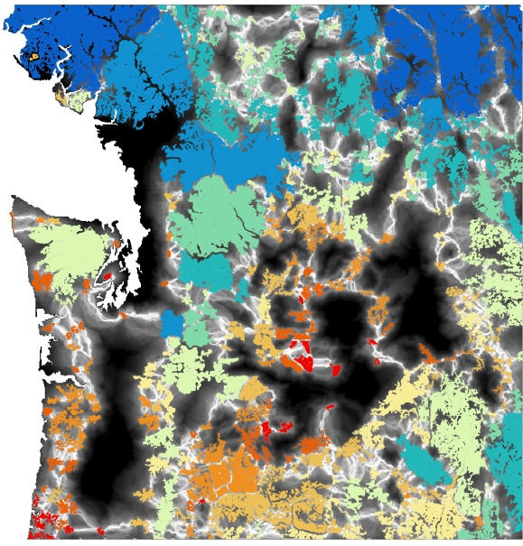
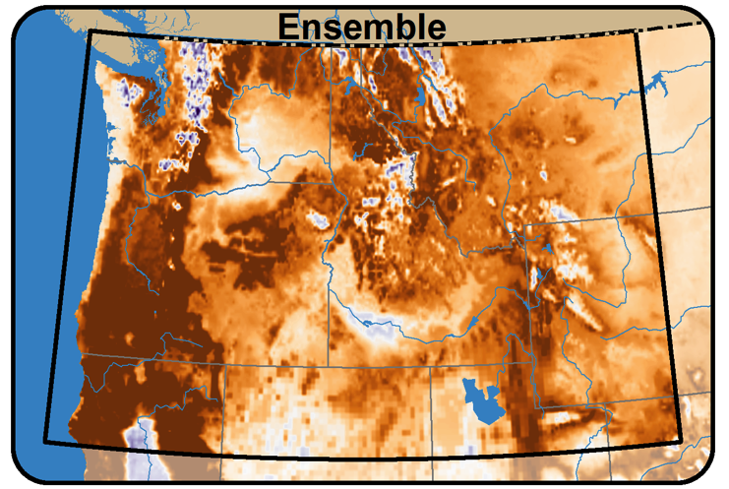
BC
WA
Notes:
We then had to figure out how to take the range of relevant connectivity, climate models, and range shift models, which often wasn’t consistent across the border, and apply them to derive actionable strategies from the very broad goal of integrating climate into connectivity management
Create a conceptual model of connectivity
How will climate affect species movement?
Where can we intervene?
Use climate data to identify key impacts to connectivity
Use connectivity and climate data to identify priority areas for implementation

Slide 14
Category | Adaptation Action | Lewis's Woodpecker | Bull Trout | Mountain Goat | Marten | Tiger Salamander | Wolverine | Ptarmigan | Whitebark Pine | Sagebrush | Total
Assisted Movement | Physically move individuals to refugia/new locations (e.g., trucking fish across barriers to isolated cold water refugia, facilitating spread of sagebrush into new suitable habitat) |  | x |  |  |  |  |  |  | x | 2
Communication/ Education | Educate decision-makers and property owners about the risks of large fires and importance of reducing that risk. | x |  |  | x |  |  |  |  | x | 3
Communication/ Education | Have a clear message of what the models are telling us |  |  |  |  |  |  |  |  | x | 1
Connectivity | Maintain connectivity between currently occupied and projected future stable locations |  |  |  | x |  |  |  |  |  | 1
Connectivity | Maintain connections between the Coast Range and the Cascades |  |  |  |  |  | x |  |  |  | 1
Connectivity | Connectivity modeling needed east and west of the Okanagan |  |  |  |  |  | x |  |  |  | 1
Connectivity | Protect elevational corridors to facilitate expansion up slope |  |  |  |  |  |  |  |  | x | 1
Fire | Fuel management to reduce risk of large fire | x | x |  | x |  |  |  |  | x | 4
Fire | Thin trees before applying fire management | x |  |  |  |  |  |  |  |  | 1
Fire | Burn early and often | x |  |  |  |  |  |  |  | x | 2
Notes:
Winding up with tables of actions to address specific climate impacts to connectivity.
We can then use spatial maps of connectivity priority areas to prioritize areas for adaptation action. As an example

Slide 15
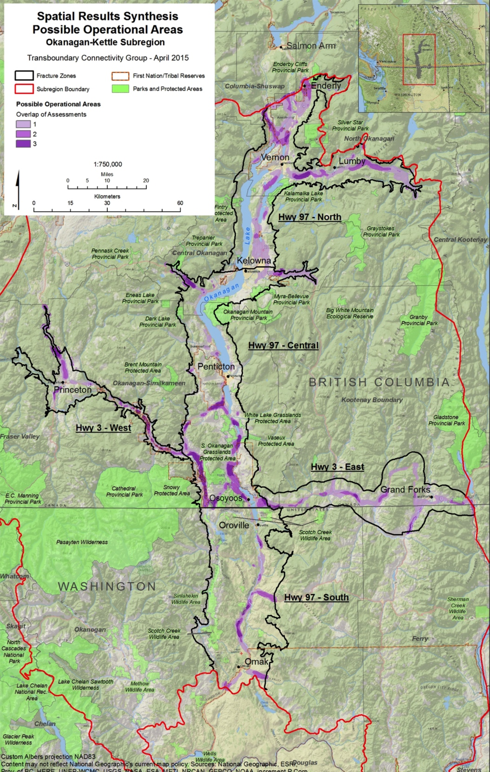
Okanagan-Kettle Analysis
Connectivity conservation priority areas (purple)
Implement adaptation strategies in those areas to maintain key habitat linkages under climate change
Notes:
Here’s a map of spatial connectivity priority areas for the Okanagan…
Purple areas show regions identified as being important linkages for both montane and sage-brush steppe species, yet that were under threat from development because of their location in valley bottoms.

Slide 16
Transboundary climate-connectivity conservation requires cooperation, flexibility, and persistence
Foster collaboration by focusing on shared priorities
Flexibility and persistence is key to maximizing participation
Employ an analysis framework that can accommodate and leverage diverse data sources

Slide 17
Thank you

