Slide 1

Land Use Planning in Oroville:
How is the Community Thinking?
Presenter:
Chris Branch
Community Development Director
City of Oroville
Ph: 1-509-560-3535
E-mail: chrisb.oroville@nvinet.com

Slide 2
PRESENTATION OVERVIEW
BRIEF BACKGROUND OF SHORELINE MANAGEMENT ACT (SMP)
HISTORY OF IMPLEMENTATION OF SMP FOR OKANOGAN COUNTY/LAKE OSOYOOS
CURRENT SITUATION

Slide 3
The SHORELINE MANAGEMENT ACT
In 1971, in response to a citizens’ initiative, the Washington State Legislature passed the Shoreline Management Act (the “SMA” or “Act”). The SMA was adopted by the public in a 1972 referendum. Its purpose is to manage the shorelines of the state in order to protect the public interest in shoreline resources.

Slide 4
Lake Osoyoos includes roughly 30 miles (48 km) of shoreline
30% Okanogan County, U. S. (9.5 miles/15.3km).
Oroville manages less than 5% of the shoreline of located at the south end of the Lake excluding the river portion between the Lake’s outlet and Zosel Dam
Much of the U. S. portion of the shorelines are in the form of permanent and seasonal residential uses with recreation as the primary driver.

Slide 5
OKANOGAN COUNTY SHORELINE MASTER PROGRAM 1976
COUNTY DIDN’T ACT – DEPT OF ECOLOGY VERSION ADOPTED AND IN EFFECT TODAY
COUNTY DECLINED TO ACT ON UPDATE IN 1990 PARTLY DRIVEN BY UNPOPULAR VEGETATION RETENTION/MANAGEMENT STANDARDS APPLICABLE TO LAKE OSOYOOS
`

Slide 6
OROVILLE SHORELINE MASTER PROGRAM - 1990
UNDER OKANOGAN COUNTY VERSION UNTIL1990 WHEN MOST CITIES AND TOWNS DEVELOPED AND ADOPTED UPDATES
OROVILLE ANNEXED PROPERY ON SIMILKAMEEN AND UPDATED PLAN
1995 WITH 50’ SETBACK ON SIMILKAMEEN NORTH OF DIKE-ADDED VEGETATION RETENTION/MANAGEMENT ON
STATE DEPT OF ECOLOGY “EARLY ADOPTER PROGRAM”
2006 COUNTWIDE REGIONAL PLAN DEVELOPMENT
INCLUDED SUBSTANTIAL PUBLIC PARTICIPATION

Slide 7
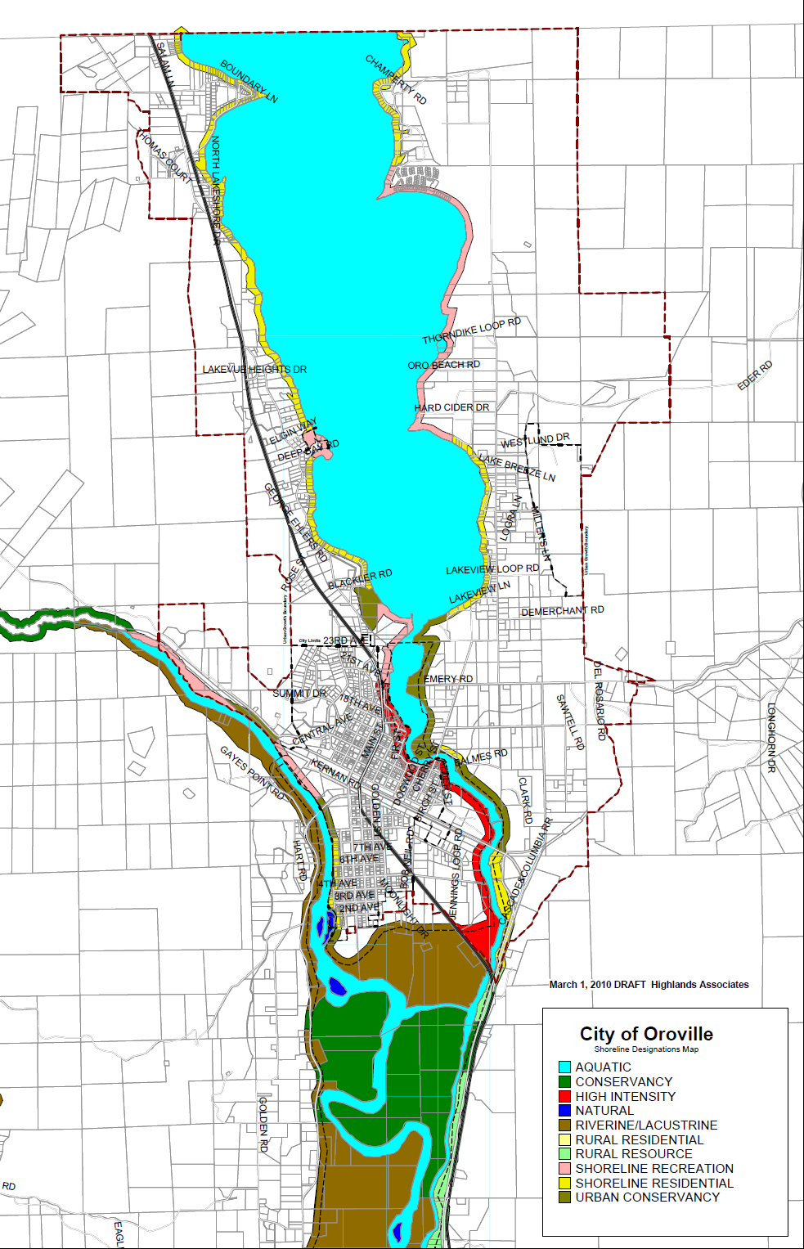
SHORELINE MASTER PROGRAMS - UPDATE
STATEWIDE GOAL - NO NET LOSS OF ECOLOGICAL FUNCTION AND VALUE
DRAFT SHORELINE MASTER PROGRAM SUBJECT TO CUMULATIVE IMPACT ANALYSIS
PREDESIGNATION FOR SHORELINES WHEN ANNEXED (UPDATE TO OROVILLE PLAN WOULD NOT BE REQUIRED)

Slide 8
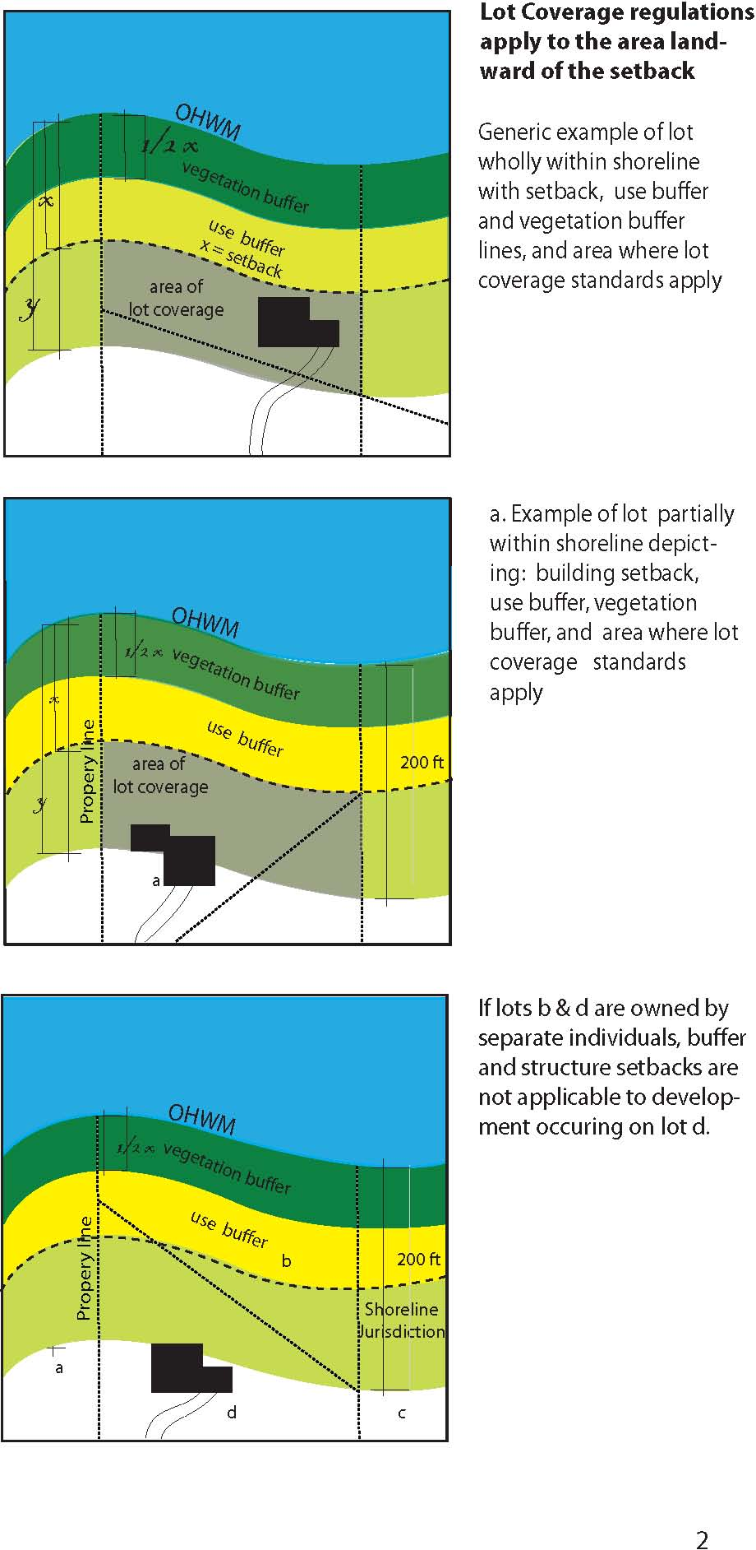
PROPOSED SETBACK

Slide 9
OCTOBER, 2015
OROVILLE WILL LIKELY ADOPT THIS YEAR WITH 50’ SETBACKS FOR SHORELINE RESIDENTIAL WITH 50% VEGETATION BUFFER (I.E., 25’ VEGETATION RETENTION/MANAGEMENT)
COUNTY APPEARS TO HOLD TO OLD 25’ SETBACK
NOT CLEAR WHETHER COUNTY WILL NEED A REVISED CUMULATIVE IMPACT ANALYSIS

Slide 10
Multiple Permitting Agencies
  U.S. Army Corp of Engineers
  Federal Clean Water Act
  Washington Department of Ecology
  Shoreline Management Act
  Washington Dept of Fish and Wildlife
  Washington Hydraulic Approval
  Washington Dept of Natural Resources
  Aquatic Lands Lease
  Okanogan County or
  City of Oroville Depending on location
  Shoreline Management Act

Slide 11
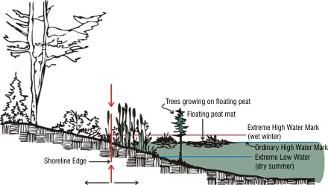
ORDINARY HIGH WATER

Slide 12
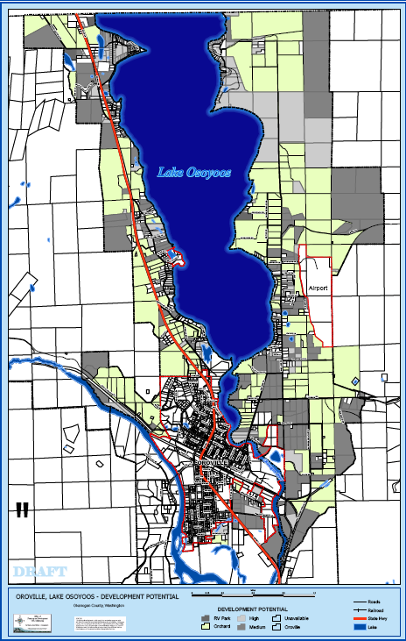

Slide 14
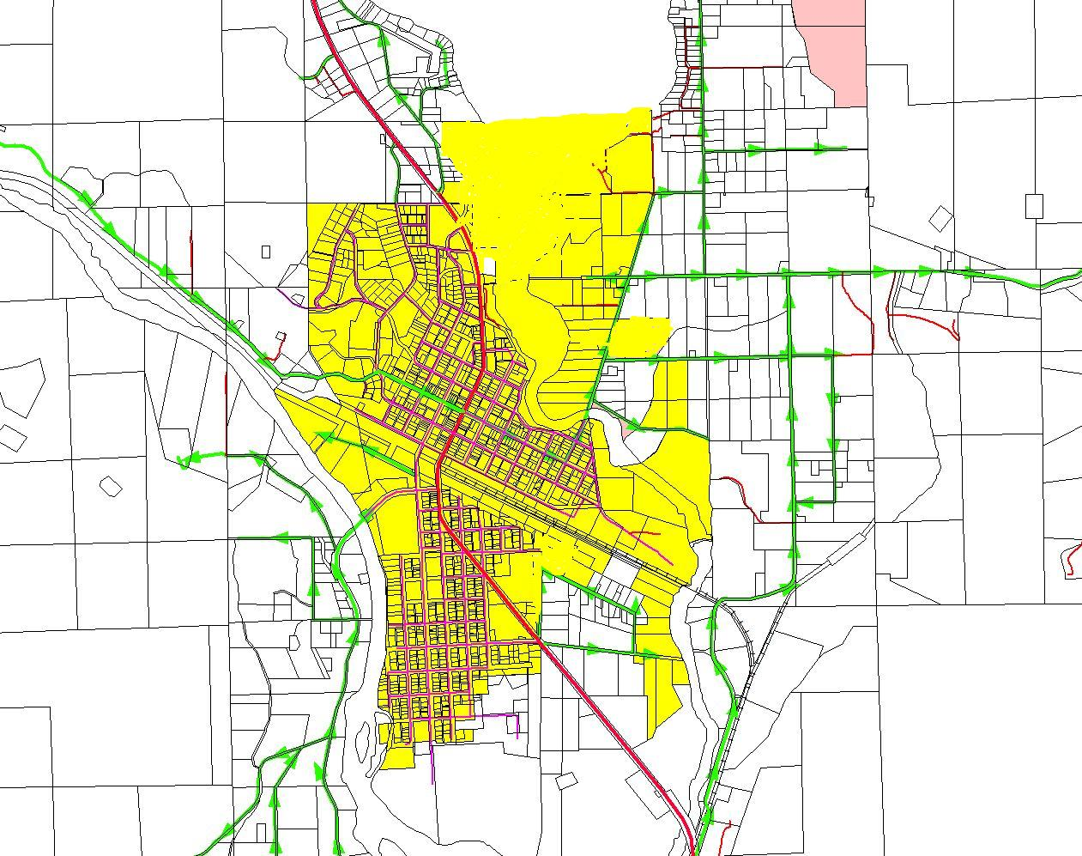
Oroville Incorporated Boundary 2011

Slide 15
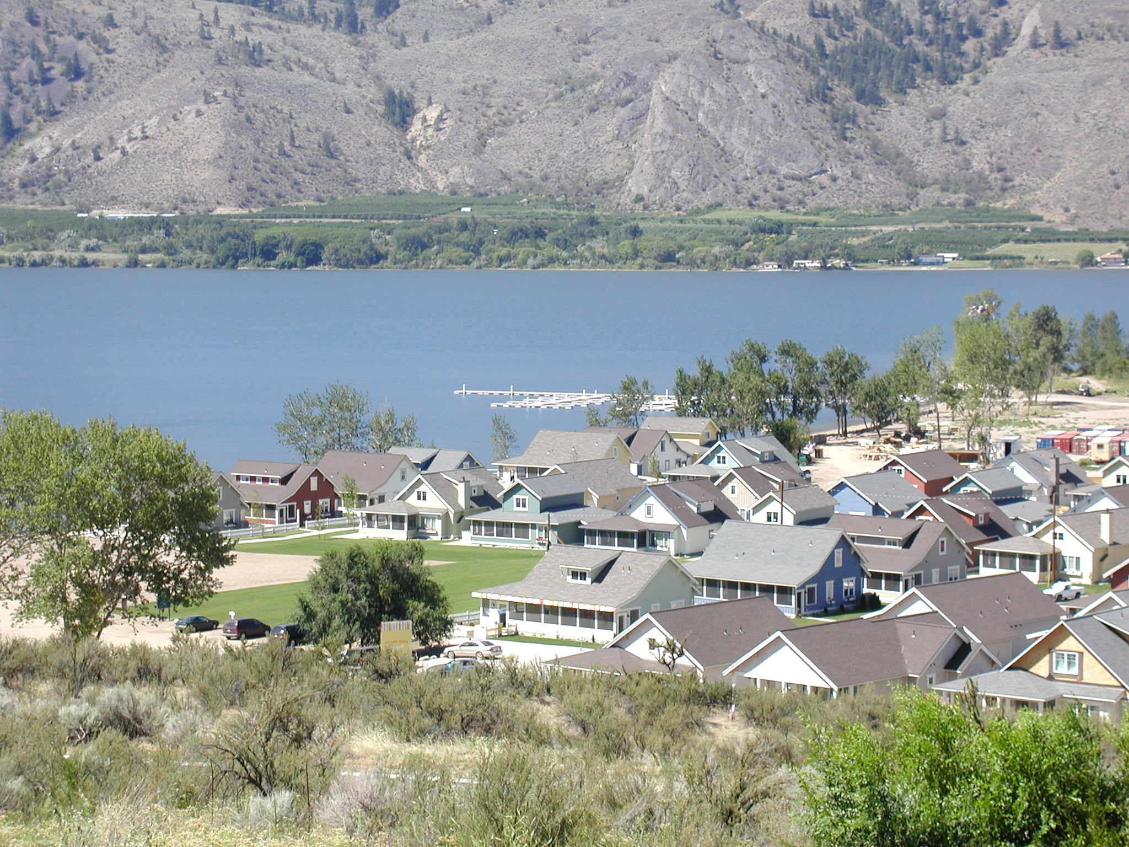
Veranda Beach

Slide 16
VERANDA BEACH
CLUSTER DEVELOPMENT ALONG SHORELINE
PROVIDED MOTIVATION FOR SANITARY SEWER
FINANCING BASED ON DEVELOPMENT PROGRESS NOT A PRETTY SCENERIO

Slide 17
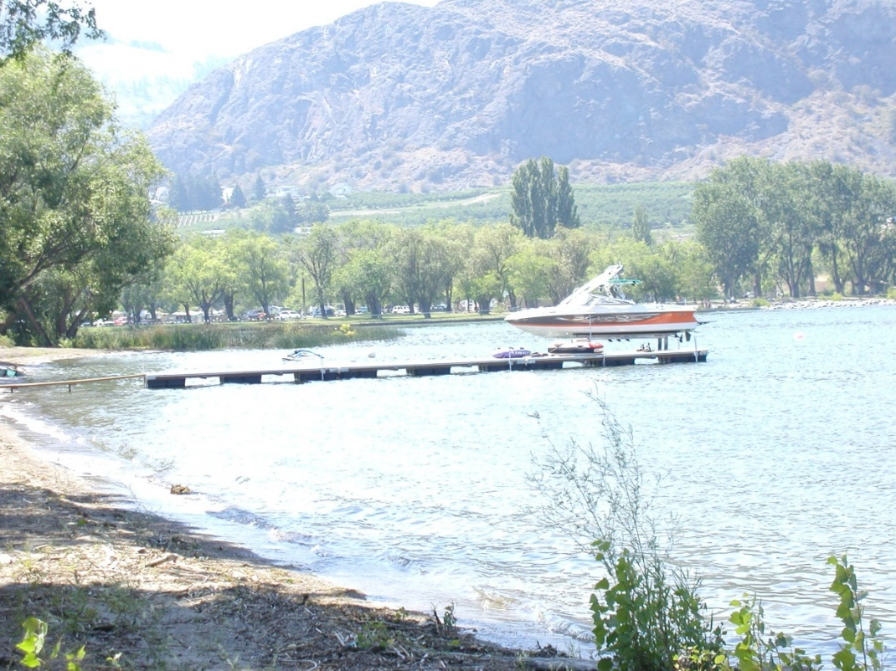
Sandalia – Annexed territory under Okanogan County Shoreline Master Program -1976
30 units
25 ft from shoreline
Close monitoring
Dock – Conditional Use Permit size shape etc due to Recreational User conflict (i.e., water skiing vs dock development)
Wetland mitigation
Public Trail Designation
Mitigation largely negotiated.

Slide 18
Sonora Shores
Phased redevopment of old mobile home/RV Park
Trail negotiated for shoreline access
Stormwater Swale
50’ Shoreline Setback – ownership factors increases setback and includes trail

Slide 19
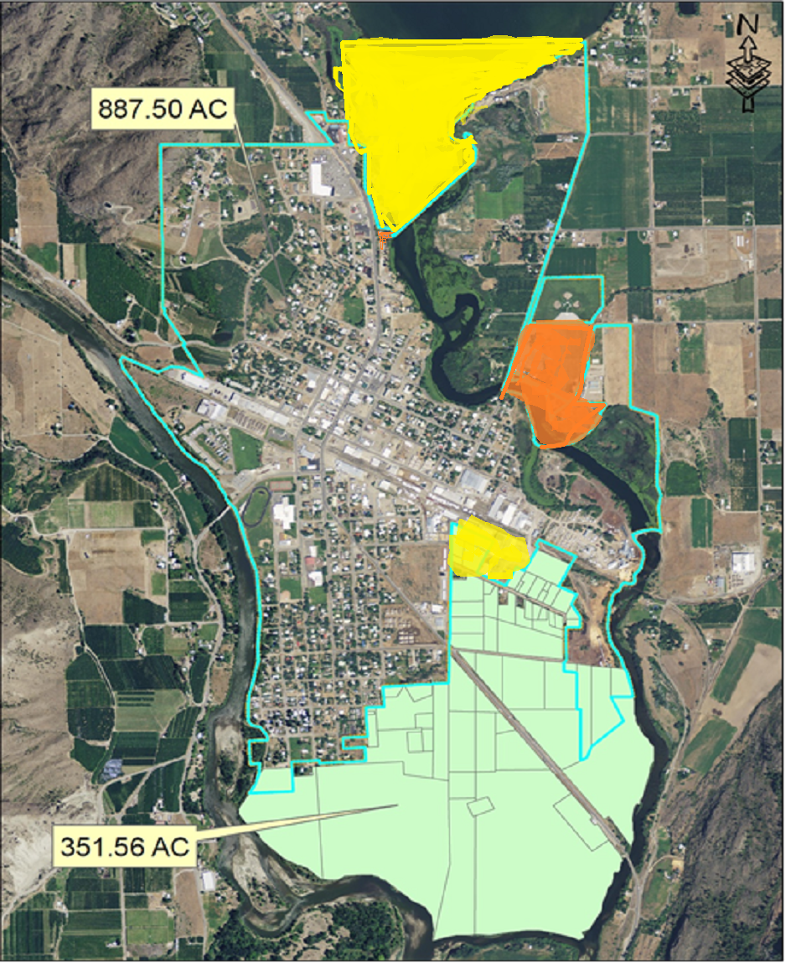
SHORELINE MASTER PROGRAM REGULATIONS -EXISTING
Oroville Currently Implements Two Shoreline Master Programs –Shoreline Master Programs
  Pre-annexation – Oroville 1995 Program
    50’ (Meter) Setback from Ordinary High Water Mark
    50’ limited vegetation removal standards on Similkameen
    25’ limited vegetation removal standards on Okanogan
    No Lake shoreline at time of update
  Post-annexation – Okanogan County 1976 Program
    25’ Setback
    No vegetation removal standards

Slide 20
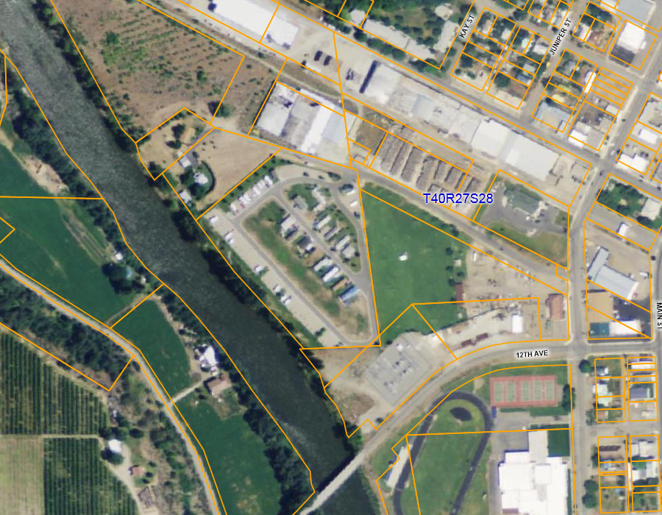
River Oaks Mobile Home and RV Park – 1998 Development
Similkameen River Frontage
Oroville Shoreline Master Program 1997 Update
50’ setback - Vegetation removal limited to selective pruning for shoreline access and view.
Natural vegetative swale at shoreline for stormwater protection

Slide 21
Recognize the meaning of Cumulative impacts
NEED DELIBERATE LEADERSHIP
DECIDE OUR COMMON MANAGEMENT OBJECTIVES AND COMMUNICATE
Consider the risk in non-reversible decision-making and use conservative approach (i.e., do more not less)
Explore what is REALLY we are REALLY trying to achieve and what is sustainable.

