Slide 1
Washington State Drought Response
Osoyoos Lake Water Science Forum
October 09 2015

Slide 2
Notes:
Washington State has experienced above normal temperatures over the past year. This September was the first month since February 2014 that Seattle experienced below normal average temperatures. That’s a streak of 18 months.

Slide 3
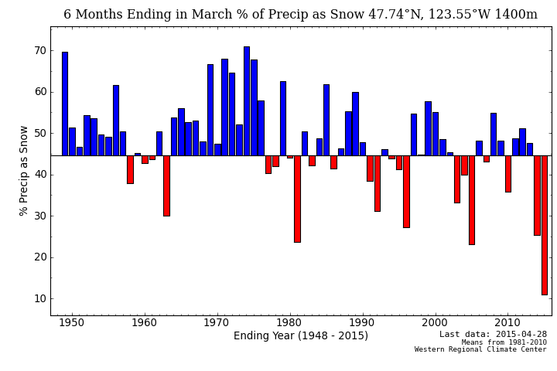
Greatest Percentage of Precipitation falling as Rain instead of Snow in the last 65 years (Olympic Mountains, elev 1400 m)

Slide 4
Washington State’s Drought Trigger
Hardship
Drought
Less than 75 Percent of Normal Water Supply
RCW 43.83B.400
Notes:
Slide 2: Two parts to designating a drought—insufficient water supply plus hardship. The makes these decisions thought two committees, one devoted to evaluating and forecasting water supply, which is composed primary of federal and state agencies with water supply forecasting expertise – and another committee, which is charged with evaluating the economic, environmental and public health aspects of the water supply deficit and determining whether those impacts rise to the level of hardship.

Slide 5
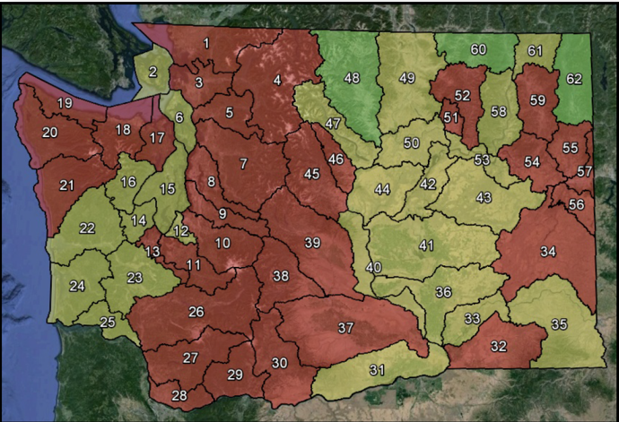
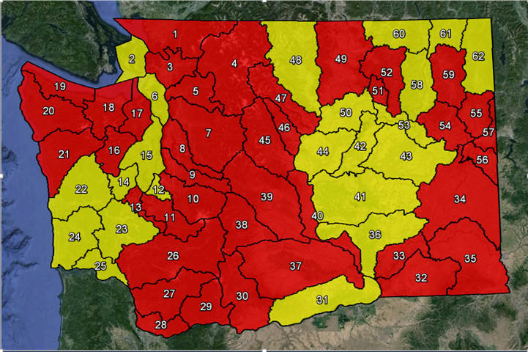
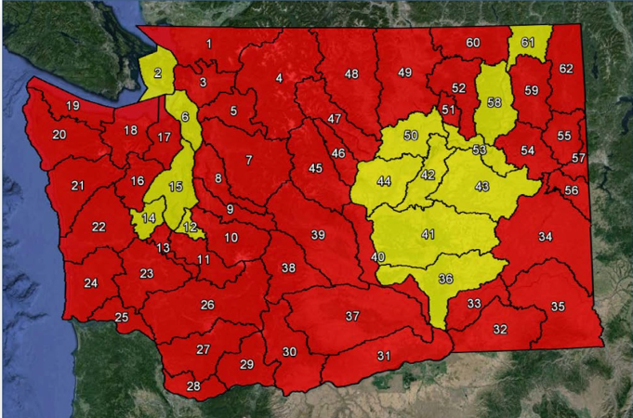
March
April
Watersheds Expected to be Below 75 Percent of Normal Water Supply
May
Notes:
Last Spring the state water supply availability committee evaluated water supply forecasts for all 62 watersheds in the state. In early March, we were looking at a year where precipitation has been largely normal. At first it appeared that snowpack dependent watersheds would have below normal runoff. But as the spring continued, we started experiencing a deficit of precipitation as well, which affected the forecasted volume of runoff.
Our initial declaration in March was followed by a secondary declaration in April, which expanded the number of watersheds to be in drought status.
By May, 48 of 62 watersheds, or 85 percent of the state’s land area, was projected to have less than 75 percent of normal water supply. At that point, the State decided to make the state drought declaration statewide.

Slide 6
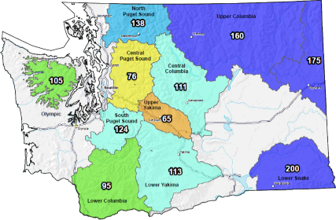
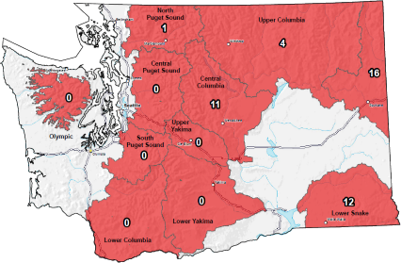
Snowpack, Percent of Normal
June 4, 2014
June 4, 2015
Notes:
Through spring explaining our “snowpack drought.”
Our rainfall over the winter was normal or above normal -- but we never had significant snowpack. 2015 warmest year on record for the state with June far exceeding typical average temperatures.
From early June this year compared to the first of June last year – Zero percentile snowpack in most river basins this year compared to nearly 100% of normal or more than 100% of normal snowpack in river basins in June 2014.
Normally, significant accumulations of snowpack would be contributing to flows

Slide 7
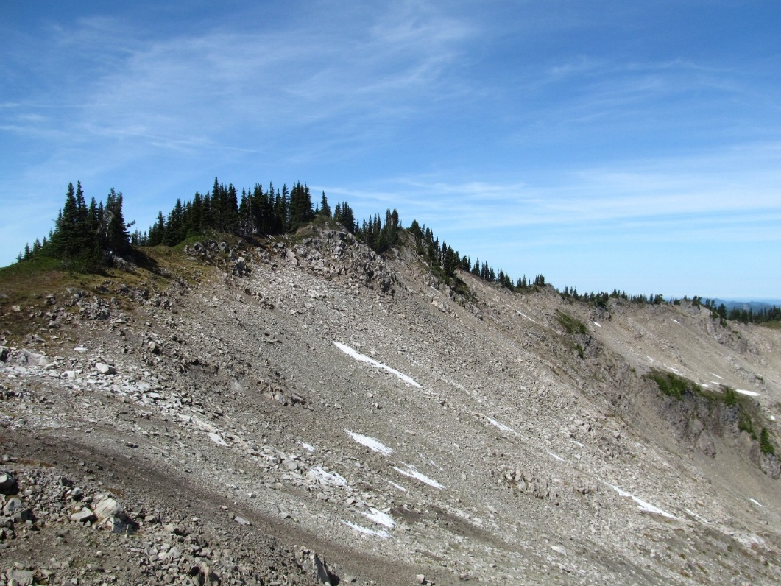
Bogachiel Peak, Olympic Mountains
June 5, 2014
Photos by David Carmody
June 6, 2015
Notes:
Here is an interesting picture contrasting the snow pack at Bogachiel Peak in the Olympic Mountains. Note that these pictures taken essentially one year apart. Obviously, 2014 had a better snowpack. When I look at these pictures, I try to visualize that snowpack as representing a frozen lake that spreads over hundreds and thousands of square miles across the upper watersheds all over the Pacific Northwest. As the froken lake melts, it becomes streamflow. This year, in 2015, that lake was essentially gone by early June.

Slide 8
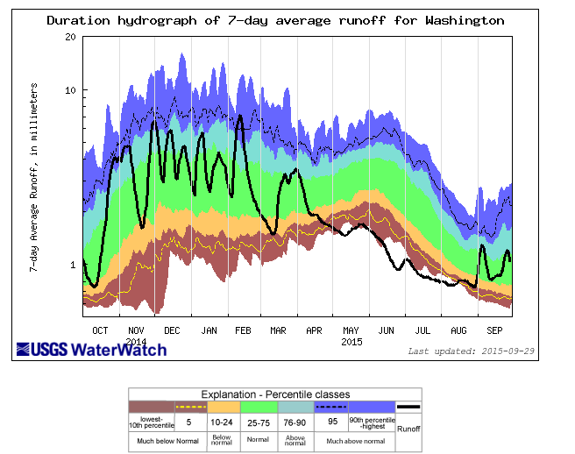
Notes:
Low snowpack and low precipitation manifested itself in very low streamflows. This is duration hydrograph for runoff in Washington State for the 2015 water year. There are several things I want you to notice here. Our fall and winter flows were normal to above normal. This is reflective of normal rainfall not being captured as snow. Also note that normally, our snowmelt peaks in the month of June. This year, we essentially saw no snowmelt peak in June. Generally speaking runoff rapidly declined starting late March and continued declining until mid-August, when we experienced some significant rainfall events in Western Washington. Finally, notice how extremely low our flows were for much of the spring and summer. For many weeks, this years flows were literally off the charts.

Slide 9
April
May
June
July
September
August
Notes:
Here’s another way of visualizing flow conditions, this time as broken down by basins. Note that in April, the Upper Columbia Basin was doing very well, normal to above normal. But by July it was transformed to much below. This suggests that the snow came off really fast this year. For the rest of the state, May through August saw conditons at record low and much below normal. This is reflective of little to no snowpack. We started seeing some improvement in August and September, thanks to precipitation.

Slide 10
Ecology Drought Response
Leasing of Water Rights in Yakima and Dungeness Basins to boost stream flows
Funding Emergency Fish Passage and Hatchery Projects
Authorization of Emergency Wells in Yakima Basin
Curtailment Orders issued for almost 900 water rights statewide to protect senior water rights
Approving Emergency Water Right Transfers (e.g., Skagit Basin, Yakima Basin)
Emergency Drought Funding to local entities and Tribes

Slide 11
Reports of fish stranding in some rivers
High water temperatures, some hatcheries letting fish go early, diseased and dead sockeye and sturgeon in the Columbia R.
Widespread fishing closures

Slide 12
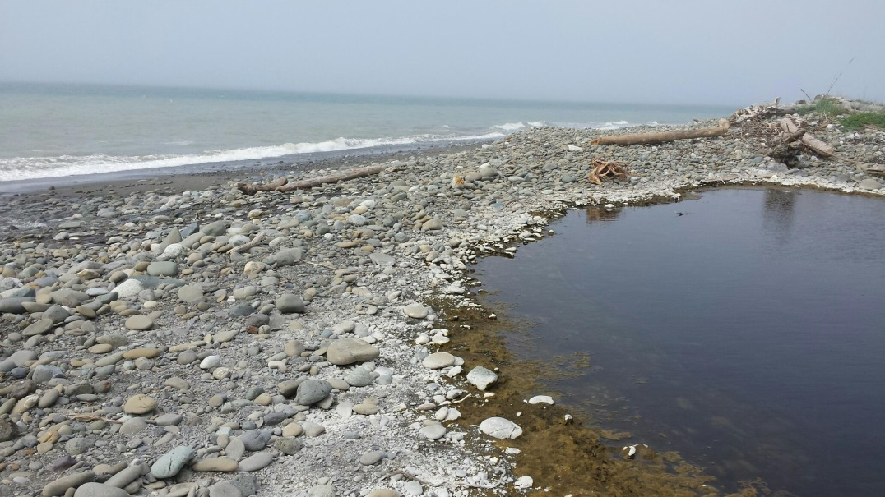
Siebert Creek May 27, 2015 Clallam County, Washington Salmon migration blocked

Slide 14
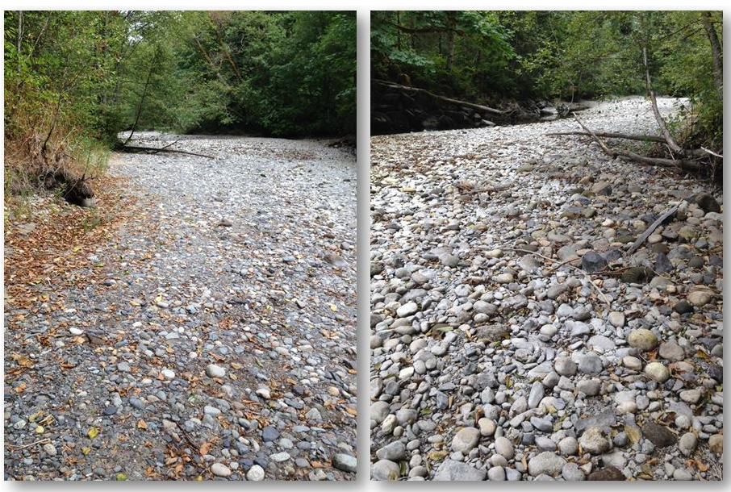
Squire Creek, Stillaguamish Basin, August 2015
Notes:
Here we have a couple pictures of Squire Creek, which is tributary to the Stillaguamish River in the Snohomish Basin north of Seattle. Obviously, this is an extreme example of low streamflow. In fact, there is no streamflow whatsoever. It is these kinds of scenes that truly trouble me -- small tributaries, with no upstream storage. What is the remedy for such streams in a drought year?

Slide 15
Drought Impacts for Agriculture
Progressively reduced allocations in the Yakima Basin
Reports of crop losses and crop stress, lower fruit quality and berry size, estimated at more than $1 Billion
Curtailment in some watersheds to protect senior water rights
Notes:
Washington State has 1.8 million acres of irrigated agriculture. Seventy-five percent of those areas are supplied by surface water, and thus agriculture is especially vulnerable in years of drought to a reduction in water supply.
We’re still trying to figure our the extent of agricultural losses. Not all farmers suffered this year. If they had water, they were fine, though even some of those farmers had to manage heat stress. But if they did not have water, perhaps because of junior water right status, then their allocation may have been reduced or cut off entirely.

Slide 16
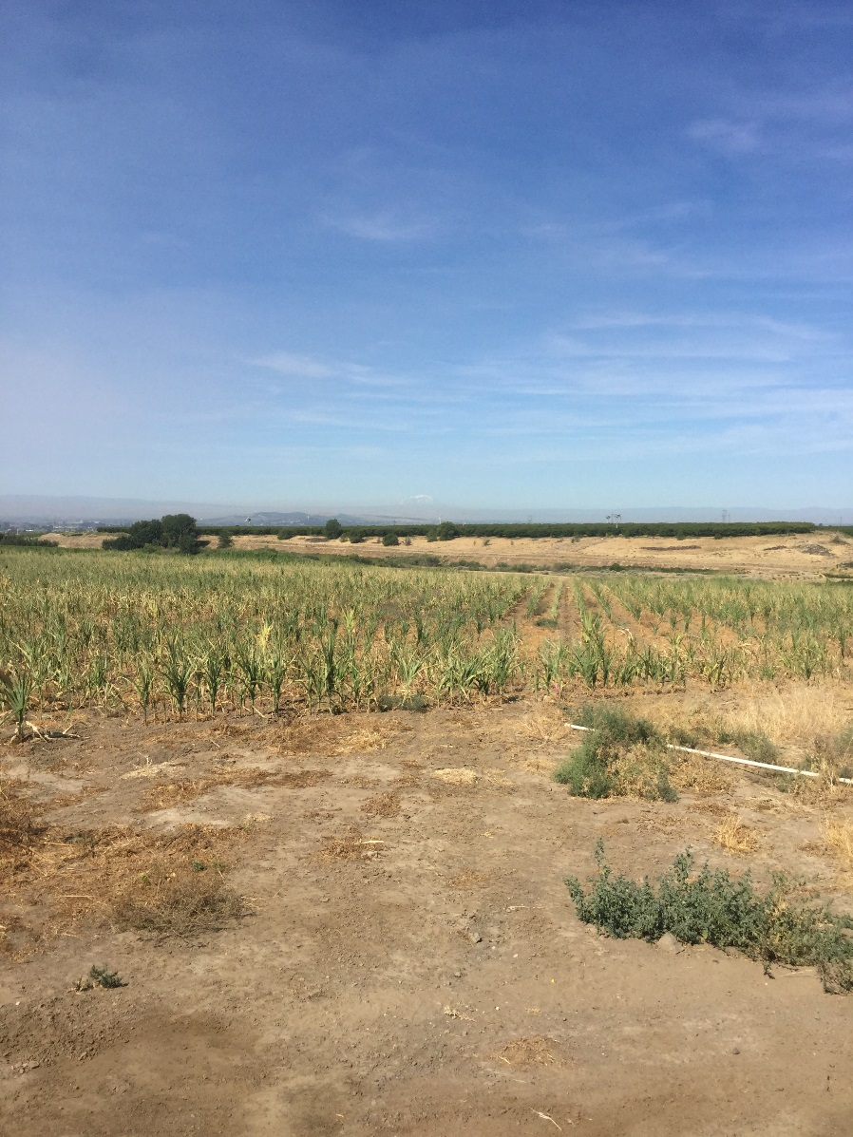
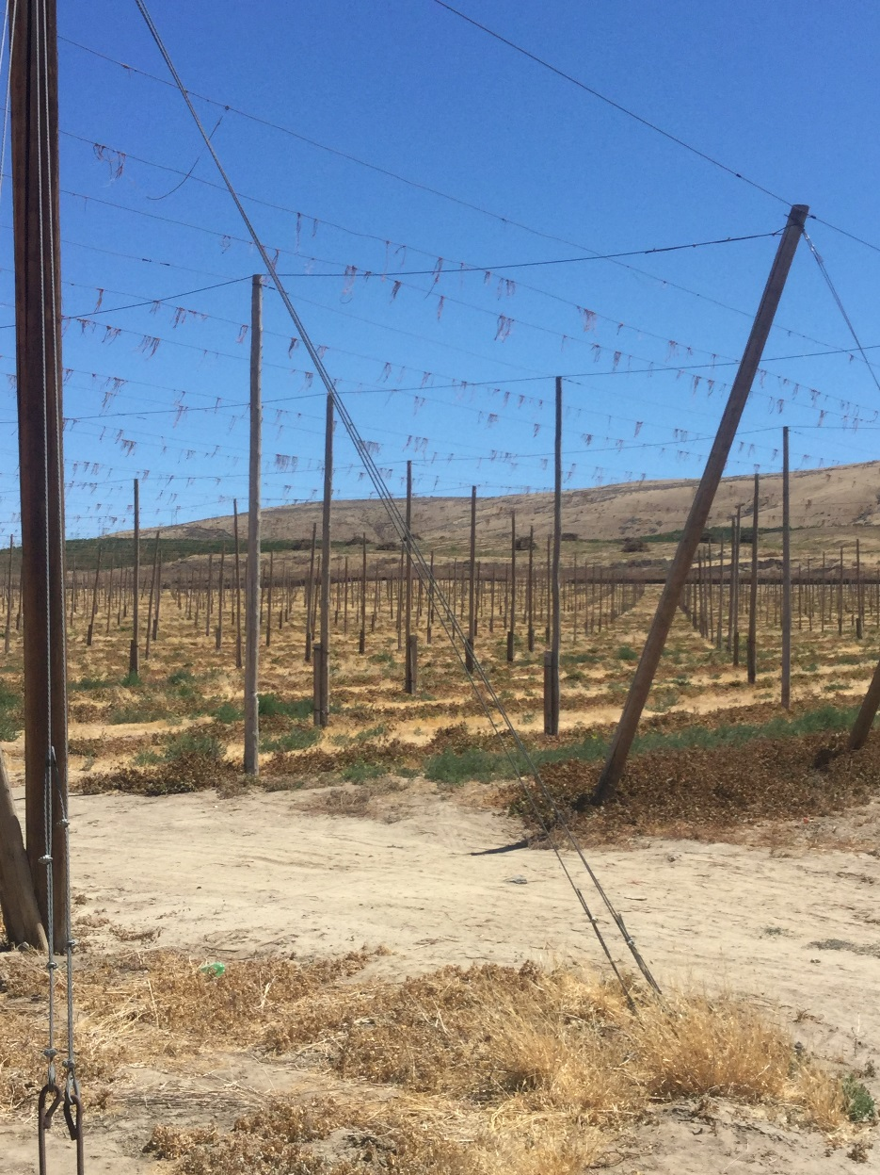
Yakima Valley Corn -- August 2015
Yakima Valley Hops -- August 2015 →
Notes:
Here we have a picture of two rather stressed-looking fields from the Roza District in the Yakima Basin, one showing corn and one showing hops. There are two things I want you to think about. One of these crops is annual, the other perennial. Presumably, the farmer who planted corn will, assuming next year is a better year, recover quickly. But the hop grower is going to take longer to recover. He or she might need a few years to get up in production. So you can see that some growers are more vulnerable than others to the interruption of water supply. The other thing you should notice is that off in the distance, you can see green trees that, at least from this distance, don’t appear to have failed. Why did they succeed? Senior water rights?

Slide 17
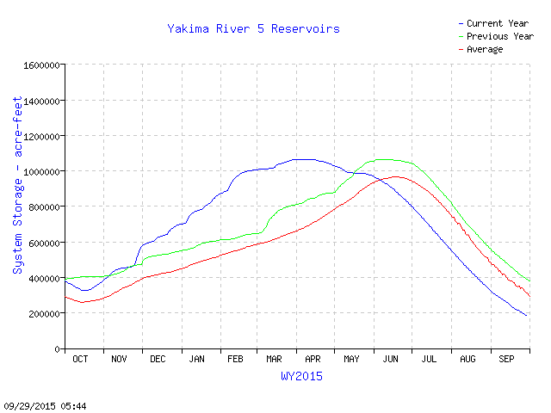
Notes:
The Yakima Project, consisting of five reservoirs, supplies the Yakima Valley with irrigation water. Here are three years showing total system storage for the last year, the previous year and the average year. This year, the Bureau filled up the reservoirs much earlier than average. They did that by capturing rain rather than waiting for snowmelt. But you’ll notice that this year’s success was somewhat short lived. By April 15, when the reservoirs are still refilling in normal years, the Bureau was already on storage control. That is, inflows to the project were less than downstream obligations, so the reservoirs were being drawn down. Normally drawdown doesn’t being until mid-June.
At the end of the water year, the reservoirs were at about 150,000 acre feet, or about 200,000 acre feet less than last year. The reduced volume of carry over is a concern, in light of forecasts for a warmer, drier winter.

Slide 18
Water systems have been impacted
Forks, Port Townsend and Port Angeles implementing watering restrictions
Reports of individual well users with wells running dry sporadically around state
Wells ran dry for Startup, Moxee and Riverside (north of Spokane)
Large Westside municipalities at Stage 2 Conservation

Slide 19
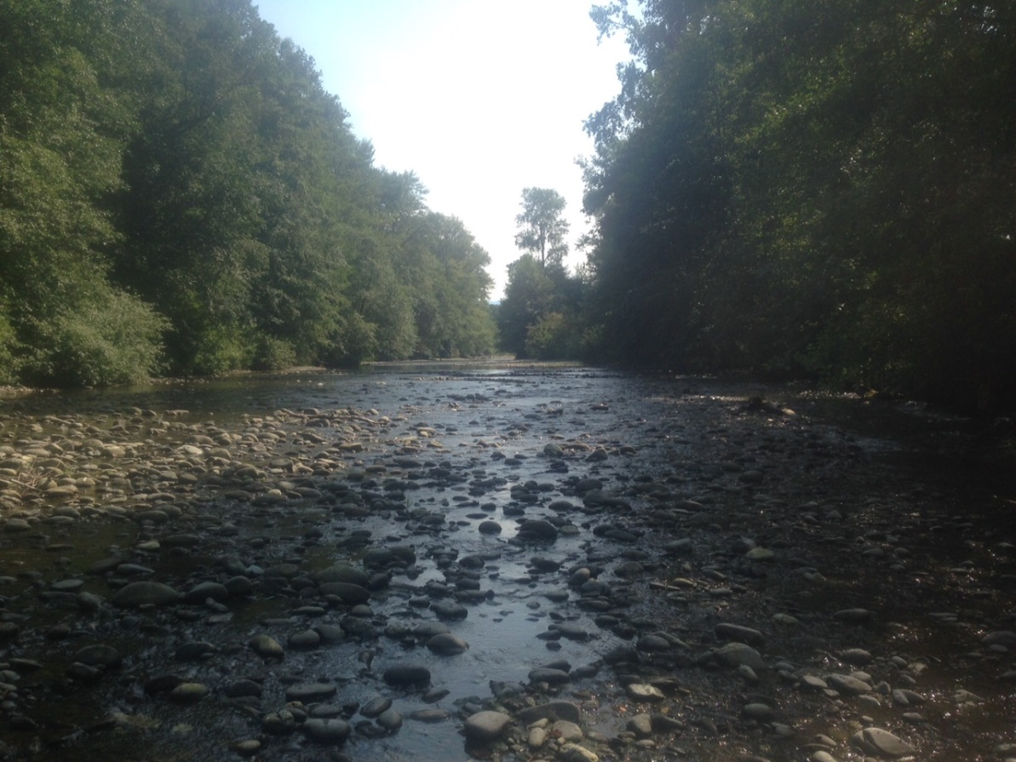
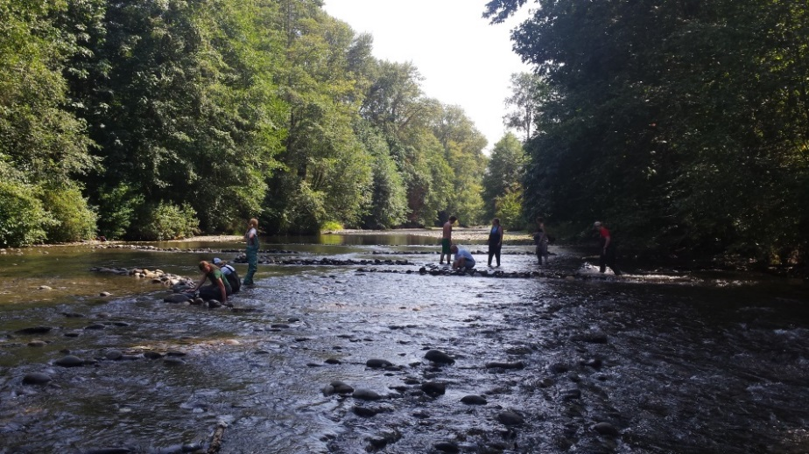
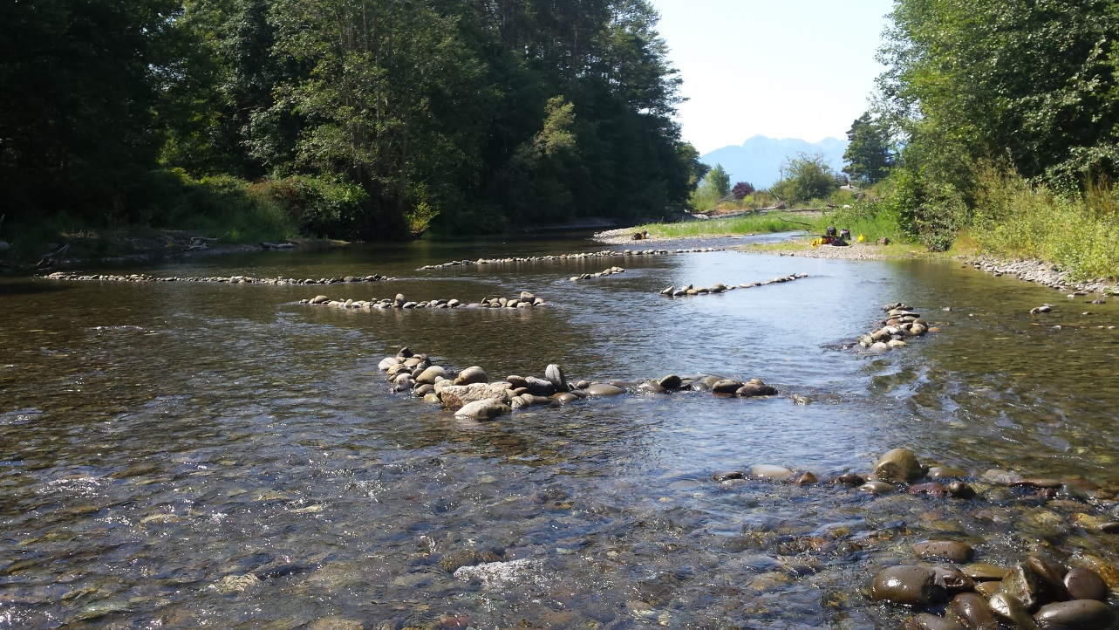
Low Flow Remediation Dungeness River August 11-12, 2015
Flows downstream from Woodcock Road before the project were too shallow for fish to swim.
Upper right: Crew builds rock structures to concentrate flow downstream from the Woodcock Road bridge
Lower right: Flows are concentrated in the stream from upper left to lower right and are deep enough for fish migration

Slide 20
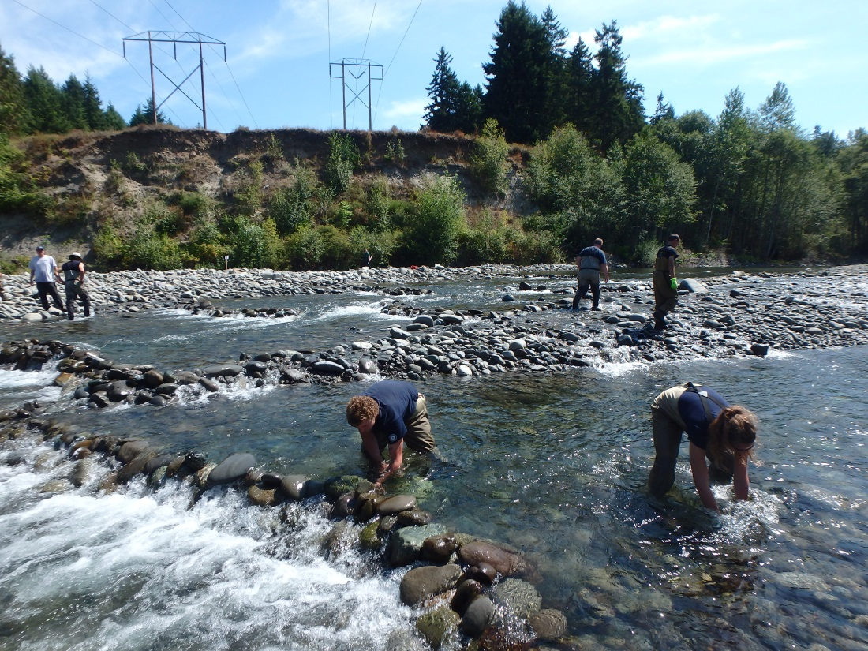
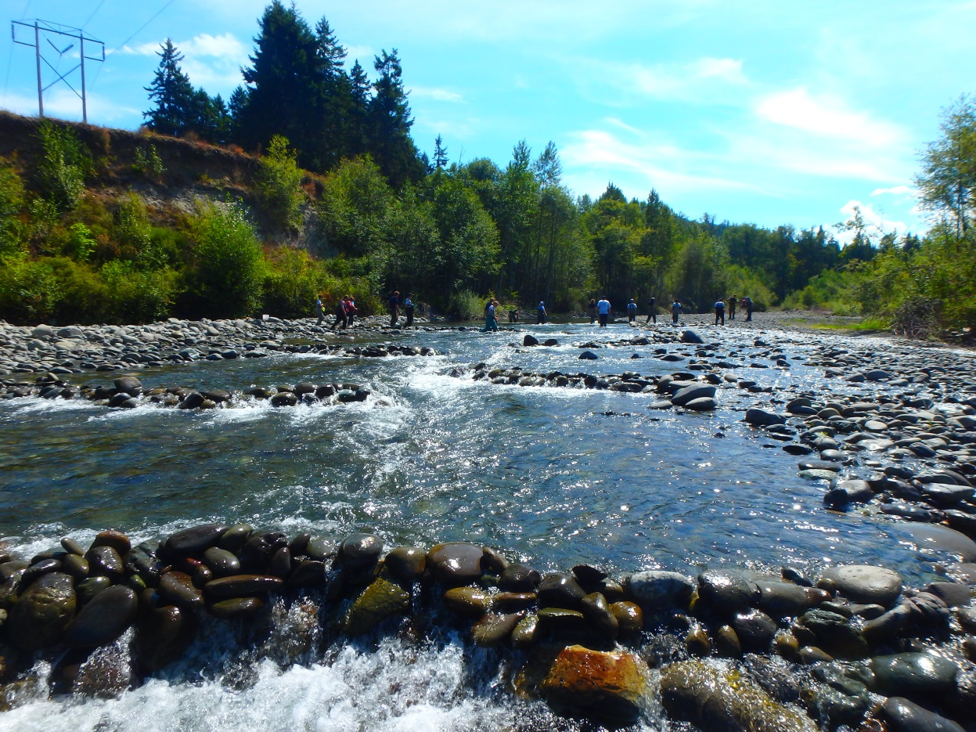
Low Flow Remediation Dungeness River August 11-12, 2015
Left: Crew builds rock structures to concentrate flow at the powerlines site
Right: Flow is concentrated down the center channel with riffles deep enough for fish to pass and resting pools between
Many thanks to staff of WDFW, Jamestown s’Klallam Tribe, & Ecology’s Washington Conservation Corps

Slide 21
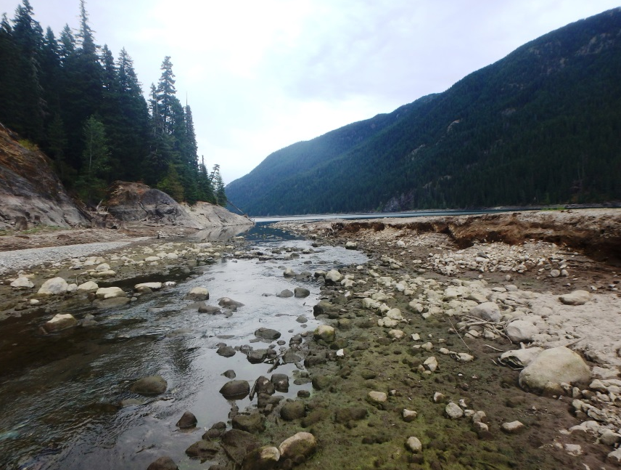
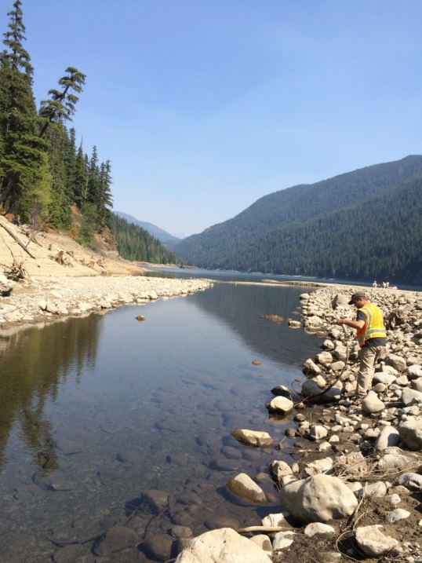
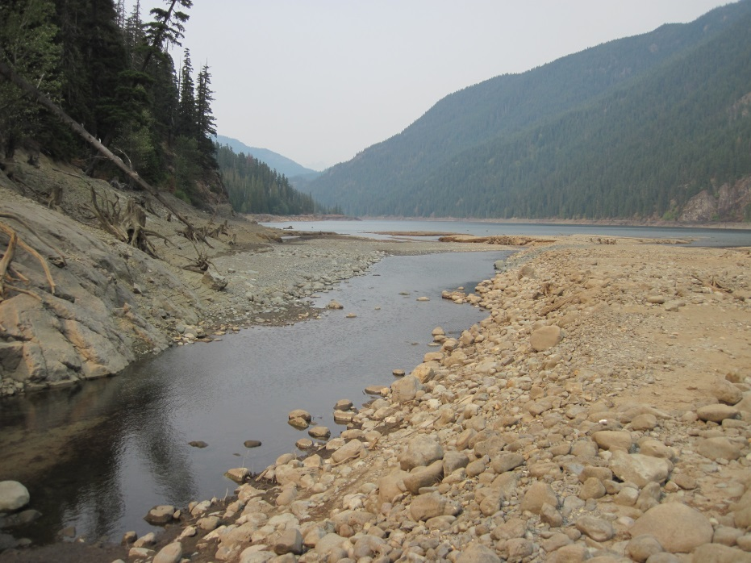
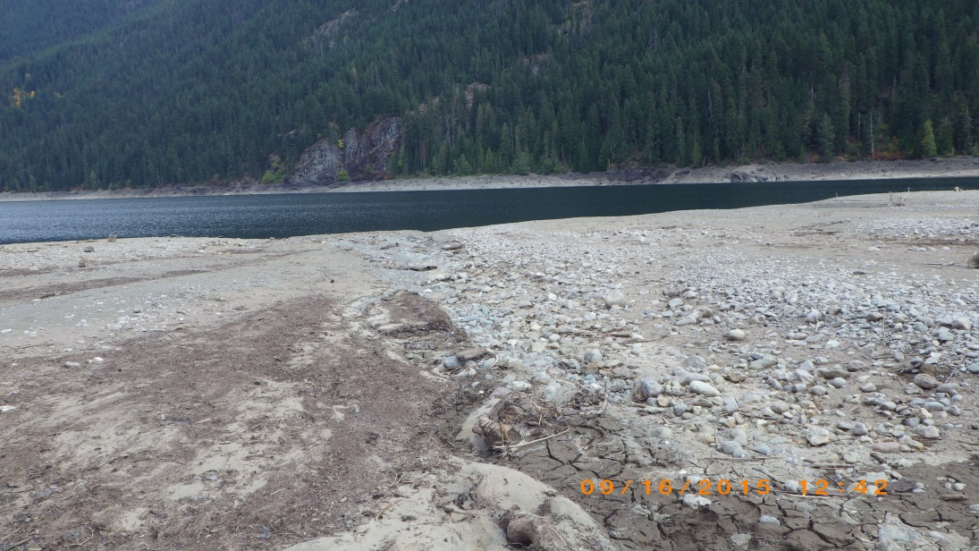
Box Canyon Creek Mouth at Lake Kachess Summer 2015
August 3
August 19
August 26
September 16

Slide 22
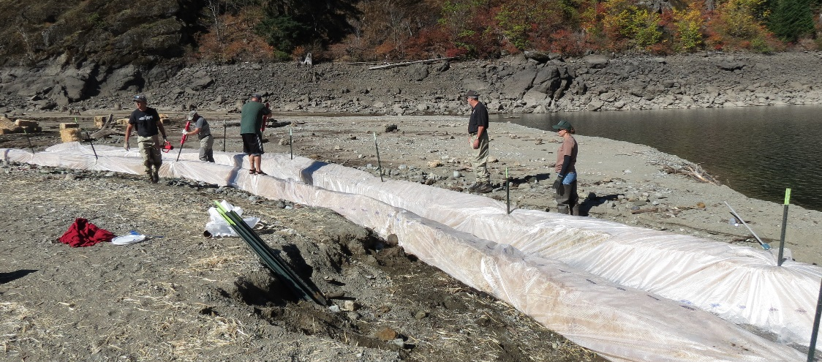
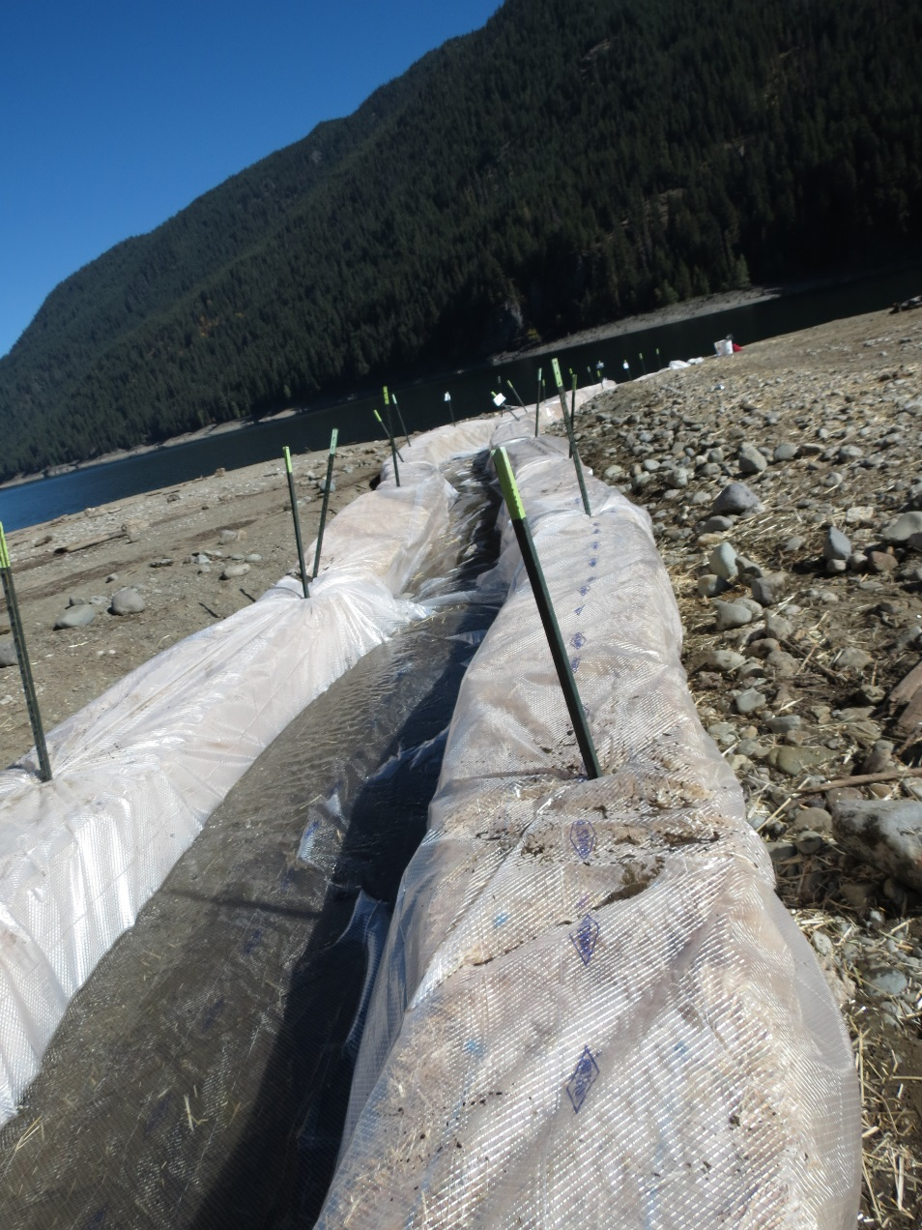
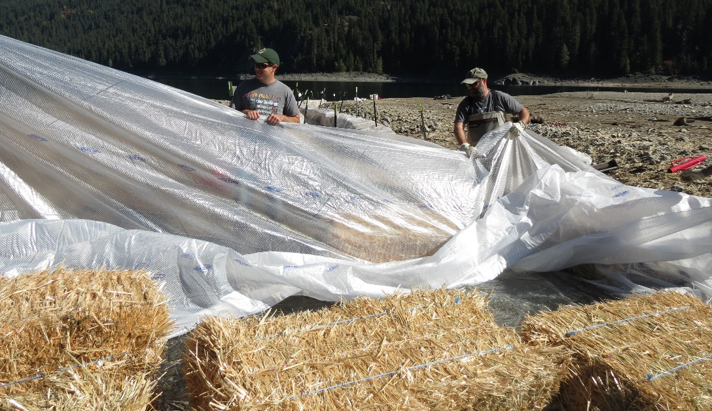

Slide 23
What do we expect for next year?
El Niño tips the odds toward warmer, drier conditions in the Pacific Northwest
Another below-normal snowpack year, but not as bad as last year
Seattle and Yakima Basin storage are much below normal

Slide 24
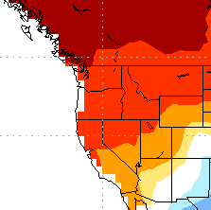
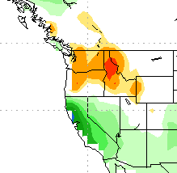
Model Average Projections for Winter (Dec-Feb)
Relative to 1981-2010 Normal
Temperature (deg C) Precipitation (mm/day)
Notes:
From a temperature anomaly perspective, the latest set of predictions from the NMME are indicating air temperatures on the order of 2°C (3.6°F) greater than normal during January through March 2016. By comparison, in 2015 average temperatures were 2.6°C (4.8°F) above normal (1982-­‐2010) for the same months.
Forecasting precipitation is more fraught with peril. And the climate experts tell us there is much less certainty regarding precipitation forecasts – during El Niño or any other year.
However, I would like you to note, in particular, the greatest precipitation deficit is forecasted for the northern Rockies where originate the Columbia and Snake Rivers. This suggests this area in particular could suffer from below normal snowpack.

Slide 25
What are we doing to prepare for next year
Update Drought Response Plan
Lease water sooner
Promoting conservation more actively
Evaluation of Impacts (Agriculture, Groundwater, Fisheries)
Monitor snowpack and climate

Slide 26
Questions? For More Information:
Jeff Marti
Department of Ecology – Water Resources Program
(360) 407-6627
Jeff.marti@ecy.wa.gov

Slide 27
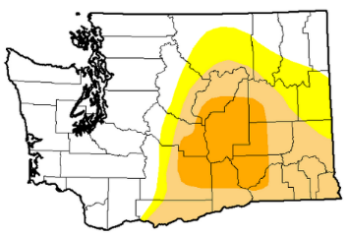
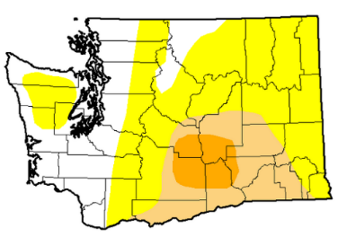
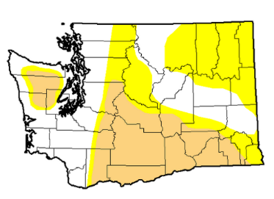
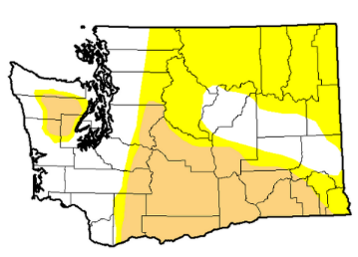
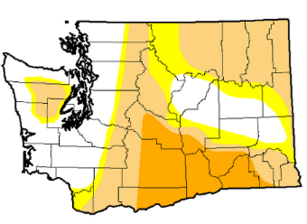
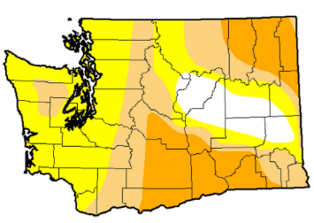
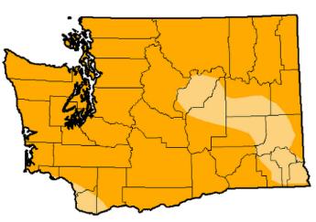
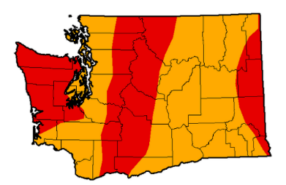
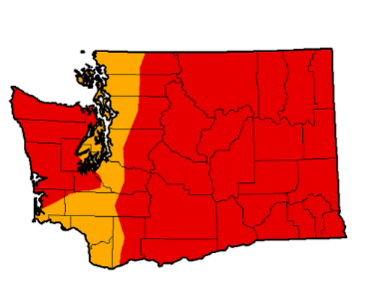
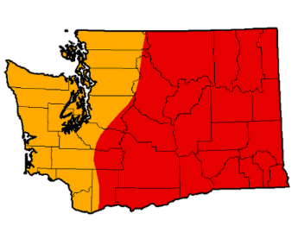
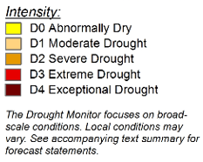
Drought Monitor 2015
January 6
February 3
March 3
April 7
May 5
June 2
July 7
August 11
August 25
September 8 thru 28
Notes:
What you see here are snapshots of Washington State’s drought conditions, as depicted in the federal Drought Monitor. Dark orange is Severe Drought and Dark Red is Extreme Drought. The steady deterioration reflects the growing precipitation deficit over time and reports of low streamflow impacts. At its late August peak, about 86 percent of Washington was in a state of Extreme Drought this summer, the worst drought condition since the Drought Monitor came into existence in 2000. Presently, all 39 of Washington State’s counties qualify for federal drought disaster assistance.

Slide 28
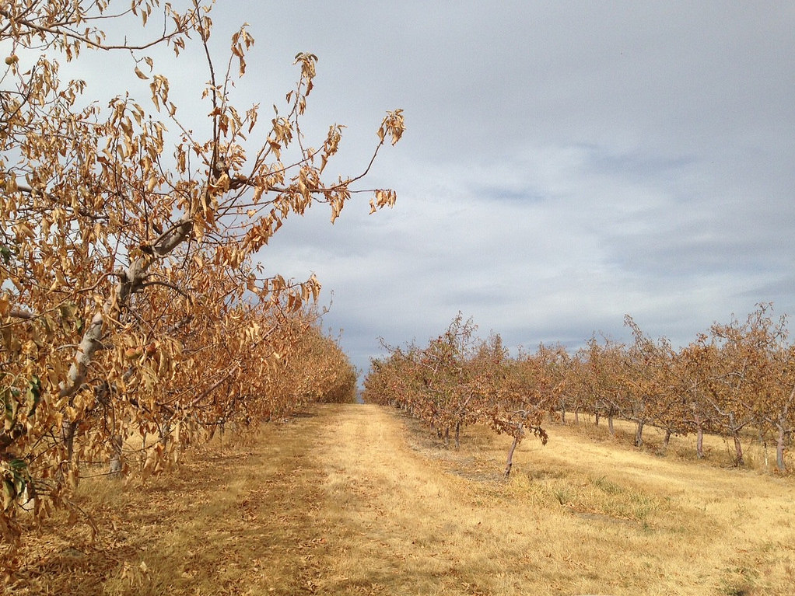
Apple trees dry and brittle Roza Irrigation District, Benton County
Notes:
September 2015 - Apple trees dry and brittle for lack of water on Roza land near Prosser in Benton, County.

Slide 29
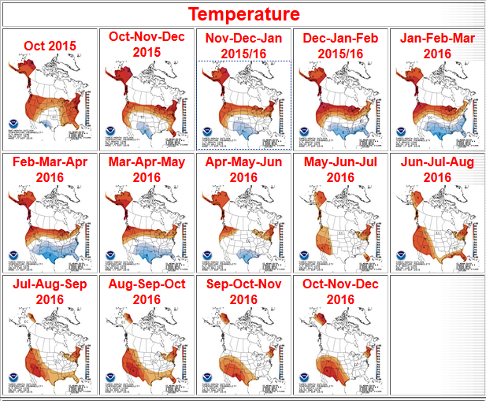
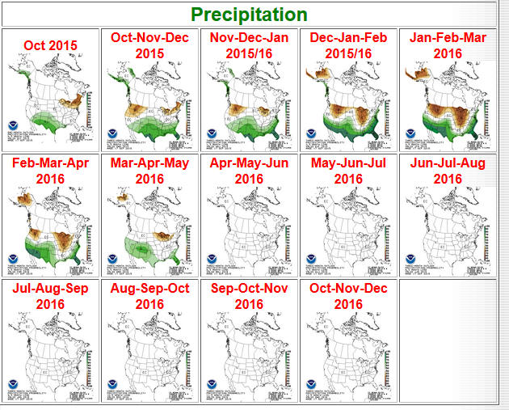

Slide 30
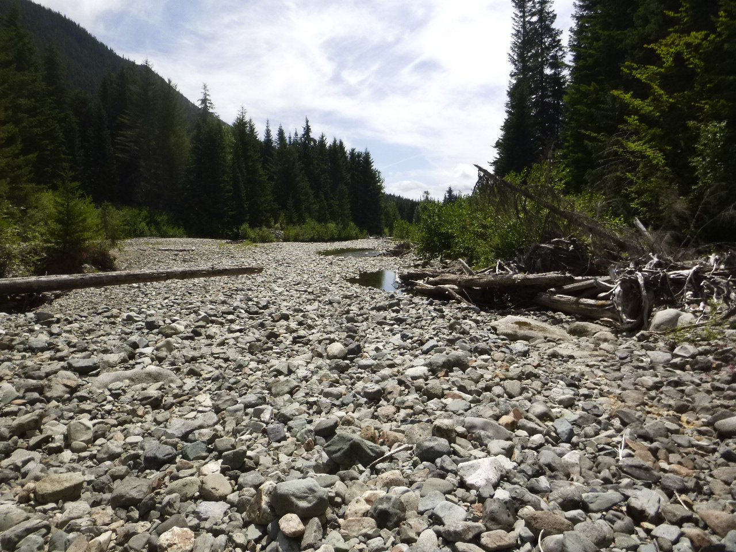
Gold Creek Dewatered Isolated Ponds Entrap Fish July 21, 2015
Bull trout in rocks
Gold Creek (Kittitas County) was dewatered into 17 isolated ponds from river mile 1.56 down to its confluence with the outlet channel. Entrapped fish were identified to species, temperatures were taken in each pool, and many fish were moved up- or downstream to cool and connected waters. Survey staff found evidence of predation at many of these ponds.

Slide 31
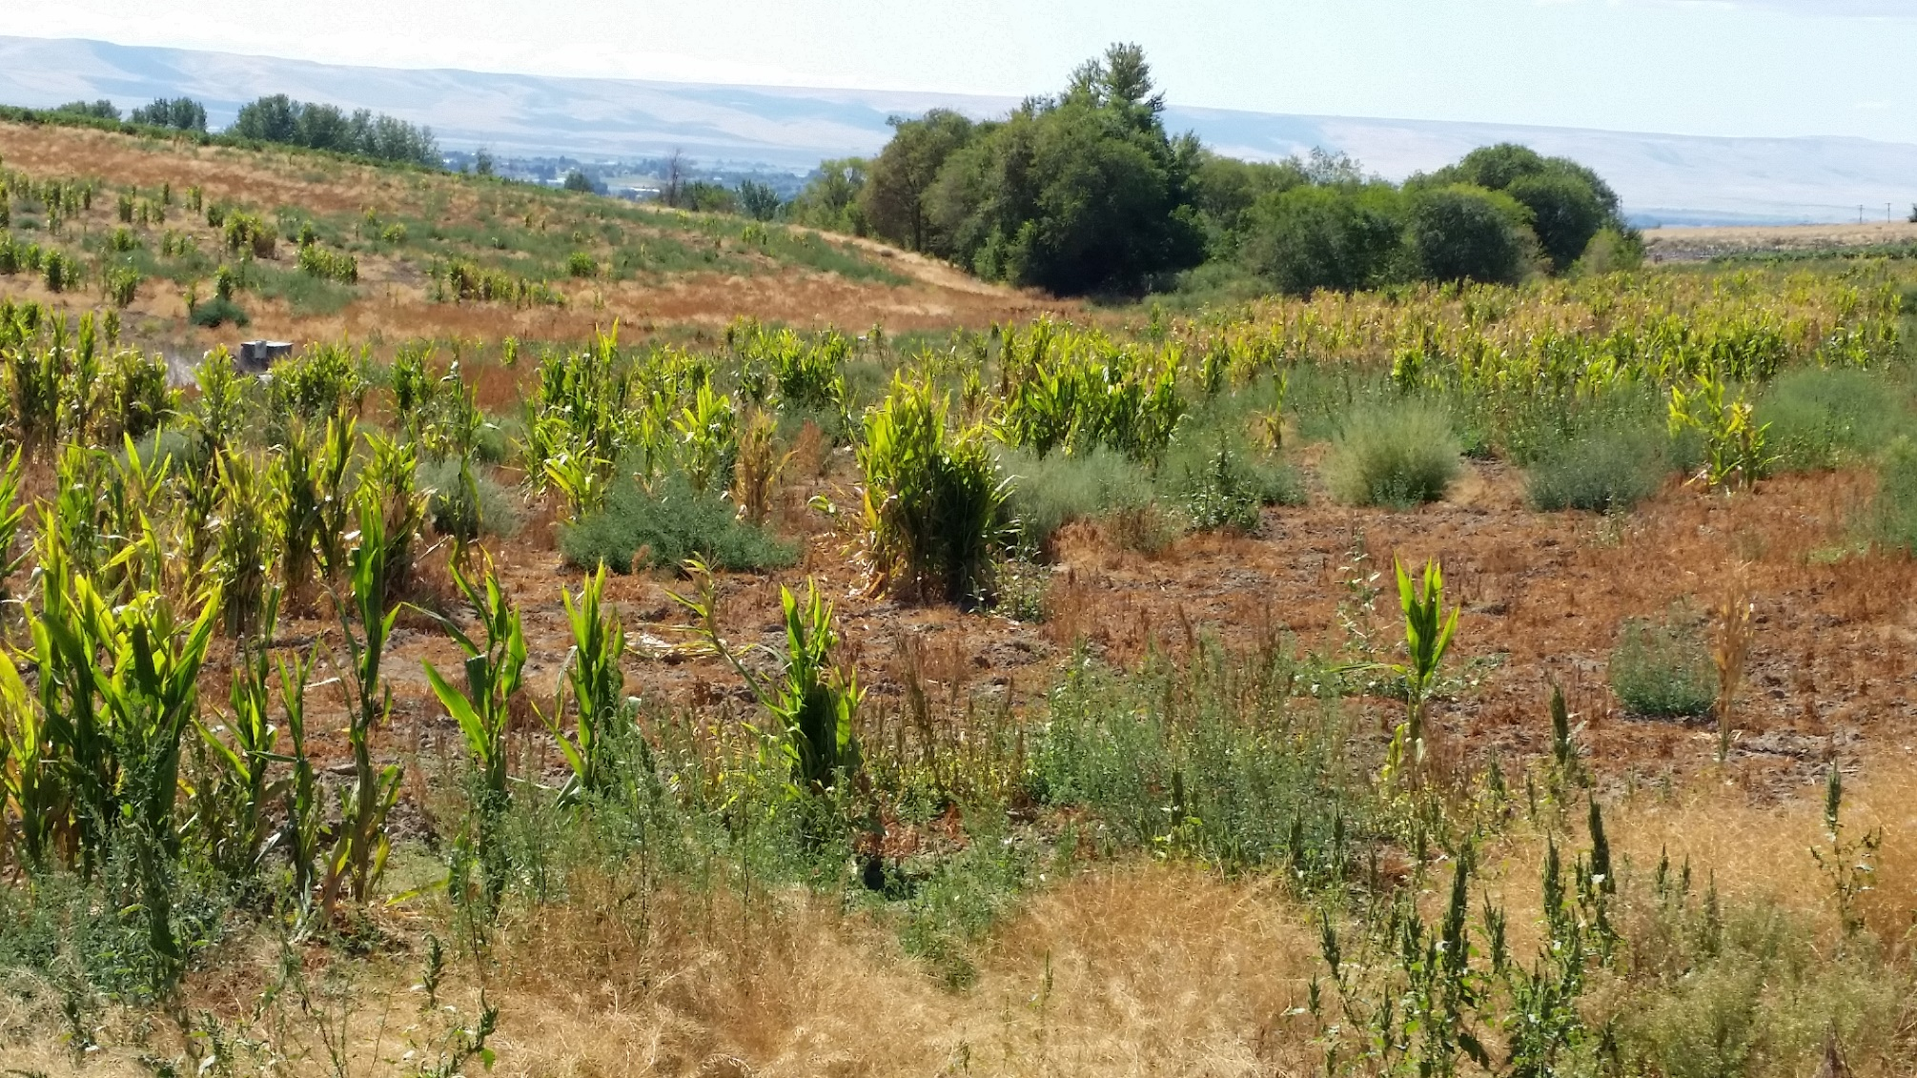
Fallowed Corn Field, Yakima County September 2015
Notes:
A timothy hay field in the Kittitas Reclamation District goes into early dormancy in August. The only green vegetation in this field are unwanted weeds that are moving in. There was only enough irrigation for one cutting instead of the normal two. Badger Pocket - Kittitas County. September 7, 2015 photo by Melissa Hansen

Slide 32
Examples of emergency grants
Providing reliable community water supplies for the City of Moxee and for Riverside Water System
Moving irrigation diversions downstream and pumping water up to where it will be used by the Lower Stemilt Irrigation District
Restoration of irrigation canal for the Icicle Irrigation District
Reducing irrigation water demand through conservation and education in the Kennewick Irrigation District
Installing structures to concentrate river flow in the Dungeness River to enhance fish passage

Slide 33
Drought Declaration Status
Set to expire Dec 31
Governor may extend for additional year
Will consult the Water Supply Availability Committee/Executive Water Emergency Committee
Advantages to moving early

Slide 34
The Legislature provided $16 million for drought response for biennium
For projects that:
Can be implemented this year
Do not expand water use (existing legal water right)
Include 50 percent matching funds, unless for a public water system project in a community that is “fiscally disadvantaged”
We are projecting that a little less than half of the funding will be used this year
Concern about next year
Notes:
So far we have committed $350,000 for leases to enhance flows. We anticipate another $625,000 for leases from Sunnyside irrigators to aid the Roza Irrigation District. We have a grant program with a 50% cost share requirement and have received several applications for communities.
- We will be providing funds to state Fish & Wildlife for fish hatching and obstruction removal.

Slide 35
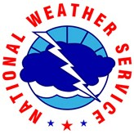

Slide 36
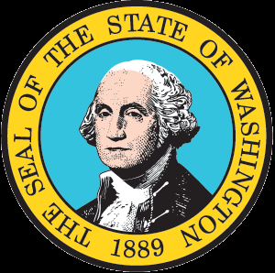
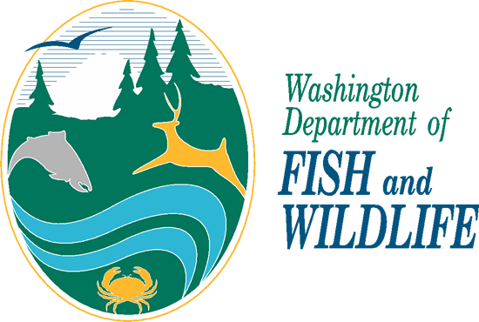
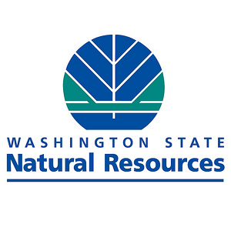

Slide 37
U.S. Drought Monitor Statistics Graph (2000 – present)

Slide 38
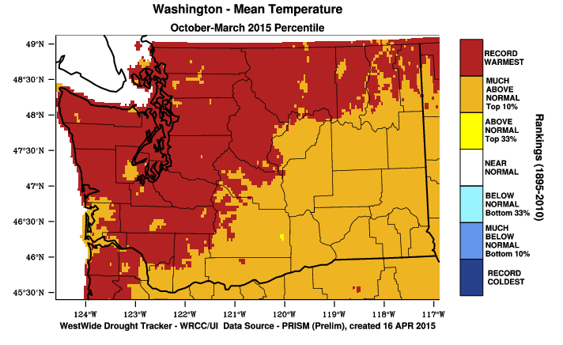
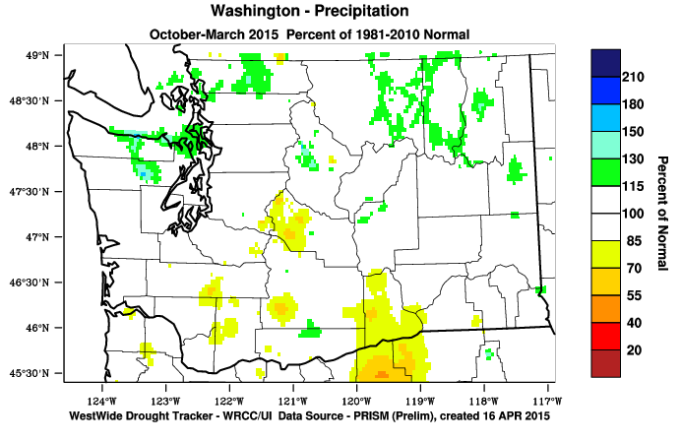
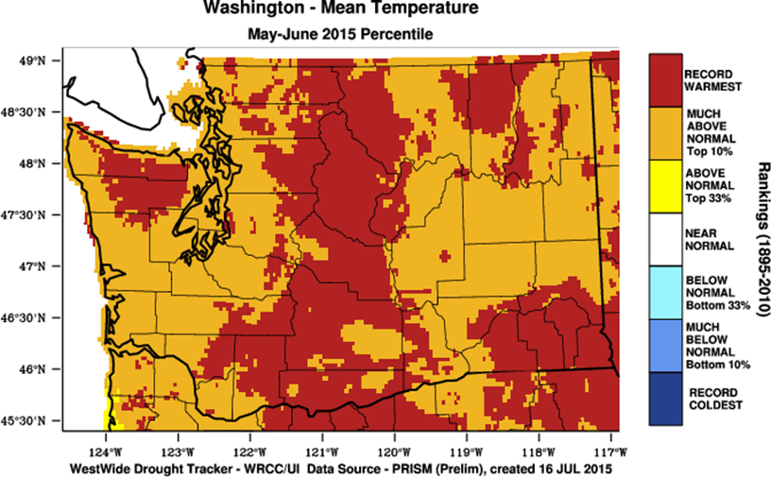
October thru March 2015
May thru June 2015

Slide 39
Greatest Percentage of Precipitation falling as Rain instead of Snow in the last 65 years (Olympic Mountains, elev 1400 m)

